Slide 1
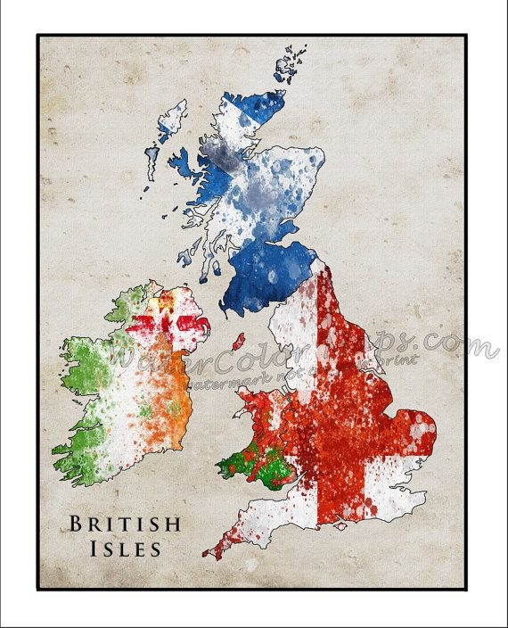
National Identities in the UK

Slide 2
National Identity in the UK
Conventional Wisdom on UK was to emphasize its
Homogeneity
This thinking has changed radically over the post-war, Post-Cold War eras
What has happened in the world and in the academy to change this view???

Slide 3

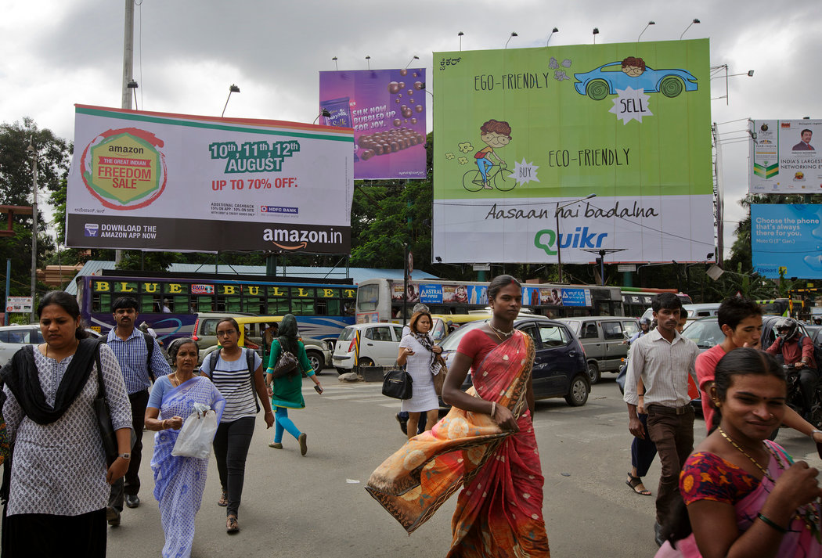

Slide 4
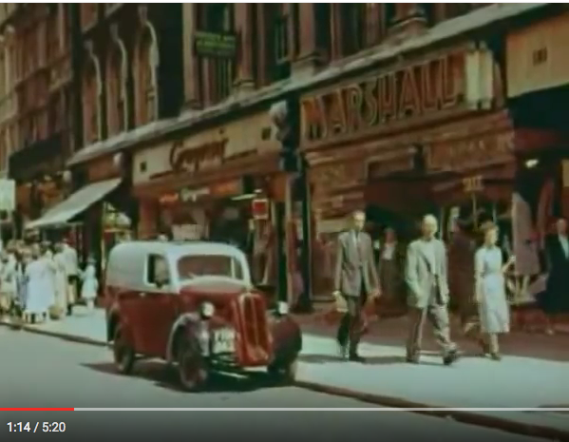
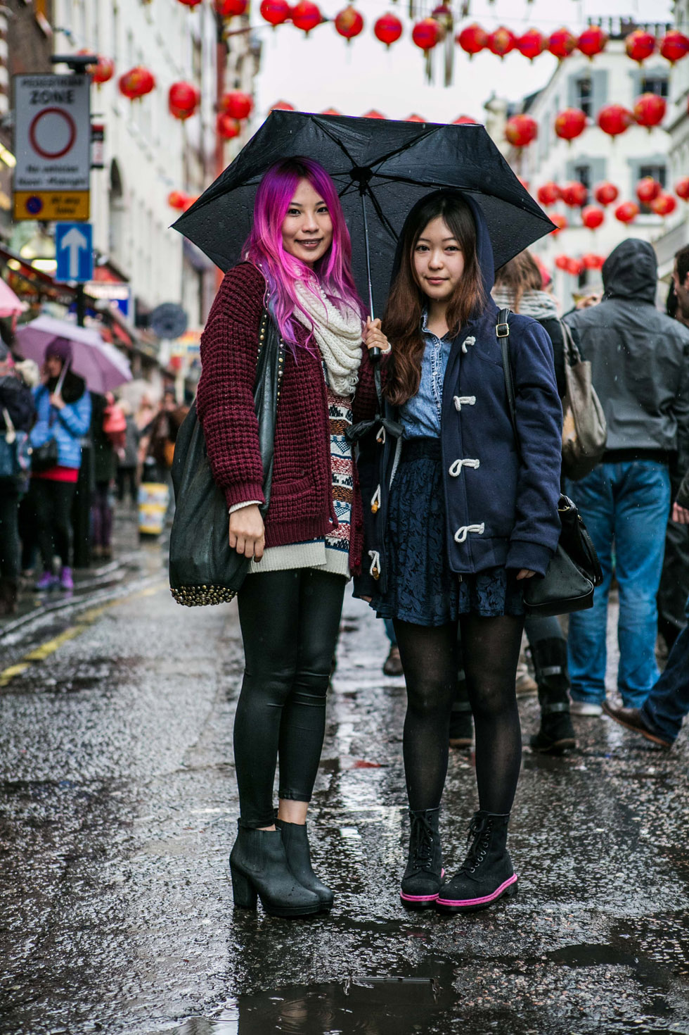

Slide 5
Decolonization struggles since WWI
De-industrialization
Decline of UK; ascendancy of US
Europeanization
Globalization; glocalization
Multiculturalism, diversity

Slide 6
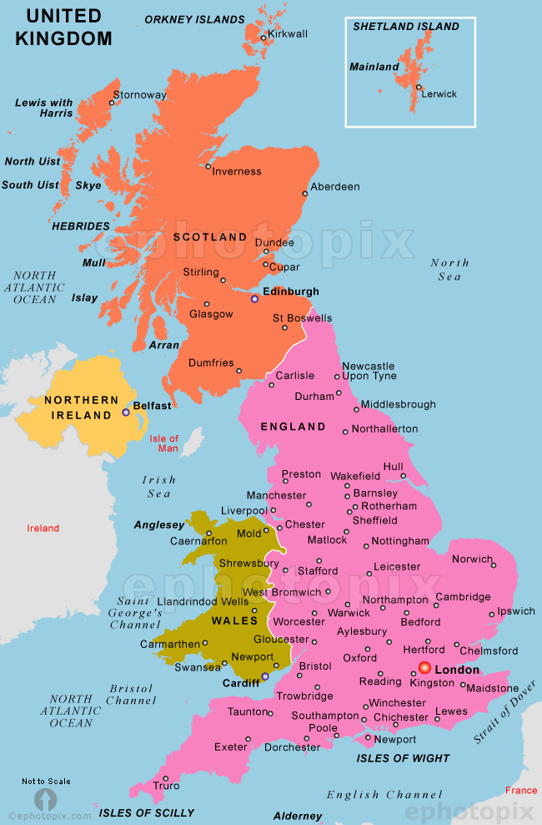
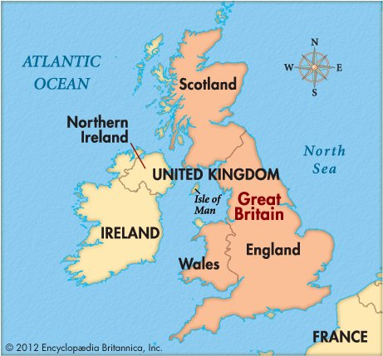
The nomenclature of the UK
The UK=
Great Britain +N Ireland
Great Britain=
Scotland, Wales and England

Slide 7
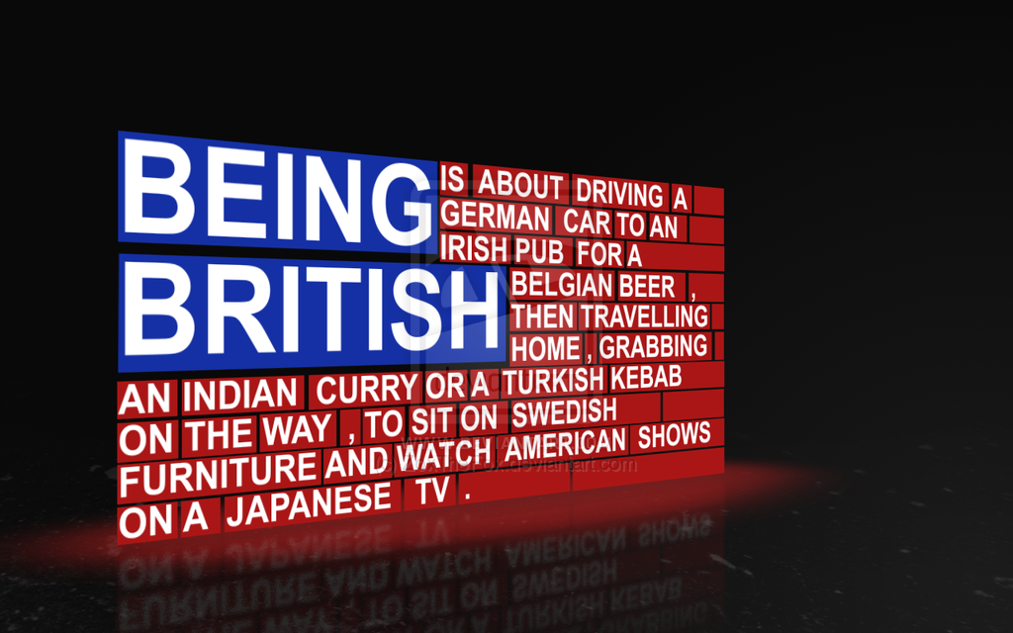
What does it mean to be british?

Slide 8
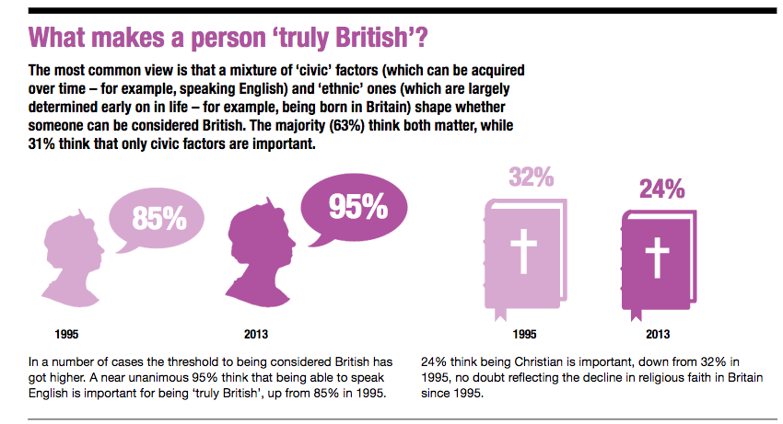

Slide 9
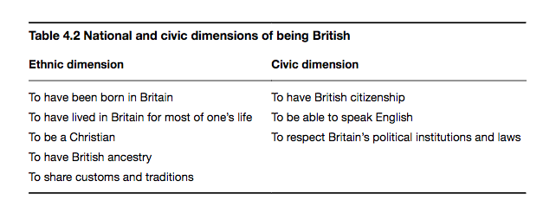

Slide 10
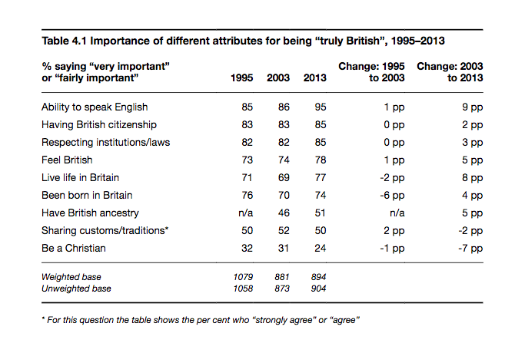

Slide 11
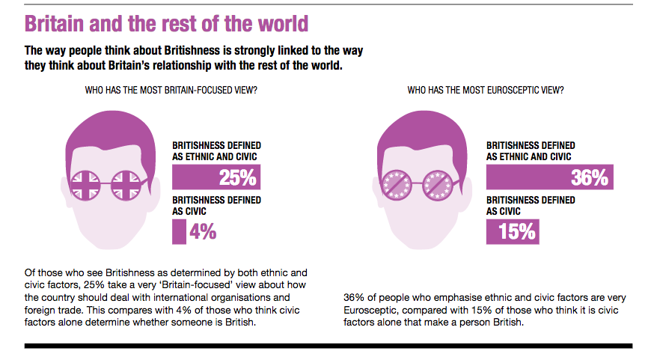

Slide 12
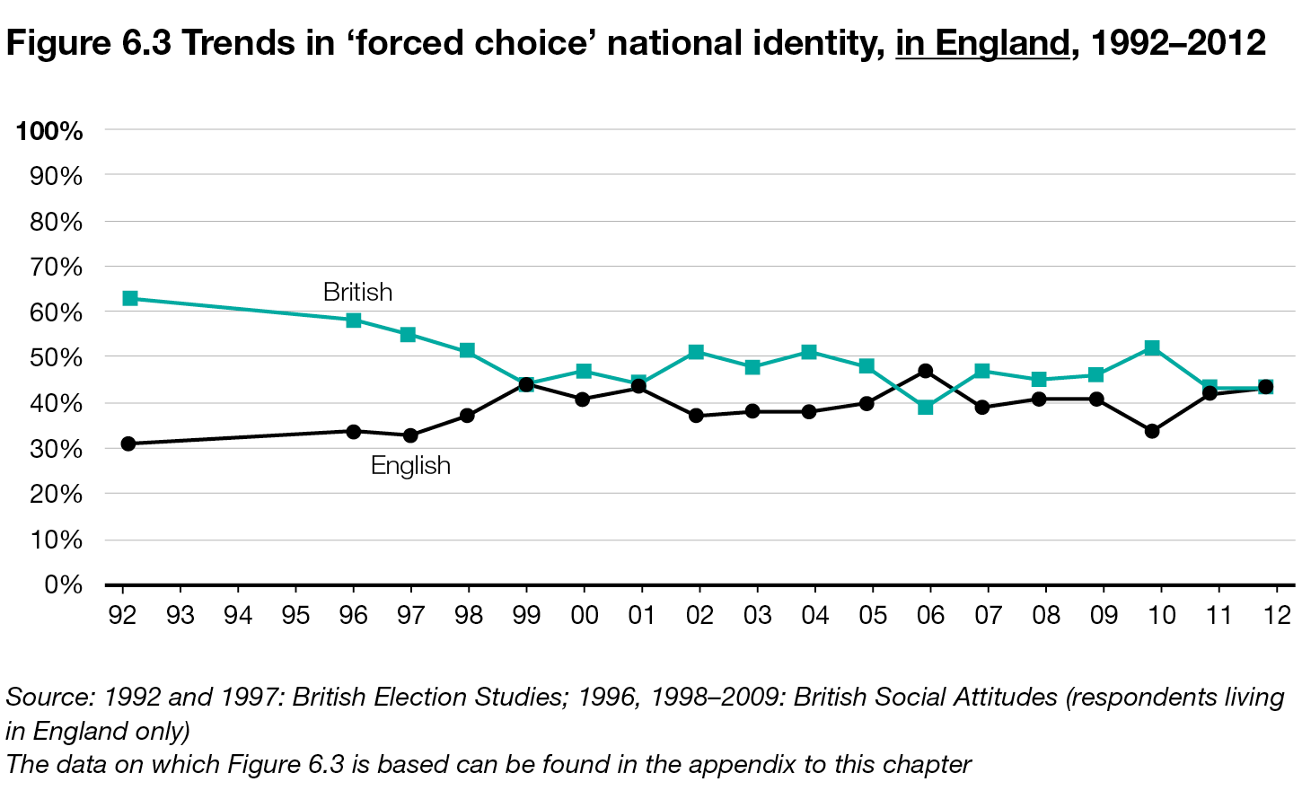
British vs. English over time, 1992-2012

Slide 13
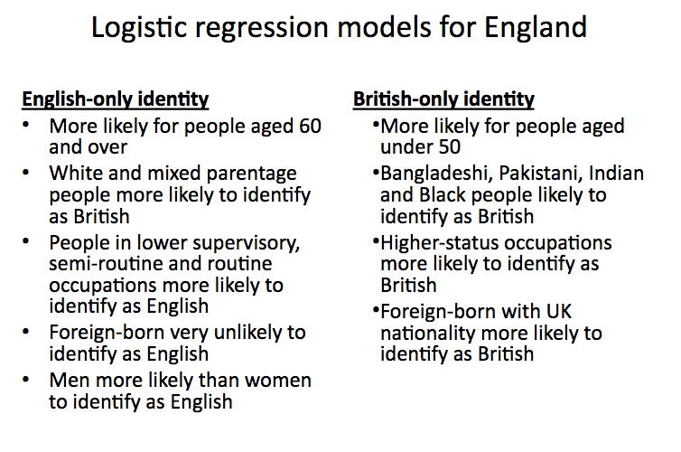
according to research by David owen, inst for employment research
University of Warwick

Slide 14
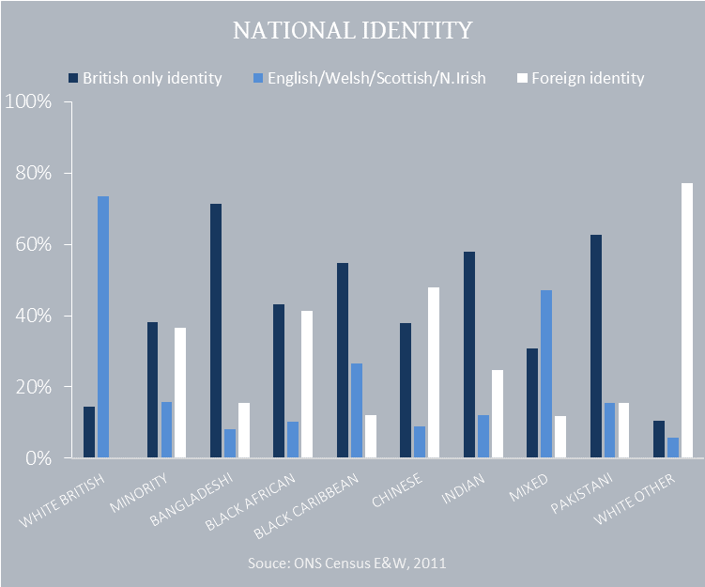
People of different ethnic groups are more or less likely to identify as British.
Whites are more likely to identify as English/Welsh/Scottish/N Irish.
Minorities are more likely to identify as British.

Slide 15
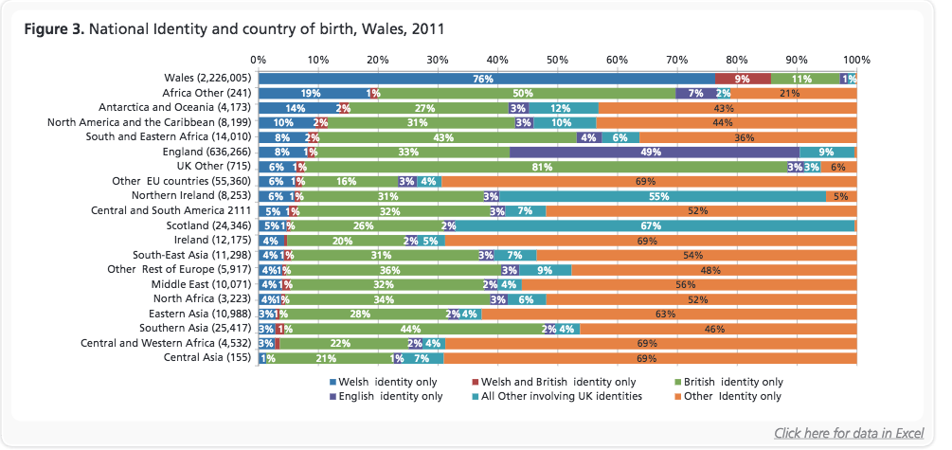
Similarly, welsh identity varies by place of birth
Welsh identity is most common among those born in wales
Although it is claimed by some foreign born/foreign origin groups

Slide 16
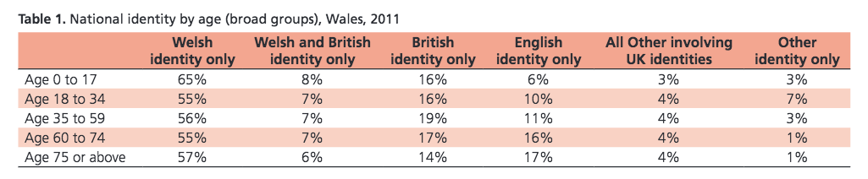
Welsh identity on the rise among young people

Slide 17
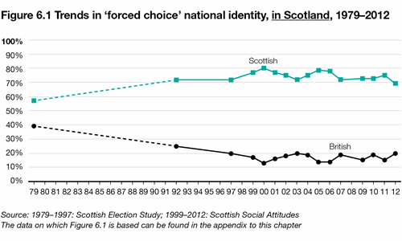
Scottish National Identity

Slide 18
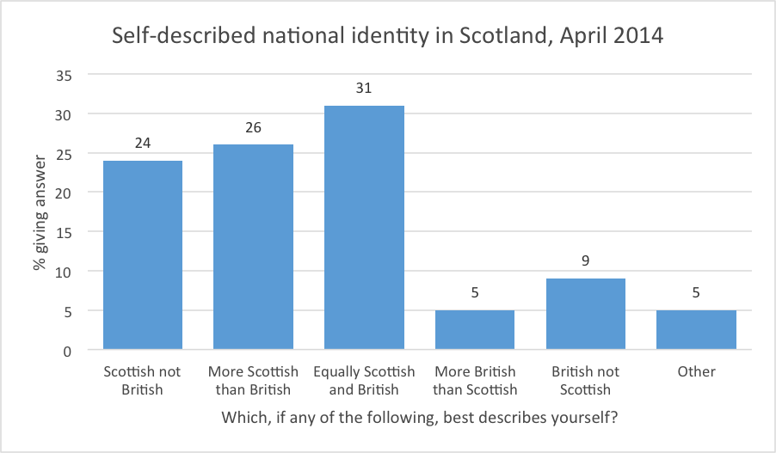

Slide 19
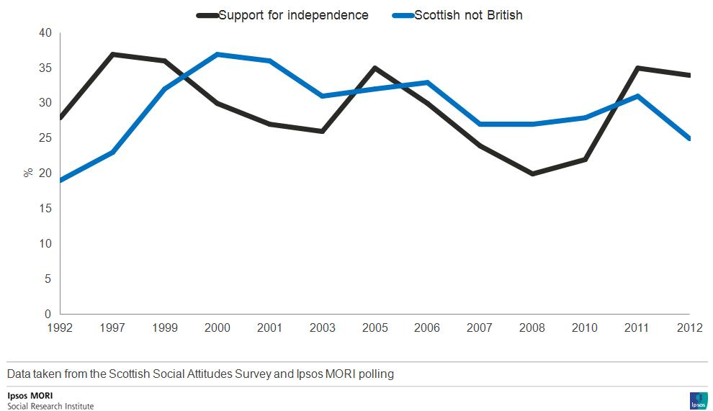

Slide 20
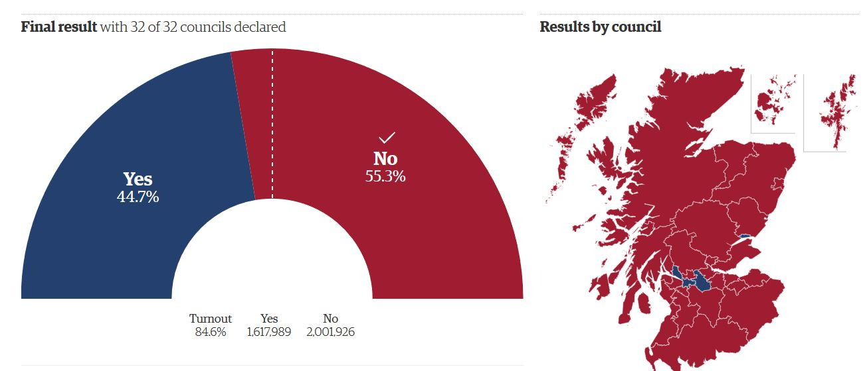
Scottish independence referendum, 2014

Slide 21
The rise of UKIP
UK Independence party
Euro Sceptic party – anti-UK being in EU
Over time, grew into anti-immigrant party

Slide 22
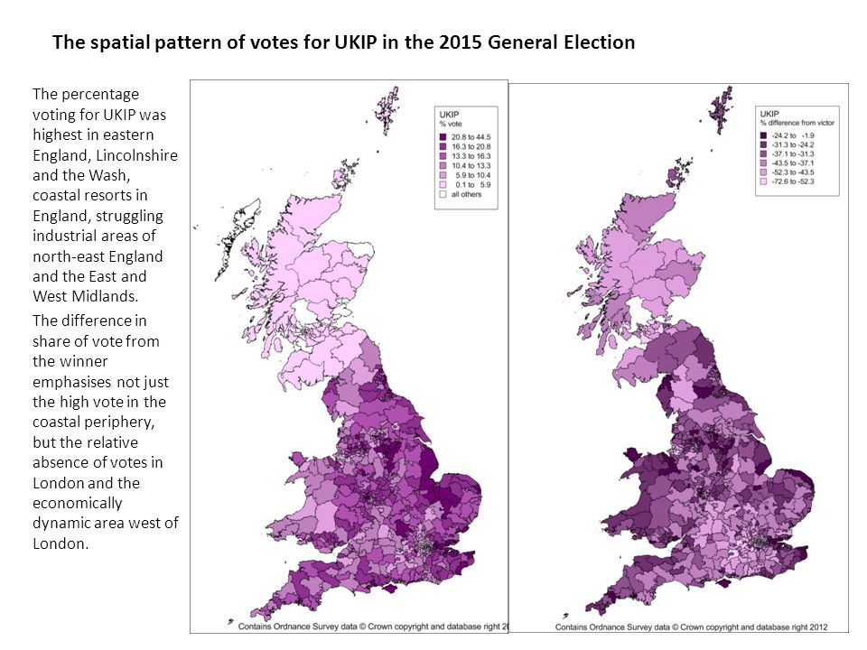
Vote for UKIP was higher in least diverse, more rural, more economically stressed parts of the UK

Slide 23
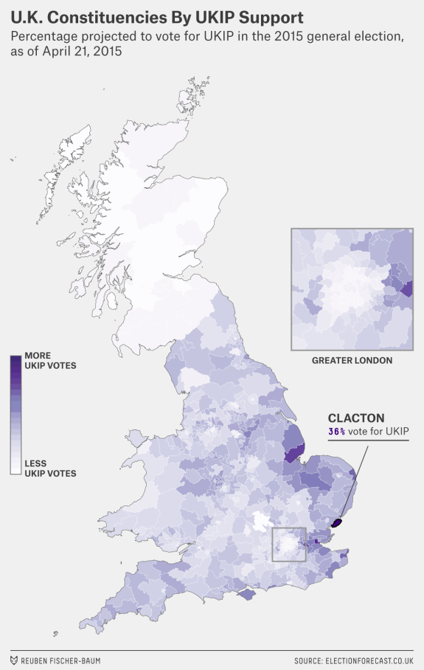
UKIP’s won one constituency in the House of Commons, Clacton
Clacton is:
coastal, older, economically disadvantaged, and receiving an influx of East Enders
See 538 article on

Slide 24

Welsh nationalist party
Plaid Cymru
Opposes UKIP
Why?
Wikipedia entry on

Slide 25
Summary of regionalism, national identities in the UK
British is a pan-ethnic identity
More likely to be claimed than English, Scottish, etc. by non-whites
Identification as British is declining over time among whites in favor of English in England (this is a trend; does not reflect the majority)
The tendency to identify as English in England is correlated with rural living, lower educational attainment, lesser skilled jobs

Slide 26
Sources and Resources
British social Attitudes. National Identity. http://www.bsa.natcen.ac.uk/media/38984/bsa31_national_identity.pdf
Centre on Dynamics on Ethnicity. http://www.ethnicity.ac.uk/
Integration Hub. http://www.integrationhub.net/module/attitudes-and-identity/
Metapolls: The world of polls. http://metapolls.net/2014/09/scottish-independence-referendum-final-results/#.WKKx7hDogtk
Scottish National Identity. http://www.bsa.natcen.ac.uk/latest-report/british-social-attitudes-30/devolution/trends-in-national-identity.aspx
Variations in national identity, diversity and integration within the UK David Owen, Institute for Employment Research, University of Warwick.
What is Britishness? By David Beecham http://www.redpepper.org.uk/what-is-britishness-citizenship/

