Slide 1
CIS101B
Week 3 Class 5
Chapter 10
System Implementation

Slide 2
CIS101B
10.1 Component Selection:
If you are purchasing a new computer or building a new computer, you need to ensure that the hardware you select can accomplish the work that will be expected of it. In most organizations, a "one-size-fits-all" approach to selecting computing hardware simply won't work. You need to evaluate the role of the user who will use the system and then create a list of specifications that will ensure the hardware can fulfill that role.
Observe the following recommendations for each computing role:
Graphics design or CAD/CAM workstation:
O Select the most powerful processor that you can afford. Graphics and CAD/CAM applications require a great deal of processing power. A 64-bit multi-core processor should be the minimum processor considered.
O Implement a high-end video adapter with extensive amounts of video memory implemented. Graphics and CAD/CAM applications require a great deal of video processing.
O Implement the maximum amount of RAM supported by the motherboard in triple- or quad-channel mode.
O Because of the extensive mathematical calculations used by the software on these systems, it is strongly recommended that ECC memory be used.

Slide 3
CIS101B
10.1 Component Selection:
Observe the following recommendations for each computing role:
Audio/video editing workstation:
O Select the most powerful processor that you can afford. Audio and video editing applications require a great deal of processing power. A 64-bit multi-core processor should be the minimum processor considered.
O Implement a high-end video adapter with a large amount of video memory and multiple display outputs. Audio and video editing applications require extensive video processing and screen space.
O Implement a high-end audio adapter and speaker system.
O Implement a very large, very fast hard disk drive. Audio and video editing applications require extensive disk space and speed. You may want to consider using a combination of the following storage devices:
1. A fast SSD drive for projects currently being worked on.
2. A large HDD drive for archiving data and backing up the SSD drive.

Slide 4
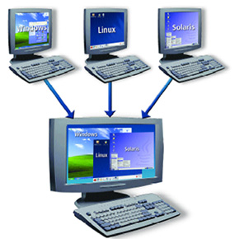
CIS101B
10.1 Component Selection:
Observe the following recommendations for each computing role:
Virtualization workstation:
O Virtualization hosts require extensive RAM and CPU processing power. Each virtual machine running on the system must share the system processor and RAM; therefore, you need to implement the maximum amount of RAM supported by the motherboard in triple- or quad-channel mode.
O A 64-bit quad-core processor should be the minimum processor considered. You may want to consider an eight-core processor or a server system with multiple physical processor sockets.
O Video and audio performance are of secondary
concern on a virtualization system.

Slide 5
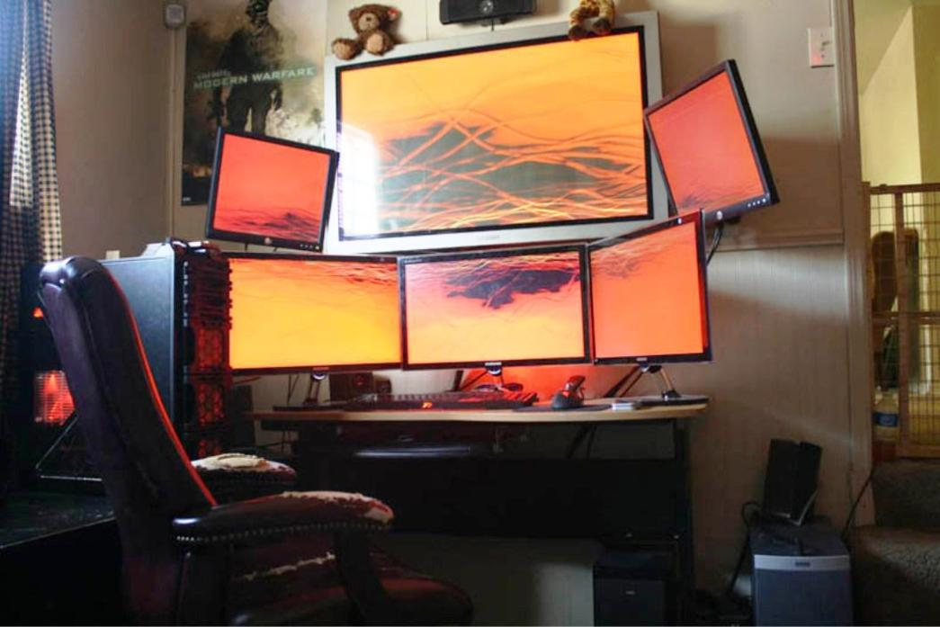
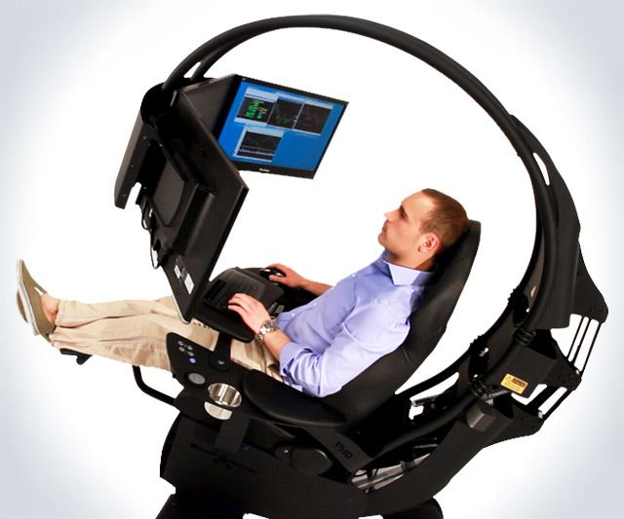
CIS101B
10.1 Component Selection:
Observe the following recommendations for each computing role:
Gaming system:
O Gaming applications require a great deal of processing power. A 64-bit multi-core processor should be the minimum processor considered.
O Gaming applications can cause the systems processor, RAM, and video adapter to generate excessive heat. You should implement a high-end cooling solution to dissipate this heat.
O Implement a high-end video adapter with a GPU. Gaming
applications require a great deal of video processing.
O Implement a high-end audio adapter with a surround-sound
speaker system.

Slide 6
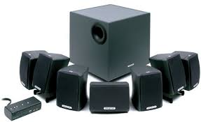
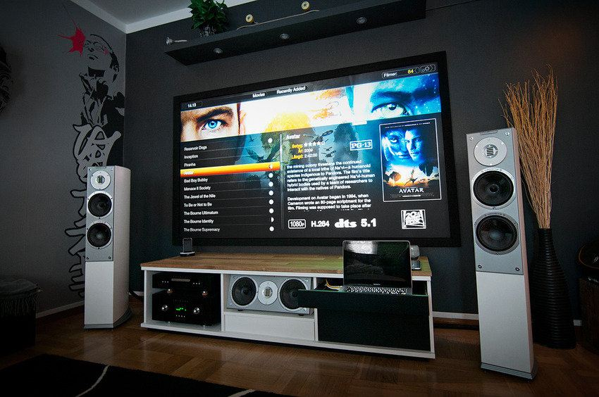
CIS101B
10.1 Component Selection:
Observe the following recommendations for each computing role:
Home theater system:
O Implement a high-end audio adapter with a surround-sound speaker system.
O Implement a video adapter with a TV tuner and HDMI output.
O To save space, you may want to select a system that uses the Home Theater PC (HTPC) compact form factor.

Slide 7
CIS101B
10.1 Component Selection:
Observe the following recommendations for each computing role:
Standard thick client:
O Ensure the hardware meets recommended requirements for running the selected operating system (such as Windows or Linux).
O Ensure the system has enough processing power, disk space, and RAM to support the desktop applications that will run on it. A standard thick client workstation should be optimized to run desktop productivity applications.
Thin client:
O A thin client only needs to be able to connect to a remote desktop session. As such, it only needs to meet the minimum requirements for running Windows locally.
O A thin client workstation only needs to be optimized to run very basic applications. Ensure the system has enough processing power, disk space, and RAM to support the applications that will be installed on it.
O Install the fastest network adapter supported by the network it will be connected to. Gigabit speeds (or faster) are recommended. This will help ensure that the remote desktop session provides a reasonable end-user experience.

Slide 9
CIS101B
10.1 Component Selection:
Observe the following recommendations for each computing role:
Home or small office server:
O A home or small office server is typically used for media streaming, file sharing, and printer sharing. As such, you should install the fastest network adapter supported by the network it will be connected to. Gigabit speeds (or faster) are recommended.
O You should implement a storage solution that provides both speed and redundancy to protect data. You should consider using a RAID array that uses striping (for performance) along with mirroring or parity (for protection). RAID 5, RAID 1+0, or RAID 0+1 would be good choices.
O A 64-bit multi-core processor should be the minimum processor considered.
O Implement the recommended amount of RAM for your server operating system in triple- or quad-channel mode.

Slide 10
CIS101B
10.2 Windows Pre-installation
When purchasing a new computer, or upgrading an existing computer, one of the first choices you will need to make is which Windows OS version and edition to install. When deciding on a particular Windows version or edition, consider the following general information:
O Each Windows OS edition has different features and limitations. For example, Windows 10 Home edition does not include BitLocker support. When deciding on an OS edition, first identify the intended use of the computer system, and then select the edition with the appropriate features.

Slide 11
CIS101B
10.2 Windows Pre-installation
O In addition to the version and edition, you will also need to select which Windows OS architecture to install. Each OS has either a 32-bit (x86) or 64-bit (x64) architecture edition.
a. The biggest advantage to using a 64-bit version is support for more than 4GB of memory (most 32-bit systems can only use about 3GB of memory). You would also choose a 64-bit version if you needed to run 64-bit applications or use hardware that had only 64-bit drivers.
b. You must have a 64-bit processor to run a 64-bit operating system. You can, however, run a 32-bit operating system on a 64-bit processor.
c. A 64-bit operating system requires 64-bit drivers. For this reason, older hardware
(that has only 32-bit drivers available) will not work on a 64-bit operating system.
d. A 64-bit operating system can run both 32-bit and 64-bit applications; a 32-bit
operating system cannot run a 64-bit application. Some 32-bit applications
running on a 64-bit version of Windows will have errors that do not exist on 32-
bit systems, so vendors might need to release patches for these applications.

Slide 12
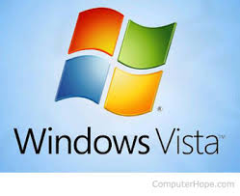
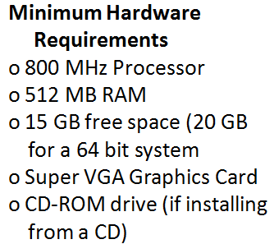
CIS101B
10.2 Windows Pre-installation
The following table describes the features and requirements for the most common Windows versions:
Version Description
Windows Windows Vista was released in 2007 as a
Vista replacement to Windows XP. Windows Vista
introduced the following features and updates:
o Windows Aero and enhanced visual
appearance, including the Windows sidebar
and gadgets
o Windows Media Center for playing and
managing digital media
o User Account Control (UAC)
o Shadow Copy file backup (Business edition only)
o BitLocker drive encryption (Enterprise edition only)
o ReadyBoost and ReadyDrive
o Compatibility Mode

Slide 13
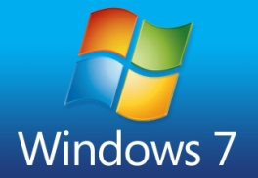
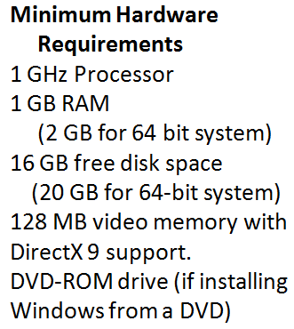
CIS101B
10.2 Windows Pre-installation
The following table describes the features and requirements for the most common Windows versions:
Version Description
Windows Windows 7, which was released in 2009, was
7 developed to address many of the problems
found in Windows Vista. Windows 7 introduced
the following features not found in previous
versions: Enhanced Aero features, including:
o Snap (maximizes window when dragged to
top of screen)
o Shake (hide/show all windows except for the
window being "shaken")
o Peek (reveals the desktop by making all
windows transparent)
o Redesigned Taskbar with the ability to pin
applications
o Libraries
o Improved backup and restore flexibility
o XP Mode (Pro, Ultimate, and Enterprise only)

Slide 14
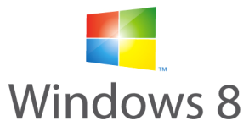
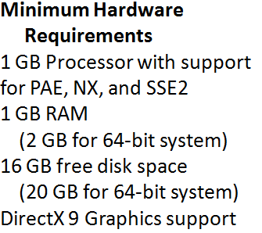
CIS101B
10.2 Windows Pre-installation
The following table describes the features and requirements for the most common Windows versions:
Version Description
Windows Windows 8 was released in 2012 and introduced
8/8.1 major changes to the Windows OS. A year later,
Windows 8.1 was offered as a free upgrade in
order to fix several issues. Windows 8/8.1
introduced the following features:
o UEFI integration (including UEFI Secure Boot) Unified Extensible Firmware Interface Secure Boot prevents operating systems from
booting unless they're signed by a key loaded
into UEFI — out of the box, only Microsoft-signed
software can boot

Slide 15
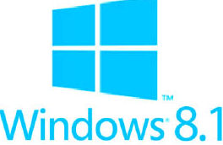
CIS101B
10.2 Windows Pre-installation
The following table describes the features and requirements for the most common Windows versions:
Version Description
o Windows Hybrid Boot mode 8 / 8.1 The Hybrid Boot method works on the principles
of system hibernation. When a user sends a
shutdown request, all logged user sessions are
closed, but the kernel session is hibernated.
o USB 3.0 support
o Windows Metro UI, which is optimized for touchscreen devices
o Windows Store apps
o Charms and the charm toolbar, which provides
access to system and app controls
o Start button removed (Windows 8)
o Start button reintroduced (Windows 8.1)
o Start Screen (replaced the traditional Start menu)
o OneDrive integration (Windows 8.1)

Slide 16
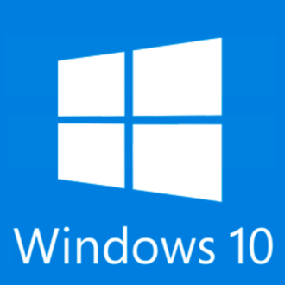
CIS101B
10.2 Windows Pre-installation
The following table describes the features and requirements for the most common Windows versions:
Version Description
Windows Windows 10 is the most recent version of the
10 Windows OS and was released in 2015.
Windows 10 was designed to address many of
the shortcomings and issues customers had with
Windows 8. Windows 10 was offered as a free
upgrade to anyone using an older version of
Windows 7 or 8. Windows 10 introduced the
following features:
Universal Windows Platform (UWP) Windows 10 makes it easier to develop apps for the UWP with just one API set, one app package, and one store to reach all Windows 10 devices – PC, tablet, phone and more. It’s easier to support a number of screen sizes, and also a variety of interaction models, whether it be touch, mouse & keyboard, a game controller, or a pen.

Slide 17
CIS101B
10.2 Windows Pre-installation
The following table describes the features and requirements for the most common Windows versions:
Version Description
Windows
10 o Native Ubuntu Linux compatibility o BASH in a command line, very cool Cortana, Microsoft's
"intelligent personal assistant" software
o Microsoft Edge web browser (replaces Microsoft Internet Explorer)
o DirectX 12 and WDDM 2.0 support
o Start menu reintroduced with new tile design
o Improved security features

Slide 18
CIS101B
10.2.4 Windows Installation Planning
Windows installation will go smoother if you take the time to plan and prepare prior to performing the installation. After identifying the operating system version and edition you would like to use, the first step prior to purchase and installation of the operating system is to verify that the operating system is compatible with the hardware and software you will use.
O Check the hardware compatibility list (HCL) to verify that hardware is compatible with the operating system.
O Go to the hardware or software vendor's website and check for operating system compatibility.
O Obtain the latest drivers for all hardware. Remember, 32-bit drivers must be used on older 32-bit operating systems while 64-bit drivers should be used with 64-bit operating systems.
O If you are installing a new version of Windows on an existing computer, run the Upgrade Advisor (if you're upgrading to Windows 7) or the Upgrade Assistant (if you're upgrading to Windows 8 or 10) to determine whether your system is compatible. These tools scan your system and verify that hardware is sufficient and compatible with the new operating system. They can also identify valid upgrade paths from your current operating system version.
For upgrades on larger networks, you can use the Microsoft Assessment and Planning Toolkit (MAP) to automatically scan multiple computers and identify each computer's compatibility for an upgrade to a newer version of Windows. MAP checks hardware compatibility, identifies the availability of updated device drivers, and recommends a migration path.

Slide 19
CIS101B
10.2.4 Windows Installation Planning
After you are sure that the system hardware and software is compatible with the new operating system, you need to choose an installation method, either an in-place upgrade or a clean install.
Option Description
In-Place An in-place upgrade updates your current Windows installation to a newer Upgrade version of Windows. All of your applications, user settings, and data are preserved, but the previous installation of Windows will no longer be available.
Clean A clean install adds a new installation of Windows, either on a new system or a
(custom) system that currently has an operating system.
Install o Following installation, you will need to reinstall all applications and configure user settings.
o If desired, you can migrate user settings and data from an existing Windows system to the new installation. This can be done using two utilities:
a. Use Windows Easy Transfer to transfer all user settings and data from the old installation to the new installation.
b. Use the User State Migration Tool (USMT) when multiple systems need to be migrated at the same time on a large network.
o You can create a dual boot computer by keeping the existing installation of Windows. To do this, create a new partition on a storage device and install the new version of Windows into it. When complete, the end user can select which installation of Windows to load when the system boots.

Slide 20
CIS101B
10.2.4 Windows Installation Planning
Be aware of the following:
O Upgrade versions of Windows are available if you have an existing installation of Windows and want to install a newer version on the same computer. Upgrade versions usually cost less than buying a full version of Windows.
O When performing an in-place upgrade, you must abide by the upgrade paths defined by Microsoft. For example, you can perform an in-place upgrade from Windows 7 or Windows 8 to Windows 10. However, you
must use a clean install to migrate from Windows Vista to Windows 10.
O You cannot upgrade from a 32-bit operating
system to a 64-bit operating system (or vice versa). You must instead perform a clean
installation and then migrate user profiles
from the old system to the new one.
O You can upgrade from one edition to another
as long as the new edition is "higher“ than the
previous edition (such as Windows 10 Home to
Windows 10 Professional).
O You cannot perform an in-place downgrade from
one edition to another (such as from
Professional to Home).

Slide 21
CIS101B
10.2.4 Windows Installation Planning
After you are sure that the system hardware and software is compatible with the new operating system, you need to choose an installation method, either an in-place upgrade or a clean install.
Be aware of the following:
If necessary, perform a full backup of your existing system prior to performing a clean install or an upgrade.
O If you are doing a clean install, you can use the backup to restore user data to the new installation.
O Though an in-place upgrade does not affect user files and settings, you should still back up the system prior to performing the installation in case something goes wrong.
O If you are unable to complete an upgrade, you can use the backup to restore your existing system.

Slide 22
CIS101B
10.3.5 Windows Installation Facts
Use the following steps to install Windows from the installation media:
1. Prepare the system hard disk(s). If you are performing a clean install on a new hard disk, you can partition and format the disk during the installation process. However, you will need to prepare disks before the installation if you want to install Windows on a hardware RAID array (RAID 0, RAID 1, RAID 5, RAID 10, etc.). Some motherboards include an integrated RAID controller that allows you to build an array from multiple SATA hard disks installed in the system. You can also install a RAID controller board in an expansion slot to define a RAID array. If you need to configure a RAID array prior to installation, do the following:
o Install the drives required to support the desired RAID level in the system.
o Do one of the following:
a. If using an integrated RAID controller on the motherboard, access the BIOS/UEFI configuration interface and enable RAID instead of traditional SATA operations.
b. If using a RAID controller board, install the board in an expansion slot and then boot the computer. During system boot, the RAID BIOS will load. Press the key combination specified in the RAID BIOS screen to enter the RAID configuration utility.
o Define a new RAID array of the desired type using the disks installed in the system.

Slide 23
CIS101B
10.3.5 Windows Installation Facts
Use the following steps to install Windows from the installation media:
Note: Adding a hard disk to a RAID array will destroy all existing data on that disk. Be sure to back up any data you want to keep before adding the disk to the array.
2. Insert the installation media (such as a DVD or USB flash drive) and then boot from that media.
3. During the first part of the installation, Windows loads the necessary files it needs to start the installation. During this phase, you may need to load additional drivers to support your storage controller so that Windows can write to the disk. This commonly occurs when installing to a RAID array. Click the Load Driver link. You must have the necessary drivers available on a USB flash drive.
3. After the initial files and drivers are loaded, you select the disk where you want to install Windows. At this point you can choose an existing partition (if one exists), or create a new partition.
4. After Windows prepares the disks, it starts copying files to the hard disk. When the file copy is complete, the system will reboot. Leave the installation media in the drive until prompted to remove it.
5. After the system reboots, Windows configures the system. You will be prompted for configuration information such as the region and language, the computer name, date and time, and network settings.

Slide 24
CIS101B
10.3.5 Windows Installation Facts
In addition to using an installation DVD, you can also install Windows using the following methods:
Method Description
Bootable Instead of installing from the installation disc, you can create a bootable USB Flash flash drive and copy the installation files to that drive. Microsoft provides a Drive utility called the Windows 7 USB/DVD Download Tool that can be used to automate the process.
Network To perform a network installation, the Windows installation files must first be Installa- copied to a network location. Then the installation process is run remotely over tion a network connection. This allows multiple systems to be installed at the same time using the same installation files. To do this, you must first:
1. Configure a Windows Deployment Services (WDS) server. This server contains the files needed to install Windows on remote computer systems over a network connection. WDS functions in conjunction with the Preboot Execution Environment (PXE) to load a miniature version of Windows on network hosts known as the Windows Preinstallation Environment (Windows PE). Windows PE is a minimal version of the Windows operating system. Its purpose is to get a basic system up and running such that the host can connect to the WDS server and install a full version of Windows.
2. Boot the host computer where Windows is to be installed using a PXE boot. The computer will connect to the WDS server and boot into Windows PE. Once done, Windows can be installed locally from the WDS server.

Slide 25
CIS101B
10.3.5 Windows Installation Facts
In addition to using an installation DVD, you can also install Windows using the following methods:
Method Description
Unattended An unattended installation is a type of installation that requires no interaction from the user during the installation process.
To do this, an XML file (called an answer file or response file) is pre-populated with all the answers to the standard Windows installation prompts.
This file is named autounattend.xml and is copied to the root of the Windows installation media.
During the installation, the answer file is used to respond to the prompts in the Windows installer.
If you have included all of the necessary information in the answer file, the installation will proceed automatically without pausing for user input.

Slide 26
CIS101B
10.3.5 Windows Installation Facts
In addition to using an installation DVD, you can also install Windows using the following methods:
Method Description
Disk Imaging With disk imaging, you install Windows on one computer and then copy that image to other computers. The imaging process is faster than installing Windows individually because all applications, configuration settings, and user accounts from the reference system are included in the imaging process.
Imaging is an efficient way of installing Windows if you have a large number of computers that use the same hardware configuration. Be aware of the following facts when using disk imaging:
o All computers need to have the same hardware abstraction layer (HAL), ACPI support, and mass storage drivers.
o Computers can have different peripheral hardware, because plug-and-play will detect peripheral hardware.
o Your Windows licensing agreement must allow multiple installations using the same product key.
o Computers must be manually renamed after imaging. Otherwise you will experience duplicate computer name errors.

Slide 27
CIS101B
10.3.5 Windows Installation Facts
In addition to using an installation DVD, you can also install Windows using the following methods:
Method Description
Repair Installation You can perform a repair installation to fix a currently installed Windows implementation. A Repair Installation will restore corrupt or missing DLLs, fix registry problems, and fix startup files while preserving user accounts, data, applications, and installed drivers.
To perform a repair installation, do the following:
1. Insert your Windows installation media.
2. Run the Setup.exe file on the installation media.
3. Elevate privileges when prompted by UAC.
4. Accept the license agreement.
Specify how the repair installation should occur. You can select from the following options:
o Keep personal files, apps, and Windows settings
o Keep personal files only
o Nothing
5. Wait while Windows is reinstalled.

Slide 28
CIS101B
10.4.2 Post Installation:
Complete the following tasks following a successful installation of Windows:
o Edit the BIOS/UEFI settings to boot from the hard drive first. This prevents the system from accidently booting from the optical drive or the USB drive.
o Update device drivers for unrecognized devices. During installation, drivers for many devices are installed from drivers on the installation disc. However, Windows may not include device drivers for all the hardware in the system. Use Device Manager to verify the status of all hardware devices. If necessary, manually download and install drivers for any unknown devices.
o Configure Windows Update and download the latest updates. This may take some time to complete, so plan according in your deployment plan.
o When Windows clients are installed into a Windows domain, verify that they are in the right time zone and are configured to get time from the correct time provider.
Use the w32tm command line utility as follows:
w32tm /tz returns the current time zone settings on the client.
w32tm /query /status returns the status of the Windows Time service on the client.
w32tm /? displays command line help for other w32tm parameters that can be used for configuring, monitoring, and troubleshooting the Windows Time service on the client.

Slide 29
CIS101B
10.4.2 Post Installation:
Complete the following tasks following a successful installation of Windows:
o After installation, you must activate your copy of Windows. Activation does not send personal information to Microsoft (it isn't the same as registration).
Some things to remember about activation are:
o During activation, the product ID, hardware hash, and the product keys are verified through Microsoft.
o You can activate over the Internet. The system will warn you if your activation is about to expire.
o If you reinstall Windows, it will need to be activated again.
o As a best practice, consider not activating Windows until you are sure the system is stable. This allows you to use the system for several days without activation, letting you reinstall if necessary.
o A significant hardware change, such as upgrading your motherboard, may require Windows to be reactivated. If this is the case, you might need to contact Microsoft to get a reactivation key.

Slide 30
CIS101B
10.4.2 Post Installation:
Complete the following tasks following a successful installation of Windows:
Configure the Windows Firewall and install anti-malware software. Be sure to update your anti-malware definition files.
Note: Be aware of the following when migrating user settings:
o If you perform an in-place upgrade installation, user settings and data are automatically retained; you do not need to use these tools to transfer files.
o If you perform a new installation on the existing system, run the transfer utility before performing the installation and save the resulting files to removable media or a network location. Following the installation, run the transfer utility to copy the data into the new installation.
o If you are moving from an old computer to a new computer, you can transfer files directly between the two computers.
o Migrating user settings and files does not migrate applications on the new computer, nor does it migrate system files such as fonts or drivers.
Once the installation is complete, install applications and add other Windows features.
Configure system backups and other data protection methods (such as System Protection and File History).

Slide 31
CIS101B
10.5.2 Virtualization:
Virtualization is the ability to install and run multiple operating systems concurrently on a single physical machine. Most virtualization solutions include the following components:
Component Description
Physical Machine A physical machine contains the actual system hardware, such as the hard disk drive(s), optical drive, RAM, processors, etc.
Hypervisor A hypervisor is a thin layer of software that resides between the virtual operating system(s) and the hardware. A hypervisor allows virtual machines to interact with the hardware without going through the host operating system. A hypervisor manages access to system resources such as:
o CPU
o Storage
o RAM
Commonly used hypervisor types include:
o VMware Workstation and ESX (made by VMware)
o Hyper-V (made by Microsoft)
o XEN (open source)
o Oracle VirtualBox
o Kernel-based Virtual Machine (KVM)

Slide 32
CIS101B
10.5.2 Virtualization:
Virtualization is the ability to install and run multiple operating systems concurrently on a single physical machine. Most virtualization solutions include the following components:
Component Description
Virtual Machine A virtual machine is a software implementation of a computer that executes programs like a physical machine. The virtual machine appears to be a self-contained and autonomous system.
Virtual Hard Disk A virtual hard disk (VHD) is a file that is created within the host
(VHD) operating system and that simulates a hard disk for the virtual machine.
Different hypervisors use different virtual hard disk file formats:
o Virtual Disk Image (VDI): Oracle VirtualBox
o Virtual Machine Disk (VMDK): VMware products
o Virtual Hard Disk (VHD): Microsoft Hyper-V

Slide 33
CIS101B
10.5.2 Virtualization:
Types of Virtualization include the following:
Type Description
Full In full virtualization, the virtual machine completely simulates a real physical host. This allows most operating systems and applications to run within the virtual machine without being modified in any way.
Partial In partial virtualization, only some of the components of the virtual machine are virtualized. Be aware of the following:
o The operating system uses some virtual components and some real physical hardware components in the actual device where the hypervisor is running.
o The operating system or application must be modified to run in a partial virtualization environment.
Para- In paravirtualization, the hardware is not virtualized. Be aware of the
Virtualiz- following:
ation o All of the guest operating systems running on the hypervisor directly access a various hardware resources in the physical device; components are not virtual.
o The guest operating systems run in isolated domains on the same physical hardware.
o The operating system or application must be modified before they can run in a paravirtualization environment.

Slide 34
CIS101B
10.5.2 Virtualization:
If necessary, virtual machines can be moved from one host to another.
Follow these guidelines when moving virtual machines:
o Before moving a virtual machine, make backup copies of the virtual machine directory and all associated files.
o If you are moving a virtual machine (guest) to a new virtual host that differs from the original host in platform or architecture, be aware of these options and limitations:
o A guest can be successfully moved from a 32-bit host to a 64-bit host.
o A guest that is moved from a 64-bit host to a 32-bit host will probably not work correctly. If the guest is a 64-bit virtual machine, it probably won't start up at all on the 32-bit host.
o If the original host and the new host both use similar architectures but are from different manufacturers, you usually cannot resume a suspended virtual machine it must be rebooted.
For example, if the original host and new host both have virtualization-enabled 64-bit processors, such as one using an AMD-V and the other using an Intel VT-x CPU, a suspended virtual machine will work after being moved and rebooted.

Slide 35
CIS101B
10.5.6 Cloud Computing:
Cloud computing is a combination of software, data access, computation, and storage services provided to clients through the Internet.
O The term cloud is a metaphor for the Internet based on the basic cloud drawing used to represent the telephone network. It is now used to describe the Internet infrastructure in computer network diagrams.
O Typical cloud computing providers deliver common business applications that are accessed from a web service or software (like a web browser).
O The cloud connection can exist over the Internet or a LAN.
O Cloud computing does not require end-user knowledge of the physical location and configuration of the system that delivers the services.

Slide 36
CIS101B
10.5.6 Cloud Computing: (cont.)
Cloud computing can be implemented in several different ways, including the following:
Type Description
Public Cloud A public cloud can be accessed by anyone. Cloud-based computing resources such as platforms, applications, and storage are made available to the general public by a cloud service provider. The service provider may or may not require a fee for using these resources. For example, Google provides many publicly accessible cloud applications, such as Gmail and Google Docs.
Private Cloud A private cloud provides resources to a single organization. Access is granted to only the users within the organization. Private clouds can be hosted internally, but because of the expense and expertise required to do so, they are typically hosted externally by a third party. An organization commonly enters into an agreement with a cloud service provider, which provides secure access to cloud-based resources. The organization's data is kept separate and secure from any other organization using the same service provider.

Slide 37
CIS101B
10.5.6 Cloud Computing: (cont.)
Cloud computing can be implemented in several different ways, including the following:
Type Description
Community A community cloud is designed to be shared by several organizations. Cloud Access is granted to only the users within the organizations who are sharing the community cloud infrastructure. Community clouds can be hosted internally, with each organization sharing the cost of implementation and maintenance. Because of the expense and expertise required to do so, community clouds are commonly hosted externally by a third party.
Hybrid Cloud A hybrid cloud is a combination of public, private, and community cloud resources from different service providers. The goal behind a hybrid cloud is to expand the functionality of a given cloud service by integrating it with other cloud services.

Slide 38
CIS101B
10.5.6 Cloud Computing: (cont.)
The advantages of cloud computing are:
> Flexibility of access
o Rapid elasticity or scalable provisioning. Rapid elasticity is the ability to provide scalable services. In other words, rapid elasticity allows users to automatically request additional space in the cloud or other types of services.
o Measured service. Measured service are services where the cloud provider measures or monitors the provision of services for various reasons, including billing, effective use of resources, or overall predictive planning.
o Resource pooling. Resource pooling allows providers to serve multiple clients and customers with provisional and scalable services. These services can be adjusted to each client's needs without any changes being apparent to the client or end user. Through modern scalable systems involved in cloud computing and software as a service (SaaS), providers can create a sense of infinite or immediately available resources by controlling resource adjustments at a meta level. This allows customers to change their levels of service without being subject to any of the limitations of physical or virtual resources.
o On-demand computing (ODC). ODC or metering of services is defined as "pay and use" computing power. ODC allows resources to be provided on an as-needed and when-needed basis.
> Ease of use
> API availability
> Ability to "try out" software applications in some cloud computing service models

Slide 40
CIS101B
10.5.6 Cloud Computing: (cont.)
Cloud computing service models include the following:
Model Description
Infrastructure IaaS delivers infrastructure to the client, such as processing, storage,
as a Service networks, and virtualized environments. The client deploys and runs (IaaS) software without purchasing servers, data center space, or network equipment.
Platform PaaS delivers everything a developer needs to build an application.
as a Service The deployment comes without the cost and complexity of buying and (PaaS) managing the underlying hardware and software layers.
Software SaaS delivers software applications to the client either over the
as a Service Internet or on a local area network.
(SaaS) SaaS can be:
A simple multi-tenancy implementation in which customers have their own resources that are segregated from other customers.
A fine grain multi-tenancy implementation in which resources are shared, but data is segregated from other customers.

Slide 41
10.5.6 Cloud Computing: (cont.)
Cloud computing service providers reduce the risk of security breaches in multiple ways:
They:
o Authenticate all users who access the service and allow users to access only the applications and data that they need.
o Segregate each organization's centrally stored data.
o Verify, test, and apply updates to the infrastructure.
o Establish a formal process for all facets of the service, from user requests to major data breaches and catastrophic events.
o Implement security monitoring of things like usage and unusual behavior.
o Implement encryption up to the point of use, such as the client's web browser.
o Probe for security holes with a third-party service provider.
o Comply with all regulatory measures, like the Sarbanes-Oxley Act.
End of Week 3 Class 5

