Slide 1
The Varieties of European Political Ideologies and Political Parties
Comparative European Politics
Dr. Brunell
Gonzaga University

Slide 2
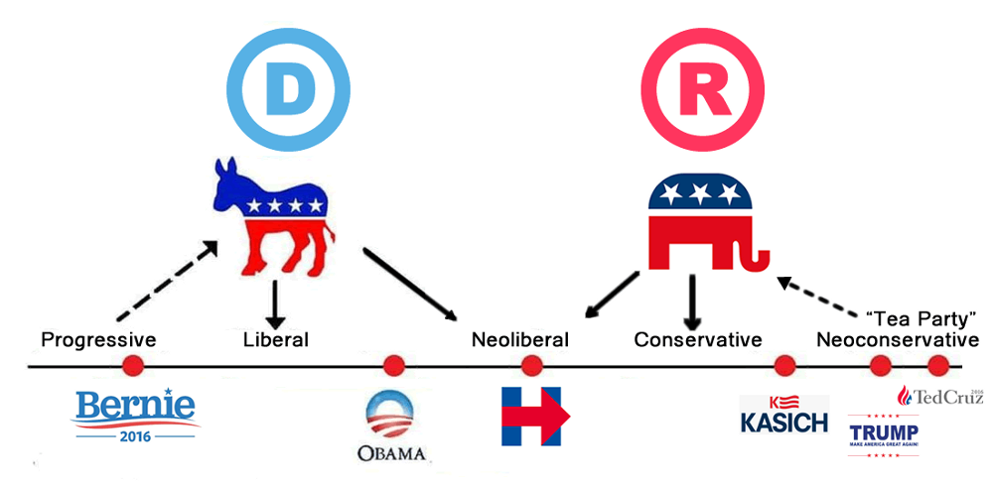
Learning Objectives
To understand the political ideological spectrum
  As it exists in Europe
  As it differs from the US

Slide 3
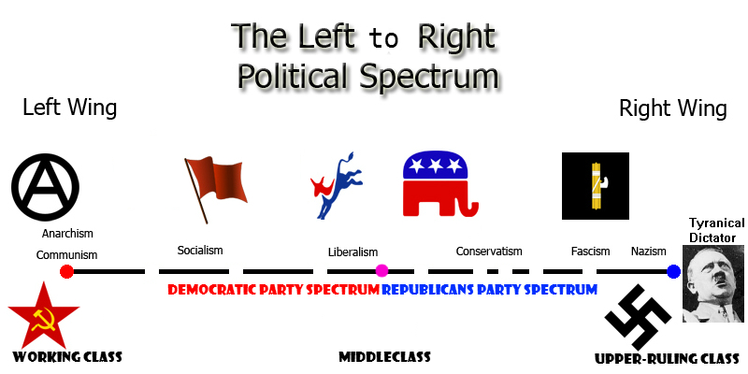
****In US terms

Slide 4
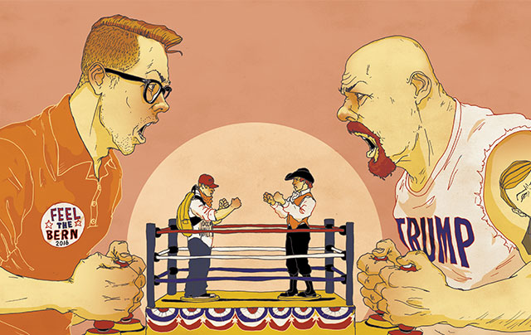
US 2016: broader than usual

Slide 5

But still different than Europe
Why?
Different political histories
Monarchy
Empire
Church
Different bases of citizenship
Esp. ethnonationalism
Jus sanguinis
Different political institutions
Esp. parliamentary systems

Slide 6
Political Ideologies in Europe
LEFT
RIGHT
Values social security for all over individual/corporate freedom to amass wealth
Larger role for state in providing for social justice
Tends to be more secular, for strong separation of church and state
Values family, church, nation; traditionalism
Often in favor of having an established church and/or special treatment for traditionally most significant church(es) and discrimination against non-traditional religious groups.
Patriotism, strong defense of nation.

Slide 7
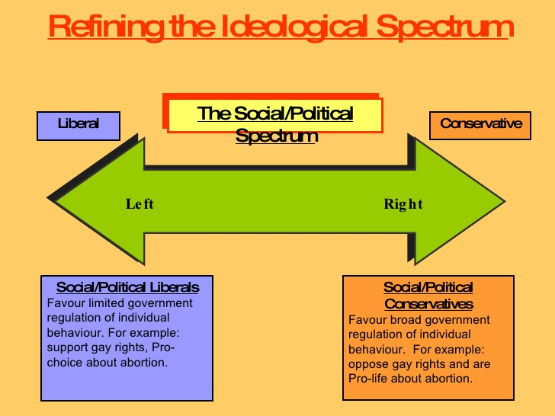

Slide 8
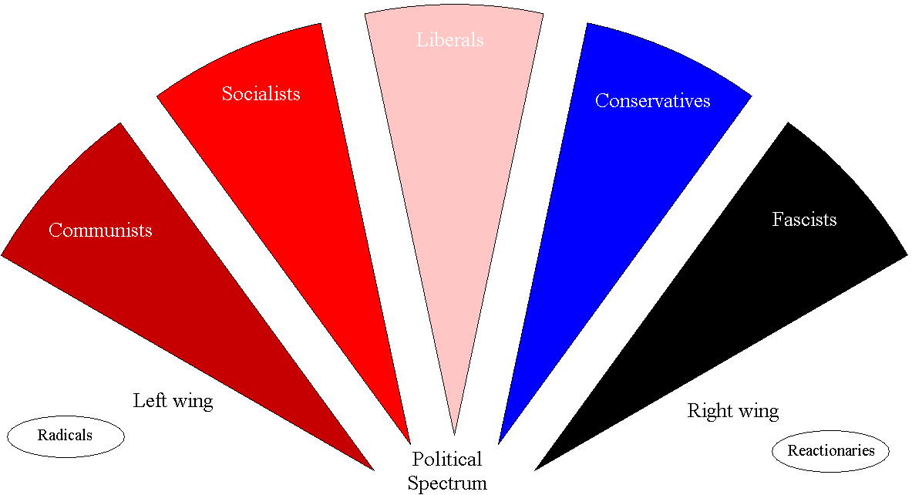
Range of Political Ideologies

Slide 9
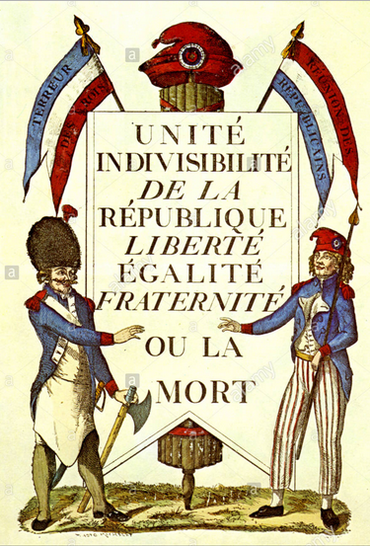
What does “liberal” mean in Europe?
For individual freedom
For free markets
Opposed to aristocracy, monarchy
Secular, anti-religious, religious intervention in public affairs
Occupies the center on political spectrum between leftists/socialists and rightists/conservatives

Slide 10
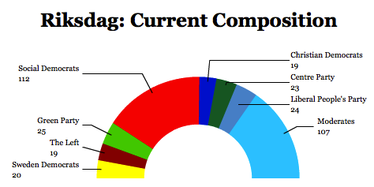
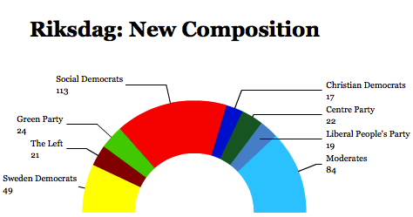
Range of Political Ideologies of Parties in European Parliaments
Riksdag before 2014 Elections
Riksdag after 2014 Elections

Slide 11
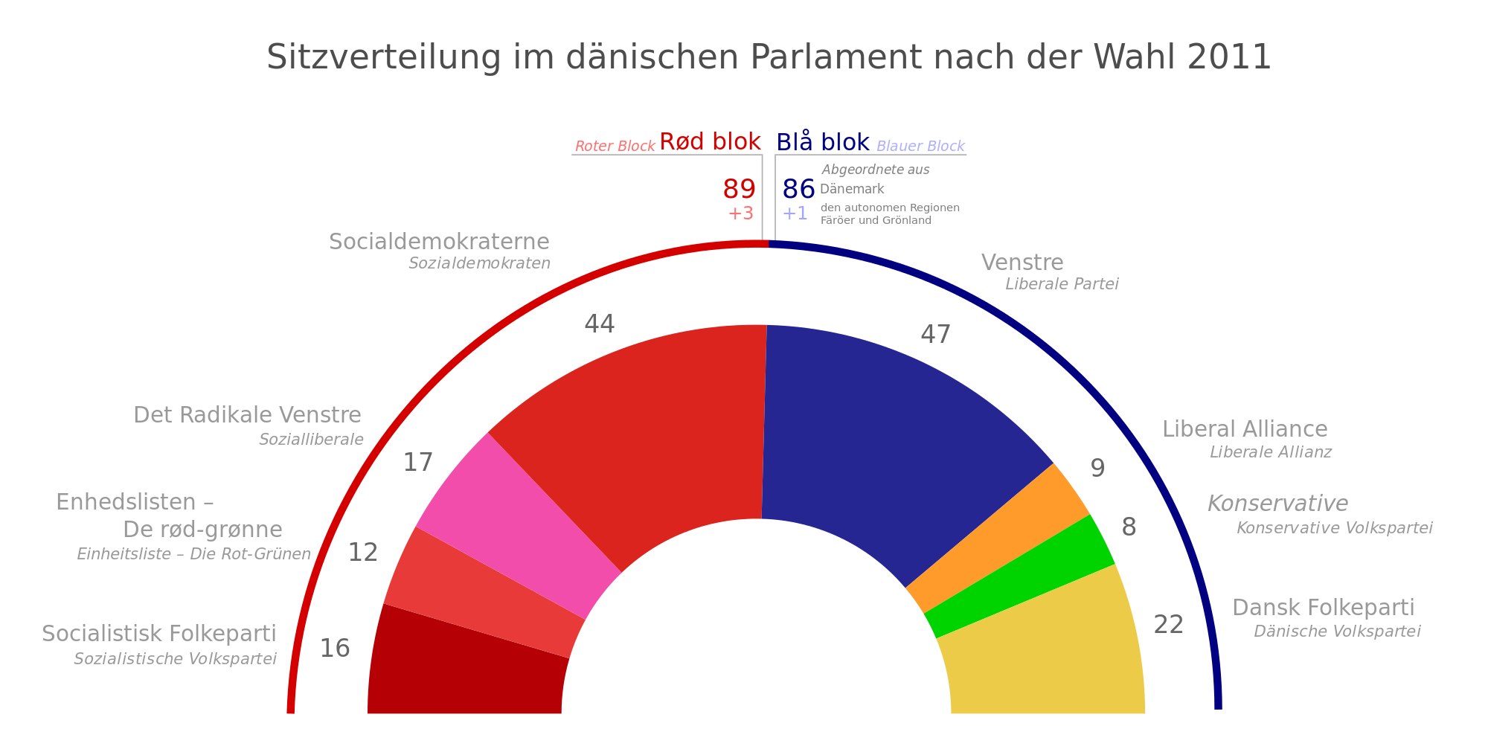
Danish Folketing 2011 election results

Slide 12
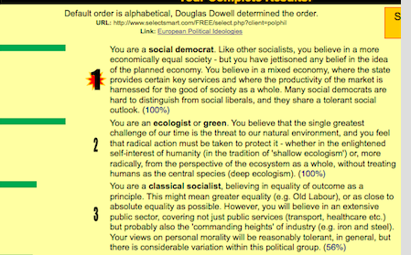
Brunell’s Result on Political Ideology Quiz

Slide 13
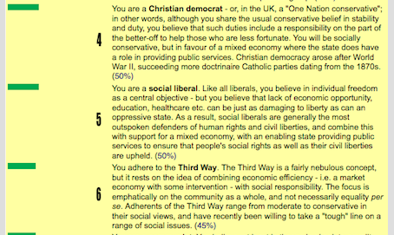
Brunell’s Results on Political Ideology Quiz

Slide 14
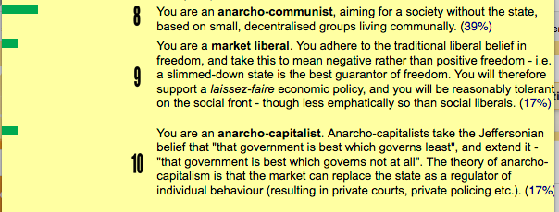
Brunell’s Results on Political Ideology Quiz

Slide 15

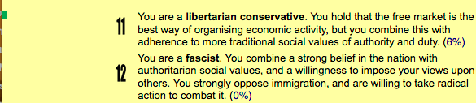
Brunell’s Results on Political Ideology Quiz

Slide 16
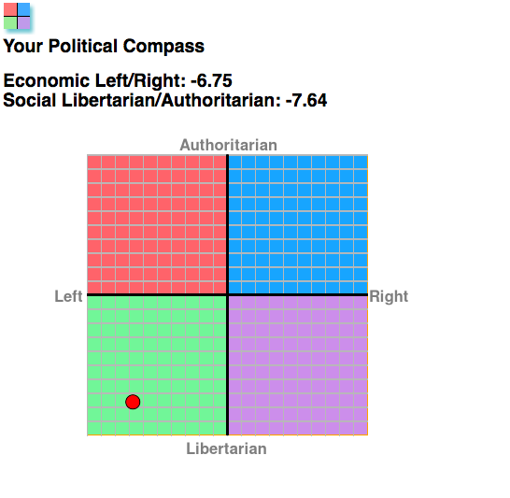
Political Compass

Slide 17
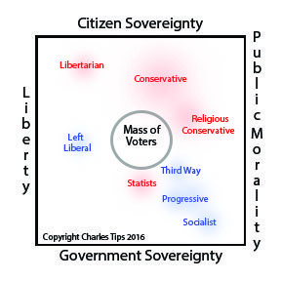
Click here for a very good explanation of US system on four part typology
And an example of how ignorant most Americans are of political ideology as revealed by the question asked.

