Slide 1
Reimagining Citizenship: Exit, Voice and Loyalty in the 21st Century
Laura Ann Brunell
Associate Professor of Political Science, International Studies and Gender Studies
Gonzaga University
Notes:
Presented at “The Capacity for Renaissance: the logic and force of the imagination,” Gonzaga-in-Florence, 20-22 February 2014

Slide 2
Civil Disobedience
“a public, non-violent and conscientious breach of the law undertaken with the aim of bringing about a change in laws” (Brownlee, paraphrasing Rawls (1971)
Key traits
Publicity
Non-violent
Conscientious
Change orientation
CIVIL – i.e., action taken by a CITIZEN to change the behavior or his/her STATE

Slide 3
Citizenship
A complex, multi-faceted concept
A set of rights, duties, obligations, entitlements, loyalties “which constitute membership of a territorially bounded political community” (Stoker et al. 2011, 133)
Notes:
Based on this definition, why should we expect ideas about citizenship to be changing today?

Slide 4
Citizenship
Who belongs?
What’s expected: on the part of the state, on the part of citizens

Slide 5
Two Models of Citizenzship
Republican
Liberal

Slide 6
The Republican Model
Direct participation of citizens in face-to-face political dialogue
Virtues
Duty, Loyalty
Common Good
Judgment
Exclusivity: stakeholders with the right virtues

Slide 7
The Liberal Model
Rights-based model
Natural Law basis
Social Contract
Duty to resist tyranny
Can withdraw from the social contract

Slide 8
Challenges to citizenship
What challenges citizenship today - both as a legal status AND as a set of practices?
What challenges are faced by Republican model?
What challenges are faced by the Liberal model?

Slide 9
Challenges to Citizenship’s Exclusivity, Loyalty
Globalization
Ease of travel, transport
Connectivity
Rise of cyber communities, Diasporas
Rise of cosmopolitanism
Neo-liberal trade and investment regimes

Slide 10
Blurring lines between citizens, residents, members
Extending voting rights to members of the national “community” living abroad
Extending voting rights to resident “aliens” living with the political community
Multiple nationalities, passports

Slide 11
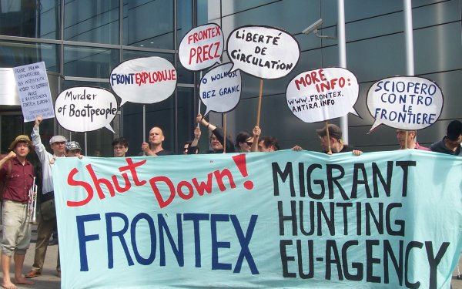
The Rise of the Security State In contradiction to this blurring, States are simultaneously policing their borders as never before

Slide 12
Rise of the Surveillance State
Loss of civil liberties in pursuit of the US “War on Terror”
NSA’s widespread surveillance of American citizens

Slide 13
Security State exacerbates existing crisis in citizenship
Declining of trust in government
Declining levels of voting, party identification
Feelings of alienation from politics

Slide 14
Implications for the Republican Model
Different sense of belonging
Of the political “community” to which one owes allegiance
Face-to-face communications supplanted by the virtual, digital

Slide 15
Extension of the Liberal Model
“The End of History”: all for “market-democracy"
Cosmpolitanism, Kantianism
Shifting of rights discourse to “the global community”
The right to protest, to project one’s voice onto the global stage
Allegiance to principles not states
“human rights”
“the environment

Slide 16
Loyalty to Principles or Loyalty to the State?
Reveal the tensions between civic values of the duty to be loyal to the state; my country right or wrong (patriotism in the extreme)
vs. the duty to be loyal to one’s own principles (cosmopolitanism, Kantianism)
And/or to the principles that the State itself purports to represent such as freedom, rule of law, limited government(civic nationalism)

Slide 17
Brave New World, Brave New Citizens
More aggressive assertions of state power create conundrums for citizens, professionals in certain types of work

Slide 18
Creative responses to securitization?
Whistleblowing
Exit, Voice, Loyalty
Snowden: Need to exit to have voice
Loyalty??

Slide 19
Loyalty has a price
Manning blew the whistle without an exit strategy
Did her duty AND was loyal to her country, the military
Her reward: 30 years in prison

Slide 20
A creative response: Sousveillance
Hasan Elahi
Tracking Transcience

Slide 21
Sousveillance as his response
View from below
“I can watch me better than you can watch me”
Tracking Transience project
Bombards FBI with information on his whereabouts, eating, spending
Now they know everything and nothing about me

Slide 22
The Challenge of Citizenship in the 21st Century
The structural, legal underpinnings of the state and citizenship are evolving
Technology has made states, citizens, terrorists, whistleblowers alike more powerful
There is an opening for discussions about what should be the limits of state power, civic duty, loyalty to the state and to liberal principles

