Slide 1

Welcome!

Slide 2

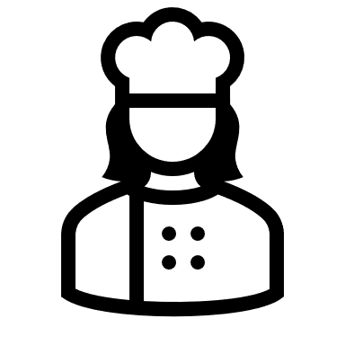
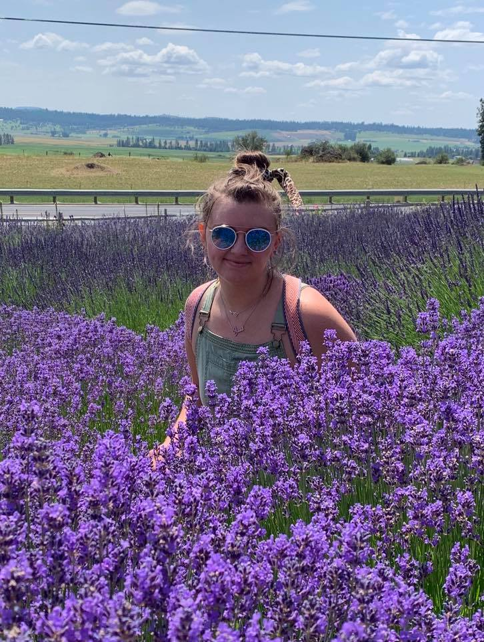
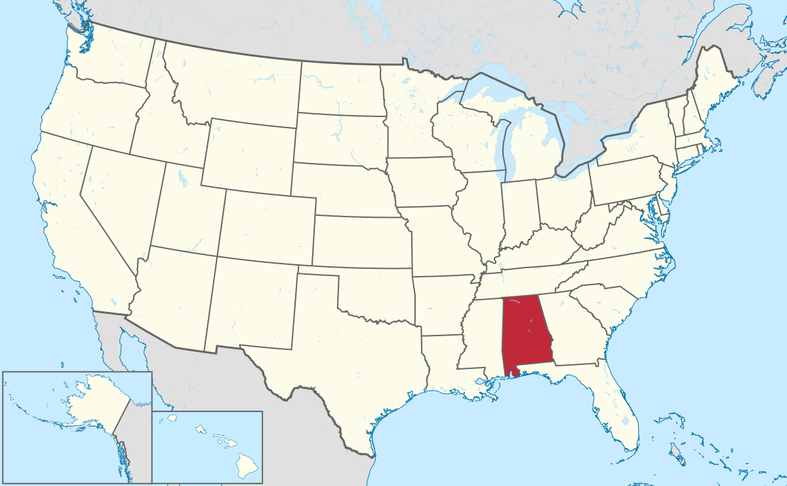
Welcome!
and I like to cook!
My name is Sarah,
I am from Alabama.
Respond: Hi Sarah!

Slide 3
Important Question
I need to record class today.
Neccesito grabar la clase hoy.
Do I have your permission?
¿Tengo su permiso?

Slide 4

Warm-up!
Respond: Hi ______!!!
Respond: Oh! Wow!
Respond: Nice!
Find your favorite cooking utensil.
Think about why you like it.
Share with the class!
Good afternoon! My name is ______, and this is a __________. I like it because __________.
Sarah
Skillet
it is old.

Slide 5
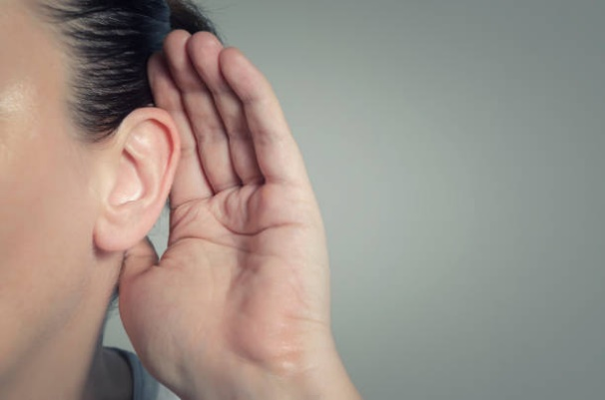
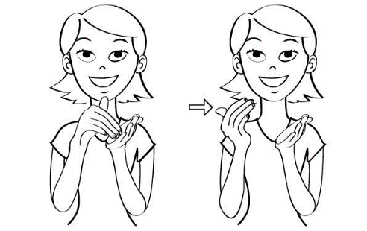
Class Signs
1. I can’t hear you!
2. Please repeat.

Slide 6
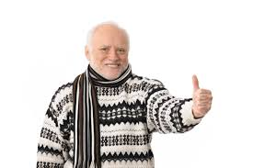
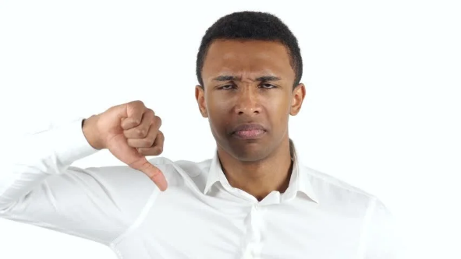
Class Signs
3. I understand!
4. I don’t understand.

Slide 7

Pronunciation practice

Slide 8
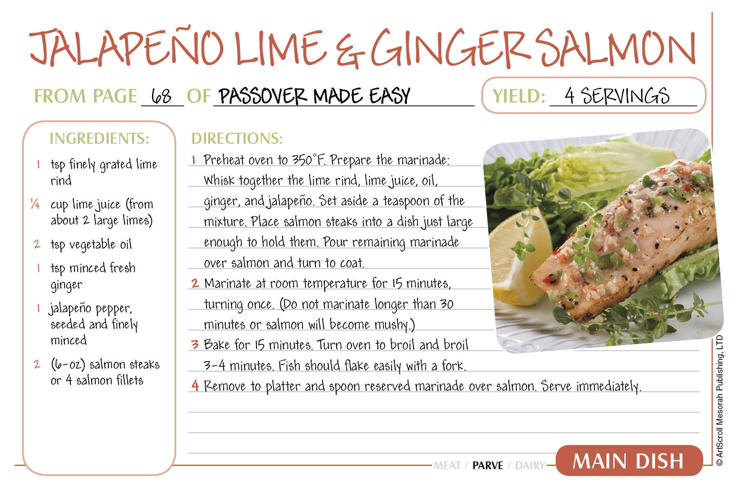
Recipe
Noun: A set of instructions for cooking.
The recipe calls for one cup of flour.

Slide 9
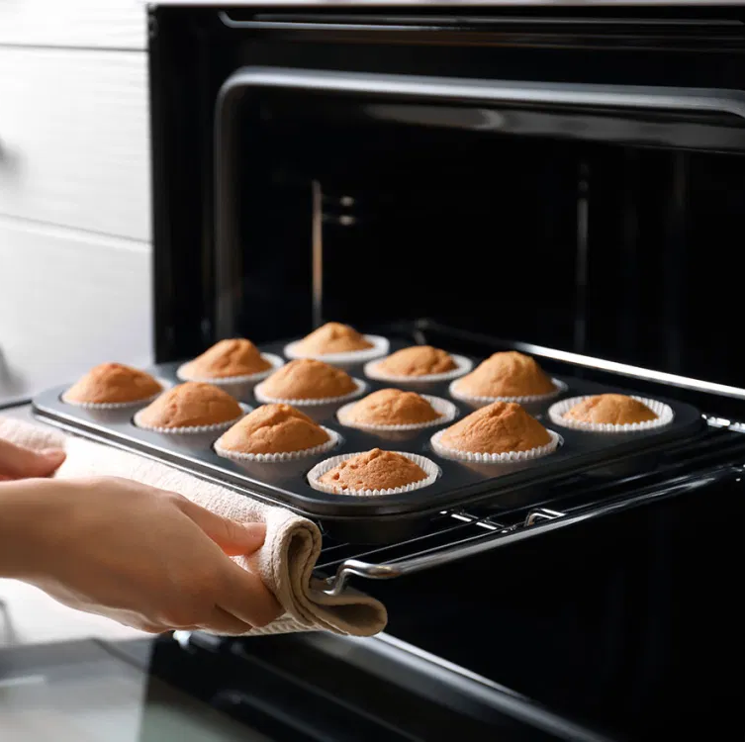
Bake
Verb: To prepare food using the oven
The muffins need to bake for 15 minutes.

Slide 10
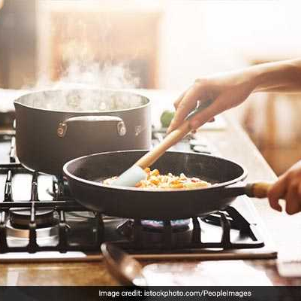
Cook
Verb: To prepare food using the stove
Lilia likes to cook for her family.

Slide 11
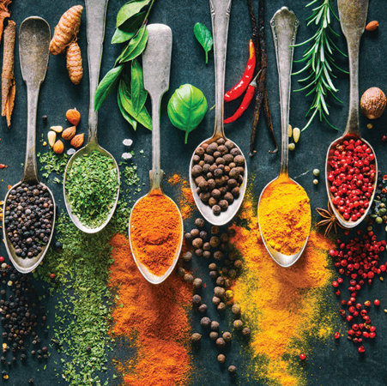
Ingredients
Noun: the parts that you are cooking or baking with.
Some of the ingredients were coco and sugar.

Slide 12
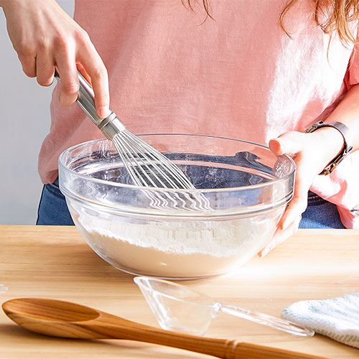
Mix
Verb: to combine
Mix the batter for five minutes.

Slide 13
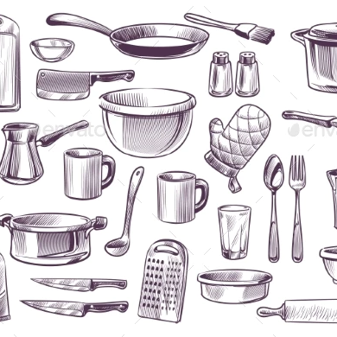
Utensil
Noun: The items you need for cooking or baking
My favorite utensil is a spork.

Slide 14
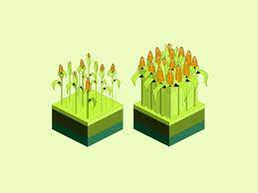
Yield
Verb: to produce or provide
This recipe will yield about 20 cookies.

Slide 15
Grammar Chuleta
en español
SVC (oracion)
VSC (Pregunta)
S- sujeto
V- verbo
C- complimento
Example: Flor fue a la tienda.
In English
SVC
S- Subject
V- verb
C- compliment
Example: Flor went to the store.

Slide 16
Breakout Rooms
Practice making simple sentences using your utensils.
Example: I cook with a skillet.
Subject
Verb
Compliment

Slide 17

homework
Think of your favorite food.
Prepare to share what it is, and why you like it.

