Slide 1
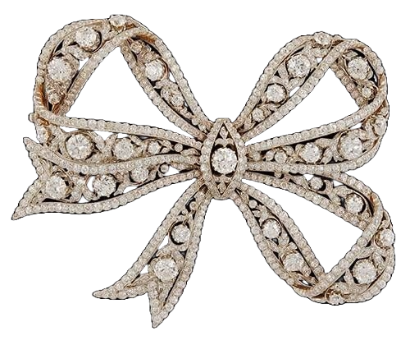
Rond De Jambe
Isabella McMurchy
Isabella Murphy | ADES 3570

Slide 2
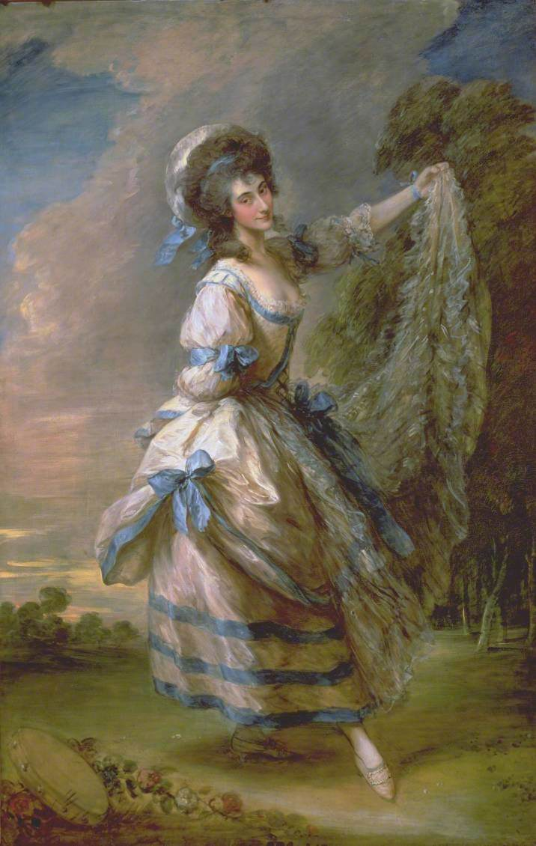
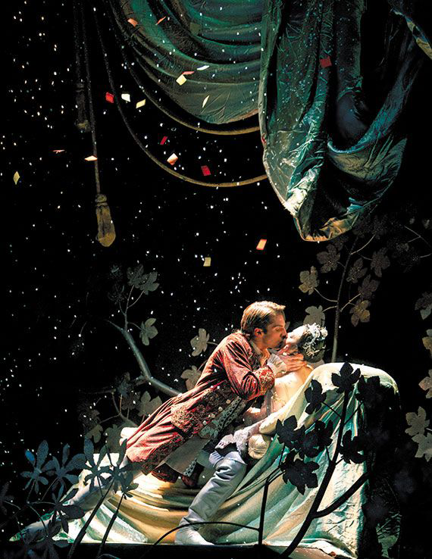
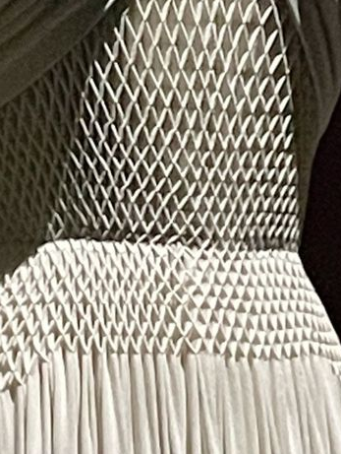
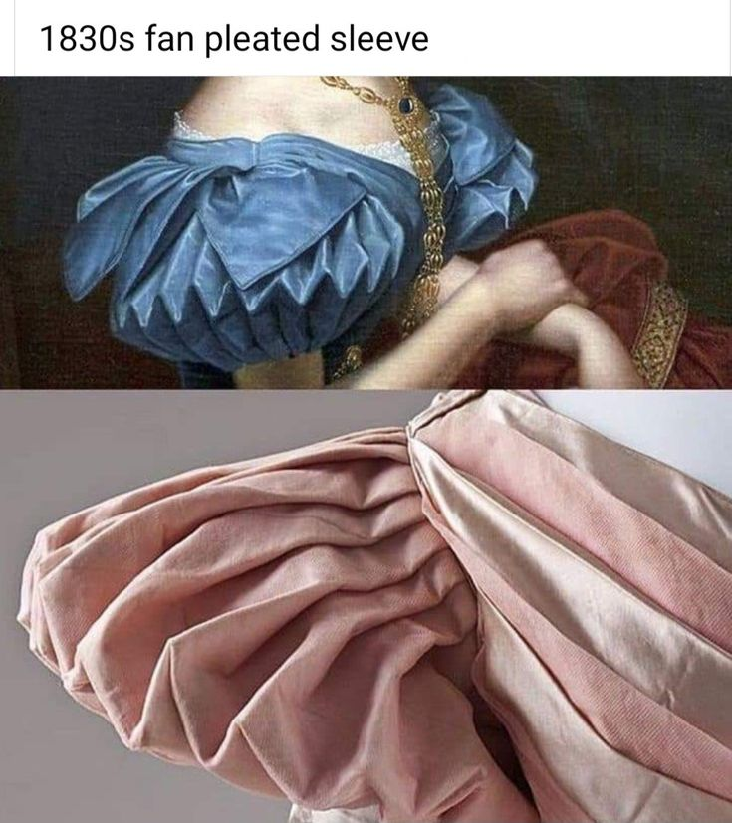
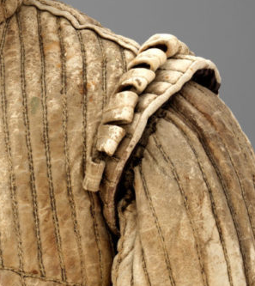
Inspiration
The initial idea started when I was sick with Covid in September. I heard the song Wriggle by Cosmo Sheldrake and from there I was inspired by the painting 1782 “Giovanna Baccelli” by Thomas Gainsborough. Baccelli was a Venetian ballerina, and I was inspired by her playful pose to create a ballet inspired outfit. Visual inspirations also included diamond/honeycomb smocking, 1830s fan pleated sleeves, and padded and slashed shoulders adorned with piccadills popular among menswear in the 1500s. From the initial sketch I knew I wanted to create something that focused on the whimsical and art of dance. The circus was also an inspiration because of acrobatics.
The name “Rond De Jambe” translates directly to “Round of Leg” and is a popular ballet move in which a dancer moves their leg in a circular motion. Circles are not only a big theme within dance itself, but also the circus, as the name is Latin word for ring or circle. I went with a color scheme that captures the light and dark elements, since Ballet is often depicting many dark stories such as Giselle and Romeo and Juliet, however it is depicted in such as way that paints the stories lighter and more fun.

Slide 3
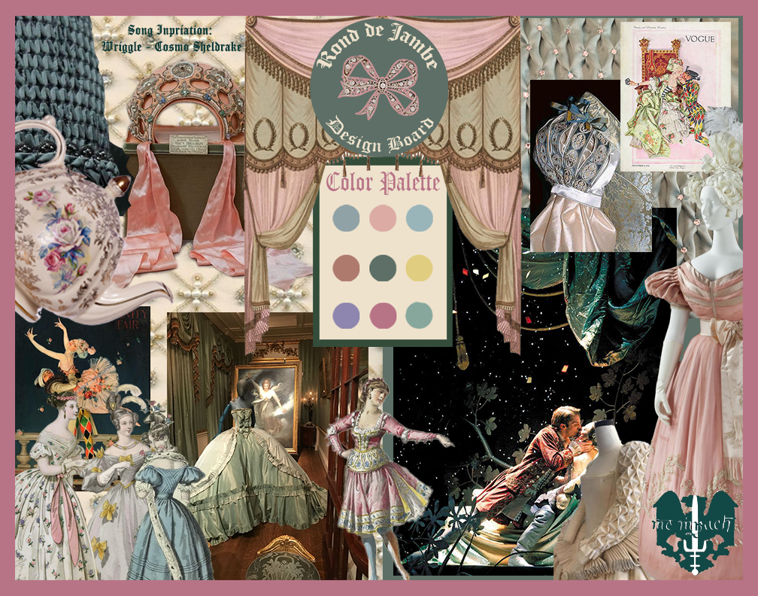
Moodboard
The inspiration behind my moodboard was a combination of things. I wanted to capture the whimsical and fun side to dance as an art form. Visual elements include diamond/honeycomb smocking, traditional Russian dress, 1500s decoration, 1830s fashion featuring fan pleated sleeves, and the ballets the Nutcracker, Sleeping Beauty, Romeo and Juliet, Giselle, Swan Lake, Anastasia, and A Midsummer Night’s Dream. Additional inspiration was J. C. Leyendecker’s art featuring both the ballet and circus.

Slide 4
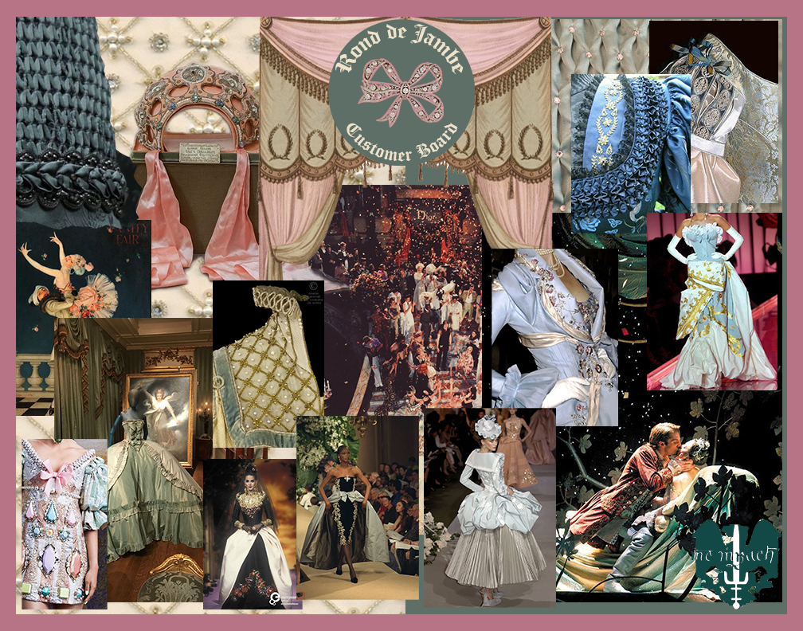
Customer Board
My customer board targets runway models, actors, thespians, and ballerinas as the garments in this collection embody stage use. This collection is would be considered Haute Couture.

Slide 5
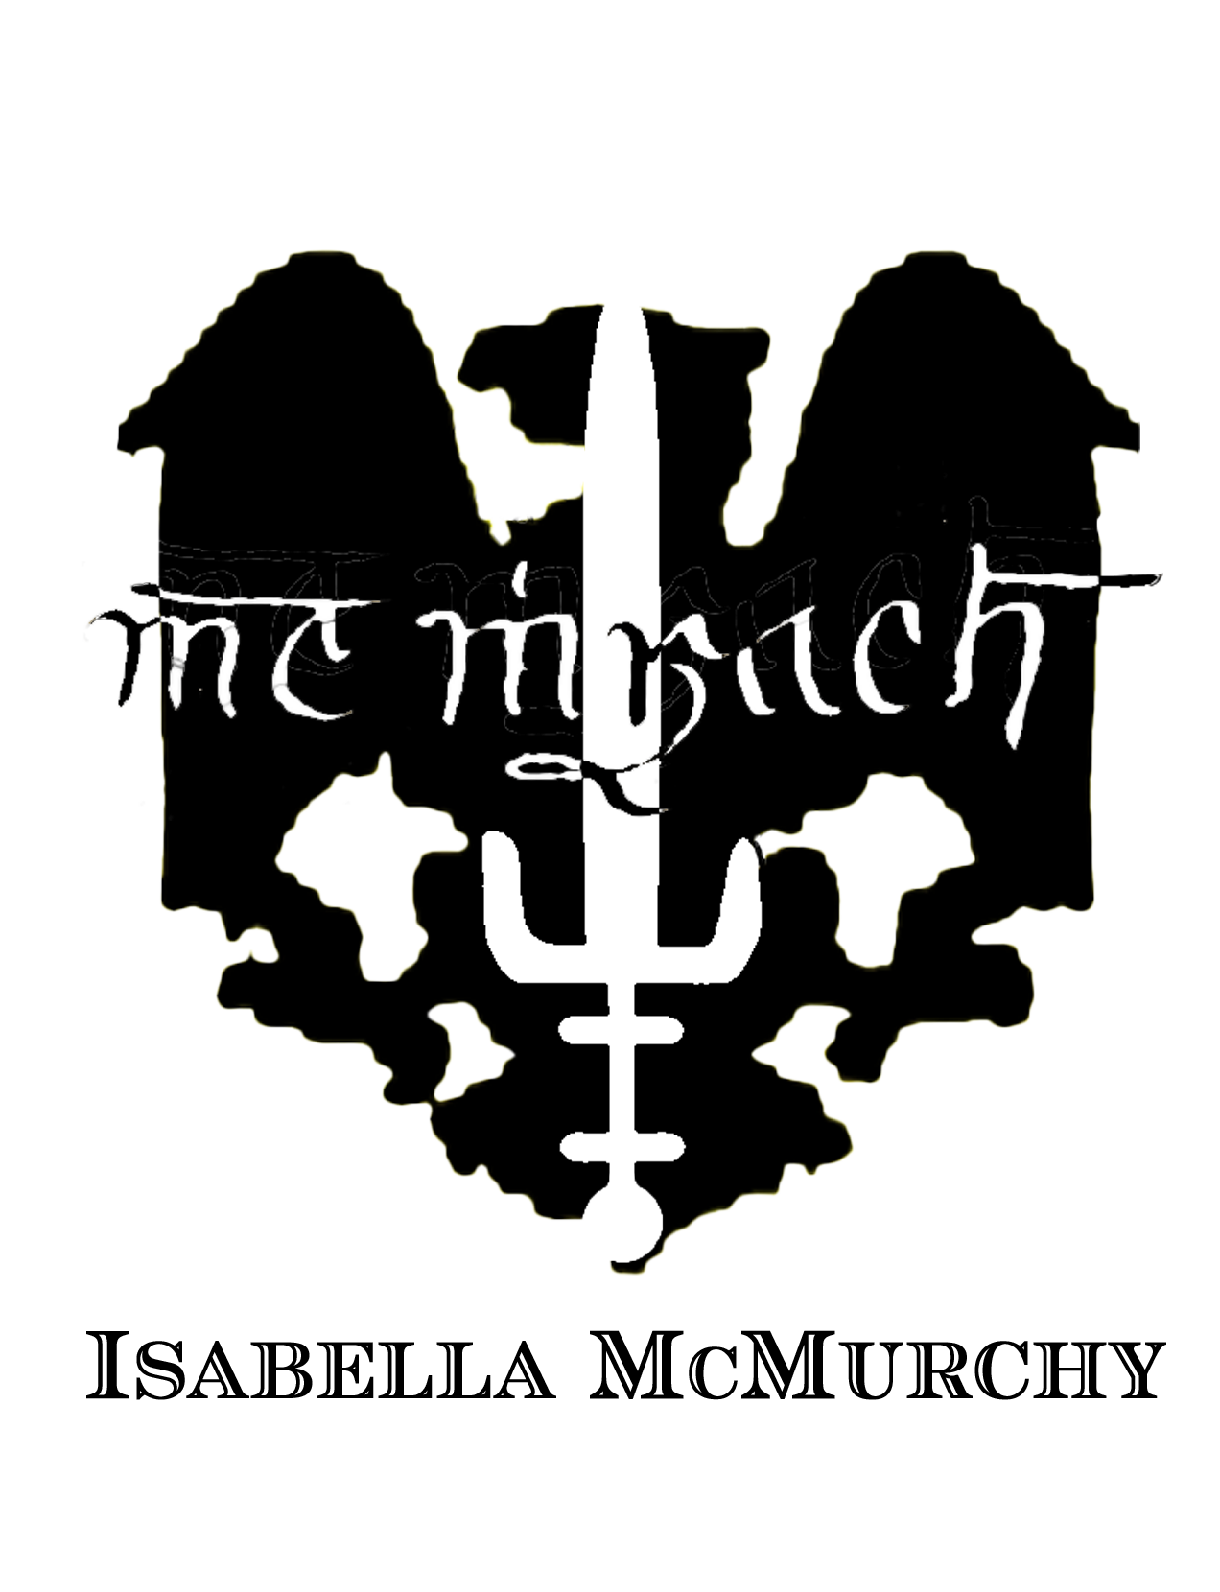
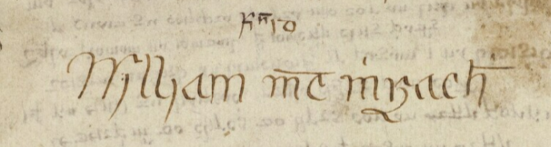
Temparay Logo
This logo is temporary as I do not entirely love how masculine the logo looks. I am still trying to trying to think of ways I can remake it. I know that I want to keep the signature because it is the nonexistent shorthand Scottish/Irish Gaelic form of my last name written by my 8th Great Grandfather William McMurchy.

Slide 6
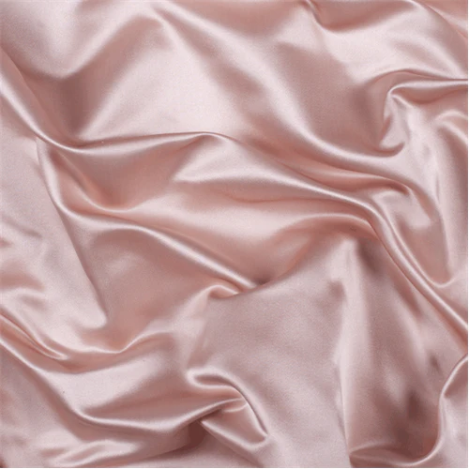
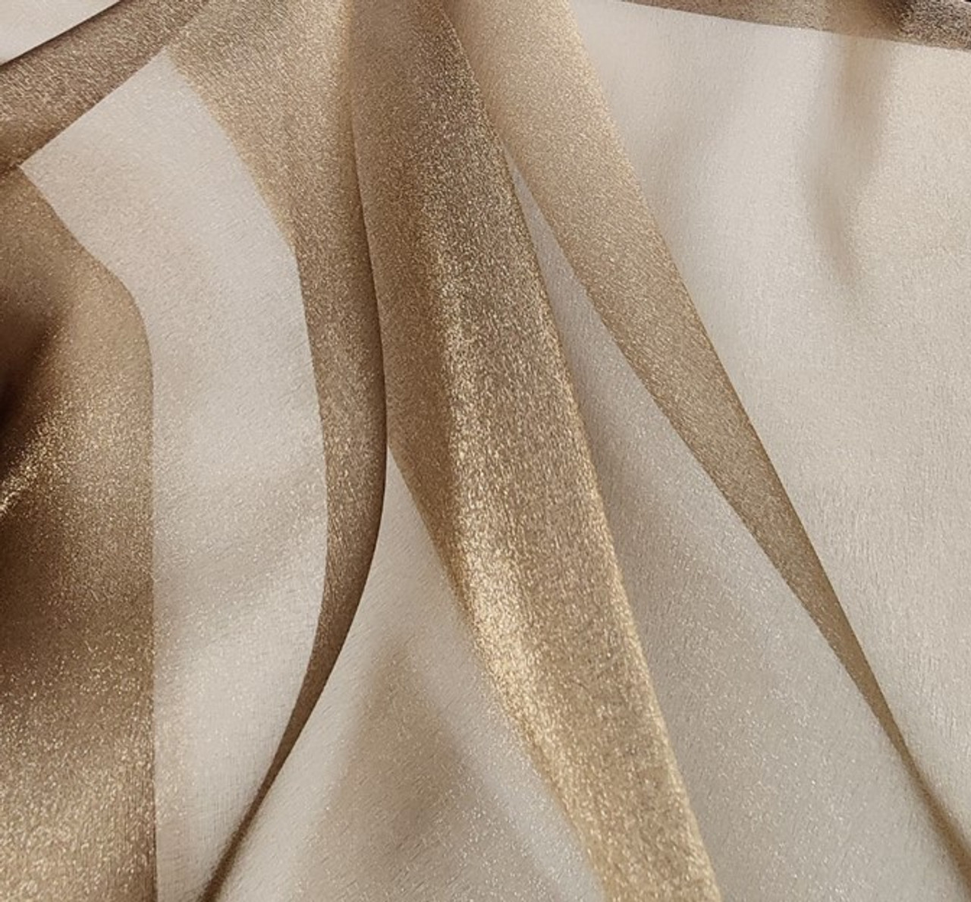
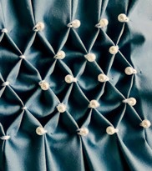
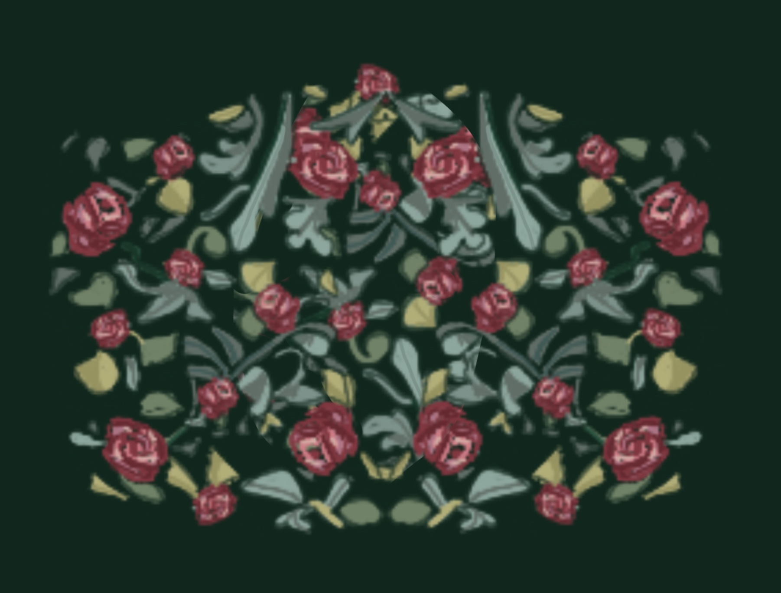
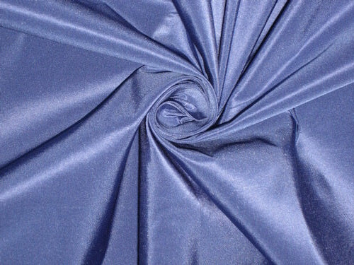
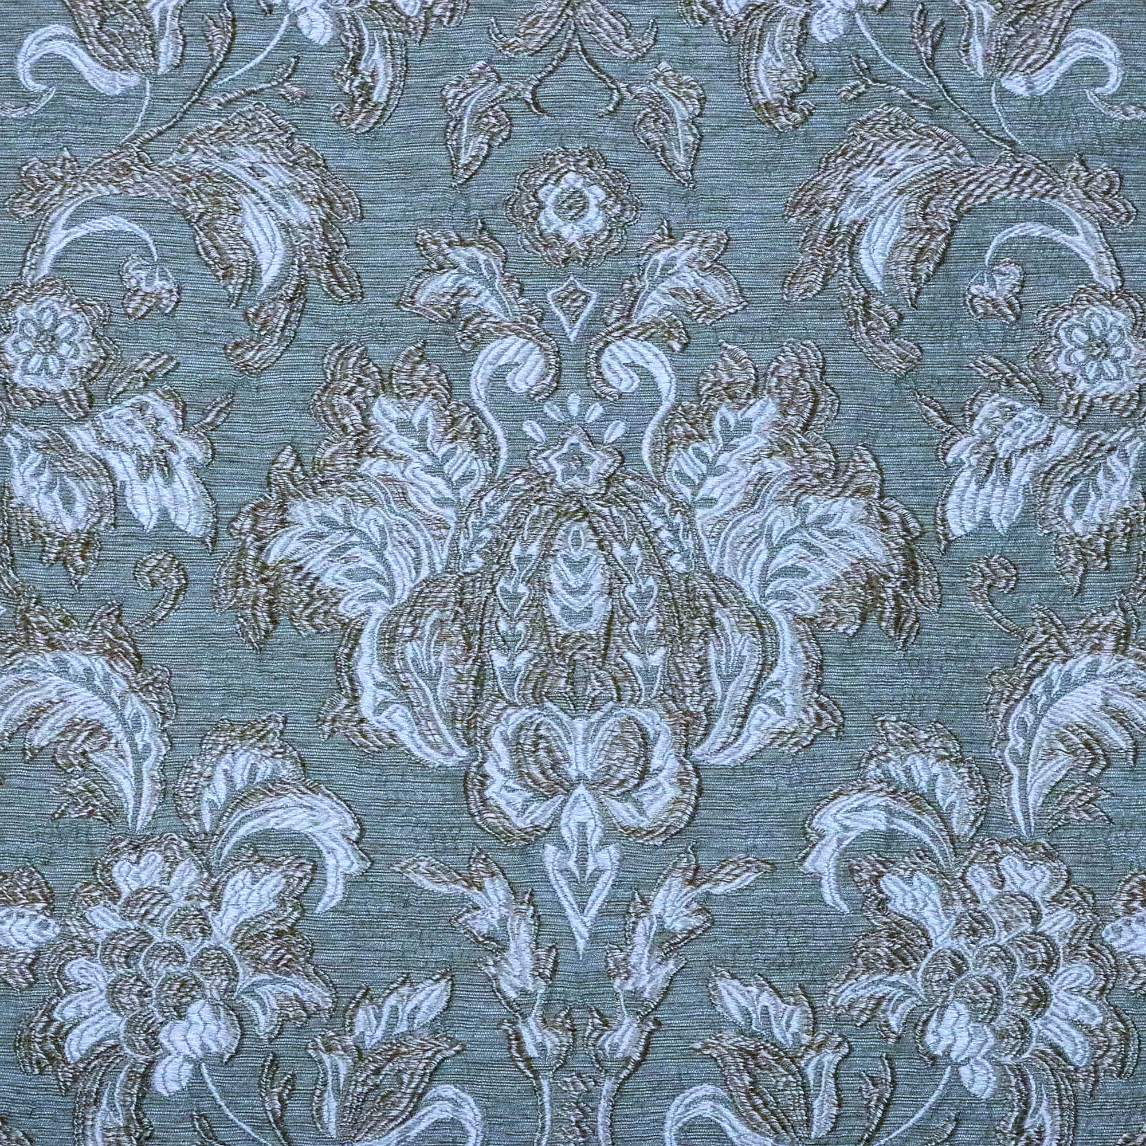
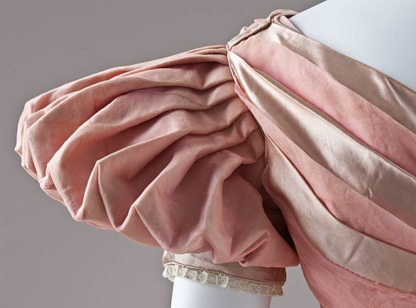
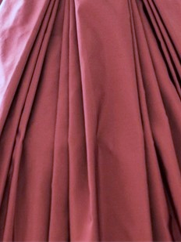
Textiles and Colors
Textiles
Colors
Techniques
Rose
Sage
Sunflower
Silk Satin
Organdy
Diamond/Honeycomb Smocking
Jacquard Weave
Viola
Deep Emerald
Spruce
Silk Taffeta
Brocatelle Jacquard
Fan Pleats
Box Pleats
Winter Mist
Hollyhock
Gold

Slide 7
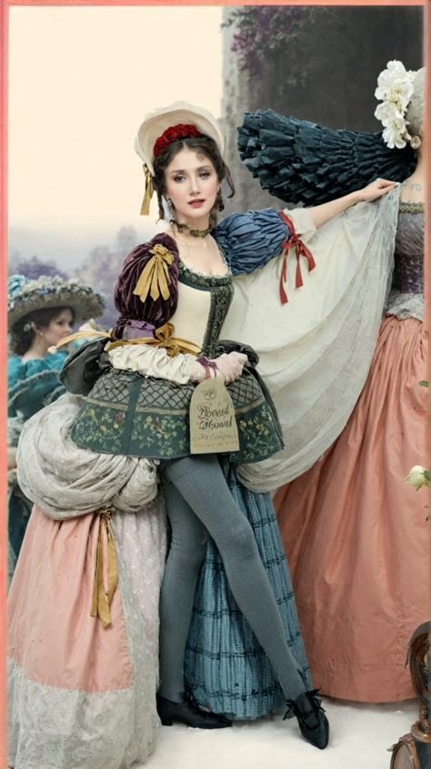
Textile Design
I created my own textile design loosely based on an AI generated rendering of my first initial sketch from Vizcom. The Textile design is completely my own and I made it using procreate.

Slide 8
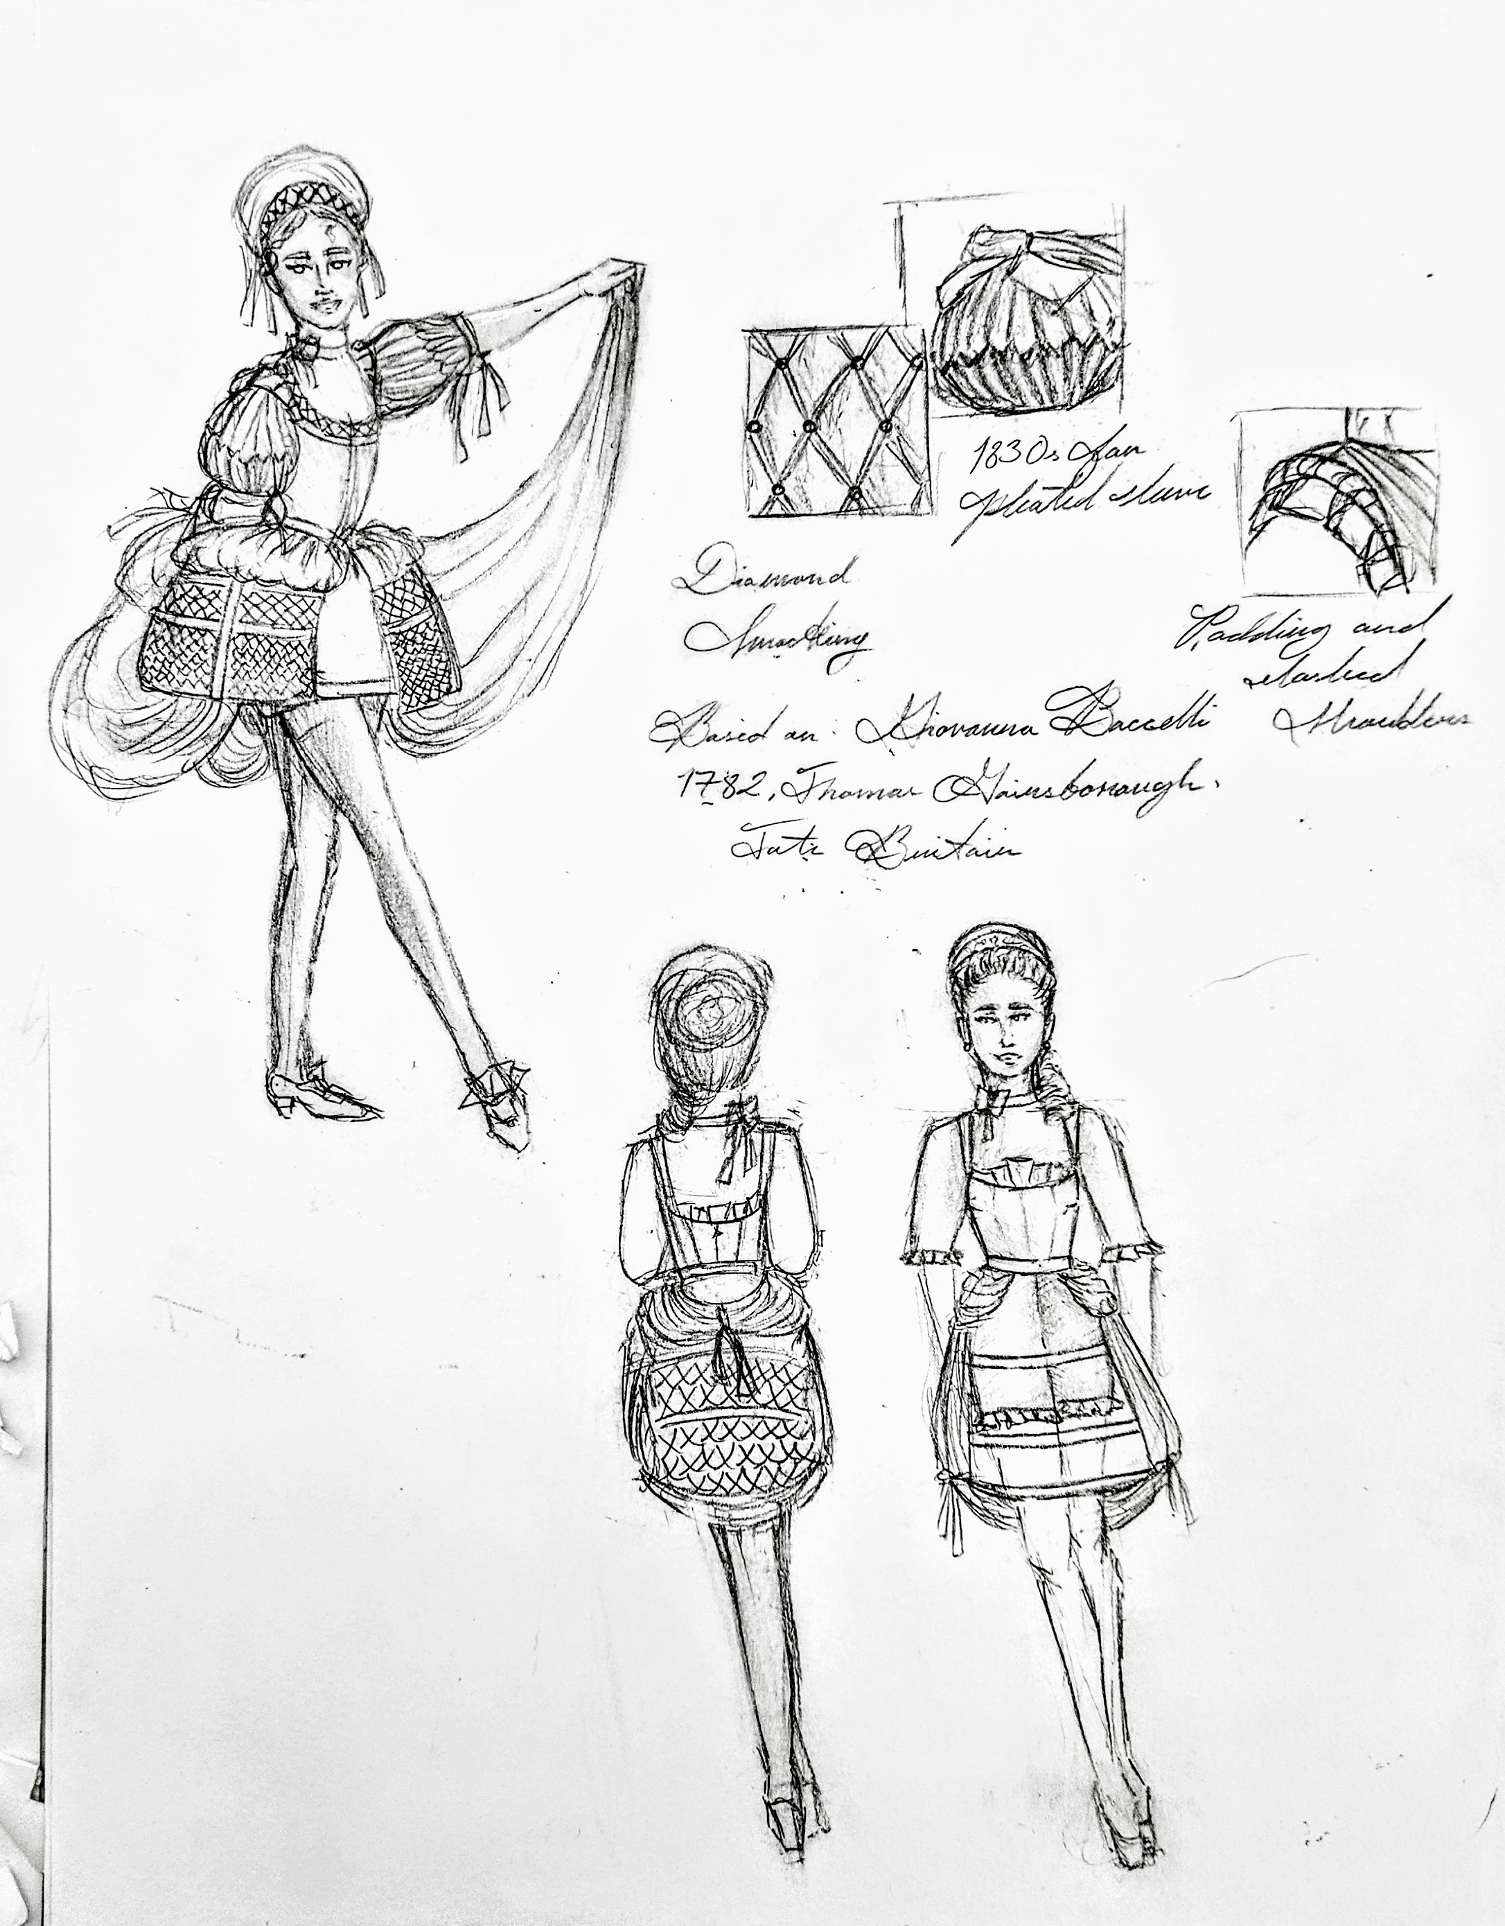
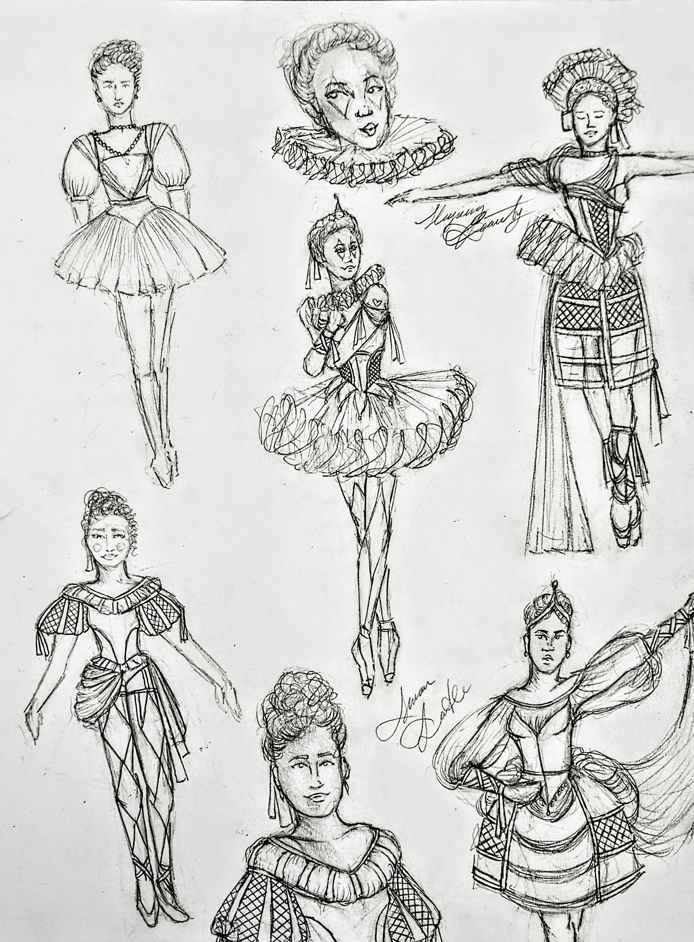
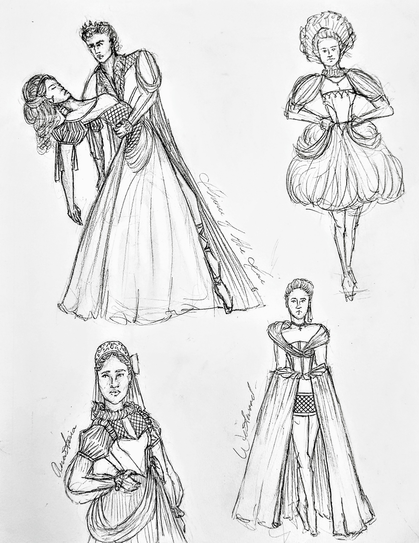
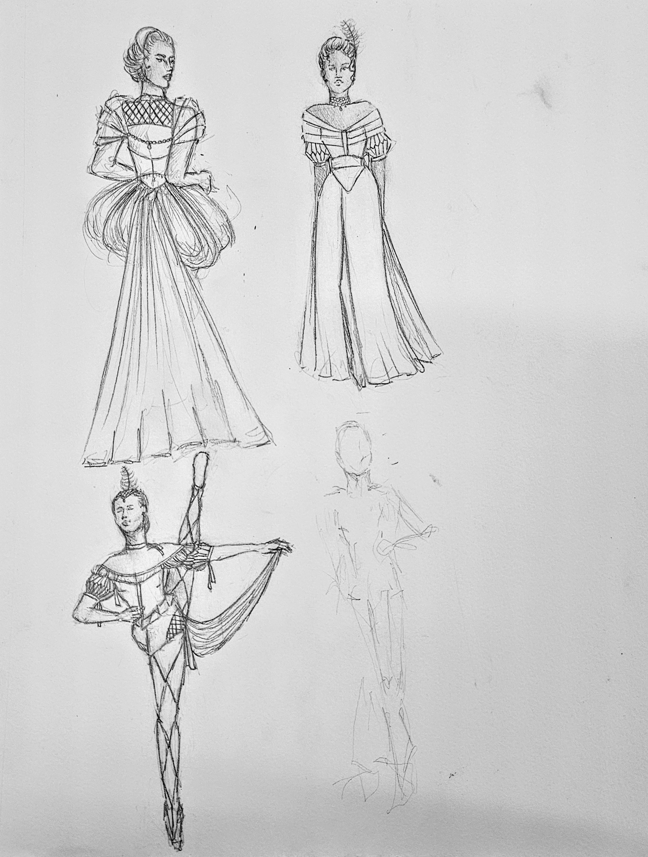
Initial Sketches
These are my initial sketches for the collection. Sketch 1 was the first sketch I made in semtember while I was sick with Covid. Sketch 7 was inspired by jesters, traditional harlequin, and ballet. Sketch 8 was inspired by the ballet Sleeping Beauty. Sketch 9 was inspired by Swan Lake. Sketch 11 was inspired by A Midsummer Night’s Dream and Giselle. Sketch 13 was inspired by Anastasia.
1
4
6
8
11
12
17
19
7
2
5
14
18
9
13
10

Slide 9
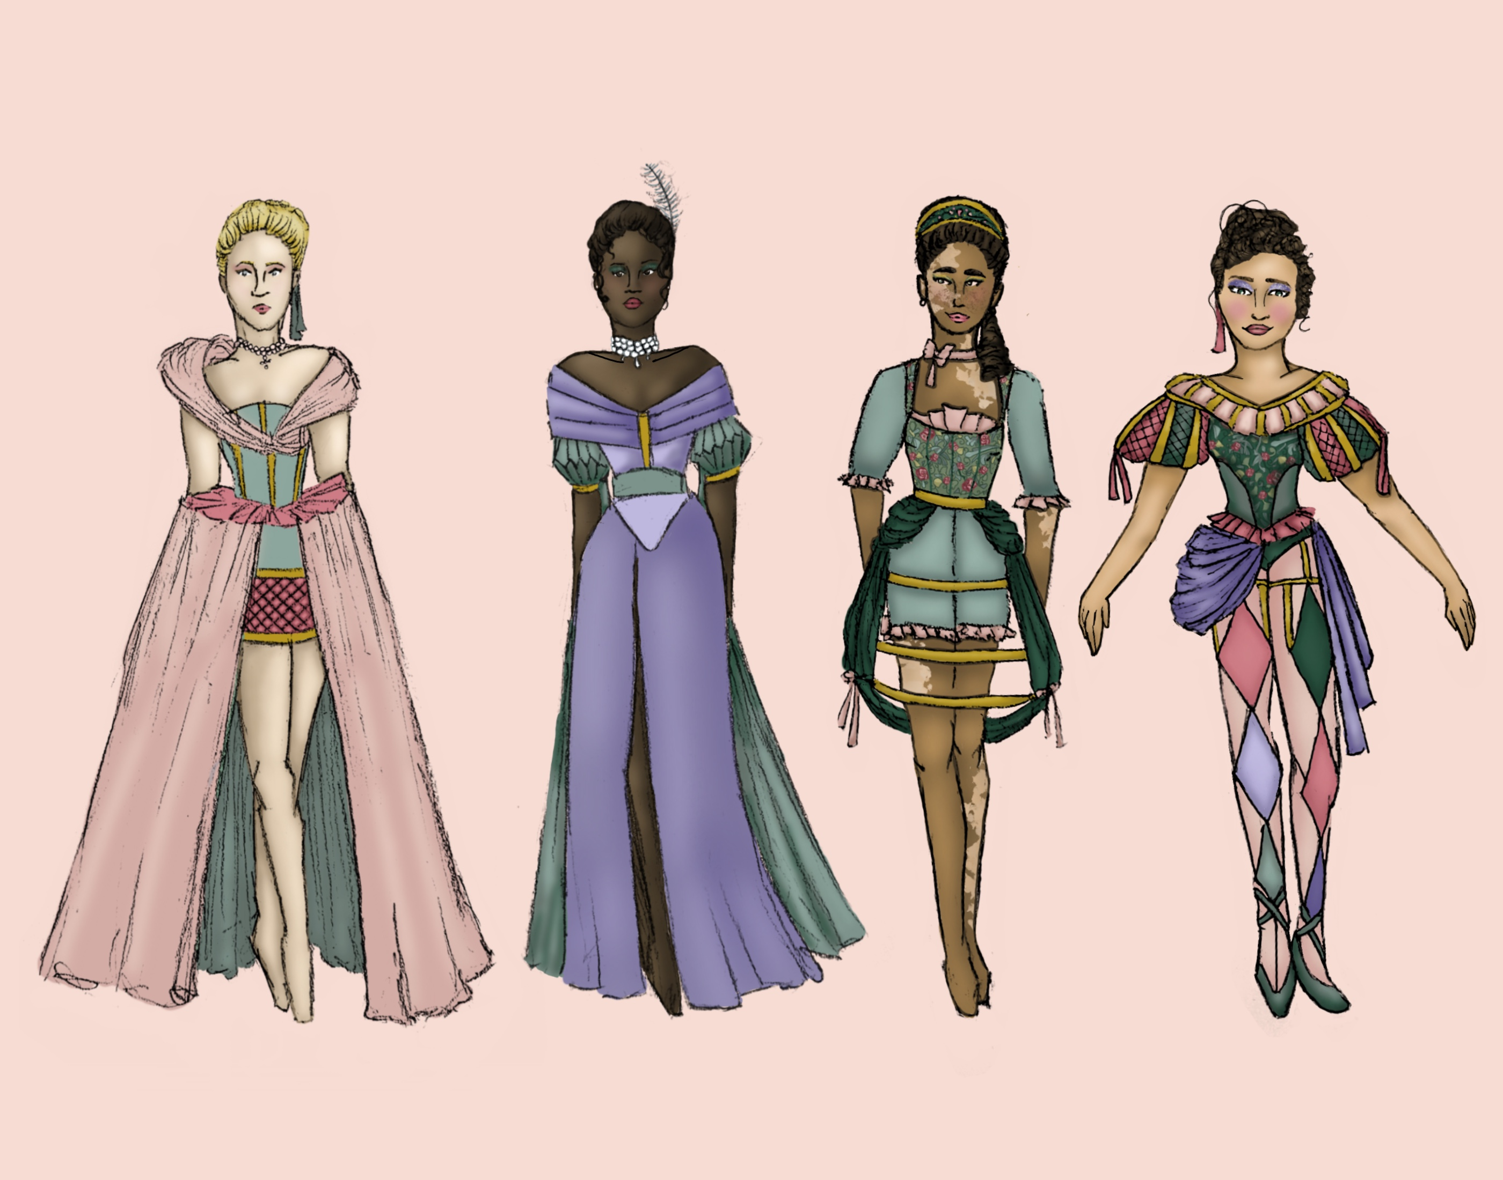
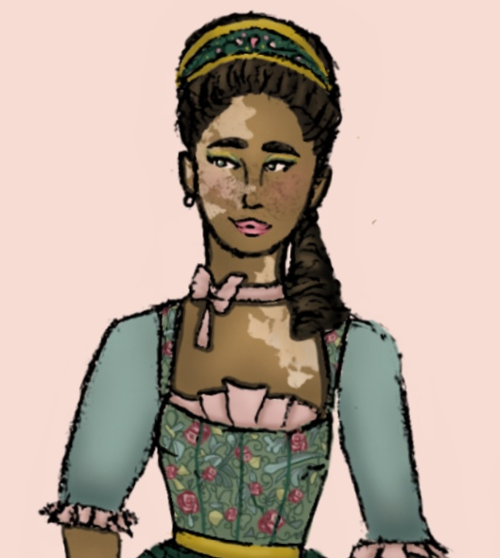
Final Sketches
These are my final renderings of my sketches. They were done in procreate.

Slide 10
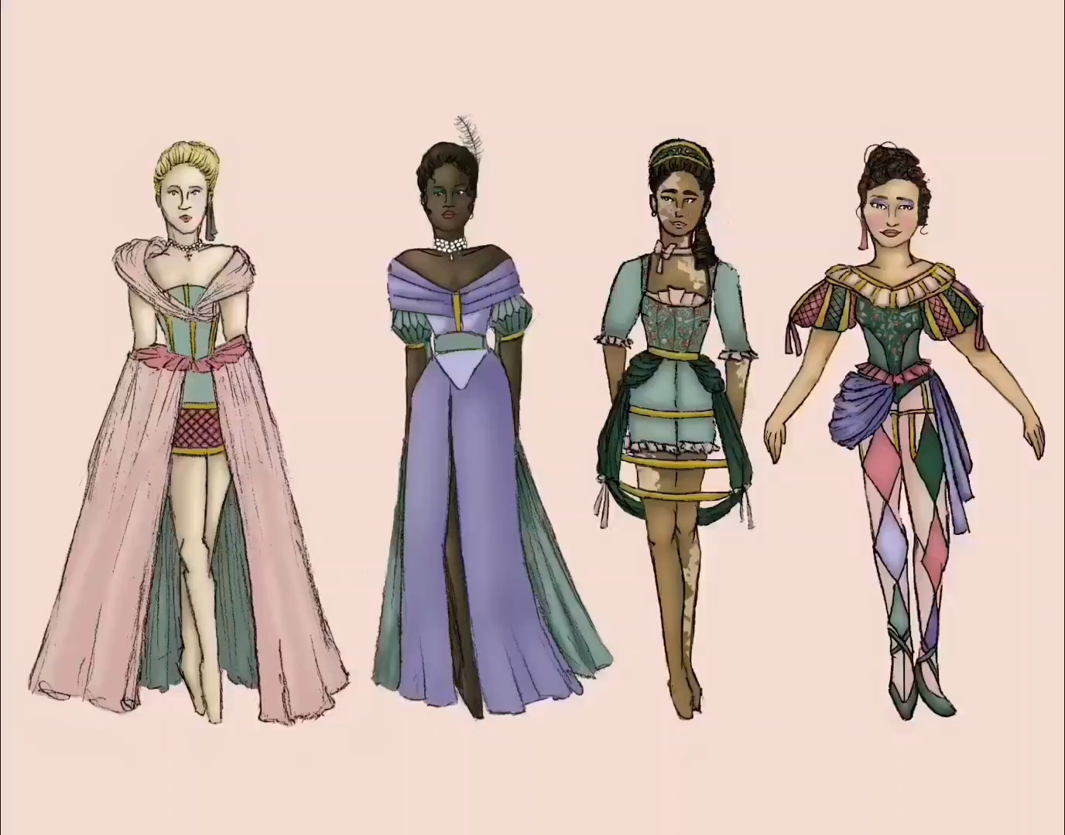
Final Sketches Process
This is a sped-up video of my process rendering my sketches in procreate.

Slide 11
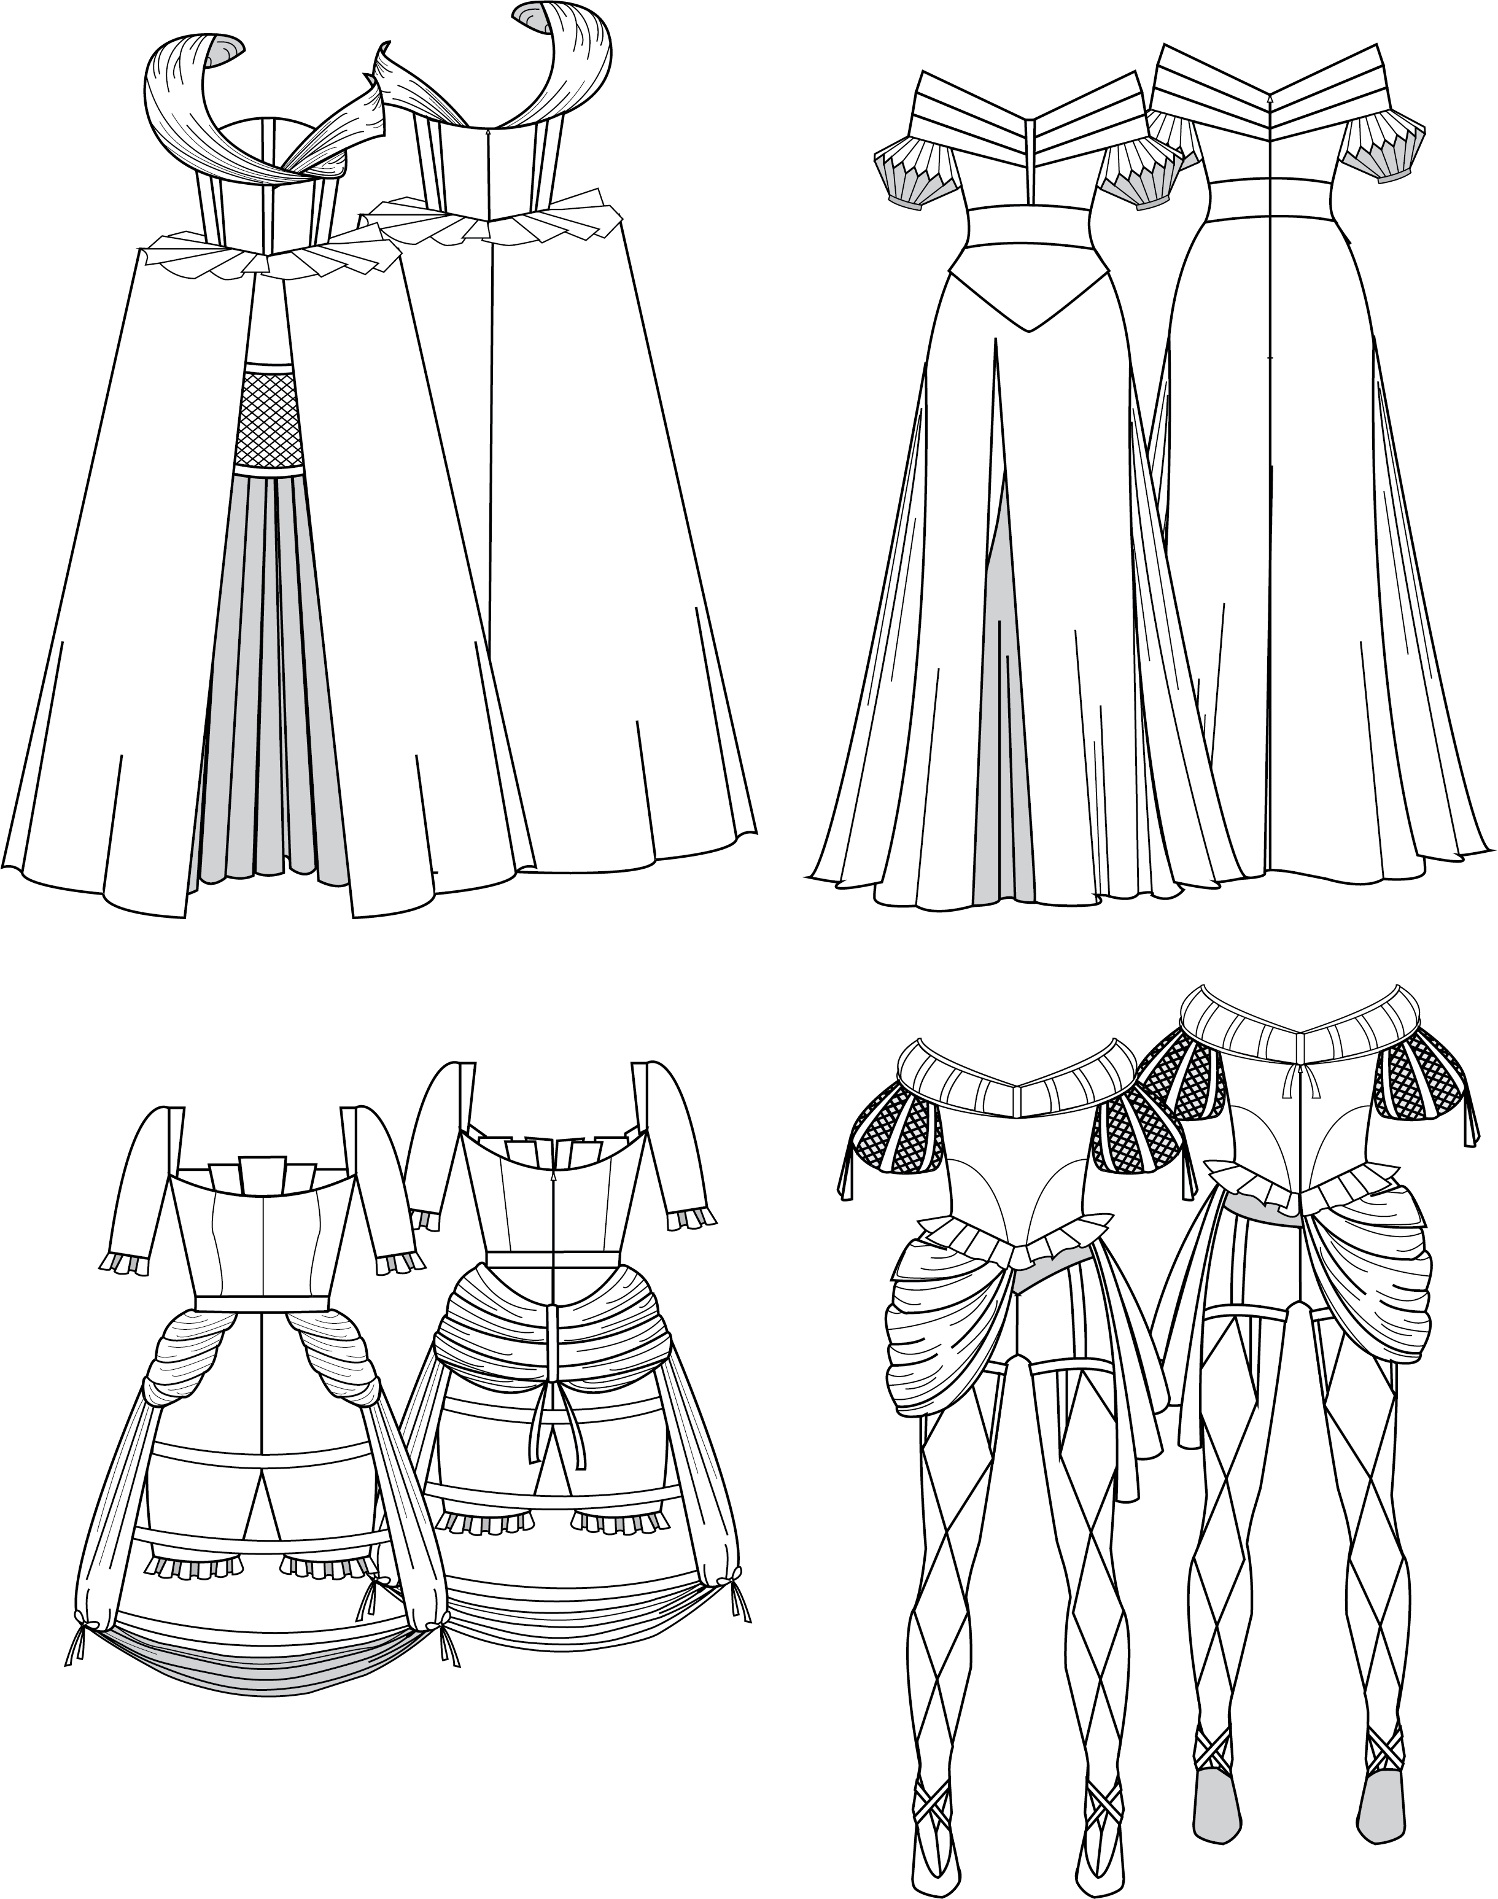
Technical Flats
Tech flats of my Final Sketches.

Slide 12
Thank You!
Do you have any questions?
Email:
IsabellaMurphy@my.unt.edu
Idmurphy2002@gmail.com
Digital Portfolio:
https://Isabella-Muphy-Fashion-Design-Portfolio.foliotek.me/

