Slide 1
China’s Gender Regime
The Gendered Costs of China’s Development

Slide 2
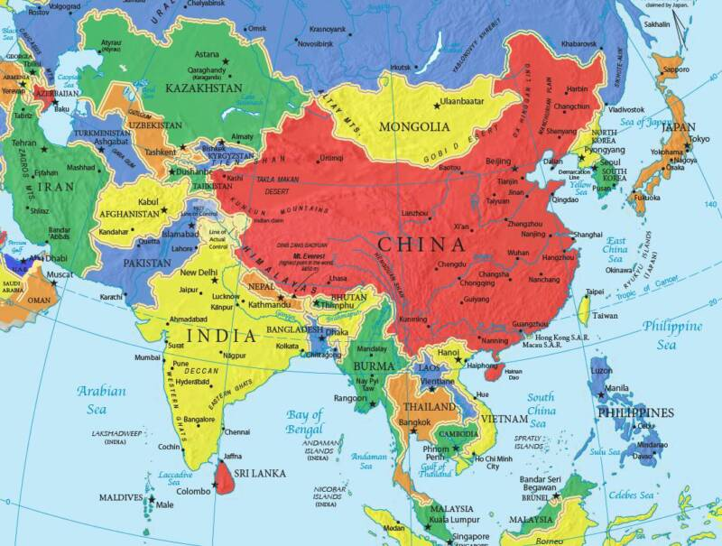
China’s Place in the World
3rd Largest Economy in the World
Grew 7.6% in 2013
GDP per capita $9800 (ranks 120th)
GINI index 47.2 (ranks 30th, after worse in Sub-Saharan Africa and Latin America)

Slide 3
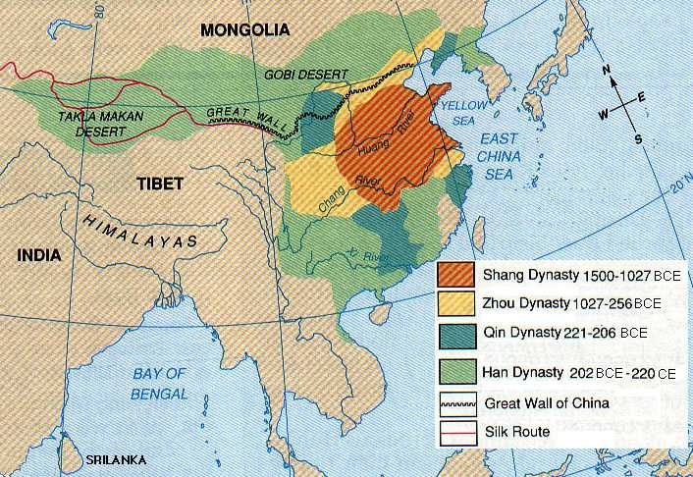
China: 4000 Years of Civilization

Slide 4
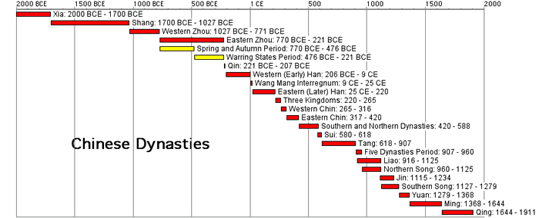
China: 4000 Years of Civilization

Slide 5
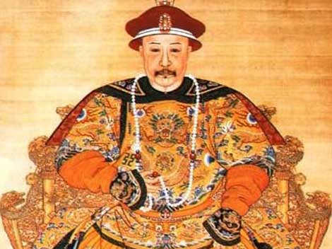
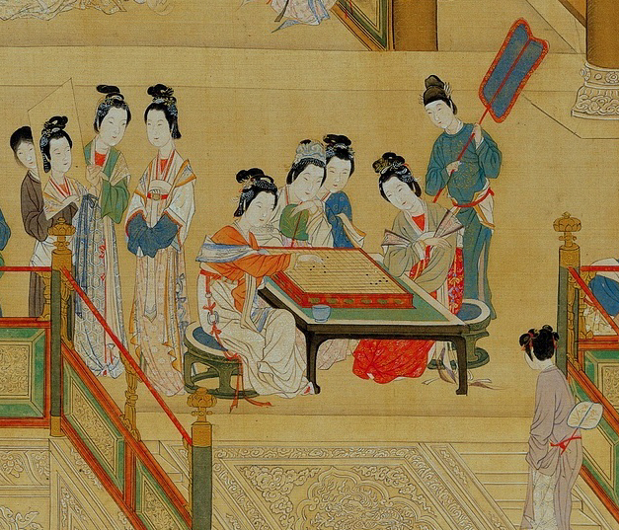
Imperial Gender Roles: Upper Class

Slide 6
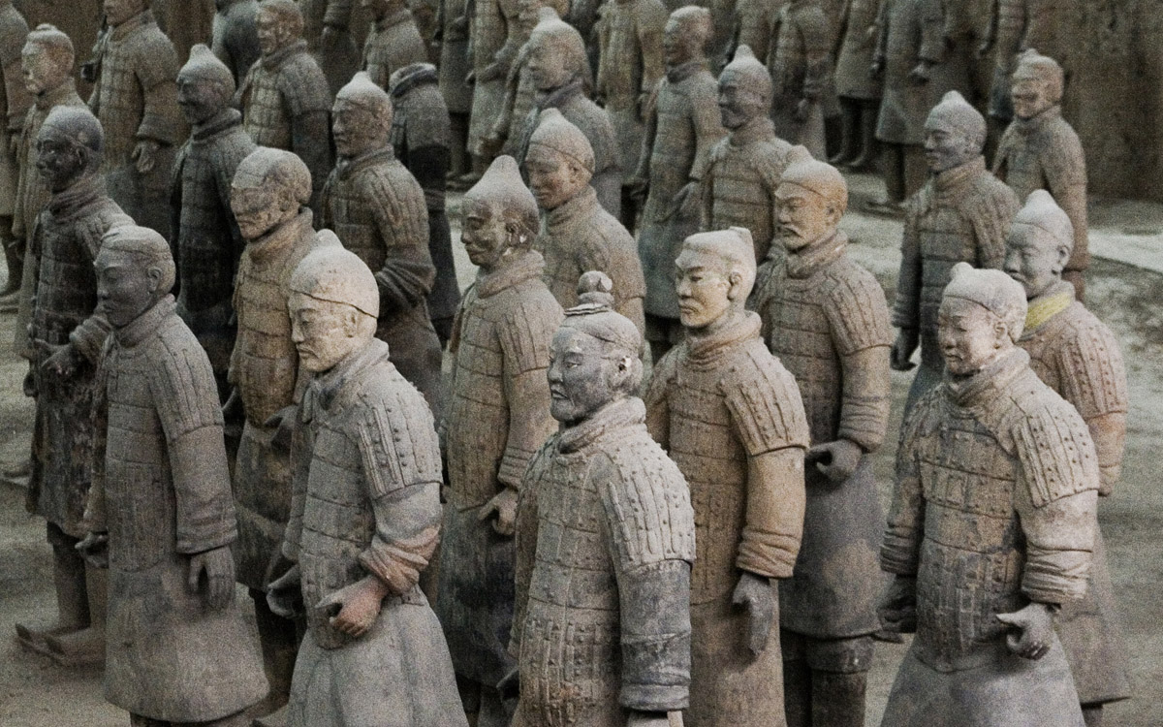
Imperial Gender Roles: Warriors

Slide 7
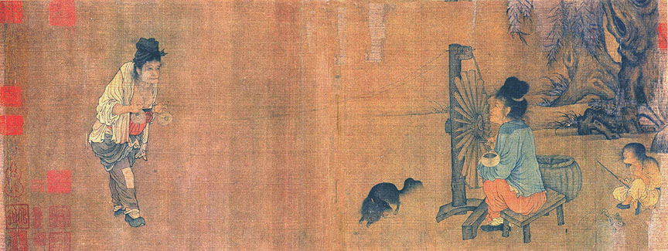
Imperial Gender Roles: Spinners and Weavers

Slide 8
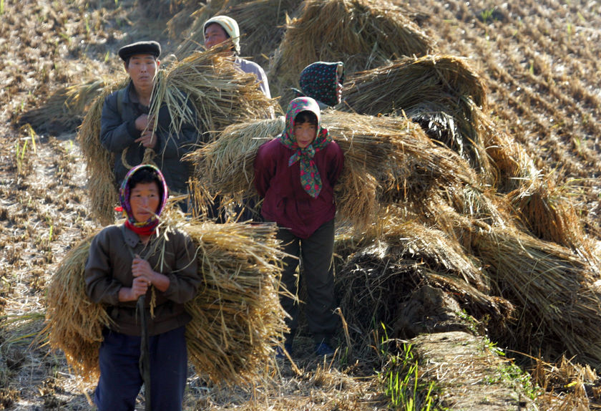
Imperial Gender Roles: Farmers and Peasants

Slide 9
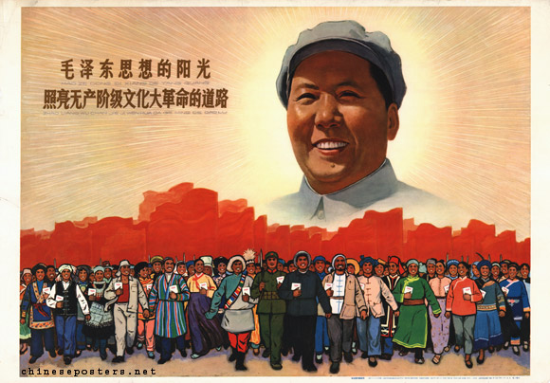
Communism in China
Chinese Revolution
Culmination of nearly 30 years of fighting between nationalists (KMT) and Maoists
Class warfare
  Poor peasants vs. privileged ruling class, civil servants merchant classes
Anti-imperialism
Anti-west

Slide 10
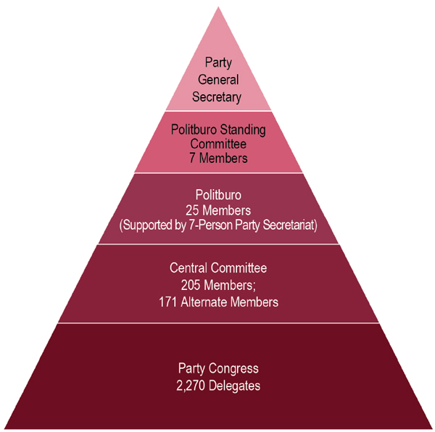
Political System:
“Democratic” Centralism

Slide 11
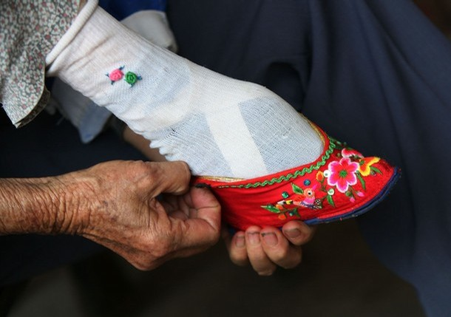
Communism Improved the Status of Women
Peasants of both sexes benefitted from collectivization
Women on more equal terms with men
End of footbinding for high-status families
Women’s equality and worth recognized
Don’t gain the right to vote til 1963

Slide 12
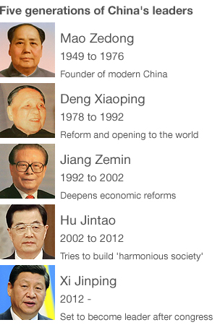
Eras of Chinese Leadership
Major Econmic Reforms begin with Deng
  Special Economic Zones
  Township and Village Enterprises
“It doesn’t matter the color of the cat as long as it catches the mouse.”
“To be rich is glorious.”

Slide 13
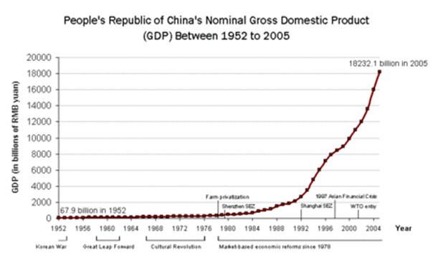
Communism as a Project of Modernization

Slide 14
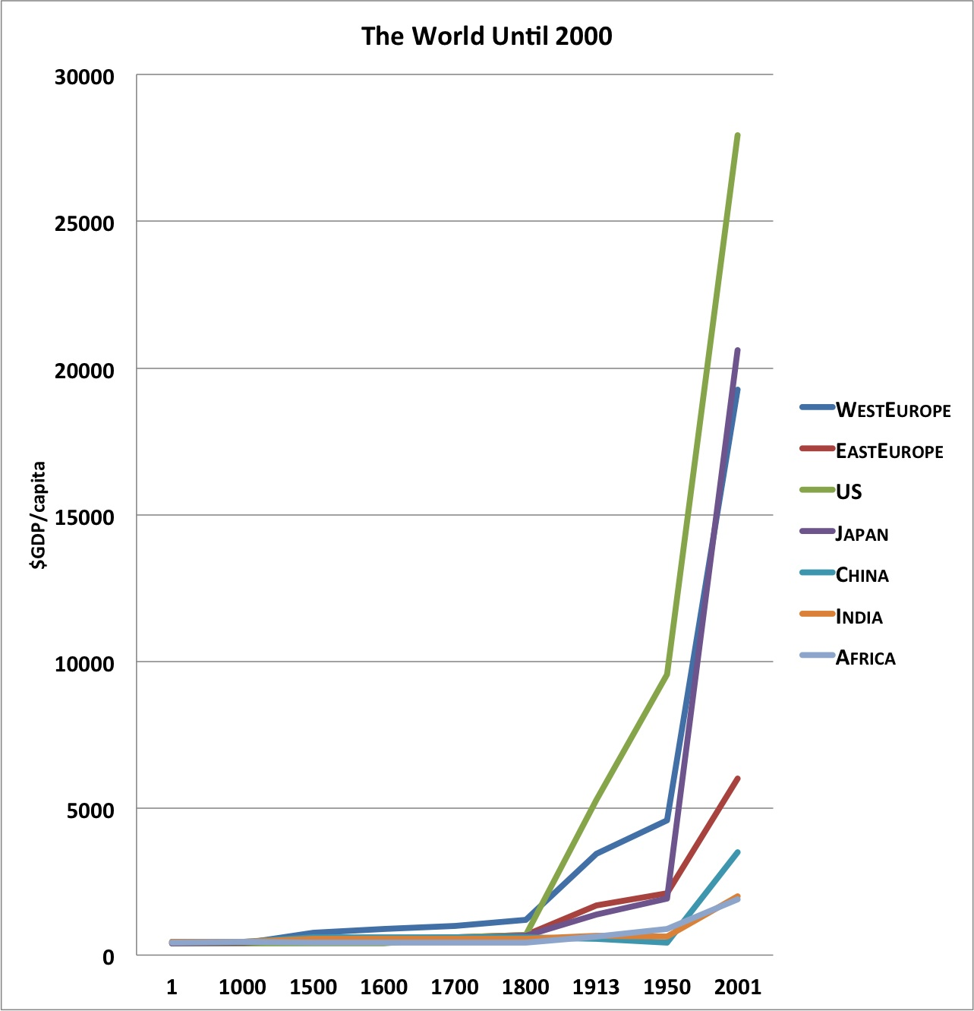
Communism as a Project of Modernization

Slide 15
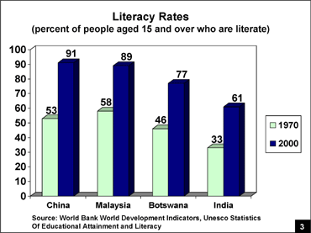
Communism as a Project of Modernization

Slide 16
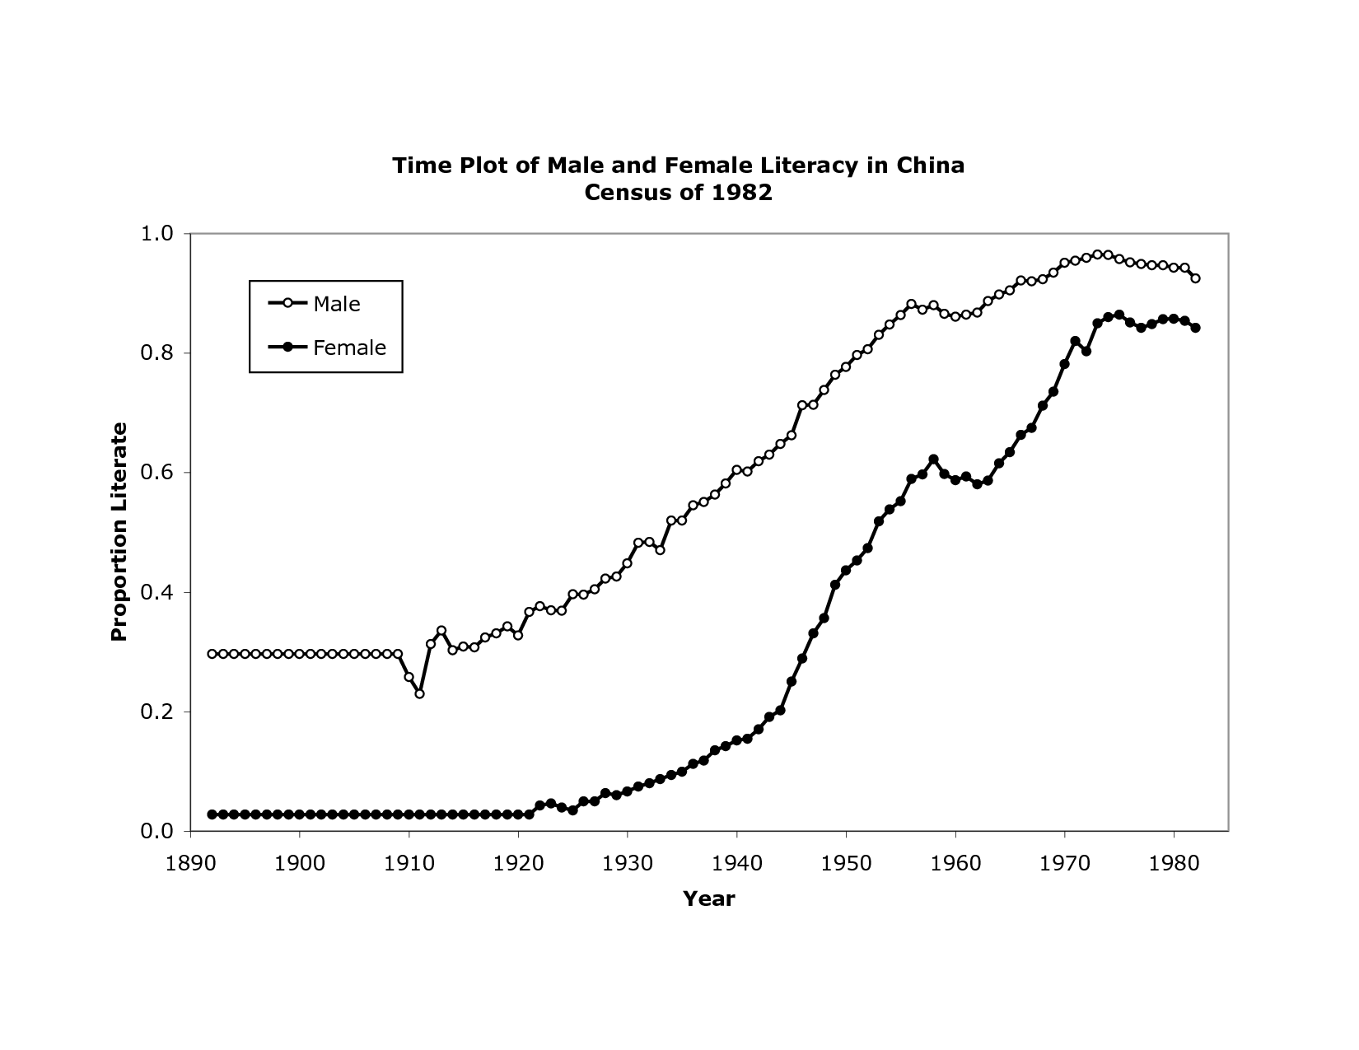
Literacy in China:
Men vs. Women

Slide 17
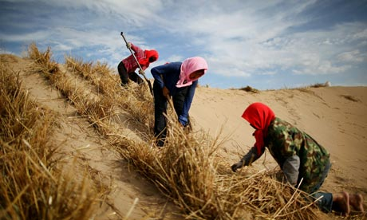
Women’s Roles in Modernizing China
Comrades
Workers
Farmers
Teachers
Care givers

Slide 18
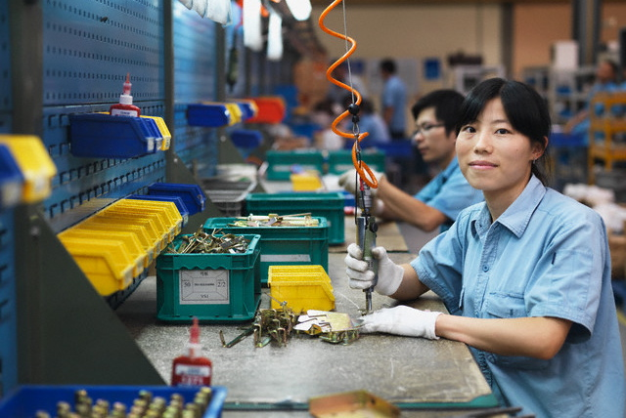
Women in China’s Economy
Women comprise 46% of Chinese workforce
70% of women; 83% of men in China are employed (at all)
The pay gap in China is .69
47.5% of migrant workers in China are female
  Discuss what “migrant” means in this context

Slide 19
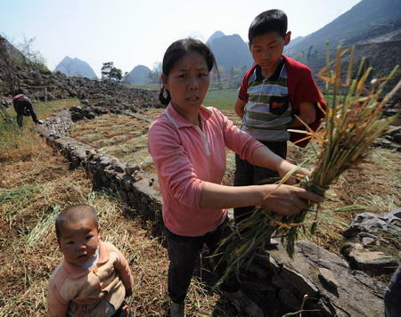
Income Gap Widening
Urban women earned
  .78 of men in 1990
  .70 of men in 1999
  .69 of men in 2010
Rural women earned
  . 79 of men in 1990
  . 56 of men in 2010
  Source: China Daily story

Slide 20
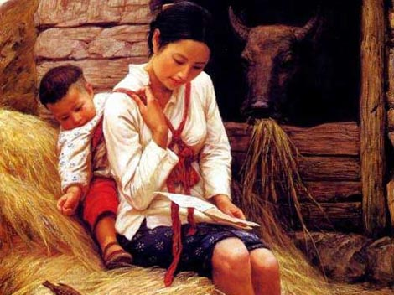
Women’s Roles in Modernizing China
Mothers
    Who control their fertility***
    State intervention into family planning
    Fertility rate (2014): 1.55 children per woman
    Contraceptive use rate: 84.6%
    Sterilization rate: 46%

Slide 21
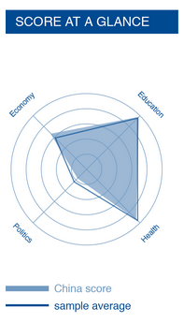
World Economic Forum
Global Gender Gap Report 2016
China ranks 99 out of 140 countries on Global Gender Parity
Women have achieved parity with men and meet the global sample averages for education and health.
Women’s economic power is far less than men’s, yet China is slightly above the global sample average on this indicator.
It is below the global average in terms of women’s participation in politics.

Slide 22

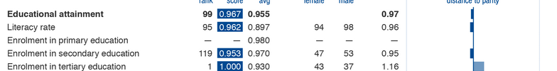
World Economic Forum
Global Gender Gap Report 2016
China’s achievements in women’s literacy and education are particularly noteworthy as they represent huge gains over pre-revolutionary levels, for both women and men.
Chinese women rank first in the world in enrollment in tertiary education.

Slide 23

World Economic Forum
Global Gender Gap Report 2016
China ranks144th out of 144 countries in sex ratios at birth, the legacy of its one child policy, in place in urban areas from 1979 through 2015.
Yet cultural preference for boys still leads many to practice sex selective abortion, despite its illegality.
In 2015, 114 boys were born for every 100 girls.

Slide 24
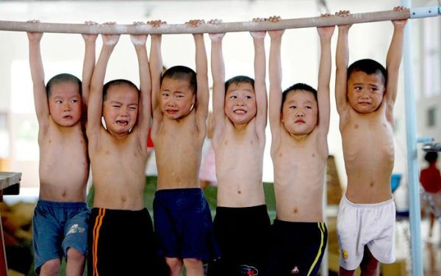
China’s One Child Policy

Slide 25
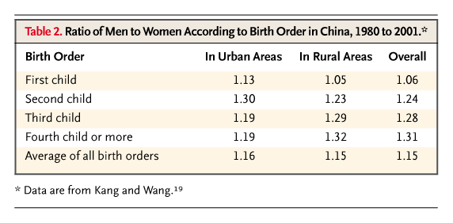
One Child Policy
Introduced in 1979
Exceptions for ethnic minorities; rural areas can have second if first girl or disabled!!
More recently, relaxed to allow people married for second time to have child together

Slide 26
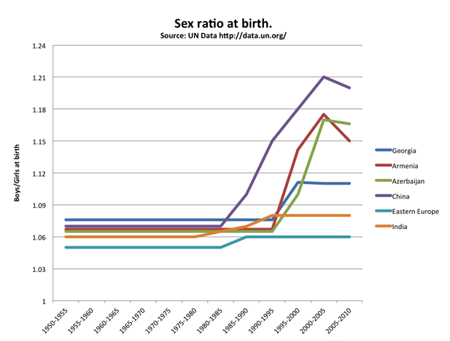
Results of the One Child Policy

Slide 27
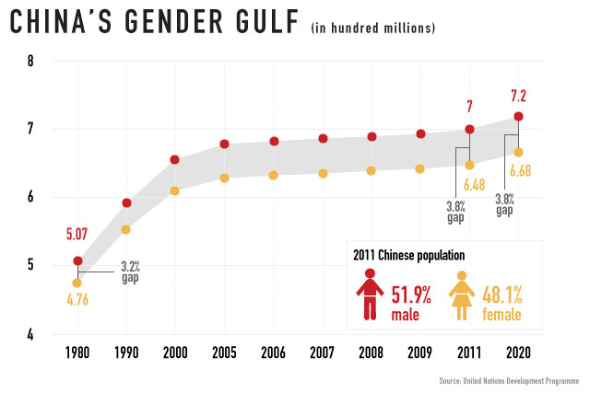
Results of the One Child Policy

Slide 28
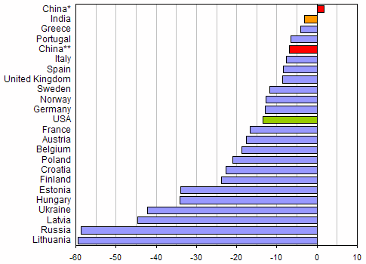
China’s Dirty Little Secret: Women and Suicide
China is the only country in the world where women’s suicide rate is higher than men’s
The problem is particularly pronounced in rural areas
Experts speculate that women’s lack of economic and family power, and lack of social support for married women are the primary factors
Click on graph to see short analysis

Slide 29
China’s Gender Regime
Political-Economic Regime Type Communist Political Regime - Rapidly Developing, but State Controlled Economic Regime | Description Communist political structures of control; strong state direction of all aspects of family, social, economic and political life Maoist (Marxist-Leninst) Ideology stressed equality of men and women as “comrades in class struggle” but women have been absent from the highest levels of political power | Economy State directed and controlled; women play strong role in agriculture and in assembly line production in EPZs Some women entrepreneurs Growing class of wealthy women super-consumers | Dominant Religion Historically, Confucianism, Buddhism have been important but Communism has stressed atheism, delegitimated religious practice and belief although some shrines/temples are allowed, maintained at public expense Rise of Falun Gong movement threatening to regime | Cultural Ideals for Women Have varied over time with periods of greater and lesser patriarchal control. While communism liberated women relative to men, it did little to change the division of labor in the home, cultural expectations of filial piety, dutiful daughters sacrificing to serve her father, husband, son | Contemporary Gender Regime Women playing important role in EPZs; massive migrations of women from rural areas to EPZs may lead to change in women’s power in the family Small family size has not diminished the work of motherhood, rather there is high investment in the one (or two) children Son preference endures

