Slide 1
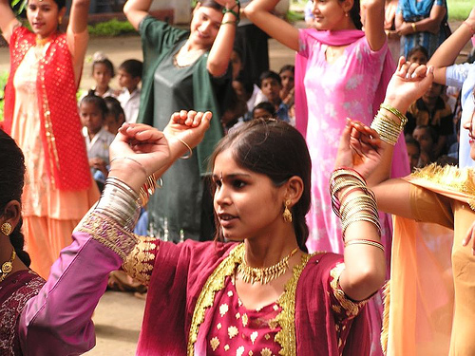
A Lecture on Culture
Global Gender Regimes
Professor Laura Brunell
Gonzaga University

Slide 2
Culture:
Guiding Questions:
What is it? (what isn’t it??)
How should we use culture to understand the status of women (and men) around the world?

Slide 3
Culture: some definitions
“Culture refers to the cumulative deposit of knowledge, experience, beliefs, values, attitudes, meanings, hierarchies, religion, notions of time, roles, spatial relations, concepts of the universe, and material objects and possessions acquired by a group of people in the course of generations through individual and group striving.”
Definition found on Texas A&M Associate Professor Choudhury’s website (click and browse this page and the other two links below)
LiveScience definition and discussion
Wikipedia entry

Slide 4
Culture
According to Paxton and Hughes – what does culture consist of?
  Religion
  Attitudes
This is an incomplete list!!
    We need a more exhaustive treatment of culture for our purposes
Danger of overdetermining culture
My culture made me do it…

Slide 5
Culture
HOWEVER: The risk of overdetermining culture DOES NOT outweigh the danger of not taking it seriously enough, i.e., dismissing it in favor of individualistic, economic or political explanations
While it is tempting to think one decides things for oneself, the reality is that:
  culture shapes and influences our behavior and choices .
  cultural behaviors and attitudes persist, i.e., change relatively slowly over time.

Slide 6
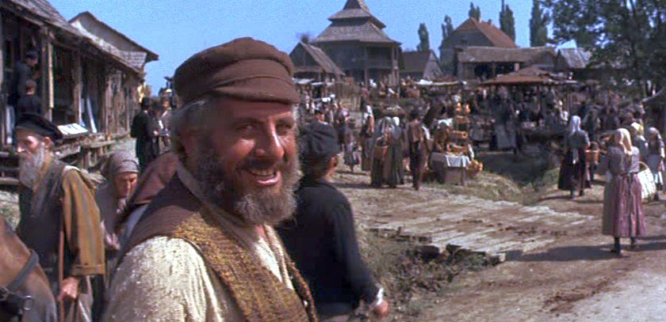
What makes culture sticky?
Tradition!!: Click on The Fiddler on The Roof to learn about tradition

Slide 7
What do we learn from Tevya about the value of Tradition?
It keeps society in balance.
It provides for a cultural continuity and preservation.
It provides people with a sense of security and the safety of predictability in social interactions.
Click on Tevya to learn from him about tradition

Slide 8
How does tradition affect gender, family and other social roles in Tevya’s village?
It prescribes the roles of each member of the family and society
  It maintains the power, privilege and responsibilities of the Father
    As the decision maker, the authority in the home.
    As the provider, breadwinner.
    As the faithful believer and servant of God.
The Papa

Slide 9
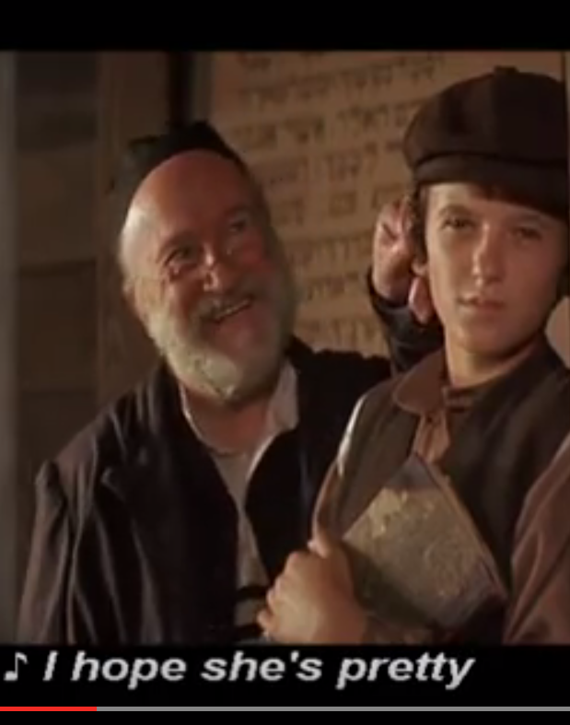
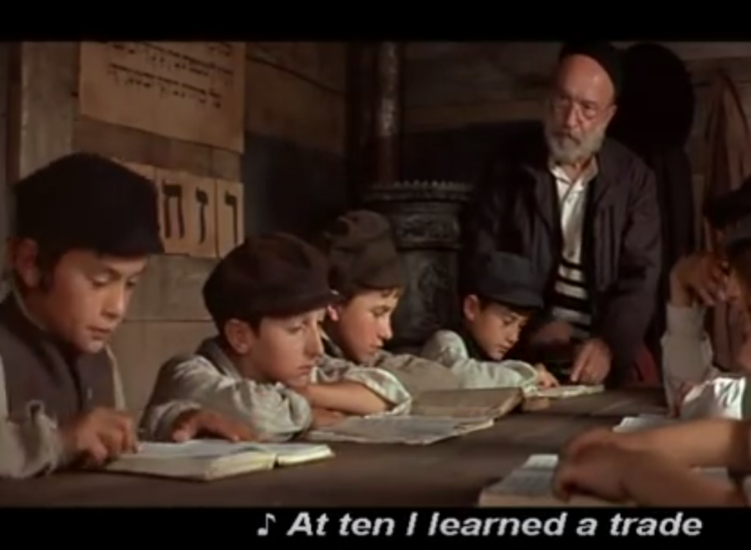
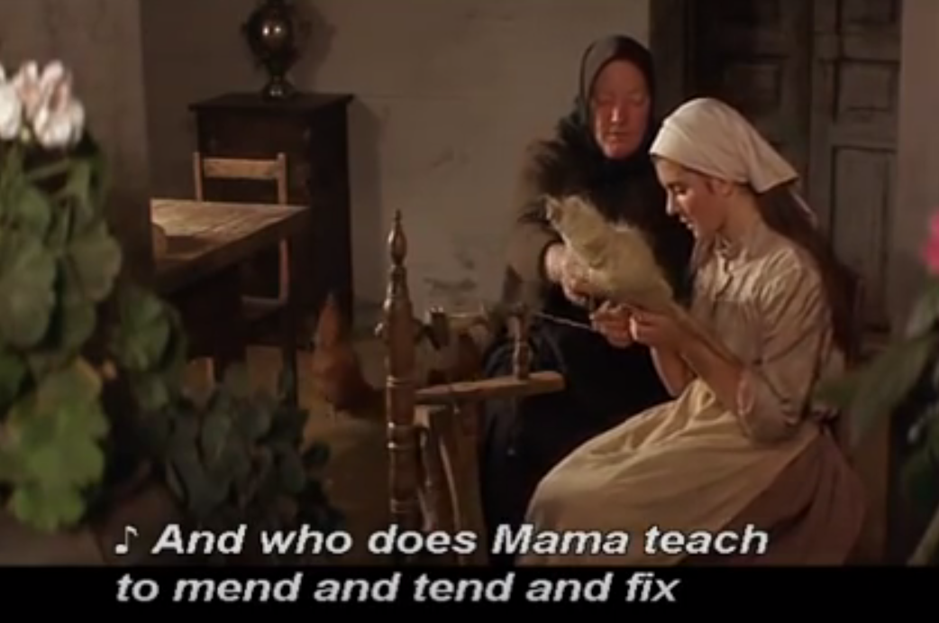
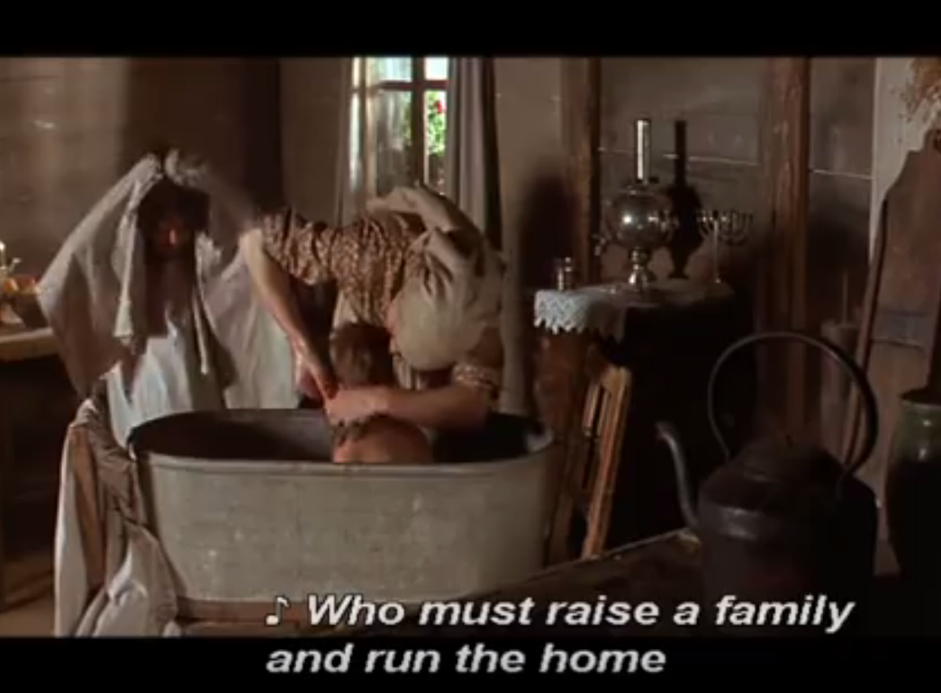
Obedient, hardworking homemaker, wife and mother; Dutiful sons and daughters

Slide 10
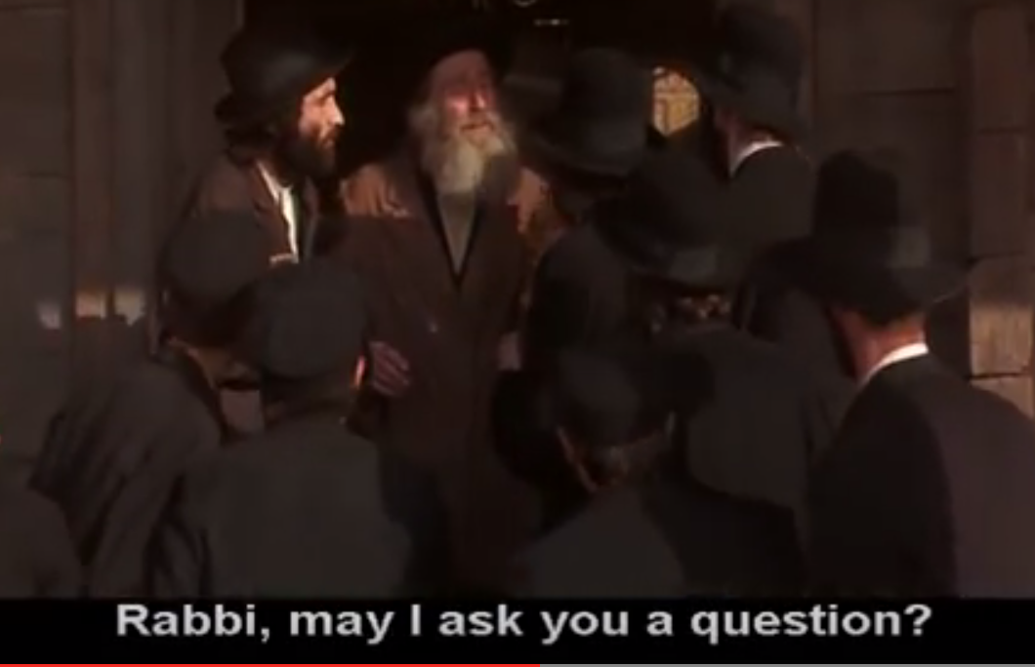
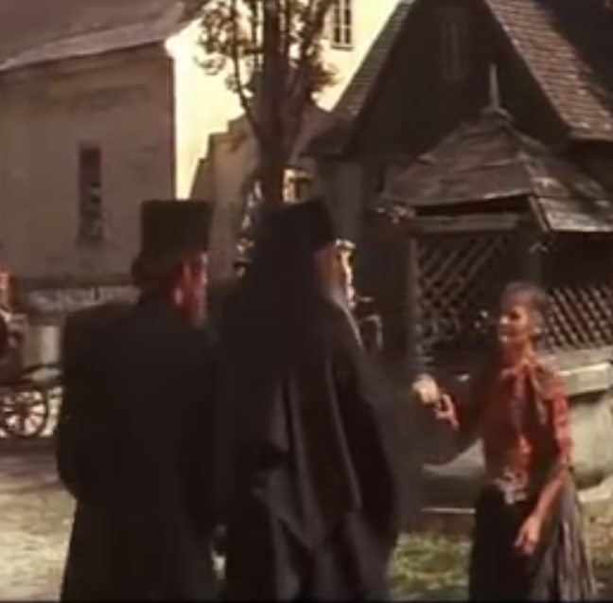
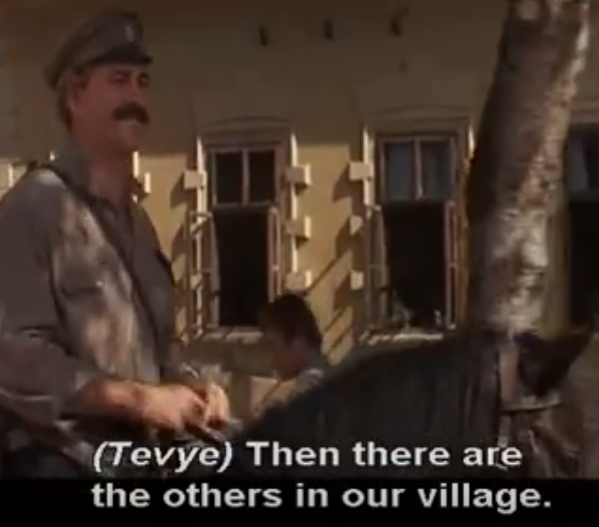
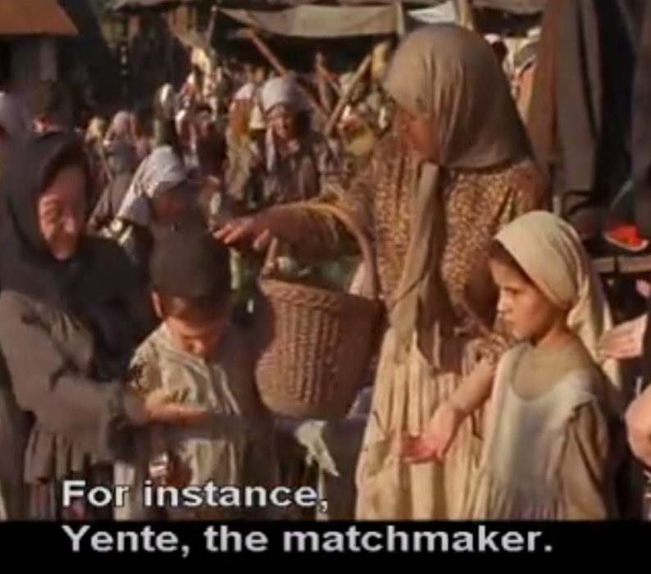

Slide 11
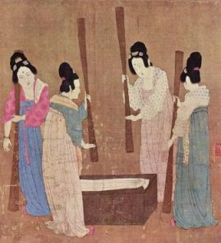
More thoughts on culture…
  We tend to think that religion ”causes” or ”creates” customs – could it be the other way: that customs and rituals start first and become institutionalized as religion only over time AND with sanction of the politically powerful?
  Could it also be that economics, i.e., the systems through which survival and wealth depend create and sustain “cultural” traditions and customs?
  Think about this in terms of marriage, marriage customs
    Bride price, bride kidnapping, dowry, arranged marriages, matchmaking, hypergyny, Levirate marriage, polygamy; child marriage.
    How did this practices emerge?
    What sustained them over time?
    What caused them to die out?

Slide 12
Gender Regime
CULTURE
Gender Regime
Economy
State

Slide 13
Model
Culture
Norms
Roles
Economic and Political Structures

Slide 14
Films on marriage
Think about the roles that:
  Culture (tradition/custom; ideals about marriage or what a life partner should be like; cultural essentialism; cultural difference)
  Economics (poverty, underdevelopment, economic inequalities between men and women and between wealtier countries and poorer ones)
  Politics (war, revolution, political instability, regime change)
each play in the marriage stories portrayed in each film.
    Sonita
      Sonita on Netflix (Afghani girl in Pakistan)
    On Kanopy
      In the Name of Love (Russian mail order brides)
      Seeking Asian Female (Asian mail order brides)
      Leaving Home (traditional marriage in rural India)
      Having It All (American women juggling family and career)

