Slide 1


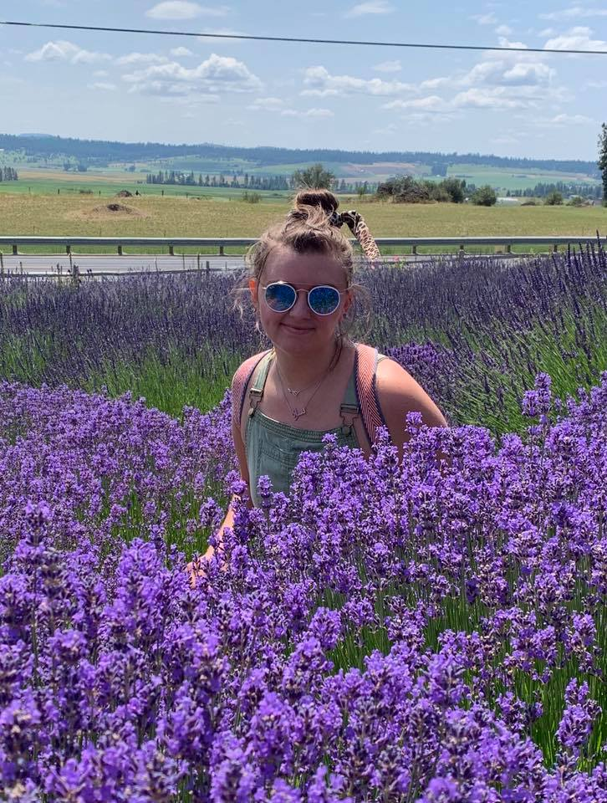
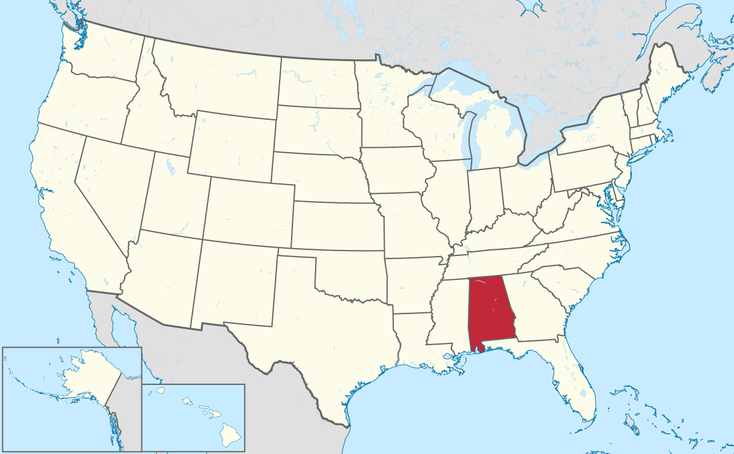
Welcome!
and I like to cook!
My name is Sarah,
I am from Alabama.
Respond: Hi Sarah!

Slide 2
Your turn!
My name is ______, and I like _____. I am from ______.
To Verb
To learn
To study
To make art
To cook
To spend time with family
To fish
To swim
To exercise
To pray
To run
To play sports
To grill
To sow
Your Name!
Your country!
Respond: Hi,__________!

Slide 3
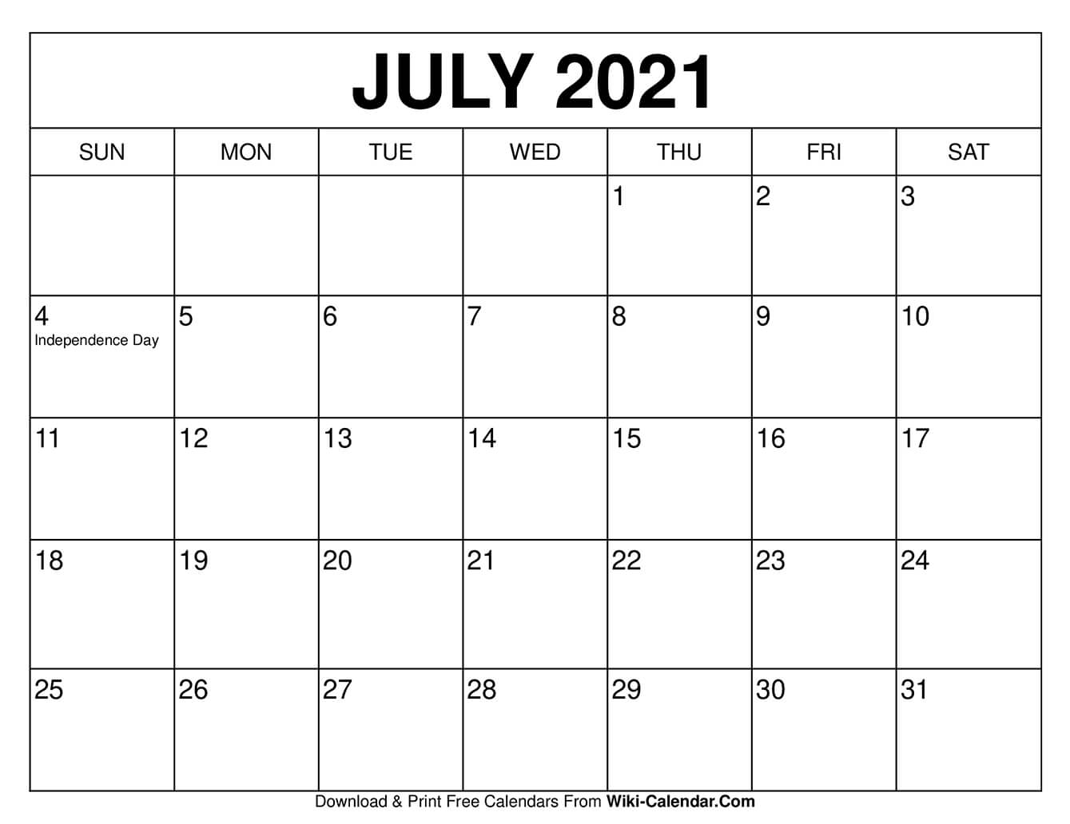
When is class?
Monday- Thursday 5:30pm-7:00pm
Saturday 10:00am-11:30am

Slide 4

Attendance?
Come if you can ☺
Can’t come? Email me or Hailey shartley@zagmail.Gonzaga.edu
hherrington@zagmail.gonzaga.edu
Surprise for you on the last day

Slide 5
GECO Certificate?
July
Week | Mon. | Tues. | Wed. | Thurs. | Fri. | Sat.
1 (5th-10th) | 5:30pm-7:00pm= 1.5 hours | 5:30pm-7:00pm= 1.5 hours | 5:30pm-7:00pm= 1.5 hours | 5:30pm-7:00pm= 1.5 hours |  | 10:00am-11:30am= 1.5 hours
2 (11th -17th) | 5:30pm-7:00pm= 1.5 hours | 5:30pm-7:00pm= 1.5 hours | 5:30pm-7:00pm= 1.5 hours | 5:30pm-7:00pm= 1.5 hours |  | 10:00am-11:30am= 1.5 hours
3 (18th -24th) | 5:30pm-7:00pm= 1.5 hours | 5:30pm-7:00pm= 1.5 hours | 5:30pm-7:00pm= 1.5 hours | 5:30pm-7:00pm= 1.5hours |  | 10:00am-11:30am= 1.5 hours
Plan 4 | 5:30pm-7:00pm= 1.5 hours | 5:30pm-7:00pm= 1.5 hours | 5:30pm-7:00pm= 1.5 hours | 5:30pm-7:00pm= 1.5 hours |  | 10:00am-11:30am= 1.5 hours
You need to compete 10 hours of class for a certificate
10 hours =1 week and 2 days
All 20 days= 30 hours

Slide 6





What are we learning?
Monday | Tuesday | Wednesday | Thursday | Friday | Saturday | Sunday
Vocabulary | Listening | Speaking | Writing |  | Reading

Slide 7

Rules and Expectations
Participate
Be respectful
Don’t understand? Tell me!

Slide 8
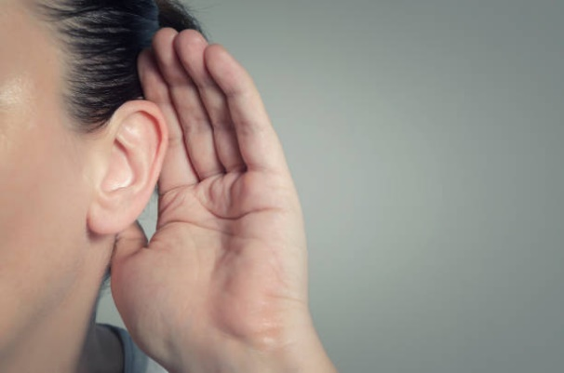
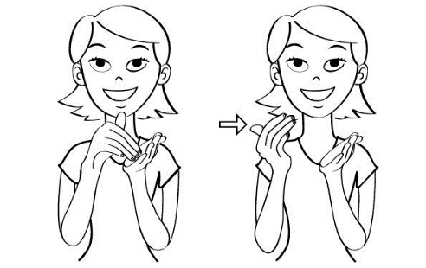
Class Signs
1. I can’t hear you!
2. Please repeat.

Slide 9
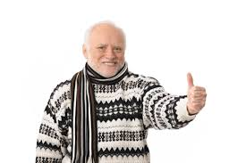
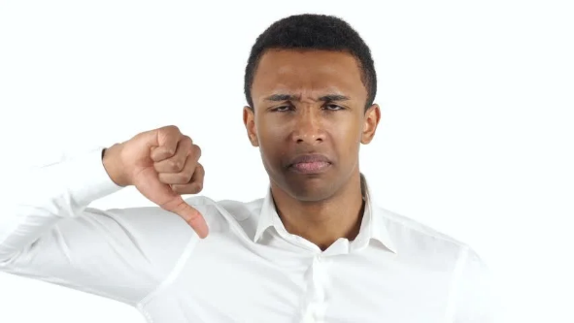
Class Signs
3. I understand!
4. I don’t understand.

Slide 10

Simon Says!

Slide 11
Simon Says!

Slide 12
Let’s check in
Name one (1) classroom rule.
  A: Participate, be respectful, don’t understand? Tell me!
What is the sign for ‘please repeat’?
Does everyone understand?

Slide 13
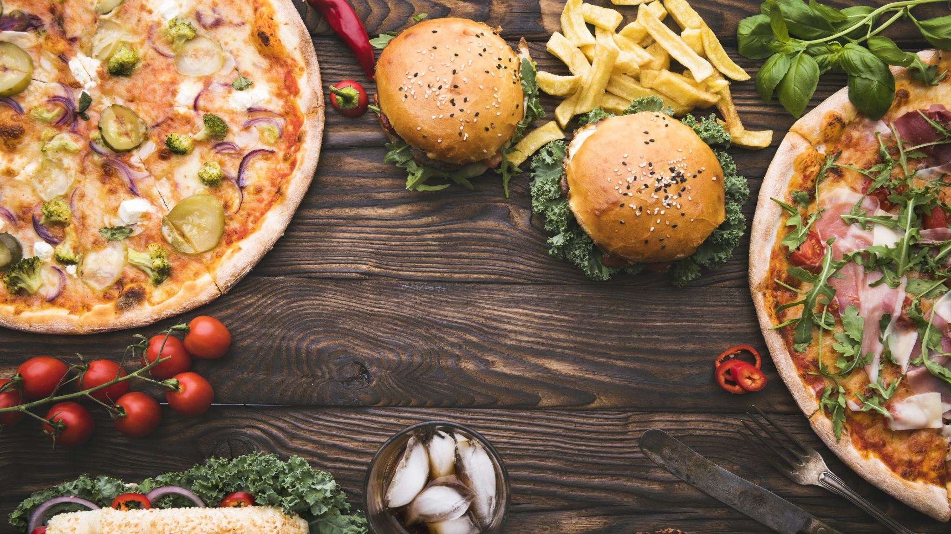
Vocabulary
Y’all
You + all
Let’s eat, y’all!

Slide 14
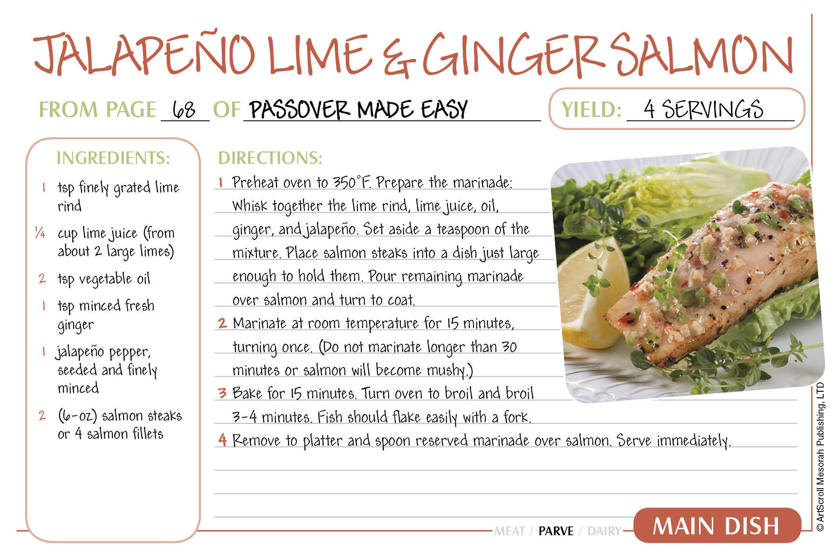
Recipe
Noun: A set of instructions for cooking.
The recipe calls for one cup of flour.

Slide 15
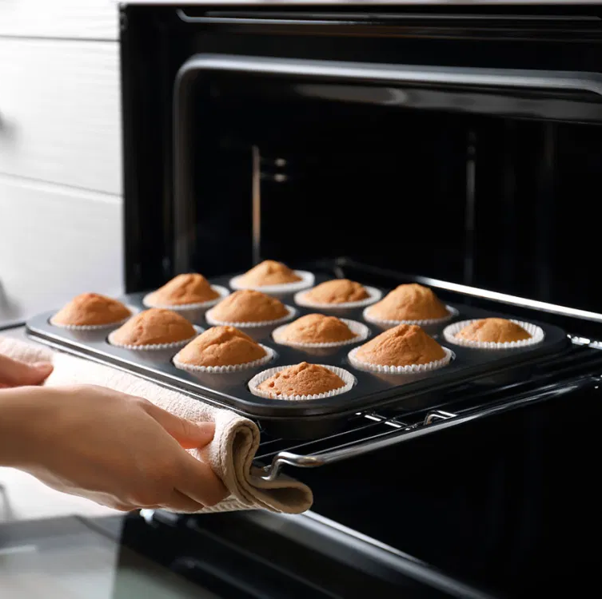
Bake
Verb: To prepare food using the oven
The muffins need to bake for 15 minutes.

Slide 16
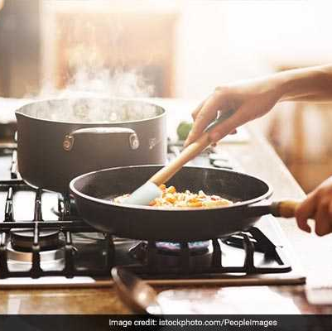
Cook
Verb: To prepare food using the stove
Lilia likes to cook for her family.

Slide 17
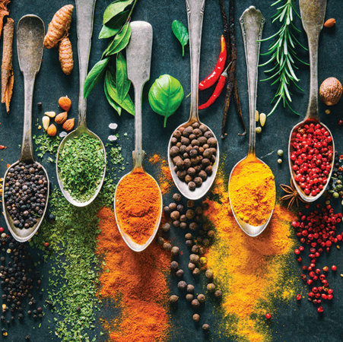
Ingredients
Noun: the parts that you are cooking or baking with.
Some of the ingredients were coco and sugar.

Slide 18
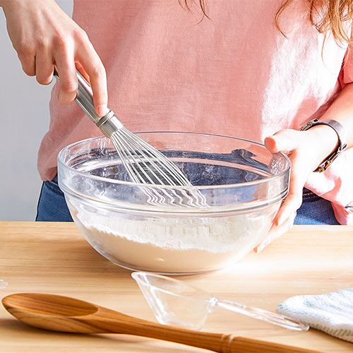
Mix
Verb: to combine
Mix the batter for five minutes.

Slide 19
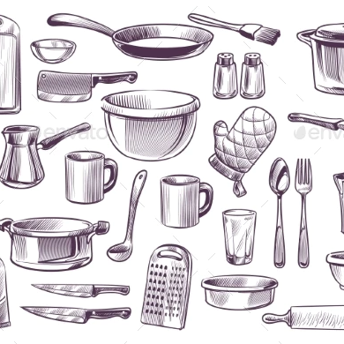
Utensil
Noun: The items you need for cooking or baking
My favorite utensil is a spork.

Slide 20
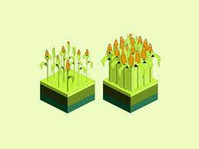
Yield
Verb: to produce or provide
This recipe will yield about 20 cookies.

Slide 21

Homework
Study vocabulary https://quizlet.com/join/bYdcA5g3X?i=3fxp2k&x=1bqt

