Slide 1
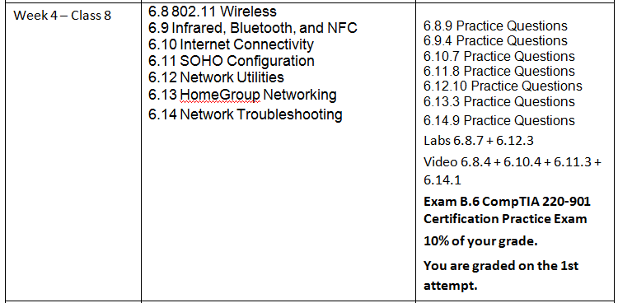
CIAT CIS101A
Week 4 - Class 2
Networking - Continued

Slide 2
CIAT CIS101A
IEEE 802 Networking Committee
802.3 – Ethernet
802.4 – Token Bus
802.5 – Token Ring
802.11 – Wireless (Wi-Fi)

Slide 3
CIAT CIS101A

Slide 4
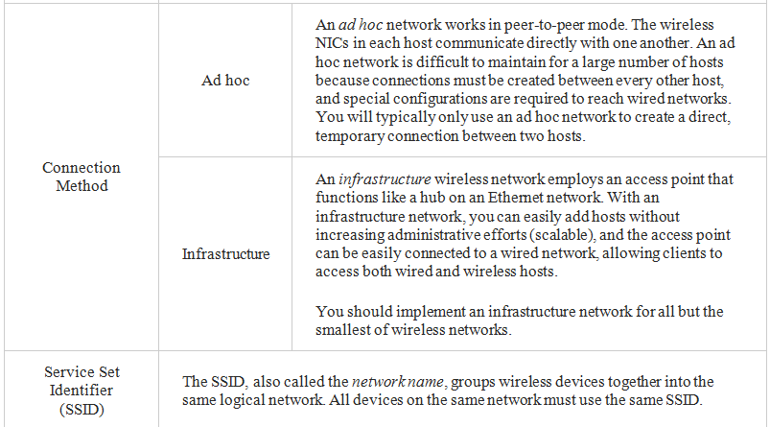
CIAT CIS101A

Slide 5
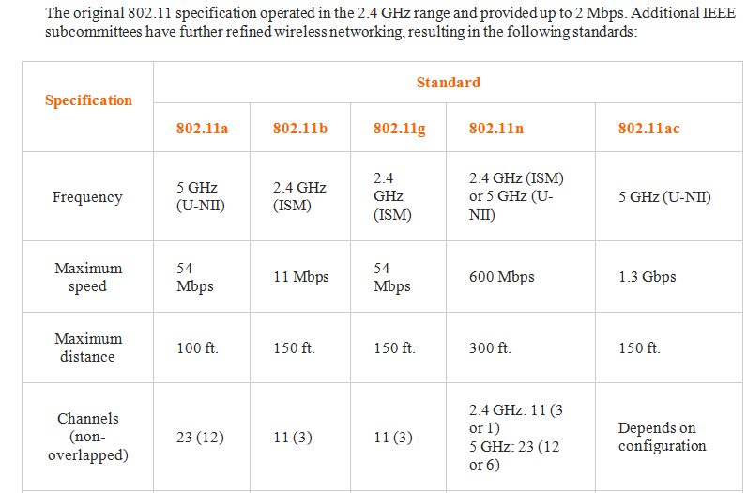
CIAT CIS101A

Slide 6
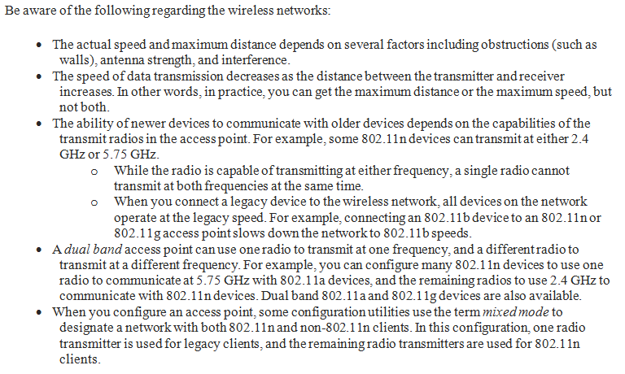
CIAT CIS101A

Slide 7
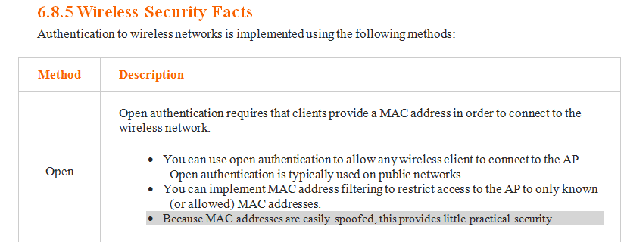
CIAT CIS101A

Slide 8
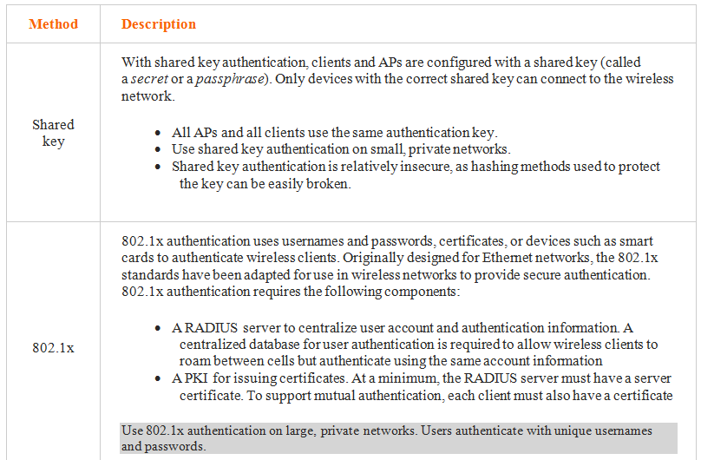
CIAT CIS101A

Slide 9
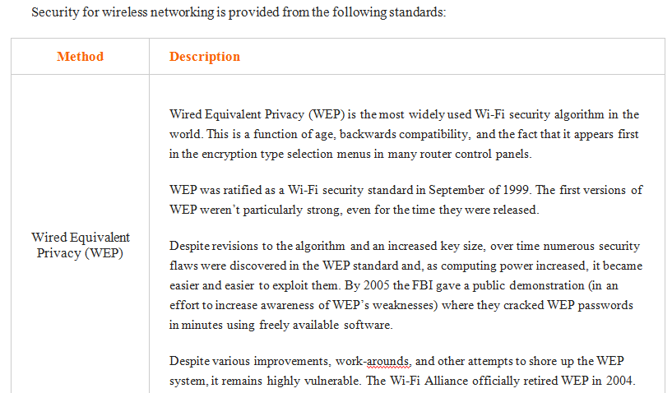
CIAT CIS101A

Slide 10
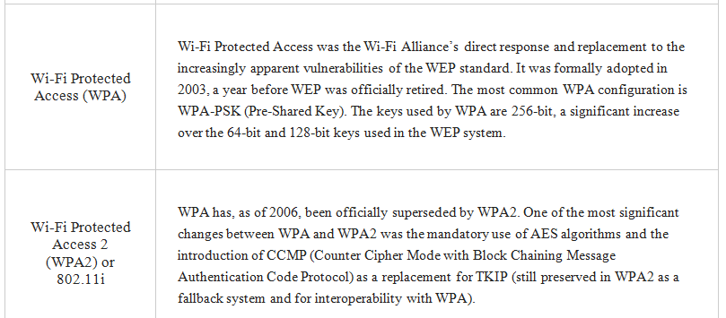
CIAT CIS101A

Slide 11
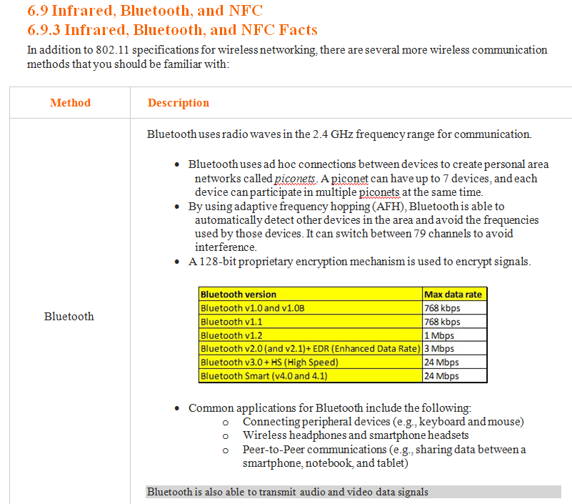
CIAT CIS101A

Slide 12
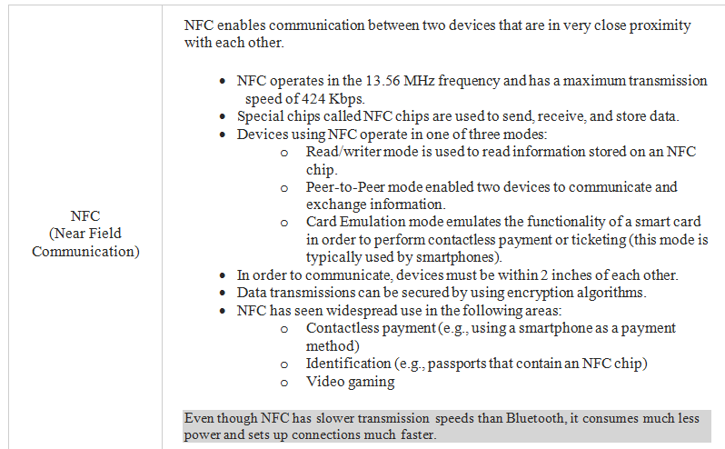
CIAT CIS101A

Slide 13
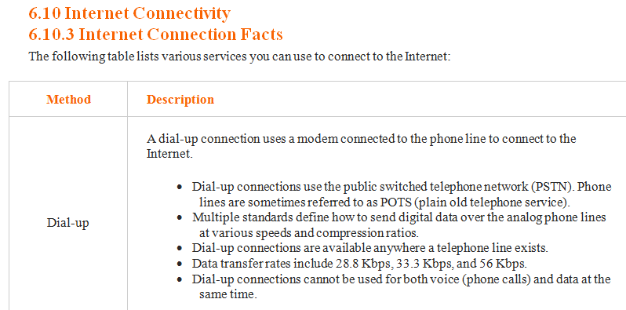
CIAT CIS101A

Slide 14
CIAT CIS101A

Slide 15
CIAT CIS101A

Slide 16
CIAT CIS101A

Slide 17
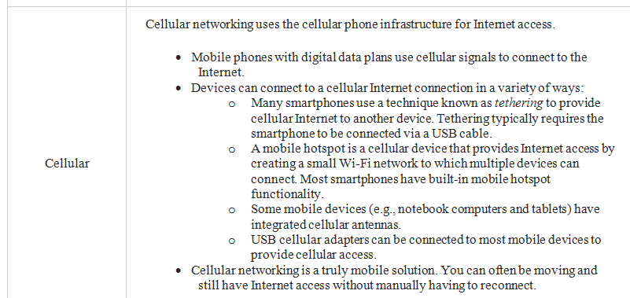
CIAT CIS101A

Slide 18
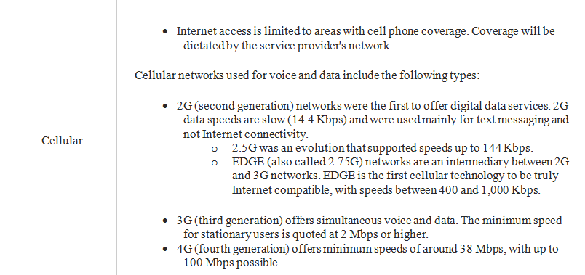
CIAT CIS101A

Slide 19
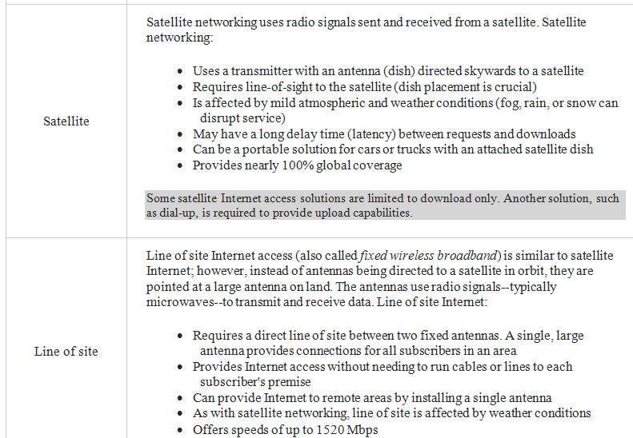
CIAT CIS101A

Slide 20
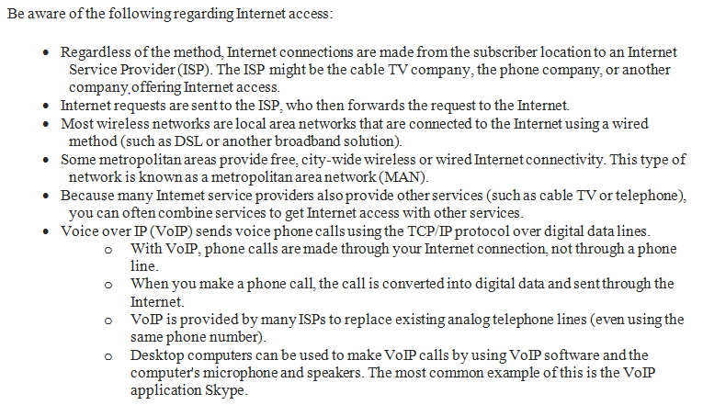
CIAT CIS101A

Slide 21
CIAT CIS101A

Slide 22
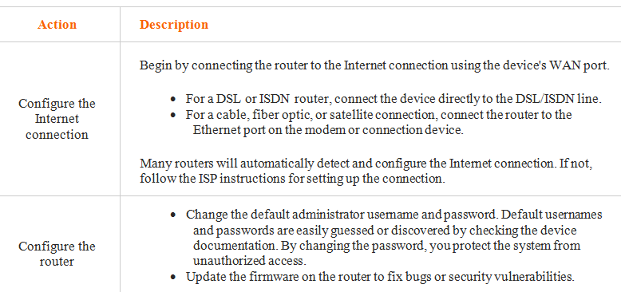
CIAT CIS101A

Slide 23
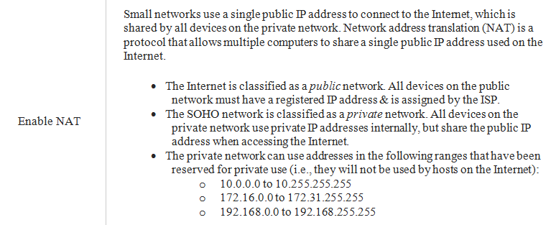
CIAT CIS101A

Slide 24
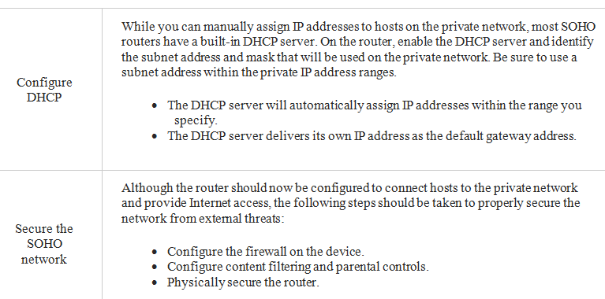
CIAT CIS101A

Slide 25
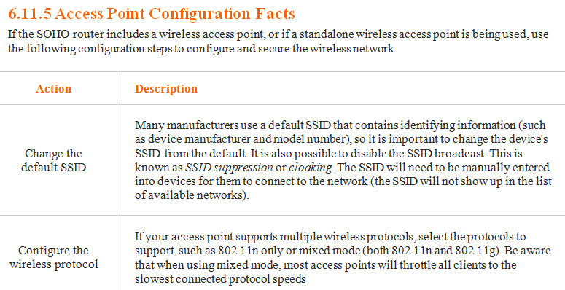
CIAT CIS101A

Slide 26
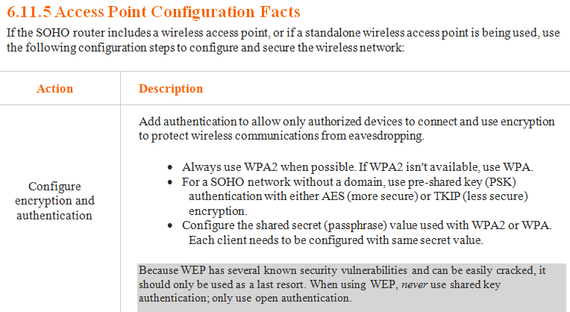
CIAT CIS101A

Slide 27
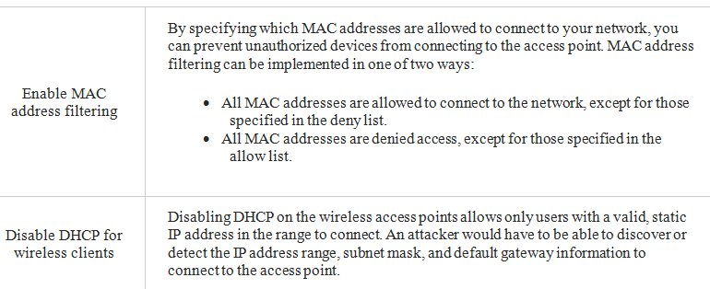
CIAT CIS101A

Slide 28
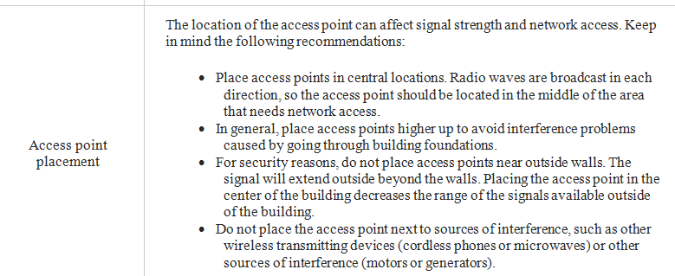
CIAT CIS101A

Slide 29
CIAT CIS101A
Network Utilities
IPCONFIG
PING
TRACERT
NSLOOKUP
NETSTAT
NBTSTAT
TELNET
SSH

Slide 30
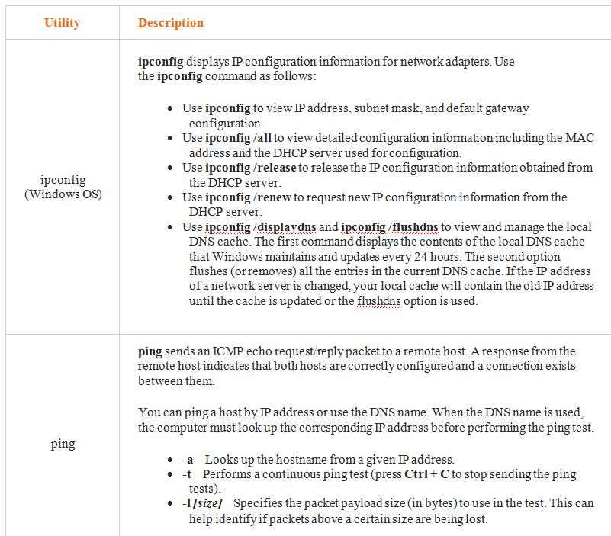
CIAT CIS101A

Slide 31
CIAT CIS101A

Slide 32
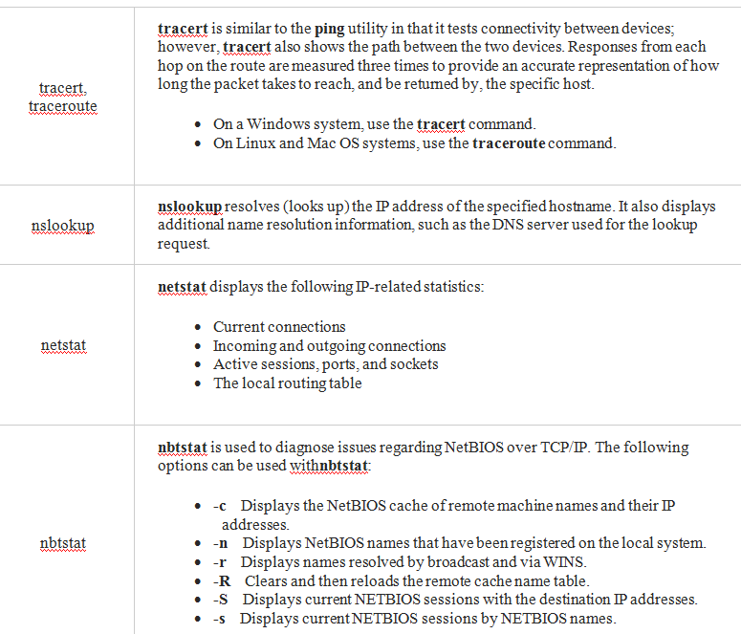
CIAT CIS101A

Slide 33
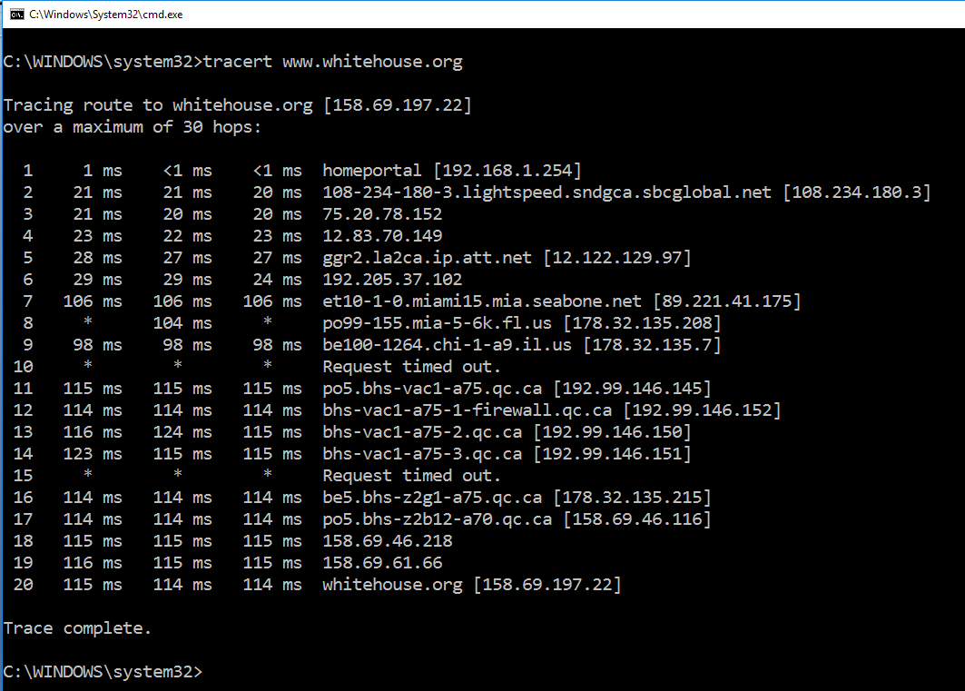
CIAT CIS101A

Slide 34
CIAT CIS101A

Slide 35
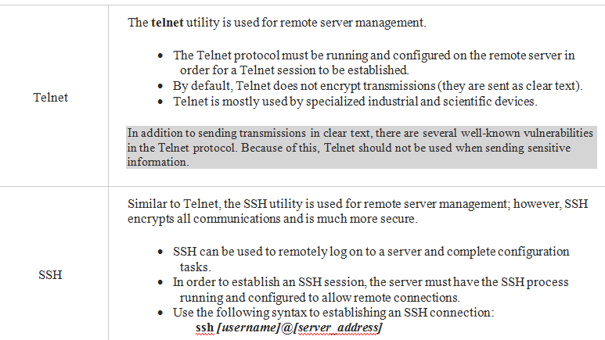
CIAT CIS101A

Slide 36
End of lesson
CIAT CIS101A

