Slide 1
Starting a Revolution
Millennials Advancing in Research Administration
Notes:
Introduce yourself
Tell the audience what you do, a little about the organization
Tell the audience how you are an expert

Slide 2
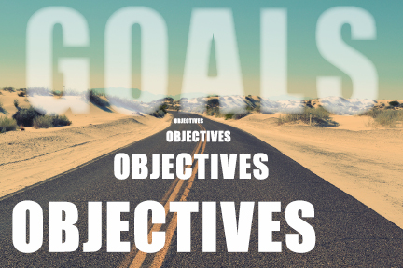
What are you going to learn from this session?
Identify and utilize a set of skills which will aid in supporting you and other millennials as you advance your career in Research Administration
Identify a network of other millennials who are prepared to support and promote each other in Research Administration.

Slide 3

The Sound of a Revolution
“You say you want a revolution
Well, you know
We all want to change the world”
“You say you got a real solution
Well, you know. We'd all love to see the plan You ask me for a contribution. Well, you know we're all doing what we can”
“Don't you know it's gonna be alright”

Slide 4

Notes:
Question –
Born between: 1980 – 1986, 1987 – 1992, After 1992, Before 1976

Slide 5
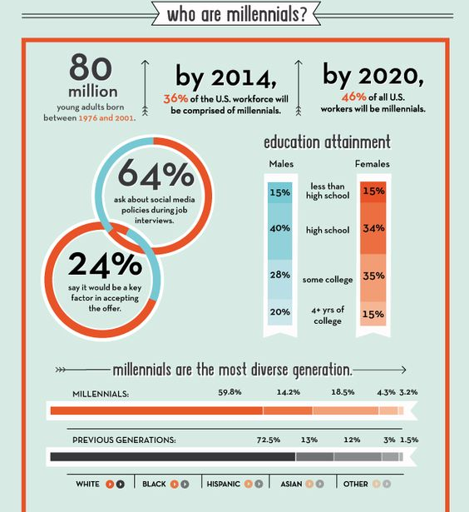
Who are the Millennials?
80 million – Millennials
(1980-2001)
76 million – Baby Boomers
(1946-1964)
We are the LARGEST generation to date!
Notes:
Power in numbers
2020 – almost 50% of the workforce will be the millennials

Slide 6
How are We Defined?
The “Me Me Me” Generation
Always wanting feedback
Unmotivated
Defiant
"more civically and politically disengaged, more focused on materialistic values, and less concerned about helping the larger community than were GenX (born 1962-1981) and Baby Boomers (born 1946 to about 1961) at the same ages"
Know-It-Alls
Self-Centered
Flexible Schedules – Work/Life balance
Always looking for greener pastures
Disloyal to the organization

Slide 7

Changing the Stereotype
How do you take a negative and turn it into a positive?
Do you experience the same type of negative stereotypes in your organization?

Slide 8
How are We Unique?
Risk-Takers
Curious
Innovative
Tech Savvy
Educated
Inquisitive
Global
We are the FUTURE
Relevant
Ambitious
Diverse
Entrepreneurial
Social
Hyper-Connected
Driven

Slide 9
How do WE Change the Perception?
Work as a team
Consider the other person’s perspective as a valid point & acknowledge the differences.
Be open for discussion but not confrontational.
Stay true to your word – let your actions and dedication speak for you.
Prove the stereotype wrong – whichever one it is, make that a goal.

Slide 10
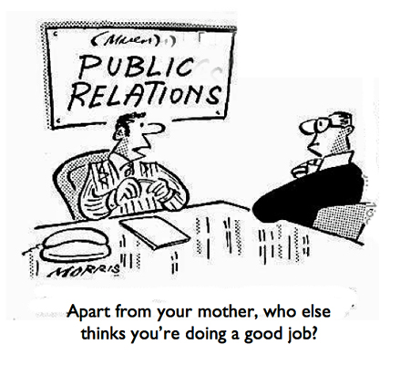

Slide 11


Slide 12

Discussion 1
How did you get into Research Administration?
Do you believe this will be a field you will stay in for an extended period of time?

Slide 13

Discussion 2
What obstacles are
you facing in your organization?

Slide 14

Discussion 3
What has your organization done to help the transition of millennials into the field of Research Administration?

Slide 15
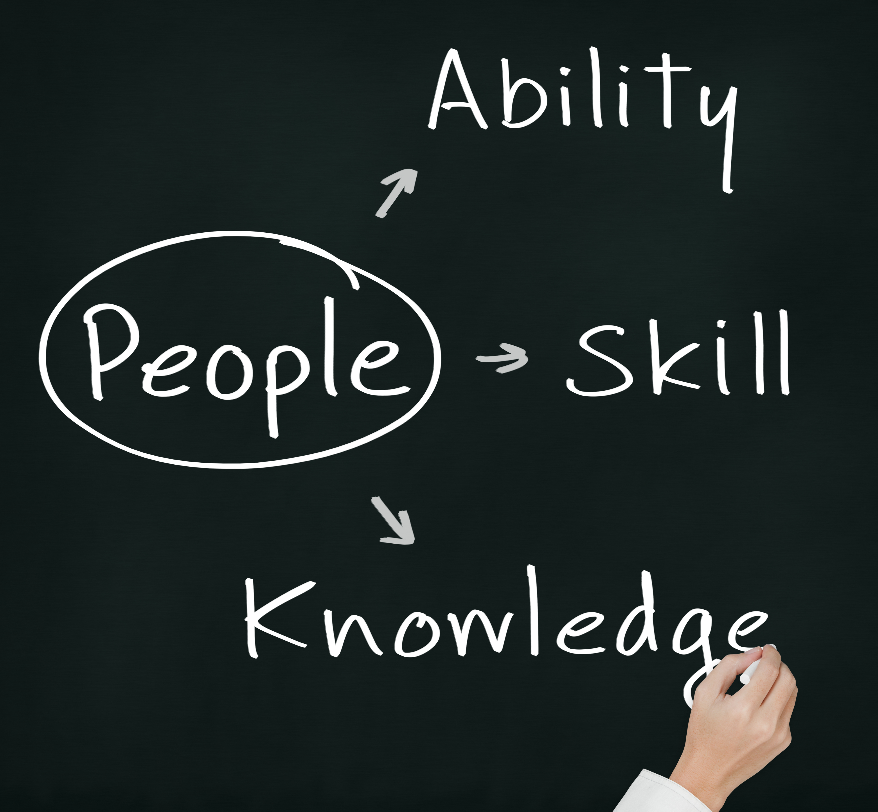

Slide 16
Best Practices
Rethinking the way we thinking about “managing”
“[Millennials] they crave opportunities to make their own decisions instead of having them made for them.”
Show Millennials Respect
“Listen to [millennials ideas and complaints, and show that they have value by doing more than giving lip service. Create a process that allows for the consideration and implementation of those ideas. Millennials want to know their voice is heard.”

Slide 17
Best Practices
Provide Feedback but not too much
“Knowing what you want them to do must be accompanied with also knowing why it needs to be done - the need to make sure the work they are doing has value.” Millennials don’t give us busy or meaningless work just to keep them occupied; they want to be sure their work matters”
Flexibility In What Work Is And How It Is Done
“We know how to structure our time in order to meet deadlines, work/life balance is extremely important in keeping millennials interested in the job and organization”

Slide 18
Best Practices
Provide Structure
“Provide the necessary structure, but let Millennials work it to the end without micromanaging.”
Listen, Listen, Listen…
We have a broad skillset, and want it to be used. “The Deloitte survey discovered that only 28% of Millennials feel like their employer is making use of their full skillset…Each employee should be able to exercise leadership, communication, and creativity in whatever they do.”

Slide 19
“Millennials are positive-thinking with an entrepreneurial and hard-working spirit who want their lives to matter, believing they can change the world.
They are a fantastic addition to your team, and, perhaps more importantly, a huge workforce that you will continue to rely on heavily in the future.”
- Rob Wormley

Slide 20
M.A.T.E.S in Research Administration
LinkedIn Group for Us!!
M.A.T.E.S (Millennials Advancing through Educational Support) in Research Administration is a group designed to support, provide training, and guide millennials working in research administration facing the glass-ceiling of the great generational divide.
https://www.linkedin.com/groups/8425433

Slide 21
References
Brack, J. (2014, November 06). Maximizing Millennials in the Workplace. Executive Development Blog. Retrieved from http://execdev.kenan-flagler.unc.edu/blog/maximizing-millennials-in-the-workplace
Boys, S. (2010, January 01). The Millennials Refuse to Be Ignored! An Analysis of How the Obama Administration Furthers the Political Engagement of a New Generation. The International Association for Public Participation, 4(1), 32-42.
Hershatter, A., & Epstein, M. (2010, March 05). Millennials and the World of Work: An Organization and Management Perspective. Journal of Business and Psychology, 25(2), 211-223. doi:10.1007/s10869-010-9160-y
Hicks, M., Ph,D, & Monory-Paz, J. (n.d.). Into the Looking Glass: Psychological Contracts in Research Adminstration. The Journal of Research Administration, 46(1). Retrieved from http://news.alacrastore.com/Business-and-Management-Practices/Into-the-looking-glass-psychological-contracts-in-research-administration-459510577
Howe, N. & Strauss, W. (2000). Millennials rising: The next great generation. New York: Vintage.
Main, D. (2013, July 09). Who Are the Millennials. Retrieved from http://www.livescience.com/38061-millennials-generation-y.html
Sparshott, J. (2015, May 11). Millennials Become the Biggest Generation in the U.S. Workforce. The Wall Street Journal. Retrieved from http://blogs.wsj.com/economics/2015/05/11/millennials-become-the-biggest-generation-in-the-u-s-workforce/
Wormley, R. (2015, October 01). Epic Guide To Managing Millennials In The Workplace [Web log post]. Retrieved August 08, 2016, from https://wheniwork.com/blog/millennials-in-the-workplace/

Slide 22
Contact Me
Katy A. Hendry, MS
Senior Grant Specialist & Internal Grants Coordinator
University of West Florida
Phone: 850-474-2943
Email: Khendry@uwf.edu
Website: KatyHendry.Foliotek.Me
Kristen Vandergriff, MS
Research Coordinator, Graduate School of Medicine
University of Tennessee, Health Science Center
Phone: 865-305-9749
Email: KLVandergriff@utmck.edu

