Slide 1
The politics of migration and immigration in europe
Based on Geddes and Scholten (2nd edition; 2016) Sage.

Slide 2

Differentiating between Migration and Immigration
At one level, simply a definitional difference:
  Migration is temporary, seasonal, or cyclical.
  Immigration is permanent.

Slide 3
Differentiating between Migration and Immigration
BUT as Geddes and Scholten point out:
  How people are categorized is a POLITICAL DECISION
  Some government distinguish between people based on national origins – e.g., people returning “home” after several generations (German Aussiedler, Dutch repatriates)
  Cultural distance between host-immigrant-migrant cultures
  Political situation in host country affects perception and reception/treatment

Slide 4
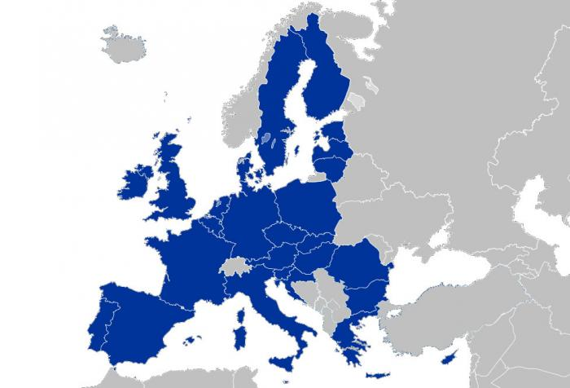
INTRA-EU Movement
Most movement between EU member states SHOULD properly be called MOBILITY not migration or immigration
WHY?
BUT – G&S point out when INTRA-EU mobility becomes PERCEIVED as MIGRATION or even IMMIGRATION when in becomes more permanent (6)

Slide 5
Migrants are NOT Refugees; refugees AREN’T migrants
Refugee
Migrants
Moving for economic opportunities – short or long term;
Intend to return to home country.
BEST SOURCE OF INFORMATION ON MIGRATION: IOM
An official, LEGAL category
CANNOT return to country because of well-founded fear of PERSECUTION, REAL THREAT OF VIOLENCE, BODILY HARM
BEST SOURCE OF INFORMATION ON REFUGEES: UNHCR

Slide 6
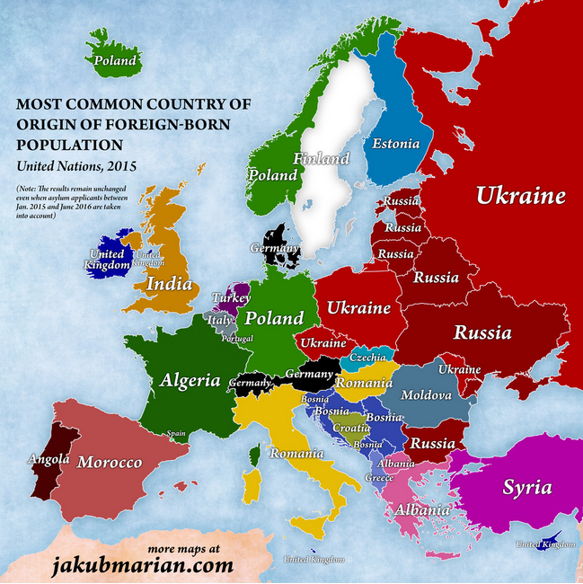
Contemporary Trends (click on map to go to WEF Story)

Slide 7
EXPLAINING MOBILITY: WHY DO PEOPLE MOVE ACROSS BORDERS?
PUSH FACTORS
PULL FACTORS
NAME SOME
WHAT ARE THESE IN EUROPE?

Slide 8
Geddes and Scholten Book
What are the main points? The Thesis of the book?
  Focused on MIGRATION AND MOBILITY
    RATHER than IMMIGRATION as conventionally understood
  Seeing migration and mobility as DEPENDENT VARIABLES rather than independent variables (causing change in the receiving countries)
    The CONTEXT of the RECEIVEING COUNTRIES AND THE WORLD ITSELF ARE CAUSING MIGRATION
    WHAT THE INDEPENDENT VARIABLES?
      ECONOMIC INEQUALITY BETWEEN NORTH AND SOUTH
      CONFLICT
      WELFARE STATE
      EUROPEAN INTEGRATION

Slide 9
THE Two dimensions OF MIGRATION AND MOBILITY
GLOBALISM
DOMESTIC LEVEL
MIGRATION AND MOBILITIY
EU

Slide 10
MIGRATION AND MOBILITY IN EUROPE
SEE TABLES IN CHAPTER ONE OF GEDDES AND SCHOLTEN

Slide 11
THE UK STORY
  DECOLONIZATION
  INTEGRATION – WHAT DOES THIS WORD MEAN?? HERE VS IN US??
  ENOCH POWELL – RIVERS OF BLOOD
    LATE 60S/EARLY 70S
    “RACE RELATIONS”

Slide 13
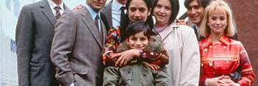
EAST IS EAST
HOW DOES THIS FILM ILLUSTRATE THE EXPERIENCE OF MIGRATION, INTEGRATION, AND RACE RELATIONS IN THE UK?

