Slide 1
CIAT CIS101A
Week 4
Class 1
Networking

Slide 2
CIAT CIS101A

Slide 3
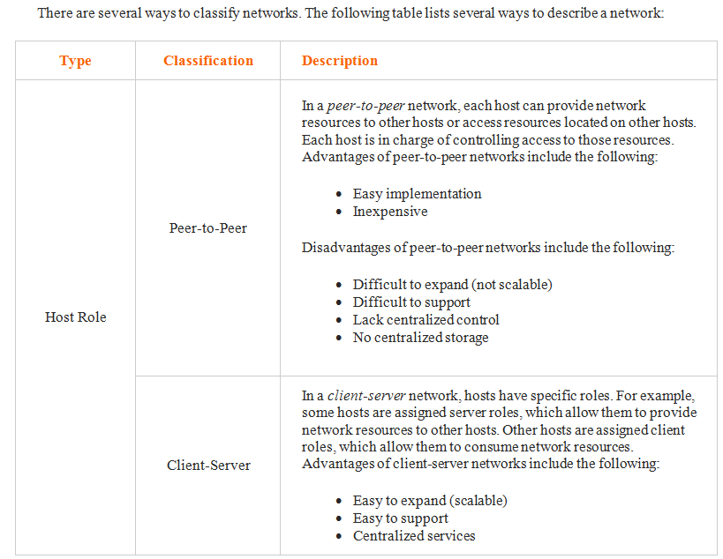
CIAT CIS101A

Slide 4
CIAT CIS101A

Slide 5
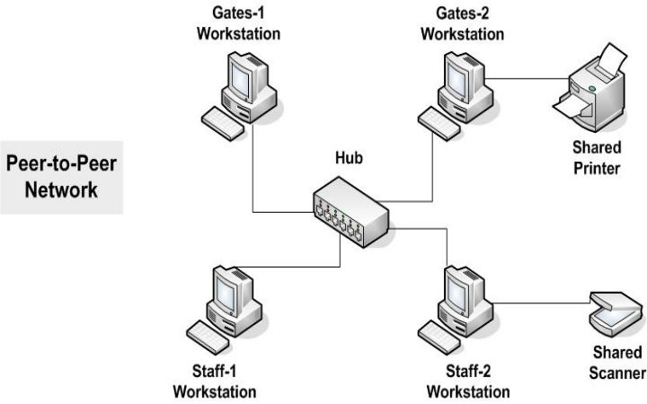
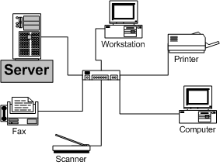
CIAT CIS101A
Peer-to-Peer Client-Server
(Workgroup Model) (Enterprise Model)

Slide 6
CIAT CIS101A
PAN Personal Area Network – Small area. Few feet for personal devices (PC – Smartphone – Tablet) - Bluetooth
LAN Local Area Network – Small geographic area. Office, Building. Wired/Wireless
WLAN Wireless LAN. Same area as LAN. Radio Signals
MAN Metropolitan Area Network. Campus, multiple buildings, city-wide. Public Utility, for example.
WAN Wide Area Network. Same as WAN, but could be statewide, nationwide or even world-wide scale.
***MAN/WAN use same structure and connection methods as such terms are indifferent and many IT Pros don’t even use MAN as a term.
***All are part of and owned by one organization.

Slide 7
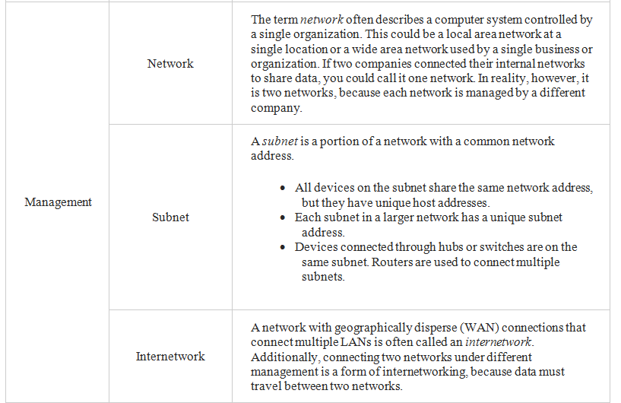
CIAT CIS101A

Slide 8
CIAT CIS101A
PARTICIPATION

Slide 9
CIAT CIS101A

Slide 10
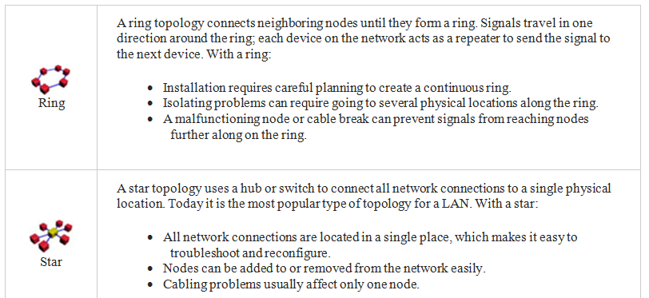
CIAT CIS101A

Slide 11
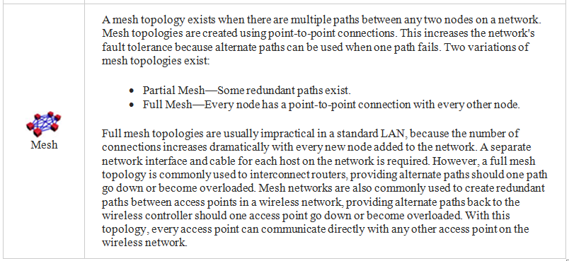
CIAT CIS101A

Slide 12
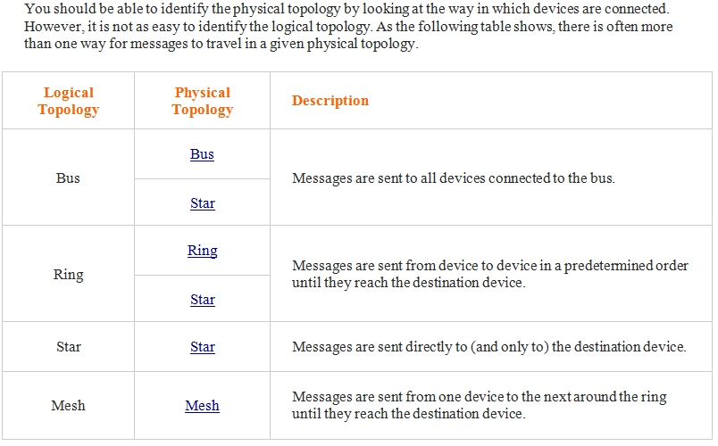
CIAT CIS101A

Slide 13
CIAT CIS101A

Slide 14
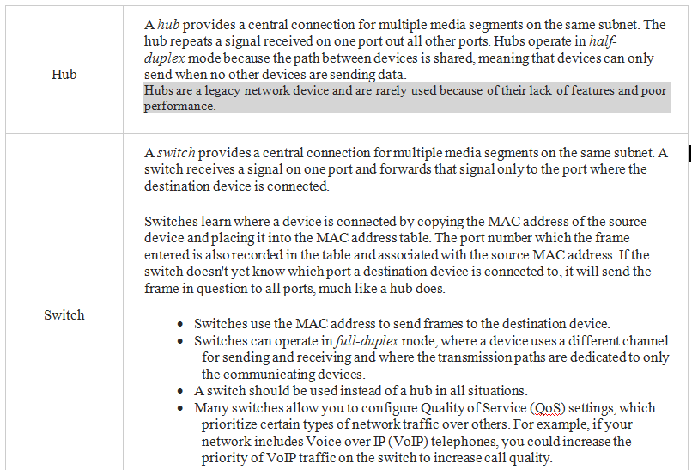
CIAT CIS101A

Slide 15
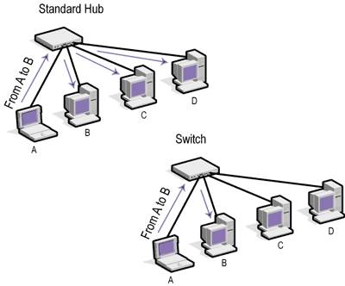
CIAT CIS101A

Slide 16
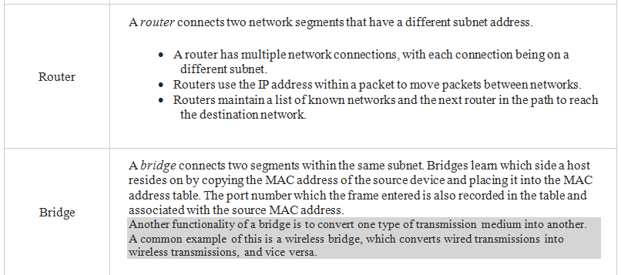
CIAT CIS101A

Slide 17
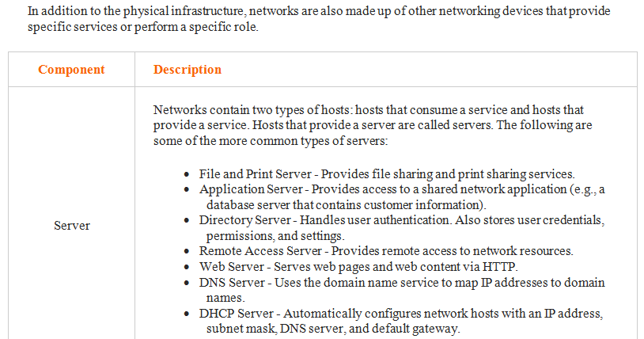
CIAT CIS101A

Slide 18
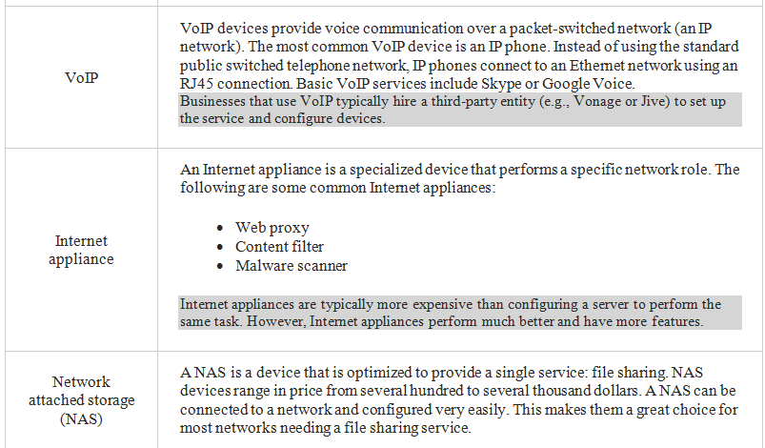
CIAT CIS101A

Slide 19
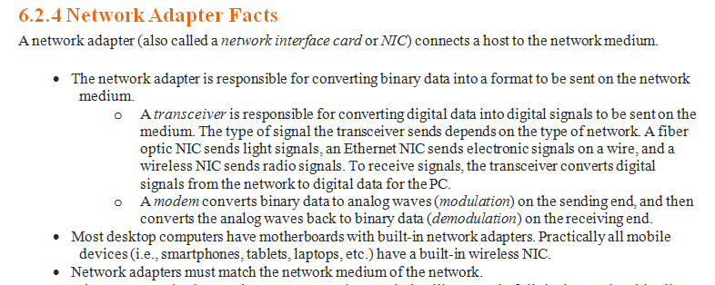
CIAT CIS101A

Slide 20
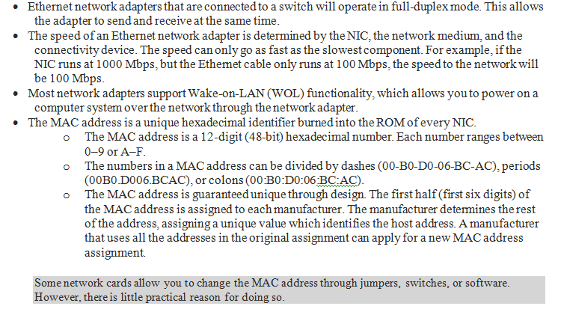
CIAT CIS101A

Slide 21
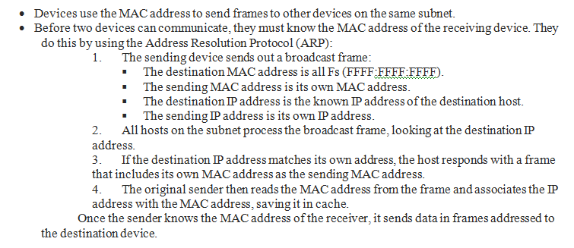
CIAT CIS101A

Slide 22
CIAT CIS101A

Slide 23
CIAT CIS101A

Slide 24
CIAT CIS101A

Slide 25
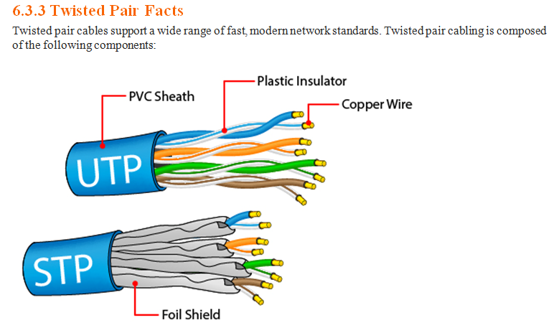
CIAT CIS101A

Slide 26
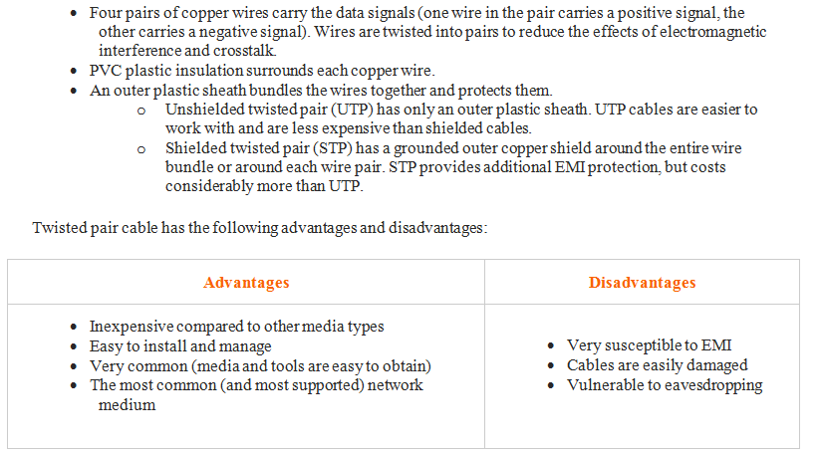
CIAT CIS101A

Slide 27
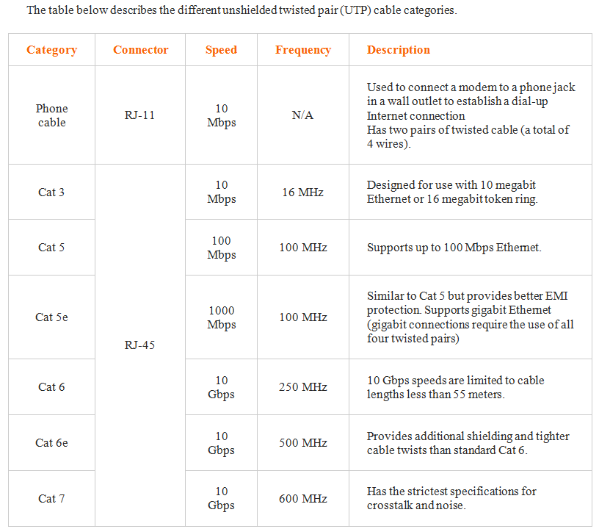
CIAT CIS101A

Slide 28
CIAT CIS101A

Slide 29
CIAT CIS101A

Slide 30
CIAT CIS101A

Slide 31
CIAT CIS101A

Slide 32
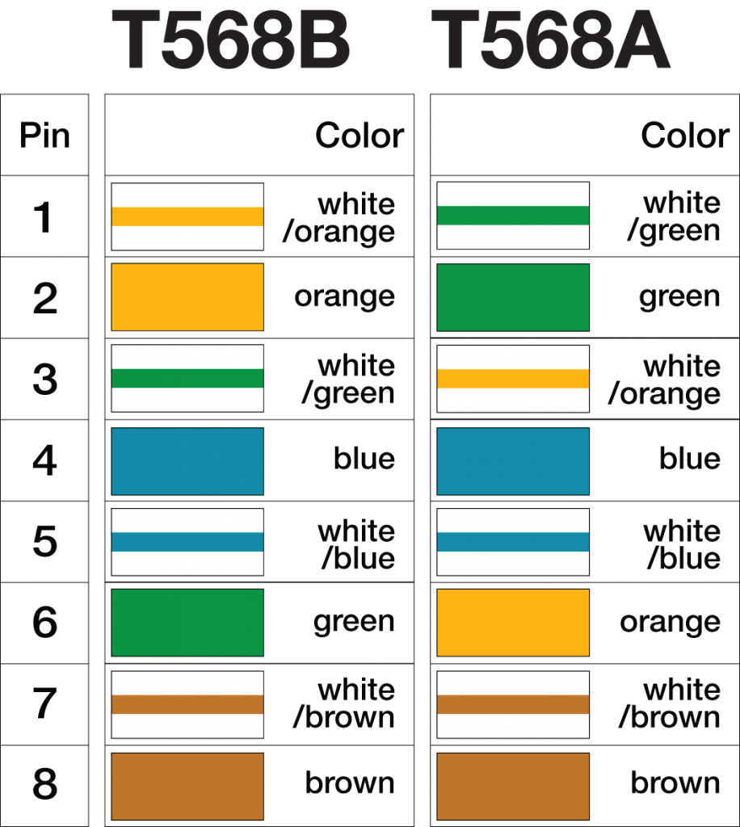
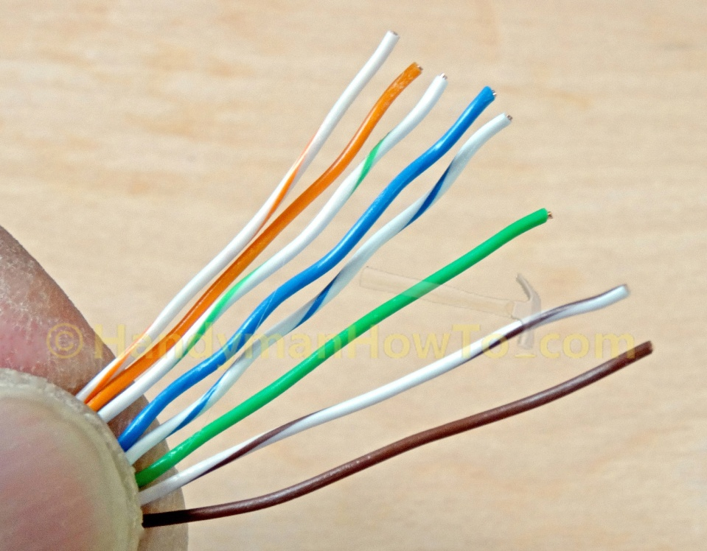
CIAT CIS101A

Slide 33
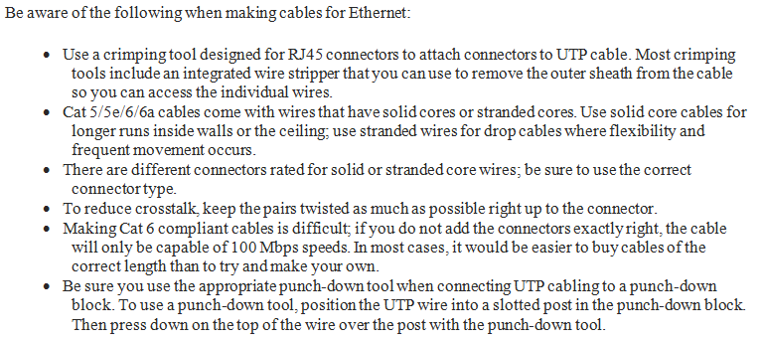
CIAT CIS101A

Slide 34
CIAT CIS101A

Slide 35
CIAT CIS101A

Slide 36
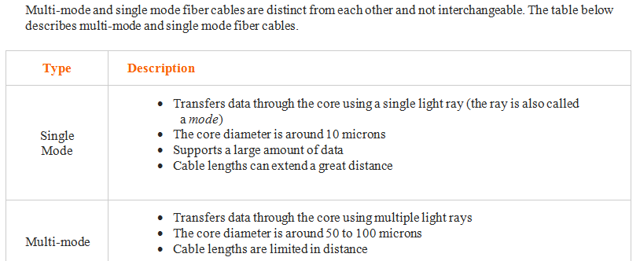
CIAT CIS101A

Slide 37
CIAT CIS101A

Slide 38
CIAT CIS101A

Slide 39
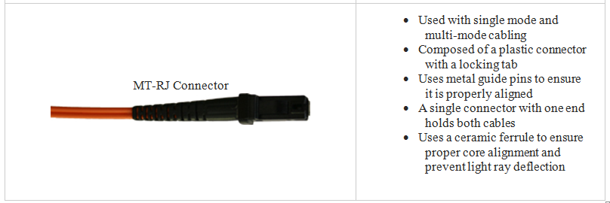
CIAT CIS101A

Slide 40
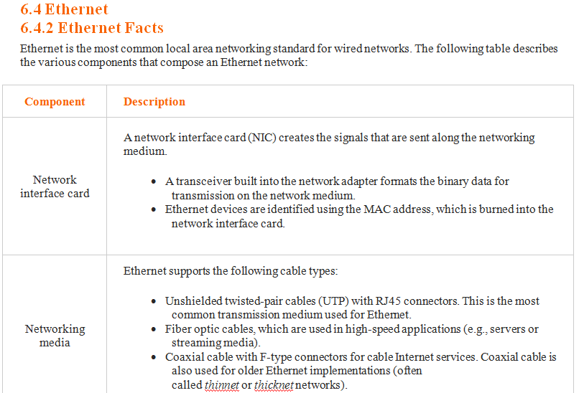
CIAT CIS101A

Slide 41
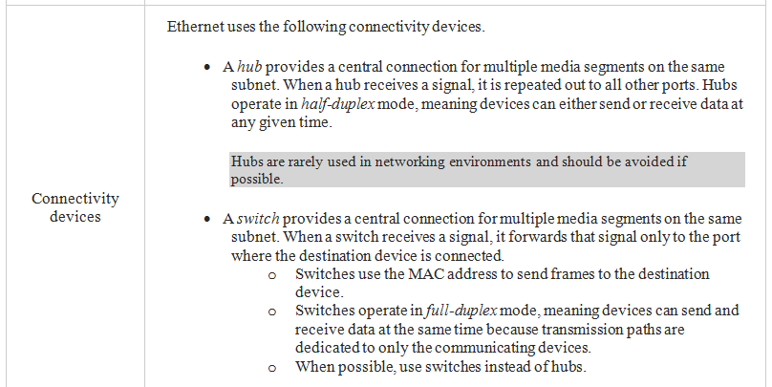
CIAT CIS101A

Slide 42
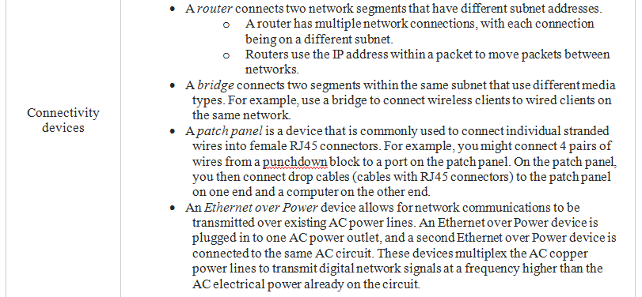
CIAT CIS101A

Slide 43
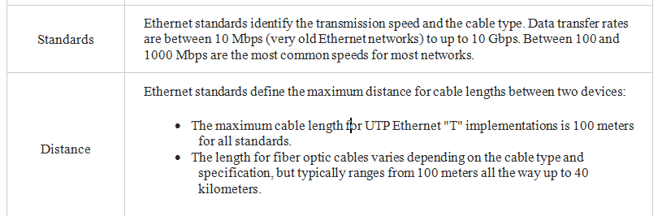
CIAT CIS101A

Slide 44
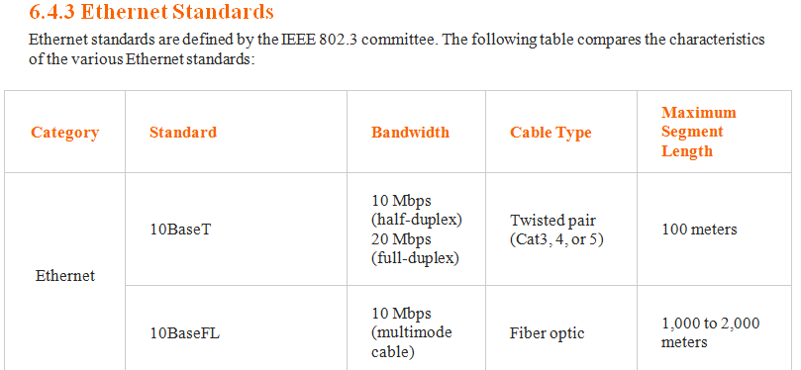
CIAT CIS101A

Slide 45
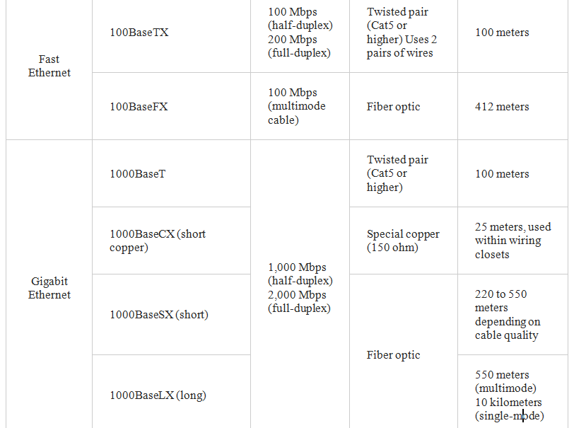
CIAT CIS101A

Slide 46
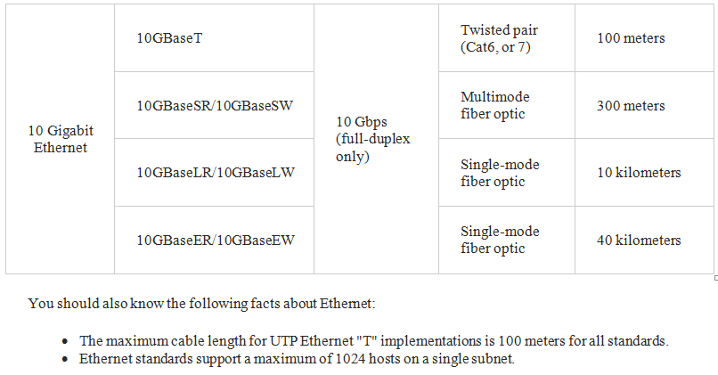
CIAT CIS101A

Slide 47
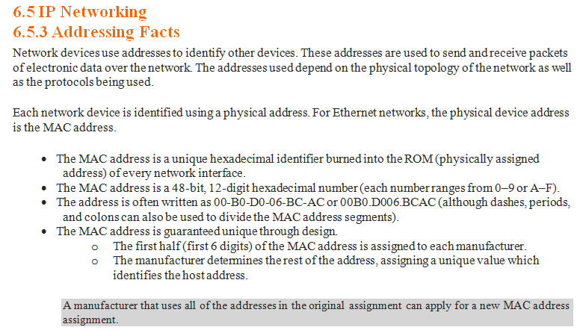
CIAT CIS101A

Slide 48
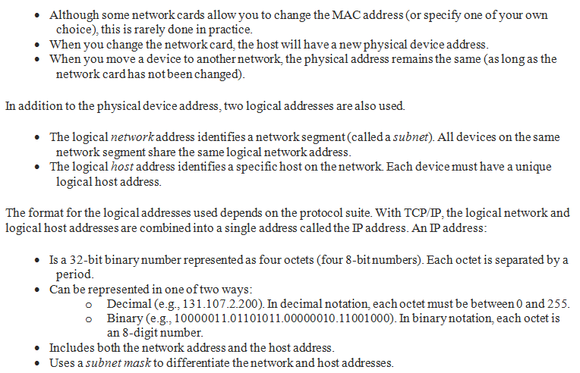
CIAT CIS101A

Slide 49
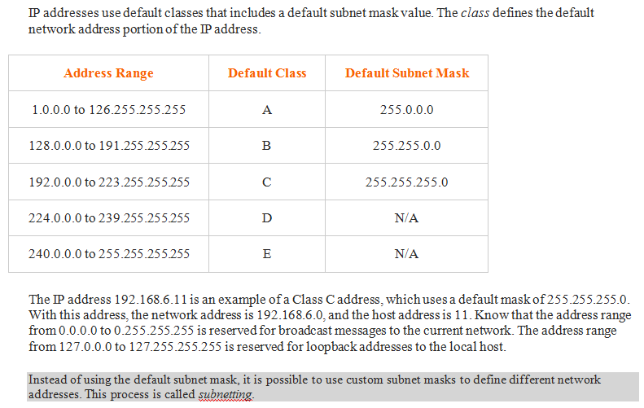
CIAT CIS101A

Slide 50
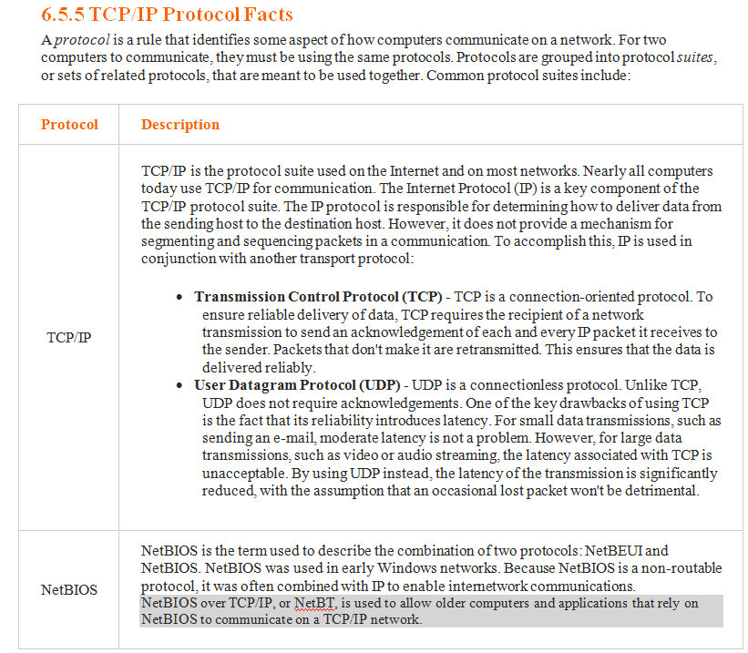
CIAT CIS101A

Slide 51
CIAT CIS101A

Slide 52
CIAT CIS101A

Slide 53
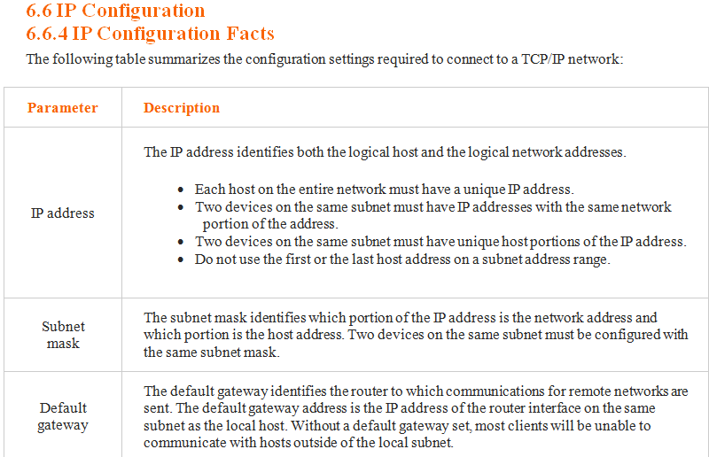
CIAT CIS101A

Slide 54
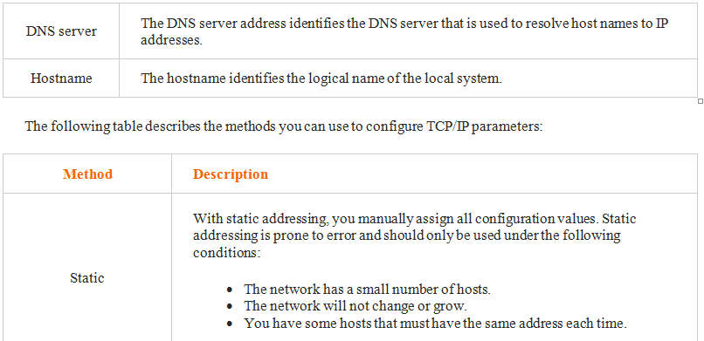
CIAT CIS101A

Slide 55
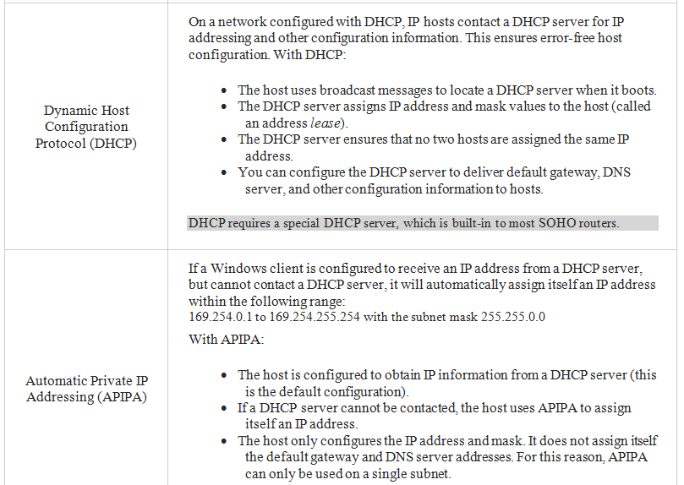
CIAT CIS101A

Slide 56
CIAT CIS101A

Slide 57
CIAT CIS101A

Slide 58
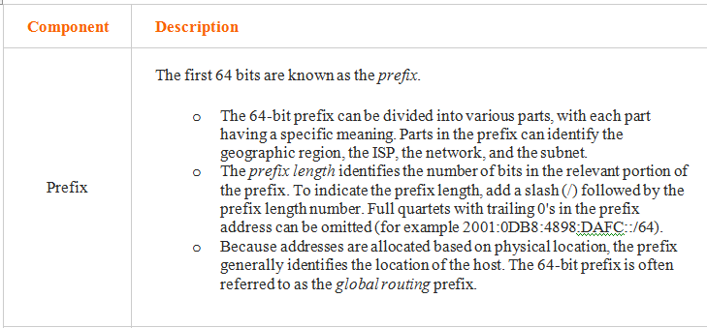
CIAT CIS101A

Slide 59
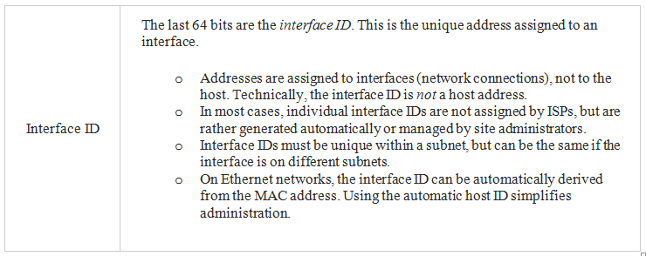
CIAT CIS101A

Slide 60
End of lesson
CIAT CIS101A

