Slide 1
CIS101B
Week 4 Class 1
Chapter 12
Security
12.1 through 12.6
12.1 Best Practices
12.1.4 Security Policy
12.2 Incident Response
12.2.3 Incident Response facts
12.3 Physical Security
12.4 Social Engineering

Slide 2
CIS101B
12.1 Best Practices
Principle of Least Privilege
Users should have only the degree of access to the workstation necessary for them to complete their work and no more. Observe the following:
Only those users who need administrative access should have it. You should use limited user accounts for everyone else. Don't make a user a member of the Administrators group unless the user needs administrative access to the system.
The workstation should only have the software required for it to fulfill its function on the network and no more.
Use delegated administration. Don't make all admin users members of the Administrators group. Make admins members of the Windows group that most closely matches the level of access they need:
Backup operators: Members of this group can backup or restore files, regardless of permissions assigned to those files.
Cryptographic operators: Members of this group can perform cryptographic operations.
Network Configuration Operators: Members of this group can manage the IP configuration on the system.
Performance Log Users: Members of this group can manage performance logs and alerts.
Performance Monitor Users: Members of this group can manage performance counters.
Remote Desktop Users: Members of this group can remotely access a workstation's desktop.

Slide 3
CIS101B
12.1 Best Practices
Require Passwords
All user accounts should have a password assigned. Passwords should also be required to unlock the screensaver and to resume from standby or hibernation.
Use Strong Passwords
A strong password is one that:
Is at least 8 characters long (longer is better)
Is not based on a word found in a dictionary
Contains both upper-case and lower-case characters
Contains numbers
Does not contain words that can be associated with you personally
Is changed frequently
Use File & Folder Permissions
This practice ties back to principle of least privilege. Users should be able to access the files and folders they need on the hard drive of the system and no more. Use file and folder permissions to explicitly specify who can do what with files and folders.

Slide 4
CIS101B
12.1 Best Practices
Disable the Guest and User Accounts
The Guest user account has no password and provides too much access to the system. The Guest user account should remain disabled.
Don’t use default user names
Avoid using default user names, such as Administrator. Change these names to something else.
Disable Autorun
Disable “Autorun” This prevents malware from automatically running when an optical disc or USB drive is inserted in the system.
Install Privacy Filters
A privacy filter is a polarized sheet of plastic that is placed over a computer screen to restrict screen visibility from any angle other than straight on. This prevents office guests and passers-by from being able to read information from the user's computer monitor.

Slide 5
CIS101B
12.1 Best Practices
Disable the Guest and User Accounts
The Guest user account has no password and provides too much access to the system. The Guest user account should remain disabled.
Don’t use default user names
Avoid using default user names, such as Administrator. Change these names to something else.
Disable Autorun
Disable “Autorun” This prevents malware from automatically running when an optical disc or USB drive is inserted in the system.
Install Privacy Filters
A privacy filter is a polarized sheet of plastic that is placed over a computer screen to restrict screen visibility from any angle other than straight on. This prevents office guests and passers-by from being able to read information from the user's computer monitor.

Slide 6
CIS101B
12.1 Best Practices
Block untrusted software sources
Software from untrusted sources could potentially contain malware. In fact, many modern network exploits attempt to trick users within an organization into downloading and installing malicious software. By doing this, an attacker can easily circumvent network security devices and launch an attack from behind the firewall. To prevent this from happening, consider the following:
Restrict user's ability to install software. For example, standard users on a Windows system are not allowed to install any software.
For users that are allowed to install software, restrict them to trusted software sources. For example:
Software for desktops and notebooks should be restricted to trusted software publishers, such as Microsoft or Adobe.
Software for mobile devices should be restricted to trusted app stores such as Google Play, the Microsoft Store, or Apple App Store.
No user should be allowed to download and install software from untrusted sites on the Internet. Unknown software publishers should be carefully investigated before allowing their software into your organization.

Slide 7
CIS101B
12.1.4 Security Policy

Slide 8
CIS101B
12.1.4 Security Policy

Slide 9
CIS101B
12.1.4 Security Policy

Slide 10
CIS101B
12.1.4 Security Policy

Slide 11
CIS101B
12.1.4 Security Policy

Slide 12
CIS101B
12.1.4 Security Policy

Slide 13
CIS101B
12.2 Incident Response
As you study this section, answer the following questions:
What actions should take place when an incident occurs?
What types of things would a computer forensic investigator want to analyze if he selected a live analysis over deadanalysis?
What methods can be used to save the contents of memory as part of a forensic investigation?
How should you ensure the integrity of collected digital evidence?
Why is chain of custody so important with forensic investigations?

Slide 14
CIS101B
12.2.3 Incident Response Facts
A security incident is an event or series of events that result from a security policy violation that has adverse effects on a company's ability to proceed with normal business.
Security incidents include employee errors, unauthorized acts by employees, insider attacks, hacker attacks, malware attacks, and unethical gathering of competitive information.
www.infosecurity-magazine.com/news/most-data-breaches-come-from-within/

Slide 15
CIS101B
12.2.3 Incident Response Facts
Incident response is the actions taken to deal with an incident during and after the incident. Prior planning helps people know what to do when a security incident occurs, especially the first responder.
The first responder:
Is the first person on the scene after a security incident has occurred
May be a dedicated member of the security response team
Has the following goals:
Contain the damage (or incident) as much as possible.
Do not damage any evidence.
Initiates an escalation procedure to ensure that the right people are informed and that the right people are brought on the incident site
Initiates the documentation of the incident

Slide 16
CIS101B
12.2.3 Incident Response Facts
Incident response should involve:
Identification and containment of the problem
Investigation of how the problem occurred and the forensics to preserve evidence that may be used in a criminal investigation
Removal and eradication of the cause of the incident
Recovery and repair of any damages
Document and report the incident, and take actions to implement countermeasures and processes to reduce the likelihood of a future attack

Slide 17
CIS101B
12.2.3 Incident Response Facts
Responding to an incident
Take actions to stop the attack and contain the damage.
For example, if the attack involves a computer system attached to the network, the first step might be to disconnect it from the network.
Although you want to preserve as much information as possible to assist in later investigations, it might be better to stop the attack, even if doing so alerts the attacker or results in the loss of evidence regarding the attack.
After containing a threat, forensic investigation can be performed on computer systems to gather evidence and identify the methods used in the attack.
When working with computer systems, use special computer forensic tools to analyze the system.
Investigations can be performed in the following ways:
A live analysis examines an active (running) computer system to analyze the live network connection, memory contents, and running programs.
A dead analysis examines data at rest, such as analyzing hard drive contents.

Slide 18
CIS101B
12.2.3 Incident Response Facts
Follow these procedures when collecting and analyzing computer evidence:
Before touching the computer, document and photograph the entire scene of the crime including the current state of the computer screen. A traditional camera is preferred over a digital camera to avoid allegations that an image was digitally altered.
Do not turn off the computer until the necessary evidence has been collected.
Some data might be lost when the computer is turned off.
Volatile data is any data that is stored in memory, CPU registers, and CPU caches that will be lost when the computer is powered off or loses power.
Persistent data resides on the system's hard drives, USB drives, optical media, and other external hard drives.
If it is necessary to isolate a system to stop or prevent future attacks, disconnect the system from the network rather than shutting it down (if possible).
Turning off the system might be the only practical method to prevent further damage and should be done if necessary, even if it results in the loss of potential evidence.
Assess the situation to determine whether you have the expertise to conduct further investigations, or whether you need to call in additional help.

Slide 19
CIS101B
12.2.3 Incident Response Facts
Follow these procedures when collecting and analyzing computer evidence: (cont.)
Analyze data in order from most volatile to least volatile:
CPU registers and caches
RAM
Virtual memory and temporary file systems
Hard disk data
Archived media (backups)
Save the contents of memory by taking one of the following actions:
Save and extract the page file.
Do a complete memory dump to save the contents of physical RAM. The page file will be lost but the physical memory will be preserved.
Clone or image hard disks.
Never analyze the original data. Make several copies for analysis to preserve the original.
Archive the original system or data for later investigations and comparisons to your copy.
In addition to looking for obvious evidence on computer systems (such as saved files), use special forensic tools to check for deleted files, files hidden in empty space, or data hidden in normal files.
For some investigations, you might need to review archived log files or data in backups to look for additional evidence. Be sure to design your backup strategy with not only recovery but also investigation and preserving evidence in mind.
Track hours and expenses for each incident. This may be necessary to calculate a total damage estimation and possibly restitution.

Slide 20
CIS101B
12.2.3 Incident Response Facts
Forensic investigation results can be used in a court of law if properly handled and documented. To ensure that evidence is admissible in court, you must be able to provide its chain of custody.
The chain of custody:
Documents the integrity of the evidence by providing a record of every person it has come in contact with and under what conditions.
Without a chain of custody document, there is no way to prove who might have had access to the evidence, meaning that the evidence could have been altered after discovery.
Failure to provide a valid chain of custody could make the evidence worthless in court.
Should be started the moment evidence is discovered and should include
what the evidence is
who found it
under what circumstances
the location of the evidence
the date and time of original discovery
how it was handled
all precautionary actions that have been taken to ensure its integrity
Should be maintained throughout the evidence life cycle to document the people and procedures used at each stage

Slide 21
CIS101B
12.2.3 Incident Response Facts
After you have analyzed the attack and gathered evidence, be aware that in some states you will be required to notify individuals if their personal information might have been compromised.
For example, if an incident involves the exposure of credit card numbers, identifying information (such as Social Security numbers), or medical information, you might be legally obligated to notify potential victims and take measures to help protect their information from further attack.

Slide 22
CIS101B
12.3 Physical Security

Slide 23
CIS101B
12.3.5 Physical Security
Data loss prevention (DLP) is a strategy for making sure that sensitive or critical information does not leave the corporate network.
Be aware of the following methods for protecting computers:

Slide 24
CIS101B
12.3.5 Physical Security
Building security

Slide 25
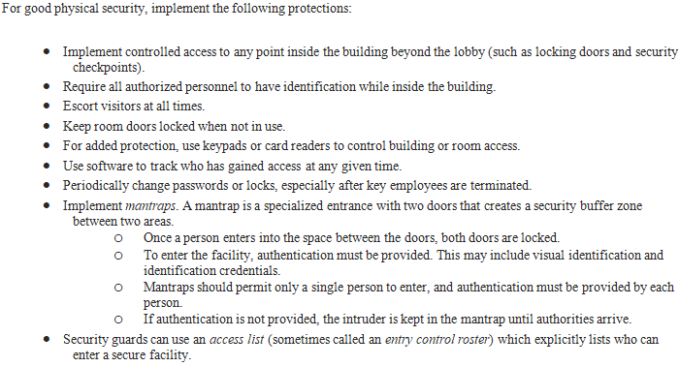
CIS101B
12.3.5 Physical Security
Building security

Slide 26
CIS101B
12.3.5 Physical Security
Hardware Locks

Slide 27
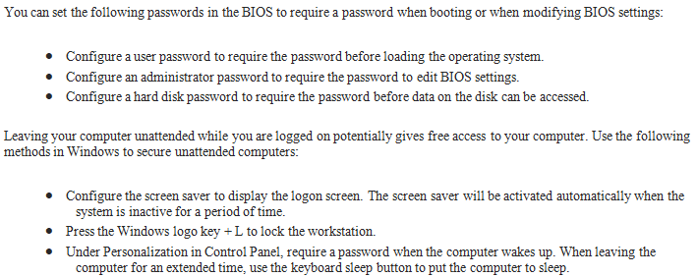
CIS101B
12.3.5 Physical Security
Lock the Workstation

Slide 28
CIS101B
12.3.5 Physical Security
Computer tracking service

Slide 29
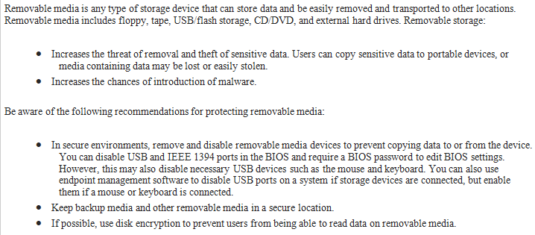
CIS101B
12.3.5 Physical Security
Removable Storage

Slide 30
CIS101B
12.3.5 Physical Security
Storage media disposal
Mobile Devices

Slide 31
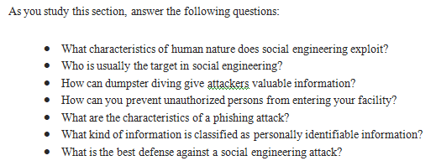
CIS101B
12.4 Social Engineering
https://www.youtube.com/watch?v=BSfdefR8H3c
https://www.youtube.com/watch?v=lc7scxvKQOo

Slide 32
CIS101B
12.4 Social Engineering

Slide 33
CIS101B
12.4 Social Engineering

Slide 34
CIS101B
12.4 Social Engineering

Slide 35
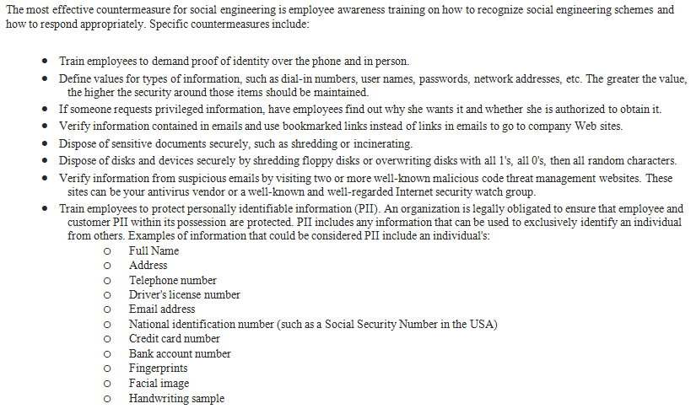
CIS101B
12.4 Social Engineering

