Slide 1
EST. 1890

Slide 2
Atlas Logistics Consulting Company
The Better Baby Boomer Blender Company
Global Sourcing
Operation Stimulus Case Competition
Ashleigh Allison, Sergio Garcia, David Looney, Hong Yun Yong
Notes:
Jacob

Slide 3
Introduction
Solution
Cost Analysis
Logistics and Time Performance
Conclusion

Slide 4
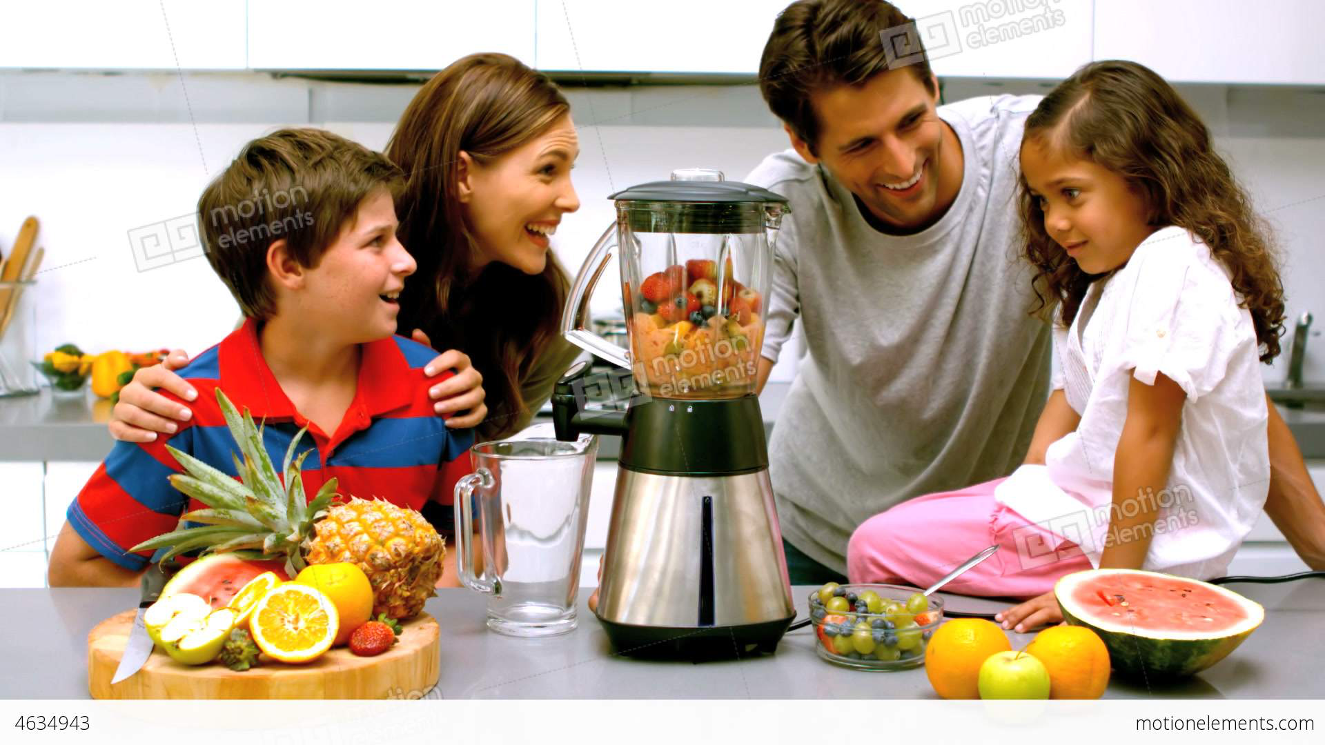
“Families serving families through
safe, superior and reliable home products.”

Slide 5
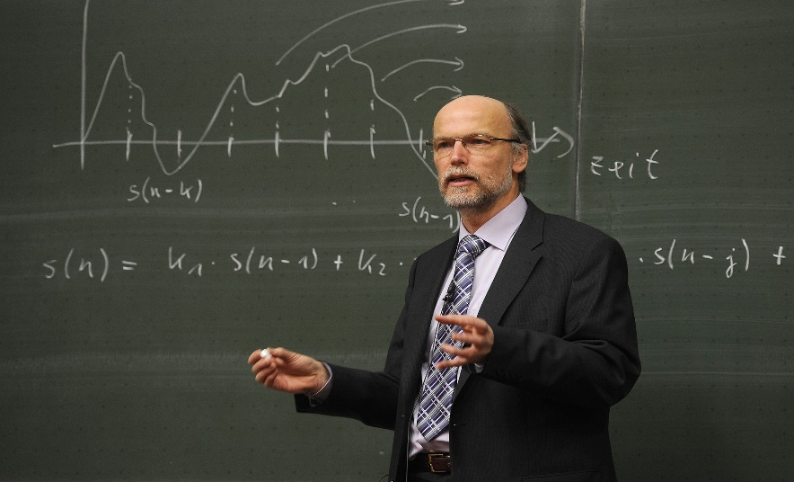
“Pracademic” Approach:
Academic in theory
Practical in Application

Slide 6
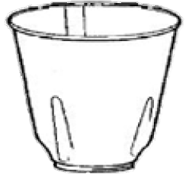
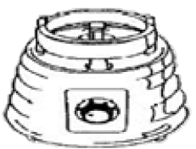
New Product, New Horizons
Atlas Logistics Consulting Company (ALCC) is consulting the Better Baby Boomer Blender Company (4BC) in the global sourcing of their new product, the Model A1 Blender.
Major Challenges:
Lowering overhead costs while maintaining product quality
Creating an efficient schedule which will meet the needs of the 4BC company
Assessing Global compatibility with American trade
Selecting four countries to support various components of the product
5. Respond quickly and efficiently to potential crises

Slide 7
Decision Matrix
Country | Plastic (30%) | Economic Stability (10%) | Ease of Transportation (10%) | Cost-Effectiveness (50%) | Total
China | 5 | 3 | 4.16 | 5 | 4.716
Taiwan | 3 | 4 | 4.25 | 4 | 3.725
Japan | 3 | 4 | 4.425 | 2 | 2.7425
Country | Glass (30%) | Economic Stability (10%) | Ease of Transportation (10%) | Cost-Effectiveness (50%) | Total
China | 5 | 3 | 4.16 | 5 | 4.716
Chile | 1 | 4 | 3.595 | 5 | 3.5595
Brazil | 1 | 3 | 3.38 | 5 | 3.438
Weigh Risk
Country | Rubber (30%) | Economic Stability (10%) | Ease of Transportation (10%) | Cost-Effectiveness (50%) | Total
China | 5 | 3 | 4.16 | 5 | 4.716
Malaysia | 4 | 3 | 4.085 | 5 | 4.4085
India | 4 | 3 | 3.585 | 5 | 4.3585
Manage Risk
Country | Stainless Steel (30%) | Economic Stability (10%) | Ease of Transportation (10%) | Cost-Effectiveness (50%) | Total
Taiwan | 3 | 4 | 4.25 | 4 | 3.725
South Korea | 4 | 4 | 4.225 | 3 | 3.5225
Japan | 5 | 4 | 4.425 | 2 | 3.3425
Country | Motor (30%) | Economic Stability (10%) | Ease of Transportation (10%) | Cost-Effectiveness (50%) | Total
China | 5 | 3 | 4.16 | 5 | 4.716
Vietnam | 3 | 2 | 3.375 | 4 | 3.4375
South Korea | 3 | 4 | 4.225 | 3 | 3.2225

Slide 8
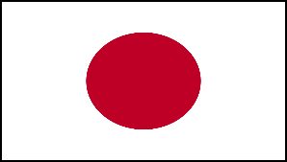
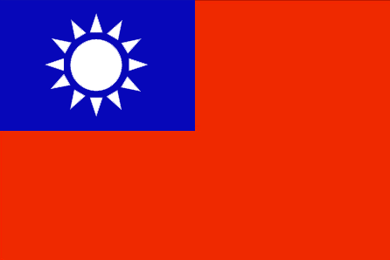
Product | Country | Alternatives
Plastic | Japan | Taiwan China
Glass | China | Chile Japan
Rubber | Malaysia | China India
Stainless Steel | Taiwan | South Korea Japan
Motor | China | Vietnam South Korea
Our Solution
Ocean Shipping to Los Angeles
Intermodal Shipping to Columbus

Slide 9
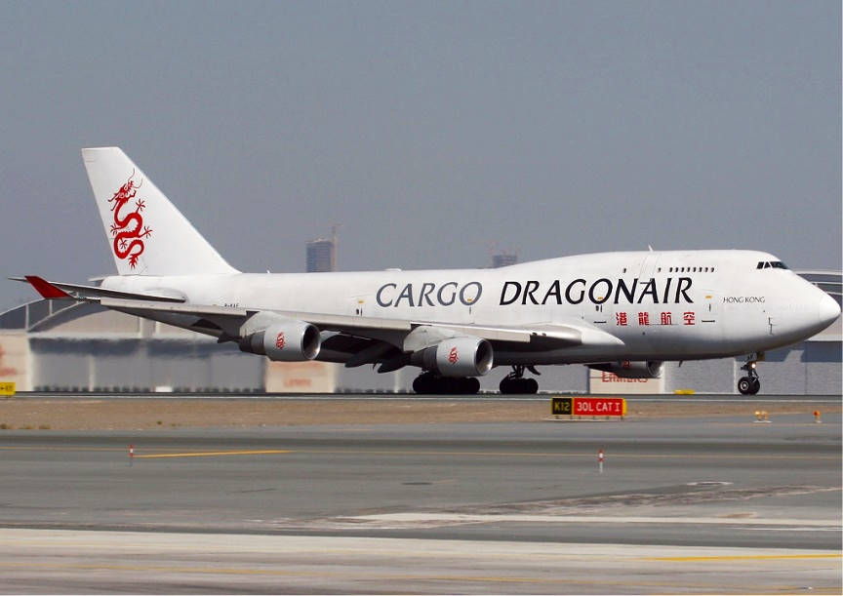
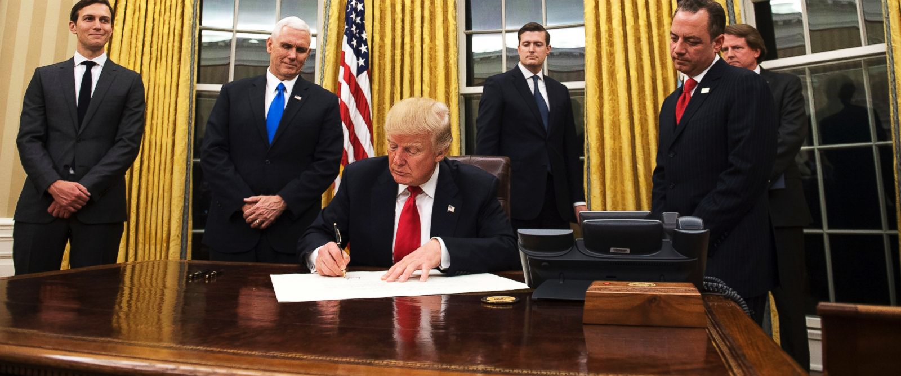
Alternatives/Contingency Plans
Dedicated Contingency Response Teams
Airfreight Options
Using Port of Savannah
Decision Matrix Identifies Alternative Countries

Slide 10
Introduction
Cost Analysis
Logistics and Time Performance
Solution
Conclusion

Slide 11
Model A1 Blender (2017)
Plastic
Potential Countries for Outsource
China | Chile
Taiwan | Brazil
Philippines | India
Malaysia | Australia
South Korea | Vietnam
Japan | Argentina
Feeder Cap
Cover
Container Bottom
Glass
Blender Jug
Stainless Steel
Rubber
Agitator Blade
Sealing Ring
Motor
Motor Base

Slide 12
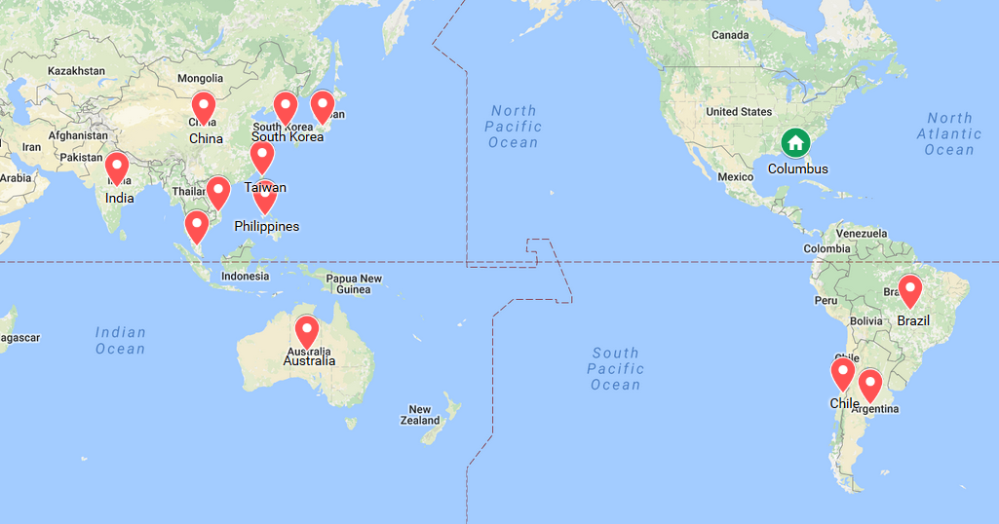
Mode of Transportation
Ocean via Panama Canal
Pro: Cost Effective Con: Duration

Slide 13
Mode of Transportation
Via LAX (Ocean, Rail and Truck)
Pro: Cost Effective Con: Duration
N/A
N/A
N/A

Slide 14
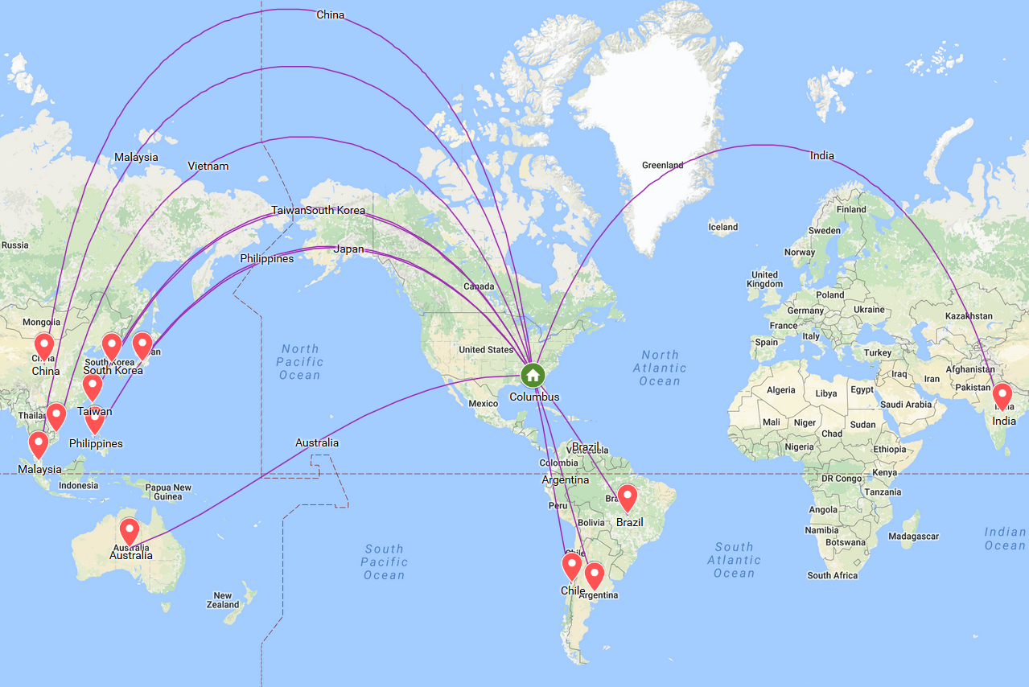
Mode of Transportation
Regular/Express Air
Pro: Speed Con: Expensive

Slide 15
Assumptions
2016’s Duty, Container Shipping, Bunker Surcharge, Clearance Fees = $0
2017 Negotiated Unit Cost = 40% of 2016 Unit Production Cost
Revenue = Production units x Retail selling price ($ 36.27)
2017 target of production = 4.6 MM units + 3% safety stock (1.5 weeks of inventory)
2017 Inventory Carrying Cost
2016 | 2017
$ 12.18 (per blender) | $ 4.87 (per blender)
$ 130.6 MM | $ 171.8 MM
3,600,000 | 4,738,000
2017 Capital Cost
$ 161.5 MM
Inventory Service Expense
$ 46.2 MM
Total Value of Inventory
31%
Storage Bills
$ 13.2 MM
$ 171.85 MM
Inventory Risk
$ 4.74 MM

Slide 16
Assumptions
2016’s Duty, Container Shipping, Bunker Surcharge, Clearance Fees = $0
2017 Negotiated Unit Cost = 40% of 2016 Unit Production Cost
Revenue = Production units x Retail selling price ($ 36.27)
2017 target of production = 4.6 MM units + 3% safety stock (1.5 weeks of inventory)
2017 Inventory Carrying Cost
2016 | 2017
$ 12.18 (per blender) | $ 4.87 (per blender)
$ 130.6 MM | $ 171.8 MM
3,600,000 | 4,738,000
2017 Capital Cost
$ 161.5 MM
Inventory Service Expense
$ 46.2 MM
Total Value of Inventory
31%
Storage Bills
$ 13.2 MM
$ 171.85 MM
Inventory Risk
$ 4.74 MM

Slide 17
Assumptions
2016’s Duty, Container Shipping, Bunker Surcharge, Clearance Fees = $0
2017 Negotiated Unit Cost = 40% of 2016 Unit Production Cost
Revenue = Production units x Retail selling price ($ 36.27)
2017 target of production = 4.6 MM units + 3% safety stock (1.5 weeks of inventory)
2017 Inventory Carrying Cost
2016 | 2017
$ 12.18 (per blender) | $ 4.87 (per blender)
$ 130.6 MM | $ 171.8 MM
3,600,000 | 4,738,000
2017 Capital Cost
$ 161.5 MM
Inventory Service Expense
$ 46.2 MM
Total Value of Inventory
31%
Storage Bills
$ 13.2 MM
$ 171.85 MM
Inventory Risk
$ 4.74 MM

Slide 18
Assumptions
2016’s Duty, Container Shipping, Bunker Surcharge, Clearance Fees = $0
2017 Negotiated Unit Cost = 40% of 2016 Unit Production Cost
Revenue = Production units x Retail selling price ($ 36.27)
2017 target of production = 4.6 MM units + 3% safety stock (1.5 weeks of inventory)
2017 Inventory Carrying Cost
2016 | 2017
$ 12.18 (per blender) | $ 4.87 (per blender)
$ 130.6 MM | $ 171.8 MM
3,600,000 | 4,738,000
2017 Capital Cost
$ 161.5 MM
Inventory Service Expense
$ 46.2 MM
Total Value of Inventory
31%
Storage Bills
$ 13.2 MM
$ 171.85 MM
Inventory Risk
$ 4.74 MM

Slide 19
Assumptions
2016’s Duty, Container Shipping, Bunker Surcharge, Clearance Fees = $0
2017 Negotiated Unit Cost = 40% of 2016 Unit Production Cost
Revenue = Production units x Retail selling price ($ 36.27)
2017 target of production = 4.6 MM units + 3% safety stock (1.5 weeks of inventory)
2017 Inventory Carrying Cost
2016 | 2017
$ 12.18 (per blender) | $ 4.87 (per blender)
$ 130.6 MM | $ 171.8 MM
3,600,000 | 4,738,000
2017 Capital Cost
$ 161.5 MM
Inventory Service Expense
$ 46.2 MM
Total Value of Inventory
31%
Storage Bills
$ 13.2 MM
$ 171.85 MM
Inventory Risk
$ 4.74 MM

Slide 20
Assumptions
2016’s Duty, Container Shipping, Bunker Surcharge, Clearance Fees = $0
2017 Negotiated Unit Cost = 40% of 2016 Unit Production Cost
Revenue = Production units x Retail selling price ($ 36.27)
2017 target of production = 4.6 MM units + 3% safety stock (1.5 weeks of inventory)
2017 Inventory Carrying Cost
2016 | 2017
$ 12.18 (per blender) | $ 4.87 (per blender)
$ 130.6 MM | $ 171.8 MM
3,600,000 | 4,738,000
2017 Capital Cost
$ 161.5 MM
Inventory Service Expense
$ 46.2 MM
Total Value of Inventory
31%
Storage Bills
$ 13.2 MM
$ 171.85 MM
Inventory Risk
$ 4.74 MM

Slide 21
Methodology
Cost Effective Priority:
Material | Country | Entry Port | Annual Shipping Costs | Atlas Logistics Revenue (20-30% of carrier base cost)
Plastic | China | LAX | $102,500 | $25,700
Glass | China | LAX | $499,200 | $155,136
Rubber | Malaysia | LAX | $4,550 | $1,414
SST | Brazil | SAV | $39,000 | $12,120
Motor | Chile | SAV | $2,253,900 | $646,400
Total |  |  | $2,970,720 | $840,770

Slide 22
Methodology
Cost Effective Priority:
Material | Country | Entry Port | Annual Shipping Costs | Atlas Logistics Revenue (20-30% of carrier base cost)
Plastic | China | LAX | $102,500 | $25,700
Glass | China | LAX | $499,200 | $155,136
Rubber | Malaysia | LAX | $4,550 | $1,414
SST | Brazil | SAV | $39,000 | $12,120
Motor | Chile | SAV | $2,253,900 | $646,400
Total |  |  | $2,970,720 | $840,770

Slide 23
Methodology
Cost Effective Priority:
Material | Country | Entry Port | Annual Shipping Costs | Atlas Logistics Revenue (20-30% of carrier base cost)
Plastic | China | LAX | $102,500 | $25,700
Glass | China | LAX | $499,200 | $155,136
Rubber | Malaysia | LAX | $4,550 | $1,414
SST | Brazil | SAV | $39,000 | $12,120
Motor | Chile | SAV | $2,253,900 | $646,400
Total |  |  | $2,970,720 | $840,770

Slide 24
Methodology
Cost Effective Priority:
Material | Country | Entry Port | Annual Shipping Costs | Atlas Logistics Revenue (20-30% of carrier base cost)
Plastic | China | LAX | $102,500 | $25,700
Glass | China | LAX | $499,200 | $155,136
Rubber | Malaysia | LAX | $4,550 | $1,414
SST | Brazil | SAV | $39,000 | $12,120
Motor | Chile | SAV | $2,253,900 | $646,400
Total |  |  | $2,970,720 | $840,770

Slide 25
Methodology
Cost Effective Priority:
Material | Country | Entry Port | Annual Shipping Costs | Atlas Logistics Revenue (20-30% of carrier base cost)
Plastic | China | LAX | $102,500 | $25,700
Glass | China | LAX | $499,200 | $155,136
Rubber | Malaysia | LAX | $4,550 | $1,414
SST | Brazil | SAV | $39,000 | $12,120
Motor | Chile | SAV | $2,253,900 | $646,400
Total |  |  | $2,970,720 | $840,770

Slide 26
Cost Analysis
Least Expensive Priority
4BC | 2016 | 2017
Revenue | $ 130.6 MM | $ 171.8 MM
Total Duty | $ 0 | $ 43.1 MM
Import Fees | $ 0 | $ 27,450
Total Freight | $ 44.6 MM | $ 2.9 MM
Total Cost of Ownership | $ 44.6 MM | $ 69.1 MM
Profit | $ 86 MM | $ 102.7 MM

Slide 27
Cost Analysis
Least Expensive Priority
4BC | 2016 | 2017
Revenue | $ 130.6 MM | $ 171.8 MM
Total Duty | $ 0 | $ 43.1 MM
Import Fees | $ 0 | $ 27,450
Total Freight | $ 44.6 MM | $ 2.9 MM
Total Cost of Ownership | $ 44.6 MM | $ 69.1 MM
Profit | $ 86 MM | $ 102.7 MM
19.44%

Slide 28
Cost Analysis
Least Expensive Priority
4BC | 2016 | 2017
Revenue | $ 130.6 MM | $ 171.8 MM
Total Duty | $ 0 | $ 43.1 MM
Import Fees | $ 0 | $ 27,450
Total Freight | $ 44.6 MM | $ 2.9 MM
Total Cost of Ownership | $ 44.6 MM | $ 69.1 MM
Profit | $ 86 MM | $ 102.7 MM
19.44%

Slide 29
Cost Analysis
Least Expensive Priority
4BC | 2016 | 2017
Revenue | $ 130.6 MM | $ 171.8 MM
Total Duty | $ 0 | $ 43.1 MM
Import Fees | $ 0 | $ 27,450
Total Freight | $ 44.6 MM | $ 2.9 MM
Total Cost of Ownership | $ 44.6 MM | $ 69.1 MM
Profit | $ 86 MM | $ 102.7 MM
19.44%

Slide 30
Methodology
Decision Matrix
Cost Effectiveness 50%
Quality 30%
Economic Stability 10%
Ease of Transportation 10%
Constraint
4 countries
Air transportation

Slide 31
Decision Matrix
Cost Effectiveness (Weight: 50%)
Scale 1 to 5 1 = Unsatisfactory, 5 = Optimal
Plastic
Country | Cost-Effectiveness
China | 5
Taiwan | 4
India | 3
Viet Nam | 3
Japan | 2
Australia | 2
S. Korea | 2
Malaysia | 2
Chile | 1
Brazil | 1
Argentina | 1
Philippines | 1
Glass
Country | Cost-Effectiveness
China | 5
Chile | 5
Brazil | 5
Vietnam | 4
Malaysia | 3
Australia | 3
Argentina | 3
Japan | 2
Taiwan | 2
Philippines | 2
S. Korea | 1
India | 1
Rubber
Country | Cost-Effectiveness
China | 5
Malaysia | 5
India | 5
Taiwan | 5
Japan | 4
S. Korea | 4
Australia | 4
Philippines | 4
Vietnam | 4
Brazil | 1
Chile | 1
Argentina | 1
Stainless Steel
Country | Cost-Effectiveness
Taiwan | 4
Viet Nam | 4
S. Korea | 3
India | 3
Australia | 3
Japan | 2
China | 2
Malaysia | 2
Philippines | 2
Chile | 1
Brazil | 1
Argentina | 1
Motor
Country | Cost-Effectiveness
China | 5
Vietnam | 4
Taiwan | 4
S. Korea | 3
India | 3
Australia | 3
Japan | 2
Malaysia | 2
Philippines | 2
Brazil | 1
Chile | 1
Argentina | 1

Slide 32
Decision Matrix
Cost Effectiveness (Weight: 50%)
Scale 1 to 5 1 = Unsatisfactory, 5 = Optimal
Plastic
Country | Cost-Effectiveness
China | 5
Taiwan | 4
India | 3
Viet Nam | 3
Japan | 2
Australia | 2
S. Korea | 2
Malaysia | 2
Chile | 1
Brazil | 1
Argentina | 1
Philippines | 1
Glass
Country | Cost-Effectiveness
China | 5
Chile | 5
Brazil | 5
Vietnam | 4
Malaysia | 3
Australia | 3
Argentina | 3
Japan | 2
Taiwan | 2
Philippines | 2
S. Korea | 1
India | 1
Rubber
Country | Cost-Effectiveness
China | 5
Malaysia | 5
India | 5
Taiwan | 5
Japan | 4
S. Korea | 4
Australia | 4
Philippines | 4
Vietnam | 4
Brazil | 1
Chile | 1
Argentina | 1
Stainless Steel
Country | Cost-Effectiveness
Taiwan | 4
Viet Nam | 4
S. Korea | 3
India | 3
Australia | 3
Japan | 2
China | 2
Malaysia | 2
Philippines | 2
Chile | 1
Brazil | 1
Argentina | 1
Motor
Country | Cost-Effectiveness
China | 5
Vietnam | 4
Taiwan | 4
S. Korea | 3
India | 3
Australia | 3
Japan | 2
Malaysia | 2
Philippines | 2
Brazil | 1
Chile | 1
Argentina | 1

Slide 33
Decision Matrix
Quality (Weight: 50%)
Scale 1 to 5 1 = Unsatisfactory, 5 = Optimal
Plastic
Country | Quality
China | 5
Taiwan | 3
Japan | 3
S. Korea | 2
India | 1
Vietnam | 1
Australia | 1
Malaysia | 1
Chile | 1
Brazil | 1
Philippines | 1
Argentina | 1
Glass
Country | Quality
China | 5
Japan | 4
Taiwan | 3
S. Korea | 3
Vietnam | 2
Malaysia | 2
Chile | 1
Brazil | 1
Australia | 1
Argentina | 1
Philippines | 1
India | 1
Rubber
Country | Quality
China | 5
Malaysia | 4
India | 4
Japan | 4
S. Korea | 3
Brazil | 2
Taiwan | 1
Australia | 1
Philippines | 1
Vietnam | 1
Chile | 1
Argentina | 1
Stainless Steel
Country | Cost-Effectiveness
Japan | 5
China | 5
S. Korea | 4
Taiwan | 3
India | 2
Chile | 2
Vietnam | 1
Australia | 1
Malaysia | 1
Philippines | 1
Brazil | 1
Argentina | 1
Motor
Country | Cost-Effectiveness
China | 5
Japan | 4
Vietnam | 3
S. Korea | 3
India | 2
Brazil | 2
Taiwan | 1
Australia | 1
Malaysia | 1
Philippines | 1
Chile | 1
Argentina | 1

Slide 34
Decision Matrix
Quality (Weight: 50%)
Scale 1 to 5 1 = Unsatisfactory, 5 = Optimal
Plastic
Country | Quality
China | 5
Taiwan | 3
Japan | 3
S. Korea | 2
India | 1
Vietnam | 1
Australia | 1
Malaysia | 1
Chile | 1
Brazil | 1
Philippines | 1
Argentina | 1
Glass
Country | Quality
China | 5
Japan | 4
Taiwan | 3
S. Korea | 3
Vietnam | 2
Malaysia | 2
Chile | 1
Brazil | 1
Australia | 1
Argentina | 1
Philippines | 1
India | 1
Rubber
Country | Quality
China | 5
Malaysia | 4
India | 4
Japan | 4
S. Korea | 3
Brazil | 2
Taiwan | 1
Australia | 1
Philippines | 1
Vietnam | 1
Chile | 1
Argentina | 1
Stainless Steel
Country | Cost-Effectiveness
Japan | 5
China | 5
S. Korea | 4
Taiwan | 3
India | 2
Chile | 2
Vietnam | 1
Australia | 1
Malaysia | 1
Philippines | 1
Brazil | 1
Argentina | 1
Motor
Country | Cost-Effectiveness
China | 5
Japan | 4
Vietnam | 3
S. Korea | 3
India | 2
Brazil | 2
Taiwan | 1
Australia | 1
Malaysia | 1
Philippines | 1
Chile | 1
Argentina | 1

Slide 35
Introduction
Cost Analysis
Logistics and Time Performance
Solution
Conclusion
Notes:
We were given the data for three quarters of operations for Ajax. We are gonna walk to the quarters one by one and explain the decisions we made based on the data we were given.

Slide 36
Decision Matrix
Economic Stability (Weight: 10%)
Ease of Transportation (Weight: 10%)
Scale 1 to 5 1 = Unsatisfactory, 5 = Optimal
Economic Stability
Country | Quality
Australia | 5
Taiwan | 4
Japan | 4
S. Korea | 4
Chile | 4
China | 3
India | 3
Malaysia | 3
Brazil | 3
Philippines | 3
Vietnam | 2
Argentina | 2
Ease of Transportation
Country | Quality
Japan | 4.425
Australia | 4.27
Taiwan | 4.25
S. Korea | 4.225
China | 4.16
Malaysia | 4.085
Chile | 3.595
India | 3.585
Brazil | 3.38
Vietnam | 3.375
Argentina | 2.815
Philippines | 2.805

Slide 37
Decision Matrix
Economic Stability (Weight: 10%)
Ease of Transportation (Weight: 10%)
Scale 1 to 5 1 = Unsatisfactory, 5 = Optimal
Economic Stability
Country | Quality
Australia | 5
Taiwan | 4
Japan | 4
S. Korea | 4
Chile | 4
China | 3
India | 3
Malaysia | 3
Brazil | 3
Philippines | 3
Vietnam | 2
Argentina | 2
Ease of Transportation
Country | Quality
Japan | 4.425
Australia | 4.27
Taiwan | 4.25
S. Korea | 4.225
China | 4.16
Malaysia | 4.085
Chile | 3.595
India | 3.585
Brazil | 3.38
Vietnam | 3.375
Argentina | 2.815
Philippines | 2.805

Slide 38
Product | Pallets Needed for weekly demand | Containers needed for weekly demand | Optimal Solution
Feeder Cap | 6 | .6 (20ft.) 0.3 (40ft.) | 1 (40ft.) 1 (20ft.)
Cover | 12 | 1.2 (20ft.) 0.6 (40ft.)
Container Bottom | 12 | 1.2 (20ft.) 0.6 (40ft.)
Sealing Ring | 1 | 0.1 (20ft.) | 1 (20ft.)
Agitator Blade | 12 | 0.6 (40ft.) | 1 (40ft.)
Blender Jug | 152 | 7.6 (40ft.) | 8 (40ft.)
Motor | 632 | 31.6 (40ft.) | 32 (40ft.)

Slide 39
Product | Pallets Needed for weekly demand | Containers needed for weekly demand | Optimal Solution
Feeder Cap | 6 | .6 (20ft.) 0.3 (40ft.) | 1 (40ft.) 1 (20ft.)
Cover | 12 | 1.2 (20ft.) 0.6 (40ft.)
Container Bottom | 12 | 1.2 (20ft.) 0.6 (40ft.)
Sealing Ring | 1 | 0.1 (20ft.) | 1 (20ft.)
Agitator Blade | 12 | 0.6 (40ft.) | 1 (40ft.)
Blender Jug | 152 | 7.6 (40ft.) | 8 (40ft.)
Motor | 632 | 31.6 (40ft.) | 32 (40ft.)

Slide 40
Product | Pallets Needed for weekly demand | Containers needed for weekly demand | Optimal Solution
Feeder Cap | 6 | .6 (20ft.) 0.3 (40ft.) | 1 (40ft.) 1 (20ft.)
Cover | 12 | 1.2 (20ft.) 0.6 (40ft.)
Container Bottom | 12 | 1.2 (20ft.) 0.6 (40ft.)
Sealing Ring | 1 | 0.1 (20ft.) | 1 (20ft.)
Agitator Blade | 12 | 0.6 (40ft.) | 1 (40ft.)
Blender Jug | 152 | 7.6 (40ft.) | 8 (40ft.)
Motor | 632 | 31.6 (40ft.) | 32 (40ft.)

Slide 41
Product | Containers needed for weekly demand | Shipments needed for annual demand
Feeder Cap | 1 (40ft.) 1 (20ft.) | 50
Cover
Container Bottom
Sealing Ring | 1 (20ft.) | 5
Agitator Blade | 1 (40ft.) | 30
Blender Jug | 8 (40ft.) | 48
Motor | 32 (40ft.) | 50

Slide 42
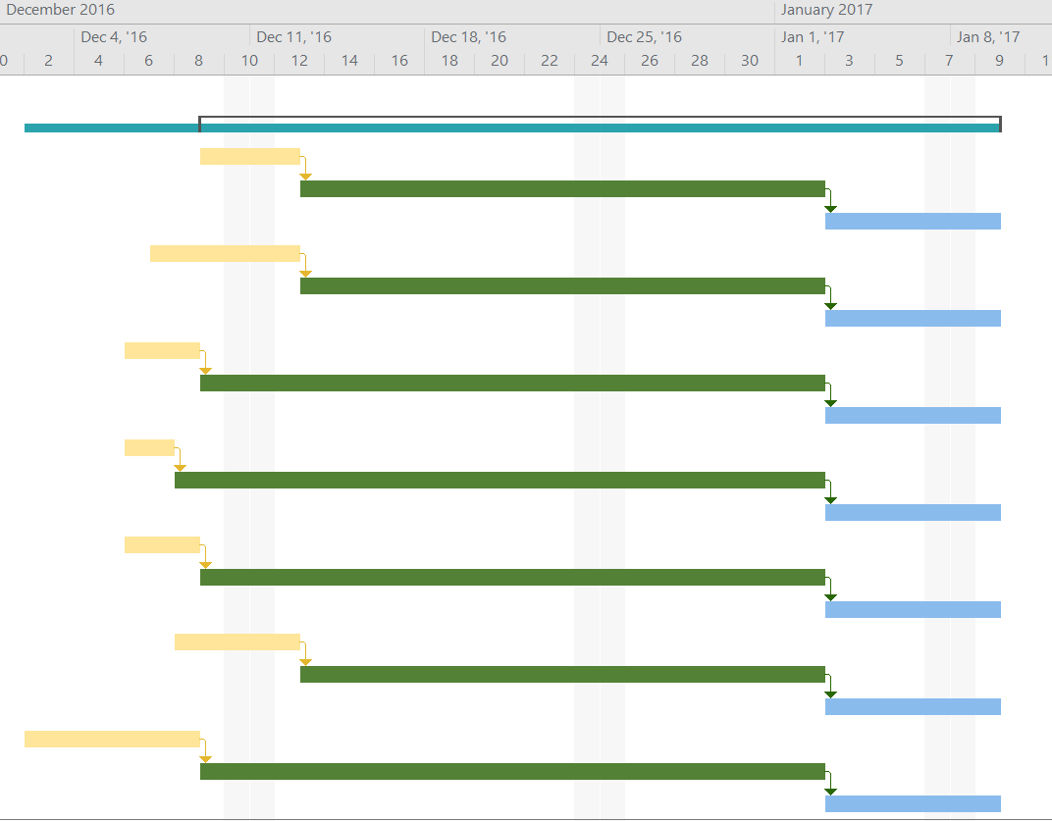
Feeder
Cap
Production
Ocean Transit
Intermodal
Lid
Production
Ocean Transit
Intermodal
Glass
Jug
Production
Ocean Transit
Intermodal
Sealing Ring
Production
Ocean Transit
Intermodal
Blade
Production
Ocean Transit
Intermodal
Container
Bottom
Production
Ocean Transit
Intermodal
Production
Motor
Ocean Transit
Intermodal

Slide 43
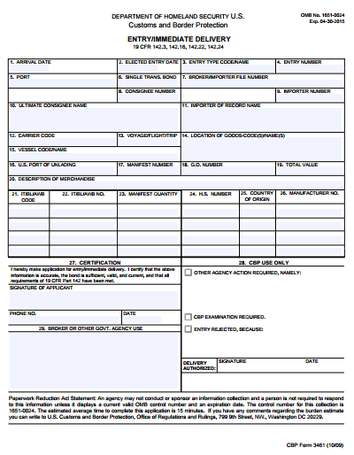
Customs Documentation
3461 (Customs Release)
Brief overview of payment which will speed up the release of goods from CBP
Once release you will have 10 days to file the 7501

Slide 44
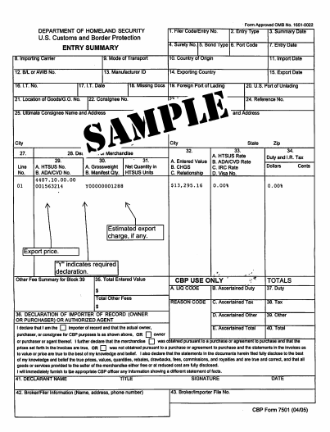
Customs Documentation
7501 (Customs Entry)
Calculation of duties due along with detailed information for CBP
Filed within 10 days of 3461 release

Slide 45
Customs Documentation
ABI (Automated Broker Interface)
Voluntary program to electronically file required import data with Customs
Simplifies the paperwork and payments that must be made to CBP

Slide 46
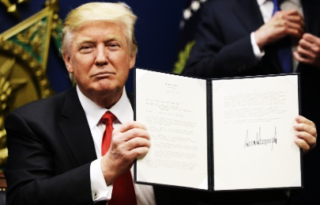
Additional Considerations
Domestic Changes
Executive Order regarding TPP
U.S. imposes 266% Duty on some Chinese Steel Imports
Trade War
Economist fight to defend Free Trade Agreements

Slide 47
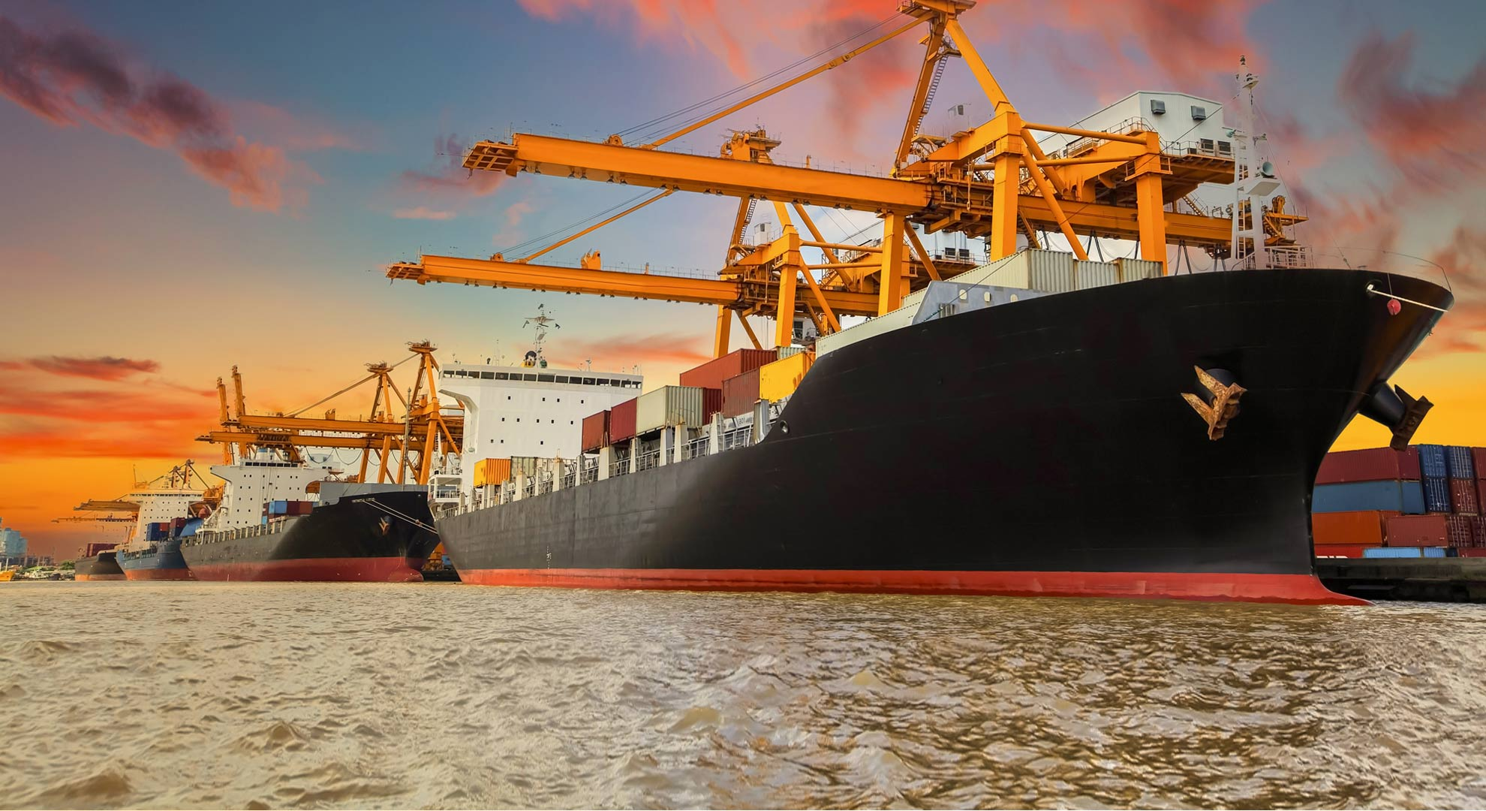
Plastic Alternatives
Optimal Solution
Japan-Ocean-LAX
Contingency Plans
Ocean-SAV
Air Regular-ATL
Air Express-ATL
Alternative Plan
China-Ocean-LAX
China-Ocean-LAX
Includes:
Feeder Cap
Cover
Bottom Container

Slide 48
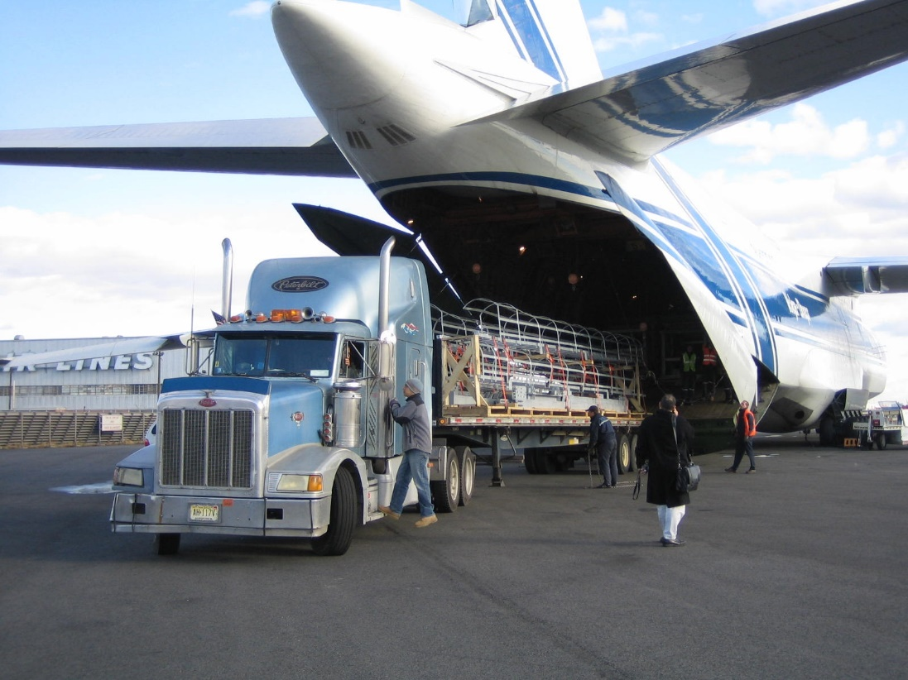
Glass Alternatives
Optimal Solution
China-Ocean-LAX
Contingency Plans
Ocean-SAV
Air Regular-ATL
Air Express-ATL
Alternative Plan
Chile-Ocean-SAV
Japan-Ocean-LAX
Includes:
Glass Container

Slide 49
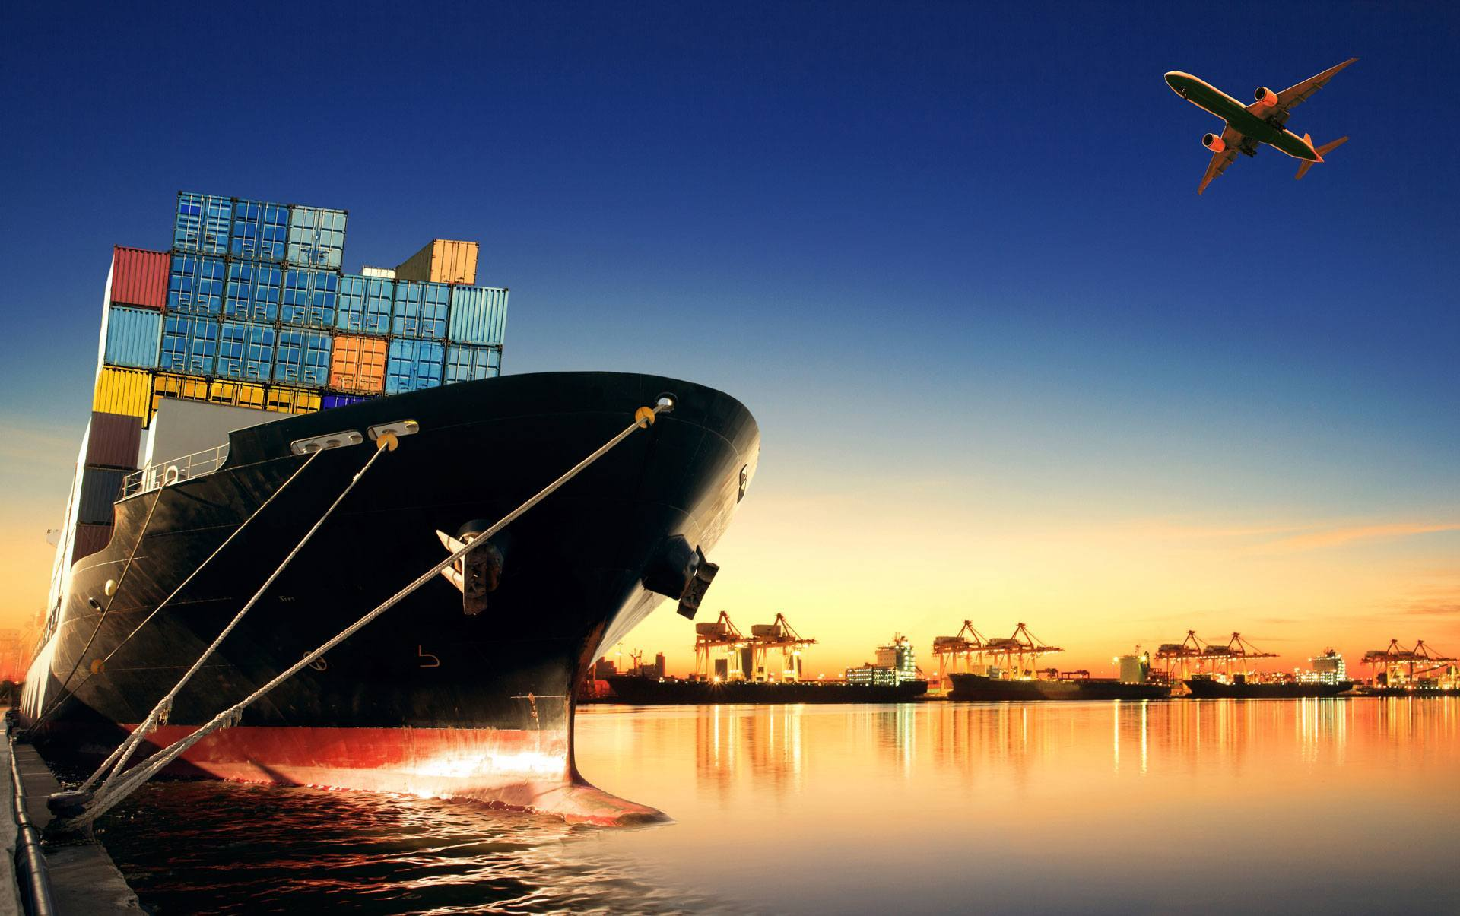
Stainless Steel Alternative
Optimal Solution
Taiwan-Ocean-LAX
Contingency Plans
Ocean-SAV
Air Regular-ATL
Air Express-ATL
Alternative Plans
South Korea-Ocean-LAX
Japan-Ocean-LAX
Includes:
Agitator Blade

Slide 50
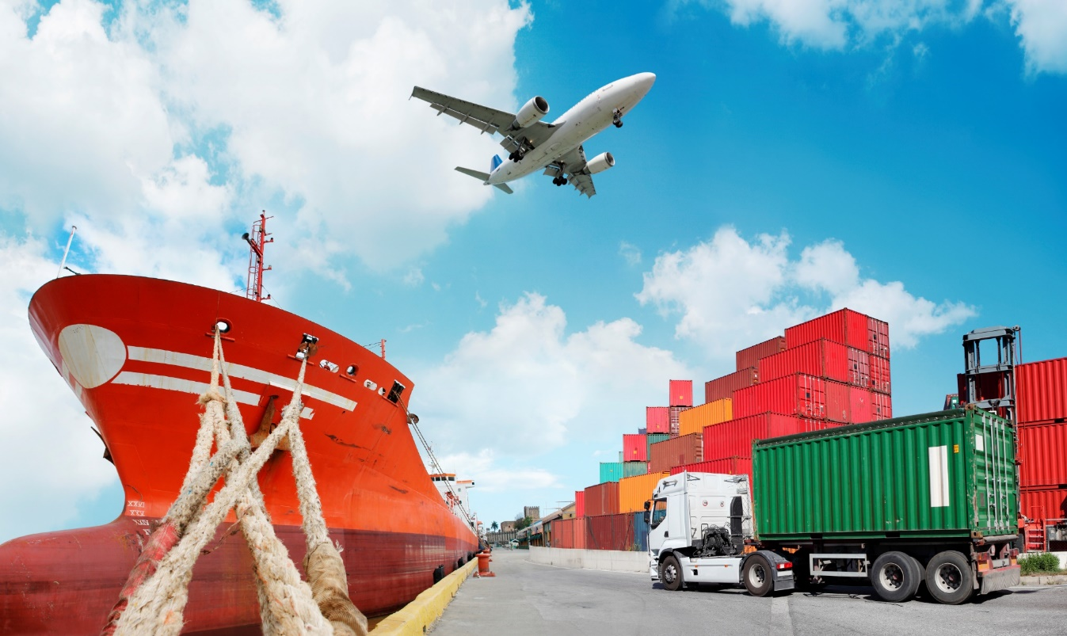
Rubber Alternatives
Optimal Solution
Malaysia-Ocean-LAX
Contingency Plans
Ocean-SAV
Air Regular-ATL
Air Express-ATL
Alternative Plans
China-Ocean-LAX
India-Ocean-LAX
Includes:
Sealing Ring

Slide 51
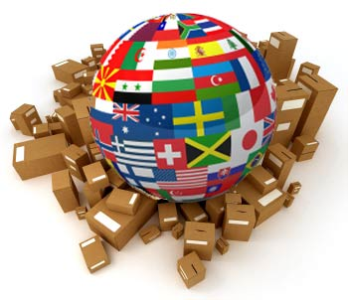
Motor Alternatives
Optimal Solution
China-Ocean-LAX
Contingency Plans
Ocean-SAV
Air Regular-ATL
Air Express-ATL
Alternative Plans
Vietnam-Ocean-SAV
South Korea-Ocean-LAX
Includes:
Motor

Slide 52
Introduction
Cost Analysis
Logistics and Time Performance
Solution
Conclusion

Slide 53
Decision Matrices
Country | Plastic (30%) | Economic Stability (10%) | Ease of Transportation (10%) | Cost-Effectiveness (50%) | Total
China | 5 | 3 | 4.16 | 5 | 4.716
Taiwan | 3 | 4 | 4.25 | 4 | 3.725
Japan | 3 | 4 | 4.425 | 2 | 2.7425
Country | Glass (30%) | Economic Stability (10%) | Ease of Transportation (10%) | Cost-Effectiveness (50%) | Total
China | 5 | 3 | 4.16 | 5 | 4.716
Chile | 1 | 4 | 3.595 | 5 | 3.5595
Brazil | 1 | 3 | 3.38 | 5 | 3.438
Country | Rubber (30%) | Economic Stability (10%) | Ease of Transportation (10%) | Cost-Effectiveness (50%) | Total
China | 5 | 3 | 4.16 | 5 | 4.716
Malaysia | 4 | 3 | 4.085 | 5 | 4.4085
India | 4 | 3 | 3.585 | 5 | 4.3585
Country | Stainless Steel (30%) | Economic Stability (10%) | Ease of Transportation (10%) | Cost-Effectiveness (50%) | Total
Taiwan | 3 | 4 | 4.25 | 4 | 3.725
South Korea | 4 | 4 | 4.225 | 3 | 3.5225
Japan | 5 | 4 | 4.425 | 2 | 3.3425
Country | Motor (30%) | Economic Stability (10%) | Ease of Transportation (10%) | Cost-Effectiveness (50%) | Total
China | 5 | 3 | 4.16 | 5 | 4.716
Vietnam | 3 | 2 | 3.375 | 4 | 3.4375
South Korea | 3 | 4 | 4.225 | 3 | 3.2225

Slide 54
Solution Comparison
 | Least Expensive | Optimal
Atlas Revenue | $ 840,770 | $ 969,472 15.3%
Annual Shipping Costs | $ 3.0 MM | $ 3.1 MM 4.1%
Total Costs of Ownership | $ 69.1 MM | $ 69.3 MM 0.2%
2017 Profit / % Change (2016) | $ 102.7 MM 19.44% | $ 102.6 MM 19.26%

Slide 55
Cost Comparison
4BC | 2016 | 2017 Cost-Effective Solution | 2017 Optimal Solution
Revenue | $ 130.6 MM | $ 171.8 MM | $ 171.8 MM
Total Duty | $ 0 | $ 43.1 MM | $ 43.1 MM
Import Fees | $ 0 | $ 27,450 | $ 27,450
Capital Cost | $ 43.8 MM | $ 23.1 MM | $ 23.1 MM
Freight/Logistics | $ 720,000 | $ 2.9 MM | $ 3.1 MM
Total Cost of Ownership | $ 44.6 MM | $ 69.1 MM | $ 69.3 MM
Profit | $ 86 MM | $ 102.7 MM | $102.6 MM

Slide 56
Cost Comparison
4BC | 2016 | 2017 Cost-Effective Solution | 2017 Optimal Solution
Revenue | $ 130.6 MM | $ 171.8 MM | $ 171.8 MM
Total Duty | $ 0 | $ 43.1 MM | $ 43.1 MM
Import Fees | $ 0 | $ 27,450 | $ 27,450
Capital Cost | $ 43.8 MM | $ 23.1 MM | $ 23.1 MM
Freight/Logistics | $ 720,000 | $ 2.9 MM | $ 3.1 MM
Total Cost of Ownership | $ 44.6 MM | $ 69.1 MM | $ 69.3 MM
Profit | $ 86 MM | $ 102.7 MM | $102.6 MM

Slide 57
Cost Comparison
4BC | 2016 | 2017 Cost-Effective Solution | 2017 Optimal Solution
Revenue | $ 130.6 MM | $ 171.8 MM | $ 171.8 MM
Total Duty | $ 0 | $ 43.1 MM | $ 43.1 MM
Import Fees | $ 0 | $ 27,450 | $ 27,450
Capital Cost | $ 43.8 MM | $ 23.1 MM | $ 23.1 MM
Freight/Logistics | $ 720,000 | $ 2.9 MM | $ 3.1 MM
Total Cost of Ownership | $ 44.6 MM | $ 69.1 MM | $ 69.3 MM
Profit | $ 86 MM | $ 102.7 MM | $102.6 MM

Slide 58
4BC Year-to-Year Comparison
 | 2016 | 2017 | Change %
Sourcing Method | US Domestic | International
Market Production Units | 3.6 MM | 4.74 MM | 31.61%
Revenue | $ 130.6 MM | $ 171.8 MM | 31.61%
Total Cost of Ownership (TCO) | $ 44.6 MM | $ 69.3 MM | 55.44%
Profit | $ 86 MM | $ 102.6 MM | 19.26%

Slide 59
Product | Country | Alternatives
Plastic | Japan | Taiwan China
Glass | China | Chile Japan
Rubber | Malaysia | China India
Stainless Steel | Taiwan | South Korea Japan
Motor | China | Vietnam South Korea

Slide 60
Application of Contingency Plans
Compromise of product integrity
Potential loss of customer trust

Slide 61
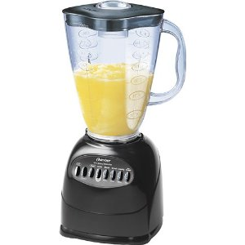
Immediate Response
Activate Emergency Response Team
Issue immediate product recall for safety purposes
Switch production to repair
Identify alternate manufacturer in Taiwan
Ship new blades via air freight
RECALL

Slide 62
Continued Response
Identify issue with blades
Rebuild customer confidence

Slide 63
August Timeline
1 | 2 | 3 | 4 | 5 | 6 | 7 | 8 | 9 | 10 | 11 | 12 | 13 | 14 | 15 | 16 | 17 | 18 | 19 | 20 | 21 | 22 | 23 | 24 | 25 | 26 | 27
 |  |  |  |  | Air Express |  |  | Air Regular |  |  |  |  |  | Air Regular |  |  |  |  |  | Air Regular
Costs |  |  |  |  | $ 19,598.90 |  |  | $ 8,749.54 |  |  |  |  |  | $ 8,749.54 |  |  |  |  |  | $ 8,749.54
Total Air Costs $ 45,847.52

Slide 64
Continued Response
Replacing 1.38 MM recalled units will take 102 days
920,000 units in the warehouse will take 68 days to repair
Cost of contingency plan: $45,847
Cost of outsourcing: $6.1 MM*
*Assuming 10% extra production cost

Slide 65
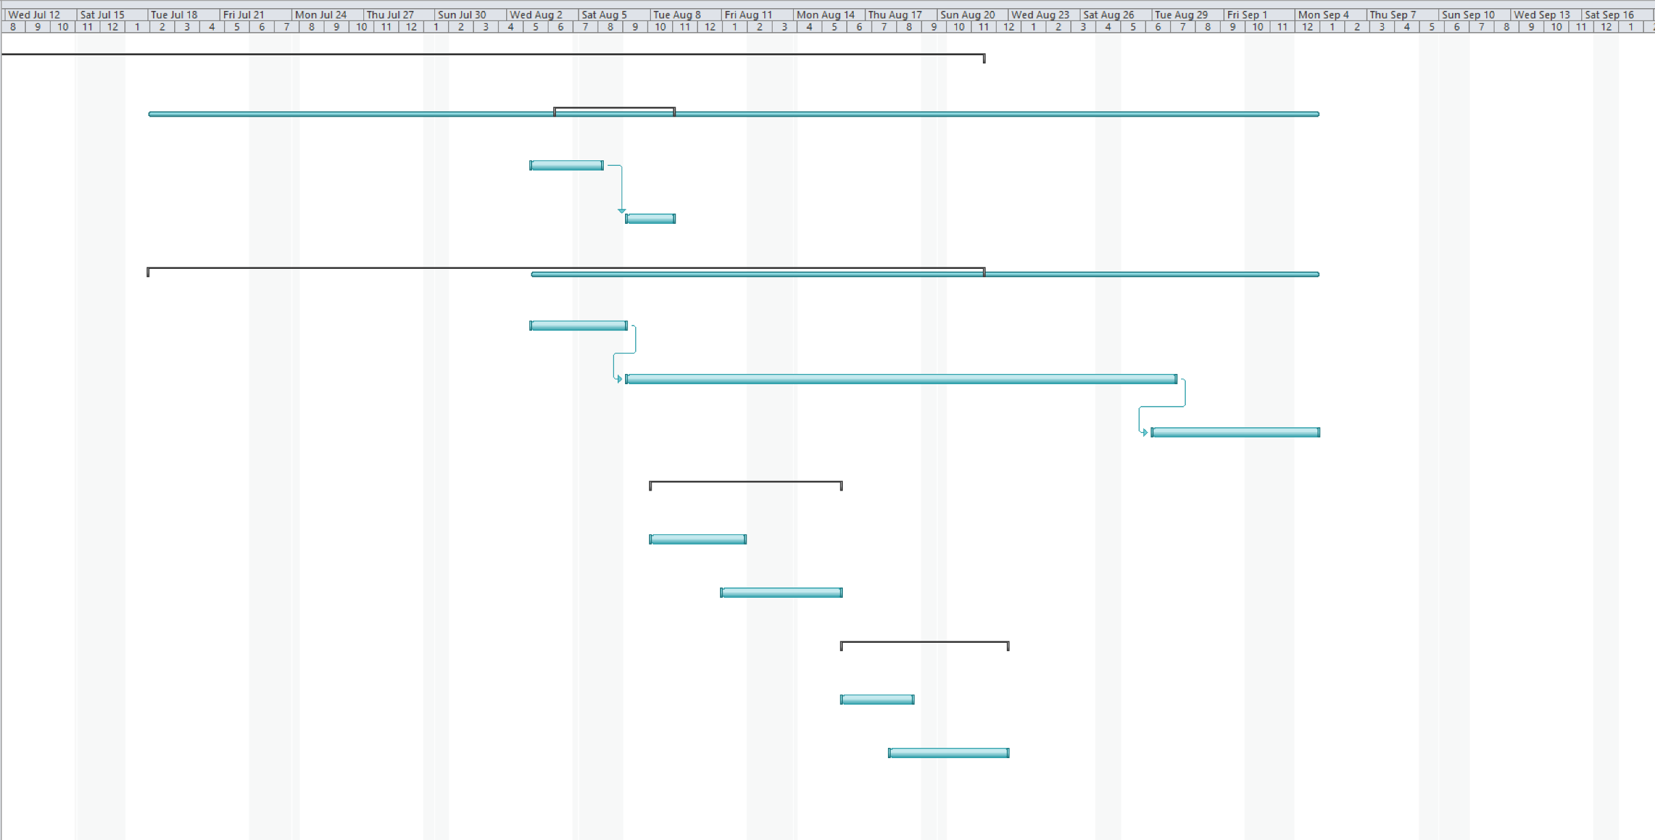

Slide 66
Introduction
Cost Analysis
Logistics and Time Performance
Solution
Conclusion

Slide 67
Product | Country | Alternatives
Plastic | Japan | Taiwan China
Glass | China | Chile Japan
Rubber | Malaysia | China India
Stainless Steel | Taiwan | South Korea Japan
Motor | China | Vietnam South Korea

Slide 68
Major Challenges:
Lowering overhead costs while maintaining product quality
Creating an efficient schedule which will meet the needs of the 4BC company
Assessing Global compatibility with American trade
Selecting four countries to support various components of the product
5. Respond quickly and efficiently to potential crises

Slide 69
Thank You!

Slide 70
Lead Time
Intermodal Transport*
Country | Los Angeles Port | Columbus Via Rail & Truck | Total Time
Argentina | N/A | N/A | N/A
Australia | 25 | 5 | 30
Brazil | N/A | N/A | N/A
Chile | N/A | N/A | N/A
China | 17 | 5 | 22
India | 20 | 5 | 25
Japan | 15 | 5 | 20
Malaysia | 18 | 5 | 23
Philippines | 18 | 5 | 23
S. Korea | 17 | 5 | 22
Taiwan | 17 | 5 | 22
Vietnam | 17 | 5 | 22

Slide 71
Plastic Sourcing Alternatives
Sourcing Country | Mode of transportation | Entry Port | Shipments / Year | Lead time (days) |  | Annual Cost
Optimal Solution
Japan | Ocean | LAX | 50 | 20 |  | $137,700
Contingency Plans |  |  |  |  | Change % |  | Change %
Japan | Ocean | SAV | 50 | 23 | 15% | $ 286,200 | 108%
Japan | Air Regular | ATL | 50 | 3 | -85% | $ 365,608 | 166%
Japan | Air Express | ATL | 50 | 2 | -90% | $ 946,823 | 588%
Alternative Plan
China | Ocean | LAX | 50 | 22 | 10% | $ 110,700 | -20%
Taiwan | Ocean | LAX | 50 | 22 | 10% | $ 148,500 | 8%
*Includes:
Feeder Cap
Cover
Bottom Container

Slide 72
Glass Sourcing Alternatives
Sourcing Country | Mode of transportation | Entry Port | Shipments / Year | Lead time (days) |  | Annual Cost
Optimal Solution
China | Ocean | LAX | 48 | 22 |  | $ 559,872
Contingency Plans |  |  |  |  | Change % |  | Change %
China | Ocean | SAV | 48 | 28 | 27% | $ 746,496 | 33%
China | Air Regular | ATL | 50 | 3 | -86% | $ 2,216,228 | 296%
China | Air Express | ATL | 50 | 2 | -91% | $ 9,033,383 | 1513%
Alternative Plan
Chile | Ocean | SAV | 48 | 14 | -36% | $ 746,496 | 33%
Japan | Ocean | LAX | 48 | 20 | -9% | $ 767,232 | 37%
*Includes:
Feeder Cap
Cover
Bottom Container

Slide 73
Stainless Steel Sourcing Alternatives
Sourcing Country | Mode of transportation | Entry Port | Shipments / Year | Lead time (days) |  | Annual Cost
Optimal Solution
Taiwan | Ocean | LAX | 30 | 22 |  | $ 56,700
Contingency Plans |  |  |  |  | Change % |  | Change %
Taiwan | Ocean | SAV | 30 | 27 | 23% | $ 90,720 | 60%
Taiwan | Air Regular | ATL | 50 | 3 | -86% | $ 218,739 | 286%
Taiwan | Air Express | ATL | 50 | 2 | -91% | $ 489,972 | 764%
Alternative Plan
S. Korea | Ocean | LAX | 30 | 22 | 0% | $ 54,270 | -4%
Japan | Ocean | LAX | 30 | 20 | -9% | $ 59,940 | 6%
*Includes:
Feeder Cap
Cover
Bottom Container

Slide 74
Rubber Sourcing Alternatives
Sourcing Country | Mode of transportation | Entry Port | Shipments / Year | Lead time (days) |  | Annual Cost
Optimal Solution
Malaysia | Ocean | LAX | 5 | 23 |  | $ 5,400
Contingency Plans |  |  |  |  | Change % |  | Change %
Malaysia | Ocean | SAV | 5 | 22 | -4% | $ 10,260 | 90%
Malaysia | Air Regular | ATL | 50 | 3 | -87% | $ 33,193 | 515%
Malaysia | Air Express | ATL | 50 | 2 | -91% | $ 47,120 | 773%
Alternative Plan
China | Ocean | LAX | 5 | 22 | -4% | $ 3,780 | -30%
India | Ocean | LAX | 5 | 25 | 9% | $ 5,400 | 0%
*Includes:
Feeder Cap
Cover
Bottom Container

Slide 75
Motor Sourcing Alternatives
Sourcing Country | Mode of transportation | Entry Port | Shipments / Year | Lead time (days) |  | Annual Cost
Optimal Solution
China | Ocean | LAX | 50 | 22 |  | $ 2,332,800
Contingency Plans |  |  |  |  | Change % |  | Change %
China | Ocean | SAV | 50 | 28 | 27% | $ 3,110,400 | 33%
China | Air Regular | ATL | 50 | 3 | -86% | $ 5,488,324 | 135%
China | Air Express | ATL | 50 | 2 | -91% | $ 22,485,332 | 864%
Alternative Plan
Vietnam | Ocean | SAV | 50 | 27 | 23% | $ 3,456,000 | 48%
S. Korea | Ocean | LAX | 50 | 22 | 0% | $ 2,894,400 | 24%
*Includes:
Feeder Cap
Cover
Bottom Container

Slide 76
Alternatives
 | Air Express | Regular Air
Countries | Days | Days
Argentina | 2 | 3
Australia | 2 | 3
Brazil | 2 | 3
Chile | 2 | 3
China | 2 | 3
India | 2 | 3
Japan | 2 | 3
Malaysia | 2 | 3
Philippines | 2 | 3
S. Korea | 2 | 3
Taiwan | 2 | 3
Vietnam | 2 | 3

