Slide 1
CIAT CIS101A
Session 4
Week 2 – Class #2
Sections 3.7 – 3.14
Learning Areas:
Memory
BIOS/UEFI
Expansion Cards
Video
Audio
Cooling

Slide 2
CIAT CIS101A
3.7 Memory:
Random Access Memory (RAM) can be classified as one of two types:

Slide 3
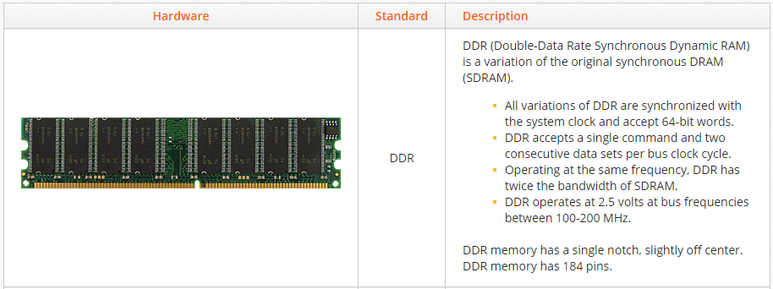
CIAT CIS101A
3.7 Memory: (continued)
All system memory used in personal computers is DRAM. Individual DRAM chips are packaged onto a board that contains circuitry for reading and writing to the memory. You should be aware of the following standards for DRAM:

Slide 4
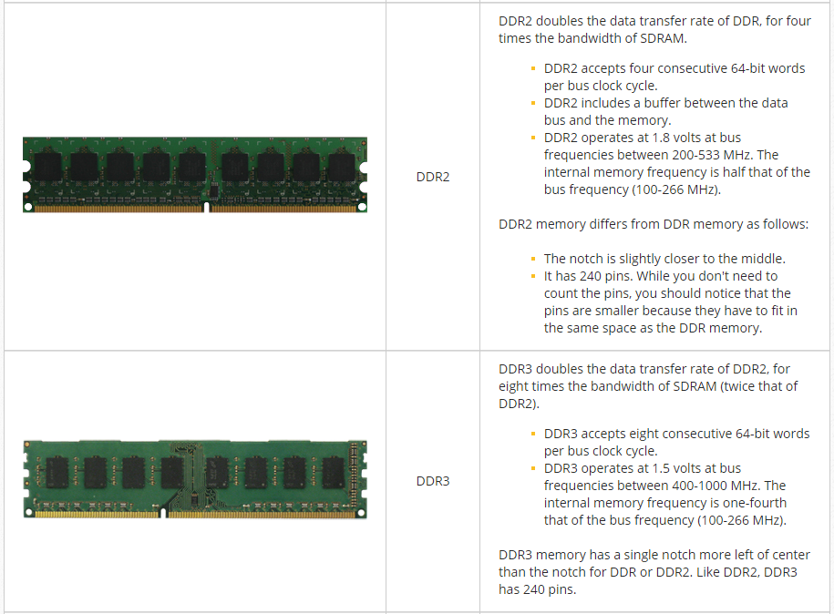
CIAT CIS101A
3.7 Memory: (continued)
All system memory used in personal computers is DRAM. Individual DRAM chips are packaged onto a board that contains circuitry for reading and writing to the memory. You should be aware of the following standards for DRAM:

Slide 5
CIAT CIS101A
3.7 Memory: (continued)
All system memory used in personal computers is DRAM. Individual DRAM chips are packaged onto a board that contains circuitry for reading and writing to the memory. You should be aware of the following standards for DRAM:
Hardware Image Standard Description
DDR3 DDR3 doubles the data transfer rate of DDR2, for eight times the bandwidth of SDRAM (twice that of DDR2).
1. DDR3 accepts eight consecutive 64-bit words per bus clock cycle.
2. DDR3 operates at 1.5 volts at bus frequencies between 400-1000 MHz. The internal memory frequency is one-fourth that of the bus frequency (100-266 MHz).
Note: DDR3 memory has a single notch more left of center than the notch for DDR or DDR2. Like DDR2, DDR3 has 240 pins.

Slide 6
CIAT CIS101A
3.7 Memory: (continued)
All system memory used in personal computers is DRAM. Individual DRAM chips are packaged onto a board that contains circuitry for reading and writing to the memory. You should be aware of the following standards for DRAM:
Hardware Image Standard Description
DDR4 DDR4 doubles the data transfer rate of DDR3 for ten times the bandwidth of SDRAM.
1. DDR4 accepts eight consecutive 64-bit words per bus clock cycle.
2. DDR4 operates at 1.2 volts at bus frequencies between 1066-2133 MHz. The internal memory frequency is about one-tenth that of the bus frequency (100-266 MHz).
3. DDR4 reduces the demand for power.
4. DDR4 is not compatible with earlier types of random access memory (RAM) because of the different signaling voltages, physical interface, and other factors.
5. DDR4 theoretically allows for DIMMs of up to 512 GB in capacity, compared to the DDR3's theoretical maximum of 128 GB per DIMM.
Note: DDR is no longer used in modern motherboards, although you might encounter DDR memory in older systems.

Slide 7
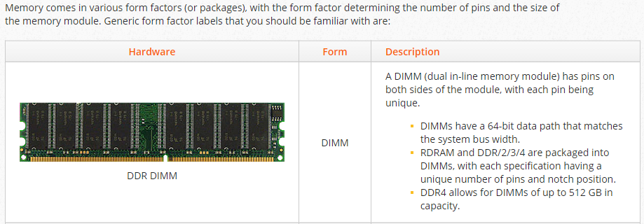
CIAT CIS101A

Slide 8
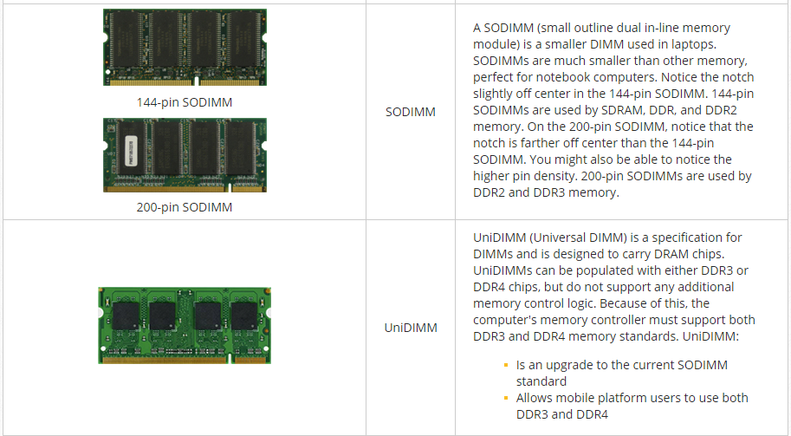
CIAT CIS101A

Slide 9
CIAT CIS101A
DDR
DDR2
DDR3
DDR4

Slide 10
CIAT CIS101A
3.7.5 Memory Speeds:
Memory is rated based on its guaranteed stable operating frequency and bandwidth (the rate at which data can be read or written). Memory ratings help you to differentiate between slower and faster RAM. The following rating systems are used:
For all DDR memory (DDR, DDR2, and DDR3), a new designation was introduced to identify that twice the data was being transferred with each bus clock cycle.
1. The number following the DDR-, DDR2-, and DDR3- prefixes is the data transfer rate (twice the bus frequency).
2. For example, DDR-400 matches a bus frequency of 200 MHz; DDR2-800 has a bus frequency of 400 MHz; and DDR3-1600 has a bus frequency of 800 MHz.
B. For DDR past 150 MHz (and for all DDR2 and DDR3 memory), the PC- designation was changed to identify the bandwidth instead of a number derived from the bus frequency.
1. The bandwidth is 16 times the bus frequency, or 8 times the DDR- designation.
2. For example, DDR-400 has a bandwidth of 3200 MBs (PC-3200); DDR2-800 has a bandwidth of 6400 MBs (PC-6400); and DDR3-1600 has a bandwidth of 12800 MBs (PC-12800).
3. For a brief time, the double-frequency designation used the PC- prefix for early DDR modules. For example, PC-200 used with DDR indicates a bus frequency of 100 MHz, not a bandwidth of 100 MBs (PC-200 is equivalent to DDR- 200 which is equivalent to PC-1600).
Note: When listing the frequency, the frequency value usually indicates the bus speed, not the internal frequency (DDR designation) used by the memory.

Slide 11
CIAT CIS101A
3.7.5 Memory Speeds:
The following table lists the various memory speed designations for the most common memory types:
Memory Type Bus Speed Designations
DDR 100 MHz PC-200 or PC-1600 or DDR-200
133 MHz PC-266 or PC-2100 or DDR-266
166 MHz PC-2700 or DDR-333
200 MHz PC-3200 or DDR-400
DDR2 200 MHz PC2-3200 or DDR2-400
266 MHz PC2-4200/4300 or DDR2-533
333 MHz PC2-5300/5400 or DDR2-667
400 MHz PC2-6400 or DDR2-800
533 MHz PC2-8500/8600 or DDR2-1066
DDR3 400 MHz PC3-6400 or DDR3-800
533 MHz PC3-8500 or DDR3-1066
667 MHz PC3-10600/10666 or DDR3-1333
800 MHz PC3-12800 or DDR3-1600
900 MHz PC3-14400 or DDR3-1800
1000 MHz PC3-16000 or DDR3-2000

Slide 12
CIAT CIS101A
3.7.5 Memory Speeds:
The following table lists the various memory speed designations for the most common memory types:
Memory Type Bus Speed Designations
DDR4 800 MHz PC4-12800 or DDR4-1600
933 MHz PC4-14900 or DDR4-1866
1066 MHz PC4-17000 or DDR4-2233
1200 MHz` PC4-19200 or DDR4-2400
1333 MHz PC4-21300 or DDR4-2666
1600 MHz PC4-25600 or DDR4-3200

Slide 13
CIAT CIS101A
3.7.5 Memory Speeds:
When comparing the speed of memory modules, be aware of the following:
A - The most useful way to compare most DDR modules will be to compare the amount of data that can be transferred per second (bandwidth), as indicated by the PC- designations. For example, PC-3200 will always indicate a "faster" memory module than one with a PC-2700 rating.
B - PC- numbers up to PC-266 identify the frequency (or double the frequency), not the bandwidth. For example, a PC-266 module has a greater bandwidth than a PC-1600 module (PC-266 = PC-2100).
C - Comparing DDR- numbers can also give you an idea of the relative bandwidth. For example, DDR-600 can transfer more data than a DDR2-400 module.
D - The bandwidth identifies a theoretical maximum that the memory can transfer in a given time period, and is directly related to the front size bus frequency.
E - If you can derive the bus frequency, you can also get a relative idea of the amount of data a module can handle.
o When comparing DDR modules, the frequency is relative to the bandwidth. For example, a DDR2 module operating on a 533 MHz bus is faster than a DDR3 module on a 400 MHz bus.
F - Other memory characteristics besides the frequency could affect the effective bandwidth or actual speed of the memory module.

Slide 14
CIAT CIS101A
3.7.5 Memory Speeds:
Another method for increasing memory bandwidth is by providing multiple channels within the memory controller.
A - Dual-channel systems use two memory controllers, while triple-channel systems use three memory controllers. Quadruple-channel (quad-channel) systems use four memory controllers. Each memory controller can communicate with one or more memory modules at the same time.
B - To operate in dual-channel mode, install memory in pairs; to operate in triple-channel mode, install memory in sets of three. To operate in quad-channel mode, install memory in sets of four
C - Dual-channel systems theoretically double the bandwidth. However, in practice, only a 5–15% increase is gained.
D - Dual-channel, triple-channel, and quad-channel support is mainly a function of the motherboard (e.g., the memory controller), not the memory itself. DDR, DDR2, DDR3, and DDR4 can all work in dual-channel systems (depending on the memory supported by the motherboard); both a triple-channel and a quad-channel system use DDR3 and DDR4.

Slide 15
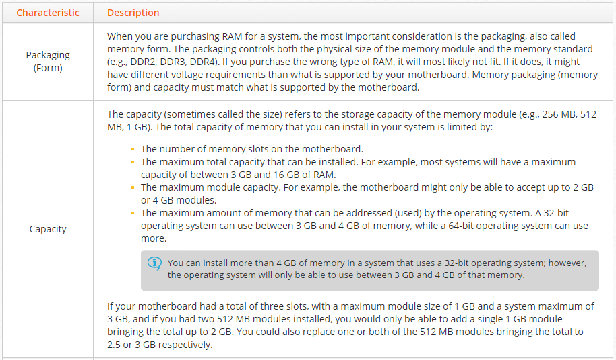
CIAT CIS101A
3.8 Memory Fact and Installation:
The best way to ensure that you get the correct RAM for your system is to consult the motherboard documentation. In addition, there are several websites on the Internet where you can look up your system or scan your system to find the correct memory type to install. When selecting RAM, consider the following factors:

Slide 16
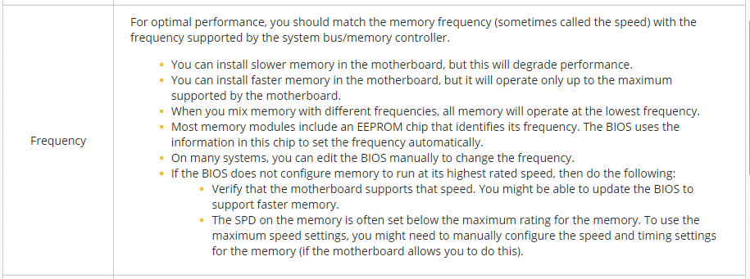
CIAT CIS101A
3.8 Memory Facts: (continued)
The best way to ensure that you get the correct RAM for your system is to consult the motherboard documentation. In addition, there are several websites on the Internet where you can look up your system or scan your system to find the correct memory type to install. When selecting RAM, consider the following factors:
Characteristics Description
Capacity (cont) You can install more than 4 GB of memory in a system that uses a 32-bit operating system; however, the operating system will only be able to use between 3 GB and 4 GB of that memory.
If your motherboard had a total of three slots, with a maximum module size of 1 GB and a system maximum of 3 GB, and if you had two 512 MB modules installed, you would only be able to add a single 1 GB module bringing the total up to 2 GB. You could also replace one or both of the 512 MB modules bringing the total to 2.5 or 3 GB respectively.

Slide 17
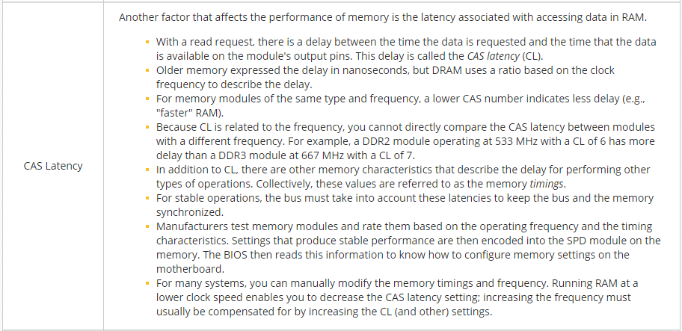
CIAT CIS101A
3.8 Memory Facts: (continued)
The best way to ensure that you get the correct RAM for your system is to consult the motherboard documentation. In addition, there are several websites on the Internet where you can look up your system or scan your system to find the correct memory type to install. When selecting RAM, consider the following factors:

Slide 18
CIAT CIS101A

Slide 19
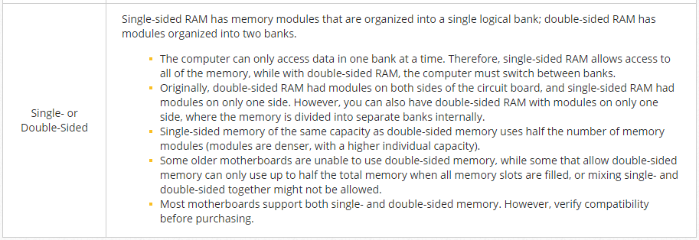
CIAT CIS101A
3.8 Memory Facts: (continued)

Slide 20
CIAT CIS101A
3.8.6 Memory Installation:
When installing memory, remember the following:
o Memory modules are very sensitive to ESD. Be sure to take proper steps to prevent ESD.
o You can add single memory modules to computers that use DDR (including 2, 3, and 4).
o Install memory in the correct slot. Although several memory slots might be open, some system boards require that you use specific slots. Check the system board documentation for more details.
1. For many systems, start with the first bank. The first memory bank is often closest to the processor.
2. On some systems you should fill each bank in order.
o Align the memory before inserting, and do not force the module in place. Most memory is keyed to prevent it from being installed backwards or in incompatible slots.
o Most RAM is held in place with small tabs on either end. To remove RAM from a motherboard, push the tabs down to rotate them back, then pull the RAM straight up.
o For a dual-, triple-, and quad-channel configuration:
1. Modules must be installed in matching sets (capacity and speed), preferably of the same manufacturer and model.
2. You can typically use different capacity modules between sets. For example, you can use two 1 GB modules as one set and two 512 MB modules in the second set.
3. Install modules in the slots specified in the motherboard documentation. Many motherboards color the slots, with slots used within a set having the same color.
If you install single memory modules, the system will continue to use the memory, but cannot use the memory in dual-channel mode.
o Following installation, power on the system and check for errors. Most BIOS programs include a memory count that displays the total amount of system memory. If it does not count the proper amount of memory, you may have installed the memory incorrectly or you may have a faulty memory module. Also, if the BIOS generates an error between 200 and 299, the error is a memory error.
o Most systems will configure memory settings (frequency, voltage, and timing including latency) automatically based on information in the EEPROM chip. If necessary, edit the BIOS to manually configure memory settings.

Slide 21
CIAT CIS101A
3.9.3 Memory Troubleshooting:
The following are common signs that a computer needs additional memory:
Memory problems usually are found in one of the following categories:
1. Either more memory is installed than the system supports or the CMOS settings are incorrect
2. Incompatible or broken modules
3. Improperly installed modules or dirty or defective sockets

Slide 22
CIAT CIS101A
3.9 Memory Troubleshooting:
You should be able to identify memory problems and meanings based on the following errors:

Slide 23
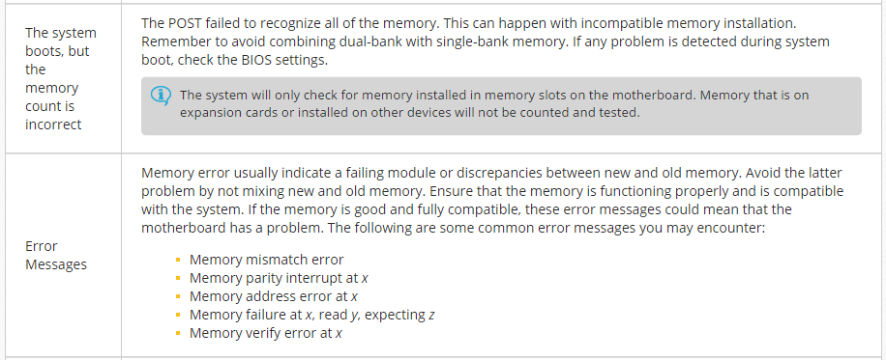
CIAT CIS101A
3.9 Memory Troubleshooting:
You should be able to identify memory problems and meanings based on the following errors:

Slide 24
CIAT CIS101A
3.9 Memory Troubleshooting:
You should be able to identify memory problems and meanings based on the following errors:
You should be familiar with this list of critical times when memory problems manifest themselves:
o First boot of a new computer. Memory is not properly seated, missing, or the motherboard is defective.
o After a memory upgrade. Ensure that the memory is compatible and was installed and configured properly.
o After software installation. New software requires more memory and can cause problems.
o After hardware installation or removal. Incompletely or improperly installed hardware can cause errors that appear to be memory related.

Slide 25
CIAT CIS101A
3.10 BIOS / UEFI
You should know the following facts about the UEFI, BIOS, EEPROM, and CMOS:
Component Description
Unified Extensible The UEFI was designed to replace the BIOS. Important things about UEFI are:
Firmware Interface)
(UEFI) o The UEFI is firmware.
o The UEFI program controls the startup process and loads the operating system into memory.
o The UEFI design improves the software interoperability and the address limitations of BIOS.
o The UEFI provides better security to protect against bootkit (malware attacks on the boot process) attacks.
o The UEFI provides faster startup times.
o The UEFI supports drives larger than 2.2 terabytes.
o The UEFI supports 64-bit firmware device drivers.
o The UEFI is compatible with both BIOS and UEFI hardware.
o You should check for UEFI updates from manufacturers frequently. Updating the UEFI (called flashing the UEFI) makes new features available.

Slide 26
CIAT CIS101A
3.10 BIOS / UEFI
You should know the following facts about the UEFI, BIOS, EEPROM, and CMOS:
Component Description
Basic Input Output The BIOS is a legacy program stored in a read-only memory (ROM) chip that the CPU System (BIOS) automatically loads and executes when it receives power. Important things to know about the BIOS are:
o The BIOS program controls the startup process and loads the operating system into memory.
o The BIOS is firmware.
o You should check for BIOS updates from manufacturers frequently. Updating the BIOS (called flashingthe BIOS) makes new features available, such as allowing the BIOS to recognize newer hardware devices.
o Most BIOS chips vary from 265 KB to 1 MB in size.
o Video cards include a BIOS chip on the device. These devices have their own ROM chip called an optionROM (OpROM).

Slide 27
CIAT CIS101A
3.10 BIOS / UEFI
You should know the following facts about the UEFI, BIOS, EEPROM, and CMOS:
Component Description
Electrically Erasable The EEPROM is a RAM chip that replaced the CMOS chip. Important things about EEPROM Programmable Read are:
Only Memory (EEPROM)
o EEPROM is a type of non-volatile memory used in computers and other electronic devices to store relatively small amounts of data.
o EEPROM allows individual bytes to be erased and reprogrammed.
o EEPROM replaced EPROM chips and are used for computers BIOSes that were built after 1994.
o EEPROM chips allow you to update the BIOS/UEFI in your computer without having to open the computer and remove any chips.

Slide 28
CIAT CIS101A
3.10 BIOS / UEFI
You should know the following facts about the UEFI, BIOS, EEPROM, and CMOS:
Component Description
Complementary CMOS is legacy computer chip technology that has become a general term used for the Metal-Oxide program that stores important system information related to the starting of a computer. It Semiconductor is often used synonymously with BIOS. Data held in CMOS includes the hard disk type and (CMOS) configuration, the order of boot devices, and other configurable settings related to the system hardware. The following are important things to know about CMOS:
o Changing the data stored in CMOS required the use of a CMOS editor program that was part of the BIOS.
o CMOS used to refer to the real-time clock and the CMOS chip that stored system information. Both were powered by a CMOS battery. Now, the EEPROM chip stores the system information that used to be stored on the CMOS chip. EEPROM requires no power to maintain data storage.
o The CMOS battery is still used to keep the real-time system clock running when the computer is powered off. It can be a low-voltage dry cell, lithium mounted on the motherboard, or even AA batteries in a housing clipped on a wall inside of the case. The electric current is about 1 millionth of an amp and can provide effective power for years.

Slide 29
CIAT CIS101A
3.10 BIOS / UEFI (Cont.)
During the computer's startup procedure, you can press one or more keys to open a CMOS editor so you can change the data stored in CMOS memory. This CMOS setup program is part of the BIOS program. The key or keys you press to open the CMOS editor depend on the BIOS manufacturer. The easiest way to find out which key to press is to read the screen as it boots or to consult the motherboard documentation. The most common keys are Delete, Insert, F1, and F2.
Common reasons for editing the CMOS settings are:
o To change the boot device order.
o To enable or disable motherboard devices.
o To add a password to the setup program to prevent unauthorized access.
If you set a BIOS/UEFI password and then forget it, you will be unable to edit CMOS settings.
To remove the password for most motherboards, move or remove a jumper, then replace it after a specific period of time.
o To configure processor or memory settings (e.g., when you need to set operating speeds or when you want to overclock hardware settings).
o (In rare cases) To manually configure device properties for legacy devices.

Slide 30
CIAT CIS101A
3.10 BIOS / UEFI
One of the main jobs of the BIOS/UEFI is to help start the system. The following process is used when you turn a computer on:
1. Power is supplied to the processor. The processor is hard-coded to look at a special memory address for the code to execute.
2. This memory address contains a pointer or jump program which instructs the processor where to find the BIOS program.
3. The processor loads the BIOS program. The first BIOS process to run is the power-on self-test (POST) process. POST does the following:
a. Verifies the integrity of the BIOS/UEFI code.
b. Looks for the BIOS on the video card and loads it. This powers the video card and results in information being shown on the monitor.
c. Looks for BIOS programs on other devices, such as hard disk controllers and loads those.
d. Tests system devices, such as verifying the amount of memory on the system.
4. After POST tests complete, the BIOS identifies other system devices. It uses CMOS settings and information supplied by the devices themselves to identify and configure hardware devices. Plug and Play devices are allocated system resources.
5. Then the BIOS searches for a boot drive using the boot order specified in the CMOS.
6. On the boot device, the BIOS/UEFI searches for the master bootloader, then loads the bootloader program. At this point, the BIOS/UEFI stops controlling the system and passes control to the bootloader program.
7. The bootloader program is configured to locate and load the operating system.
8. As the operating system loads, additional steps are taken to load all additional programs and configure devices for use by the operating system.

Slide 31
CIAT CIS101A
3.10 BIOS / UEFI
One of the main jobs of the BIOS/UEFI is to help start the system. The following process is used when you turn a computer on:
From time to time, your PC's manufacturer may release updates to your BIOS firmware.
To update the BIOS, you will need to download the update along with a utility provided by your PC manufacturer that is used to rewrite data stored in the BIOS chip.
This process is called flashing the BIOS.
The actual steps you should follow to flash the BIOS will vary by manufacturer.
Note: You should connect your PC to a UPS before flashing the BIOS. If a power outage occurs during the flash process, it will irrecoverably damage the BIOS and prevent your system from booting.

Slide 32
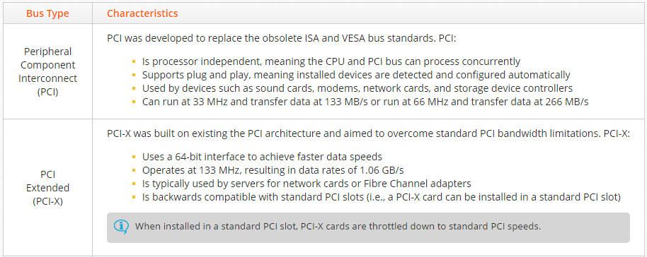
CIAT CIS101A
3.11 Expansion Cards:
3.11.2 Expansion Bus Types:
Expansion cards are used to expand a computer's functionality or increase its performance. Expansion cards are installed into the expansion slot on a motherboard. Expansion cards and slots use different expansion bus standards that define communication specifications as well as physical characteristics. The following table describes the characteristics of the most common expansion bus types:

Slide 33
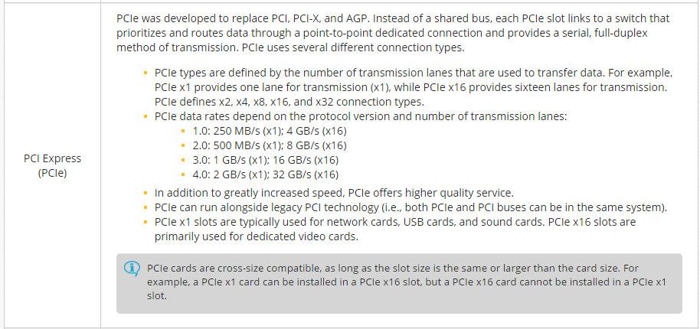
CIAT CIS101A
3.11 Expansion Cards:
3.11.2 Expansion Bus Types:
PCIe cards are cross-size compatible, as long as the slot size is the same or larger than the card size. For example, a PCIe x1 card can be installed in a PCIe x16 slot, but a PCIe x16 card cannot be installed in a PCIe x1 slot.

Slide 34
CIAT CIS101A
3.11 Expansion Cards:
3.11.2 Expansion Bus Types:

Slide 35
CIAT CIS101A
3.12 Video Cards:
Video cards process graphical information for output to an external display. Video cards can be implemented as a dedicated expansion board or integrated with other components (e.g., the motherboard or CPU).
o Dedicated video cards:
a. Are installed in an expansion slot on the motherboard
b. Have a GPU and a dedicated, high-speed video memory bank
c. Are more powerful than integrated video cards, but are also more expensive
o Integrated graphics:
a. Integrate the GPU with another hardware component (e.g., a motherboard or CPU)
b. Share system memory for graphic processing
c. Are much cheaper than dedicated video cards, but are also less powerful
Note: Intel CPU chips tend to have integrated graphics, whereas AMD usually requires a dedicated video card.

Slide 36
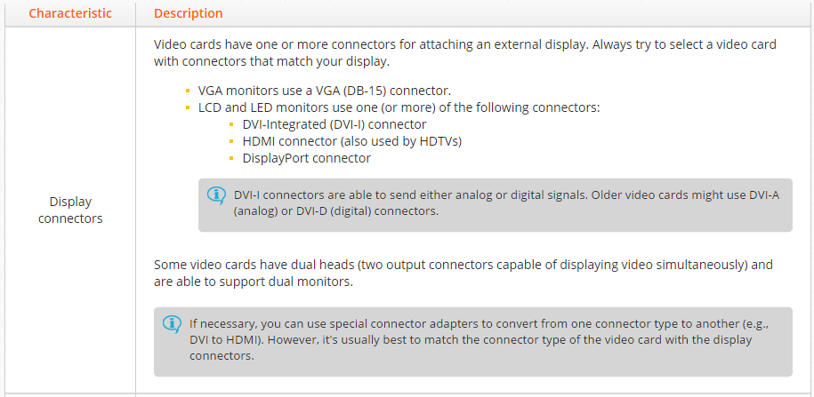
CIAT CIS101A
3.12 Video Cards:
When selecting a video card, keep in mind the following characteristics:

Slide 37
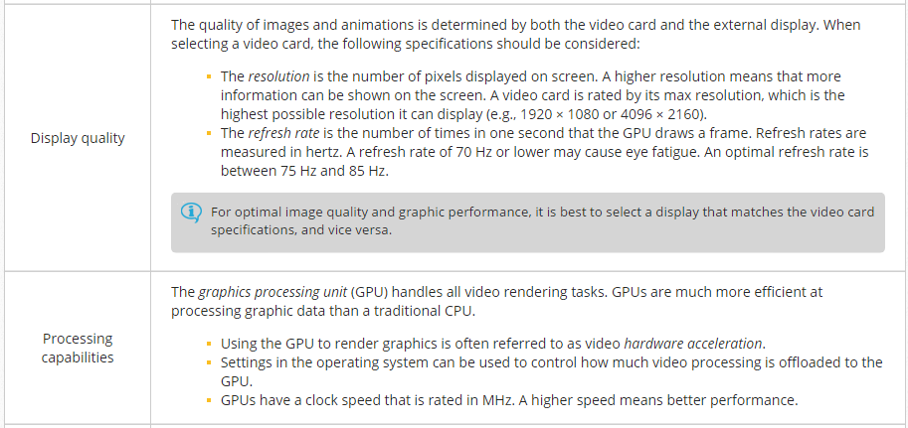
CIAT CIS101A
3.12 Video Cards:

Slide 38
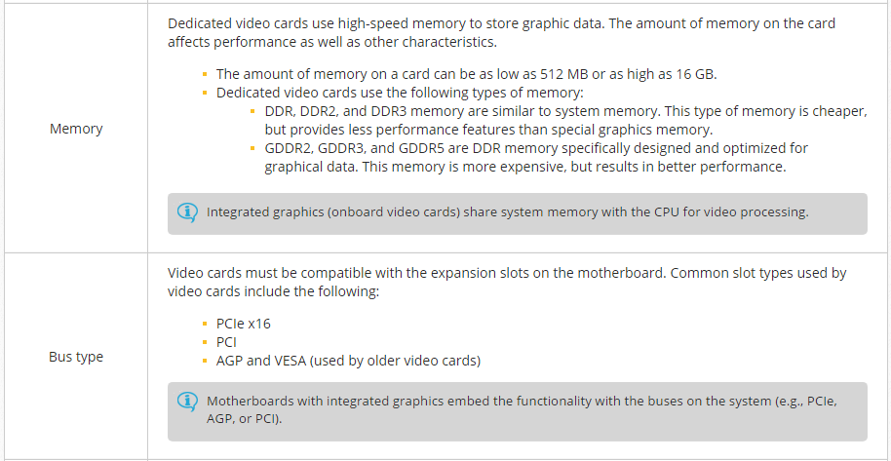
CIAT CIS101A
3.12 Video Cards:

Slide 39
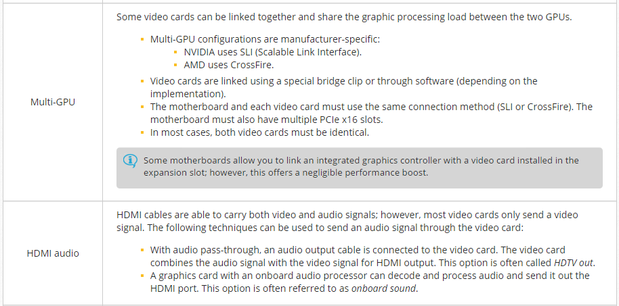
CIAT CIS101A
3.12 Video Cards:

Slide 40
CIAT CIS101A
3.12 Video Cards:

Slide 41
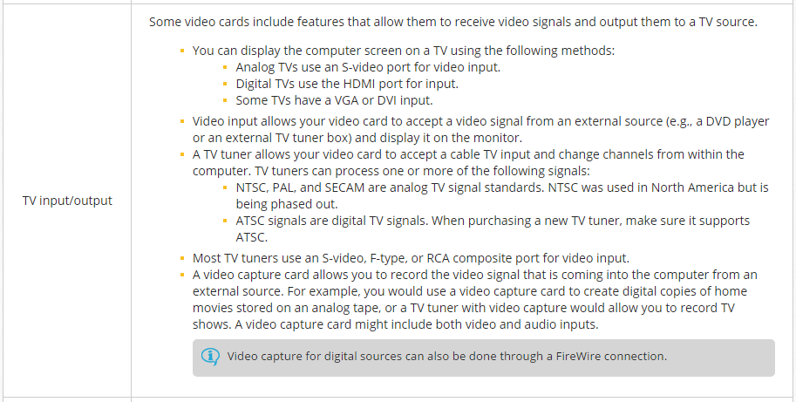
3.12 Video Cards:
CIAT CIS101A

Slide 42
CIAT CIS101A
3.12 Video Cards:

Slide 43
CIAT CIS101A
3.12.4 Video Card Installation:
Use the following process to install a dedicated video card:
o Video cards must be compatible with the expansion slots on the motherboard.
o If the motherboard has integrated graphics, disable it in the CMOS configuration when installing a dedicated video card.
o Install the video card in the first open expansion slot.
o If using a multi-GPU configuration (SLI or CrossFire):
1. Install the secondary video card in the next open expansion slot.
2. Link the two video cards together using the bridge clip.
o Connect any additional power connectors to the video card(s) (e.g., 6-pin or 8-pin auxilary power).
Note: Some motherboards have an additional power connector near the expansion slots that are used with multi-GPU configurations.
o Connect the external display to the video card using the appropriate cable. When using a multi-GPU configuration, connect the monitor to the primary (first) video card.
o After installing the video card and making all necessary connections, turn on the computer.
o In the operating system, install the video card drivers.
o If using a multi-GPU configuration, install all necessary configuration software.

Slide 44
CIAT CIS101A
3.13 Audio Cards:
A sound card is an expansion card (or an integrated component on the motherboard) that manages sound input and output. Because computers use digital data, sound cards must convert analog sound into digital data, and digital data into analog sound. The following components are used to do this:
o The Analog-to-Digital Converter (ADC) converts analog sound into digital data.
o The Digital-to-Analog Converter (DAC) converts digital data into analog sound (in preparation to be played on speakers).
o The Digital Signal Processor (DSP) is an onboard processor that handles analog and digital conversion.

Slide 45
CIAT CIS101A
3.13 Audio Cards:
When purchasing a sound card, be aware of the following considerations:
Component Description
Bus support Sound cards can be installed via an expansion slot (e.g., PCI or PCIe x1) on the motherboard. When selecting a sound card, make sure the bus type is compatible with your motherboard.
Note: Most new motherboards have an onboard sound card.
Channels Audio can be split into multiple channels, which increases the sound quality and makes it more realistic. Some standard channel configurations are as follows:
o 2 channel audio is stereo. Examples of 2 channel audio include standard TV and radio.
o 4 channel audio is quadraphonic audio and was an early attempt at surround sound.
o 5.1 channel audio, also known as surround sound, has 6 audio channels: five speakers and one low-frequency effects subwoofer (LFE) channel.
o 7.1 channel has 8 audio channels: 7 speakers and one LFE subwoofer channel. This is the first technology providing error correction

Slide 46
CIAT CIS101A
3.13 Audio Cards:
When purchasing a sound card, be aware of the following considerations:
Component Description
Sampling Rate The sampling rate is the number of analog signal samples taken in over a period of time. Sample rates are expressed in cycles per second, called hertz (1,000 hertz (Hz) = 1 kilohertz (kHz)). A high sampling rate gives a more accurate representation of the sound. Examples of different sampling rates include:
o 8 kHz (telephone) This is adequate for conversation because the human voice's full range is about 4 kHz.
o 22 kHz (radio quality)
o 44 kHz (CD quality) This sample rate can accurately reproduce the audio frequencies up to 20,500 hertz, covering the full range of human hearing.
o 48 kHz (Digital TV, DVD movies)
o 96 kHz (DVD audio)
o 192 kHz, used by:
a. LPCM (Linear Pulse Code Modulation), a DVD-music production format
b. BD-ROM (Blu-ray Disc-ROM)

Slide 47
CIAT CIS101A
3.13 Audio Cards:
When purchasing a sound card, be aware of the following considerations:
Component Description
Sampling Rate The sampling rate is the number of analog signal samples taken in over a period of time. Sample rates are expressed in cycles per second, called hertz (1,000 hertz (Hz) = 1 kilohertz (kHz)). A high sampling rate gives a more accurate representation of the sound. Examples of different sampling rates include:
Higher sample rates require more bits of data per sample:
o 8-bit sound cards use a sampling size of 256.
o 16-bit sound cards use a sampling size of 65,536.
o 20-bit sound cards use a sampling size of 1,048,576.
o 24-bit sound cards use a sampling size of 16,777,216.
o 32-bit sound cards use a sampling size of 4,294,967,296.
Note: The bit portion of a sound card's sampling size does not correspond with the bus size.

Slide 48
CIAT CIS101A
3.13 Audio Cards:
When purchasing a sound card, be aware of the following considerations:
Component Description
Feature Support Additional features on sound cards provide higher quality sound or additional functionality
o DirectSound 3D allows a computer to play audio in surround sound.
o EAX is a high-definition sound technology originally developed for video games. This technology provides such realistic nuances that audio can actually cue gamers.
o THX is a sound quality standard, originally created for film, now available on sound cards. This is a sound card feature that allows computers to present theater quality sound output.
o Dolby Digital is a technology that broadcasts sound at a frequency the human ear can hear and diminishes collateral sound. This is a sound card feature that allows computers to present higher quality sound output.
o DTS (Digital Theater Systems) Digital requires an optical reader to decode physical data and send it to a computer for processing. This is a sound card feature that allows computers to present theater quality sound output.
o SDDS (Sony Dynamic Digital Sound) was originally developed for theater sound. SDDS decoders provide error correction.
o MIDI (Musical Instrument Digital Interface) is a protocol for recording and playing audio created on digital synthesizers. This feature allows the computer to become an integrated component to a musical instrument.

Slide 49
CIAT CIS101A
3.13 Audio Cards:
When purchasing a sound card, be aware of the following considerations:
Component Description
Analog Input Analog output jacks allow you to play sound on your computer through external devices:
And Output
o The speaker out connector sends signal to external speakers. This signal is amplified and the computer controls the sound level that is sent.
o The line out connectors send audio to other sound devices. This signal is unamplified.
Note: Analog input jacks allow you to record audio through the sound card.
o The line-level (line-in) connector receives signals from CD players and musical instruments coming from the line out port of the other device.
o The mic-level (mic in) connector receives signals from a microphone.

Slide 50
CIAT CIS101A
3.13 Audio Cards:
When purchasing a sound card, be aware of the following considerations:
Component Description
Digital Audio Most audio devices, such as stereo consoles, TVs, and speakers require analog audio. Newer devices, such as some CD players, DVD players, and HDTVs, are capable of processing digital audio signals. Digital audio support in a sound card:
o Allows you to play digital audio directly from an internal CD player
o Allows for compression of audio data to support Dolby Digital or DTS surround sound
o Can use fiber optic cables to eliminate electrical interference
Sound cards support digital audio in the following ways:
o An internal connector on the sound card connects to a digital audio output connector on a CD/DVD drive. Through this connection, you can play CDs directly through the sound card.
o An internal connector on the sound card sends HD audio, such as from a DVD or Blu-ray disc, to an audio pass-through on a video card. This allows the HD audio signal to be combined with the video signal through an HDMI connector.
o Sony/Philips Digital Interface Format (S/PDIF) is a consumer standard for digital audio. These are either optical or coaxial external connectors and allow input and output between other digital audio-capable devices.

Slide 51
CIAT CIS101A
3.13 Audio Cards:
When purchasing a sound card, be aware of the following considerations:
Component Description
Additional In addition to audio input and output ports, some sound cards also include the following ports:
Ports
o MIDI port to interface with MIDI sound devices
o FireWire
o Some high-end audio cards include HDMI video processors and video output, combining the features of an audio card with a video card. The sound card might have 1 or 2 HDMI ports (for input and/or output).
Sound card drivers and other software save digital audio into several different file types. Common file types include:
o WAV (Windows standard), a widely used and compatible file type
o AIFF (Audio Interchange File Format), the Macintosh equivalent of the WAV
o AU (UNIX standard), supported by most web browsers
o MP3 (MPEG-2 Layer III), a highly effective audio compression standard
o AAC (Advanced Audio Coding), also known as MPEG-2, a compression expected to replace MP3
o WMA (Windows Media Audio), a highly compatible standard developed to compete with Real Audio
o MIDI, not a true audio file, but contains data to reproduce sounds through electronic synthesis

Slide 52
CIAT CIS101A
3.13.5 Sound Card Installation Facts
Be aware of the following when configuring system sound:
Many motherboards include an onboard sound card. Use the connectors on the motherboard's I/O plate to connect components to the onboard sound card.
Sound cards are typically added to a computer using PCI or PCIe slots. Some sound cards also connect through USB.
External sound cards for laptops can use an ExpressCard slot.
When installing a sound card using an expansion slot, make sure to disable the onboard sound card in the CMOS configuration.
After installing the sound card, install the drivers and other software that came with the sound card.
In Control Panel, use the Sound applet to:
Configure settings for sound card connections such as speakers, audio input, and microphone.
Identify the sources that you want to record.
Configure sounds to play with system events or to play a sound to test your configuration.
An audio codec is a specific method of formatting sound files. Common codecs include WAV, WMV, AIFF, and MP3. To play sounds saved using these formats, your computer must have the corresponding codec installed.
You can see the list of installed codecs in System Information.
By default, Windows comes with common codecs installed. Other codecs might be installed as you add other software.

Slide 53
CIAT CIS101A
3.13.5 Sound Card Installation Facts
Be aware of the following when configuring system sound:
To troubleshoot sound problems, try the following:
Make sure that the speakers are connected to the sound card and that the speakers have power.
Check the volume setting on the speaker and the back of the sound card (if present).
Check software sound settings. Verify that the sound is not muted and check mixer settings.
If some files play but others do not, make sure you have the right codecs installed for playing that file type.
If you are working with a built-in audio interface, verify that it is correctly configured in the BIOS. If you have installed an add-in card, make sure the built-in audio is disabled.
If no sound plays, make sure the card is seated, check for resource conflicts, and update the drivers if necessary.
Ensure that the sound card is not experiencing electromagnetic interference (EMI) from the disk drive or power supply. To remedy this problem, move the affected card to an expansion slot located away from the source of EMI.

Slide 54
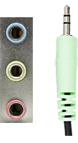
CIAT CIS101A
3.13.6 Sound Card Connectors:
Sound cards provide input and output (I/O) ports for connecting external, audio-related devices to the computer. The most commonly found ports are described in the following table:
Port Description
Mini TRS Mini TRS ports on the sound card accept 3.5mm plugs for analog audio I/O. The number of ports on the sound card depends on the type of I/O support (e.g., the number of speaker channels, microphone, or line in support).
Ports are often labeled with text or graphics to identify its function. Standardized color coding might also be helpful in determining the proper connection.
Pink = Mic in (mic-level)
Light blue = Line-in (line-level)
Lime green = Line out (front speakers or headphones)
Black = Line out (rear speakers)
Orange = Line out (center and subwoofer)
Note: Although these colors are standard, be sure to consult the sound card documentation for specific details.

Slide 55
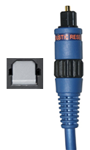
CIAT CIS101A
3.13.6 Sound Card Connectors:
Sound cards provide input and output (I/O) ports for connecting external, audio-related devices to the computer. The most commonly found ports are described in the following table:
Port Description
TOSLINK
A TOSLINK (or optical audio cable) connector is used with digital optical I/O for S/PDIF audio.

Slide 56
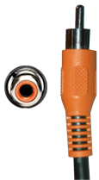
CIAT CIS101A
3.13.6 Sound Card Connectors:
Sound cards provide input and output (I/O) ports for connecting external, audio-related devices to the computer. The most commonly found ports are described in the following table:
Port Description
RCA
An RCA connector on a sound card is used for coaxial digital I/O for S/PDIF audio
Note: While RCA connectors can be used for analog audio, RCA connectors on a sound card are normally used for S/PDIF digital audio.

Slide 57
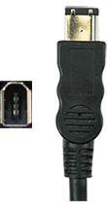
CIAT CIS101A
3.13.6 Sound Card Connectors:
Sound cards provide input and output (I/O) ports for connecting external, audio-related devices to the computer. The most commonly found ports are described in the following table:
Port Description
IEEE 1394
Some sound cards include one or more IEEE 1394 (FireWire) ports. These ports function as normal IEEE 1394 ports. (runs at 400 or 800 M/bps)
Note: Apple calls this technology Firewire, whereas Sony calls it iLink.

Slide 58
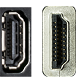
CIAT CIS101A
3.13.6 Sound Card Connectors:
Sound cards provide input and output (I/O) ports for connecting external, audio-related devices to the computer. The most commonly found ports are described in the following table:
Port Description
HDMI
A sound card with an HDMI port is capable of sending HD audio to an HDMI device.
Some sound cards are able to output video or combine a video signal from a video card and output the combined audio/video signal through the HDMI port.

Slide 59
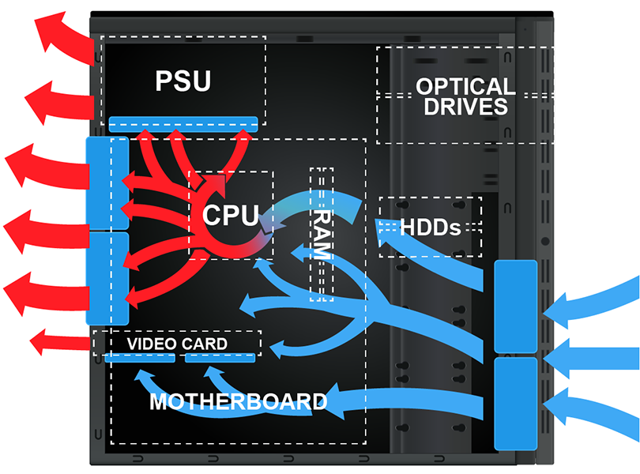
CIAT CIS101A
3.14 System Cooling:
The normal operation of computer components produces heat. Overheated components can cause intermittent errors and reduce component life. If components are overheated for an extended period of time, they will fail. To keep component temperatures optimal, computer cases maintain a consistent, one-way flow of air through the case. The following diagram shows how air should flow through a computer case:

Slide 60
CIAT CIS101A
3.14 System Cooling:
Because proper airflow is necessary to keep components cool, consider the following recommendations to ensure optimal system cooling:
o Keep the case free of dust and debris. Excess dust can restrict airflow and prevent proper heat transfer.
o Reduce the number of airflow obstructions.
a. Employ proper cable management (e.g., bundle cables together and secure unused cables to the case).
b. Space out multiple hard disk drives instead of stacking them next to each other.
c. Do not use an excess number of expansion cards.
o Maintain appropriate ambient temperatures. Optimal ambient temperatures are between 60 and 80 degrees Fahrenheit. For server rooms, the ambient temperature might be as low as 45 degrees.
o Ensure proper ventilation.
a. Keep air intakes and exhausts free from obstructions.
b. Leave space between the computer and any walls or desks.
o Preserve negative pressure inside the case by keeping all covers and shields installed (e.g., unused expansion cards, I/O shield, front drive bays).

Slide 61
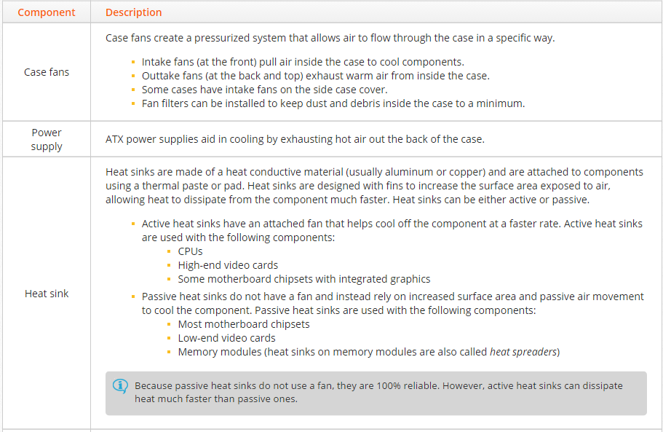
CIAT CIS101A
3.14 System Cooling:
The following table identifies several components that are used to help regulate a computer system's internal temperature:

Slide 62
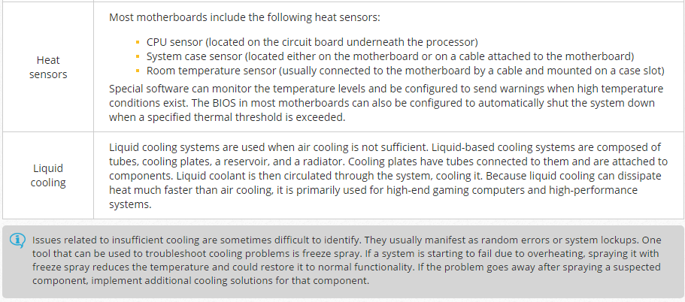
CIAT CIS101A
3.14 System Cooling:
The following table identifies several components that are used to help regulate a computer system's internal temperature:

