Slide 1
CIAT CIS101A
Storage

Slide 2
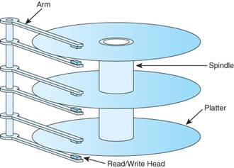
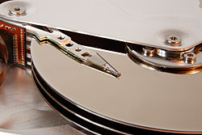
5.1.2 Storage Device Facts
The following table describes common storage devices:
Device Type | Description
Hard disk drive (HDD) | A hard disk is a thick magnetic disk encased in a thicker protective shell. A hard disk consists of several aluminum platters, each of which requires a read/write head for each side. All of the read/write heads are attached to a single access arm to prevent them from moving independently. Each platter has circular tracks that cut through all of the platters in the drive to form cylinders. The spinning of the platters is referred to as revolutions per minute (RPM). The higher revolutions per minute, the faster the data can be accessed.
 | Standard hard drives are categorized as follows: 5400 rpm (inexpensive SSD) 7200 rpm (good quality SSD) 10,000 rpm (expensive SSD)

Slide 3
5.1.2 Storage Device Facts
Hard disk drive (HDD) | Some of the advantages of hard disk are:
 | They have lots of storage (starting at 16 GB up to several TB). They are significantly faster than floppy disks. The cost per MB is cheap.
 | Some of the disadvantages of hard disks are:
 | Many hard disks are internal devices, though you can get external enclosures. They are prone to failure. They are vulnerable to physical damage (e.g., when dropped).

Slide 4
5.1.2 Storage Device Facts
Solid state drive (SSD) | A solid state drive is a flash device with a storage capacity similar to a small hard drive. Solid state drives are used as replacements for hard disk drives for storing operating system, application, and data files.
 | Some advantages of solid state drives:
 | They are faster than hard drives. They have no moving parts, so they last longer. They have lower power consumption than hard drives (good for laptops). They are less susceptible to physical damage (from dropping) and immune from magnetic fields. They are smaller and lighter than hard drives.
 | The Main disadvantage currently for solid state drives is cost-They are several times more expensive than comparable hard drives. However, their advantages make them a good choice, especially for portable devices.

Slide 5
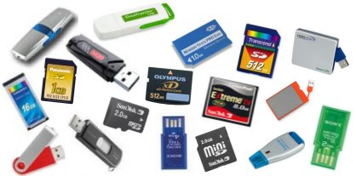
5.1.2 Storage Device Facts
Flash devices | Flash memory cards store information using programmable, no-volatile flash memory.
 | Some of the advantages of flash devices are: The memory is re-programmable. They can retain content without power. They are optimal for use in devices like cameras. They are highly portable. They have a larger capacity than CDs and DVDs. They have relatively fast memory access.
 | Some of the disadvantages of flash devices are: Their storage capacity is not yet comparable to the capacity of modem hard disks. Different memory card formats require different readers.

Slide 6
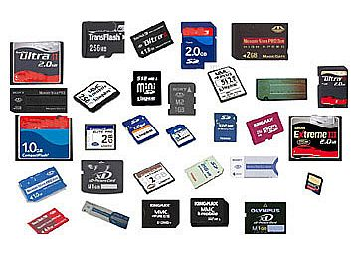
5.1.2 Storage Device Facts
Flash devices | Common flash memory cards include:
 | CompactFlash cards eMMC cards SD cards SSD cards MiniSD cards MicroSD cards xD cards Hybrid cards (combines SSD and HDD technology) Memory sticks

Slide 7
5.1.2 Storage Device Facts
Optical disc | Optical discs such as CDs, DVDs, and Blu-ray discs are a storage medium that uses lasers for both reading and writing information. Optical discs store information through pits in their reflective coating. As the disc spins, the optical drive sends laser optics to the disk, and receives the stored information through the deflected output.
 | Some of the advantages of optical discs are: They are great for music and video (they play in audio or video devices that aren’t computers). They are portable and universal. They are cheap. You can buy discs that are recordable. They have a long shelf life and are relatively sturdy. Blu-ray discs can store a large amount of data (25 GB or more, depending upon the format).
 | Some of the disadvantages of optical discs are: They are slower than hard disks. They have a small capacity (650 MB for CDs, 4.7 GB for DVDs). There are some compatibility issues between disc formats and readers.

Slide 8
5.1.2 Storage Device Facts
Tape drive | Tape drives (also called digital linear tape or DLT drives) store data on magnetic tapes. Tape drives are most commonly used for data backups, such as taking a backup of all hard drives in a system.
 | Some advantages of tape drives: Tapes can typically store large amounts of data. DLT tapes range in capacity from 10 GB to 800 GB per tape. Tapes can be changed, allowing you to save data from different sources on the same drive. Tapes are relatively inexpensive and small enough for long-term storage.
 | Some disadvantages of tape drives: Access to data on tape is typically slower than reading or writing to other storage types, making them not well suited for instant, interactive access. Data must be read from tape sequentially. The tape must be cued to the exact location on tape when data must be retrieved.

Slide 9
5.1.2 Storage Device Facts
The term removable storage refers to the ability to easily connect and disconnect storage devices or storage media from a computer (as compared to internal or fixed storage).
Optical discs, flash devices, eSATA drives, and tapes are examples of removable media.
Hard disks and solid state drives are typically not removable media as they are installed internally in the computer.

Slide 10
5.2.3 SATA Installation Facts
Serial ATA (SATA) is computer bus technology primarily designed for the transfer of data from a hard disk. SATA:
Uses serial communication (meaning each device is on its own channel)
Provides built-in support for disk protection methods
Provides for easy configuration--just connect the device to the SATA port
Has an L-shaped connector
Supports external devices through the external SATA (also called eSATA) standard. eSATA is faster than USB and FireWire

Slide 11
5.2.3 SATA Installation Facts
SATA is the latest generation of standards for hard disk and other storage devices. You should be familiar with the following SATA standards:
Standard | Description
SATA1 | SATA1 is the original SATA standard. It provided for 1.5 Gbps (150 MBps) data transfer.
SATA2 | The second generation of SATA devices support up to 3 Gbps (300 MBps). SATA2 includes the following enhancements: Xbox360 hard disk interface (called xSATA) Hot pluggable support, allowing drives to be added and removed while the system is running Improved connectors to reduce ESD, improve usability, and extend life when used with external devices Native Command Queuing (NCQ) for increased performance Port multiplier support, allowing multiple devices to be connected to a single SATA port

Slide 12
5.2.3 SATA Installation Facts
SATA3 | The third generation of SATA devices support up to 6 Gbps (600 MBps). This standard mainly addresses solid state drives with SATA (hard disk drives are not capable of sending data at this rate). The standard includes new connectors for solid state devices and thin optical drives.
eSATA | The eSATA (external SATA) standards are a subset of other standards specifically for externally connected devices. eSATA devices use a special SATA data cable with a locking clip to prevent the cable from being accidently disconnected. Because power is not supplied through the SATA data cable, eSATA devices require an external power connector or power source. eSATA is typically faster than USB or FireWire. eSATA has a rectangular connector.
eSATAp | The eSATAp (Power over eSATA or Power eSATA) standards are meant to replace eSATA. eSATAp combines the functionality of an eSATA and a USB port with a source of power in a single connector. Both SATA data and dvice power are integrated in a single cable. The eSATAp connector and port are neither an L-shaped or rectangular.

Slide 13
5.2.3 SATA Installation Facts
You should know the following facts about SATA:
Each SATA drive has its own channel, with a single drive connected to each cable and port.
The cable length can be up to one meter (up to 2 meters for eSATA).
SATA devices use a special 15-pin power connector that supplies 3.3, 5, and 12 volts. You can use an adapter cable to convert a 4-pin Molex connector to a SATA power connector, but if you do, the resulting cable will not have 3.3 volts (3.3 volts are typically not used in most SATA devices).
Devices you can connect using SATA include: Hard disk drives (HDD) Optical drives (CD/DVD/Blu-ray) Solid state drives (SSD)

Slide 14
5.2.3 SATA Installation Facts
All new motherboards include support for multiple SATA devices. Some motherboards include eSATA connectors, or you can use a port connector device to add external ports using the internal SATA connections. You can also install an adapter card in an available bus slot to increase the number of SATA ports.
Removable storage devices are typically connected through eSATA, USB, or FireWire ports. A hard drive enclosure allows you to connect a SATA hard drive to the USB or FireWire port of your computer, making the hard drives a form of portable storage.
Connect the boot drive to the lowest SATA channel number of the installed devices. The boot sequence will normally follow the channel order unless a boot priority is specified in the BIOS/UEFI.
When installing a newer SATA2 drive into a system that only supports SATA1, you might need to: Configure the drive to operate in SATA1 mode. This is typically done by setting a jumper. Update the BIOS/UEFI to recognize the new drive. Even with these steps, some SATA2 drives will not work in a motherboard that supports only SATA1. In that case, install a SATA2 controller card.

Slide 15
5.3.4 Optical Media Facts

Slide 16
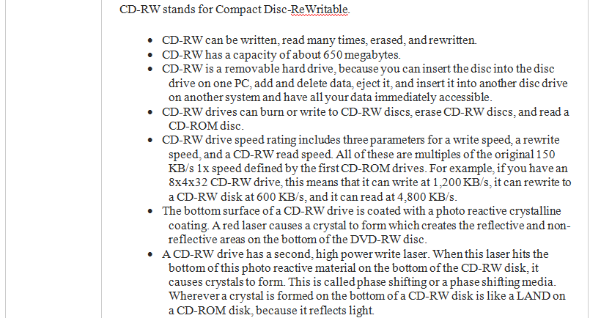
5.3.4 Optical Media Facts (Continued)

Slide 17
5.3.4 Optical Media Facts
Facts

Slide 18
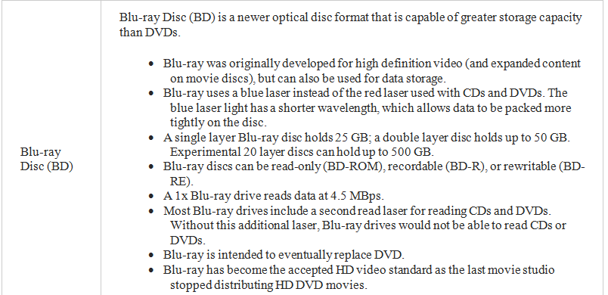
5.3.4 Optical Media Facts
Facts

Slide 19
5.3.4 Optical Media Facts
Be aware of the following when working with optical drives:
When you place a disc in the drive, it can take several seconds for the drive to recognize the new disc and spin up to speed. If you receive a message saying that the drive is not accessible after trying to access a recently inserted new disc, wait a few seconds and try again.
If you install a new hard drive, the drive letter for your optical drive might change. Software programs or shortcuts that rely on the old drive letter will likely not run properly until they have been told the correct drive letter for the drive.
Access time is a general measure of drive performance. Like hard drives, average access time includes average seek time and average latency time. However, it also includes average spin up/down time. This is the time required for a drive to spin up or down to the proper speed to read the data from that particular location of the disc.
If the drive tray won't open for some reason, you can insert a straightened paper clip in the small hole beneath the drive door to push the drive tray out of the drive.

Slide 20
5.3.4 Optical Media Facts
Use the following precautions to protect discs:
Some recordable discs use a foil placed on the top of the disc instead of imbedding the foil inside the plastic. Be very careful when working with these types of discs. A scratch or even some types of markers can damage this layer.
To help prevent scratching, keep the disc in its case when not being used.
To minimize the effect of scratches that might be generated while wiping a disc, wipe the disc in straight lines from the center to the edge (like the spokes of a wheel).
Keep the disc away from direct sunlight and other sources of heat.

Slide 21
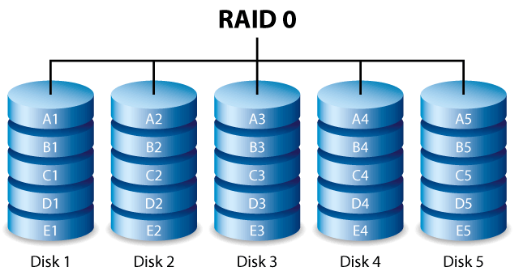
5.4.2 RAID Facts
Redundant Array of Independent Disks (RAID), also called Redundant Array of Inexpensive Disks, is a disk subsystem that combines multiple physical disks into a single logical storage unit.
Depending on the configuration, a RAID array can improve performance, provide fault tolerance, or both.
The following table describes common RAID levels:
RAID Level | Description
RAID 0 (Striping) | A stripe set breaks data into units and stores the units accoss a series of disks by reading and writing to all disks simultaneously.
 | Striping: Provides an increase in performance Does not provide fault tolerance. A failure of one disk in the set means all data is lost. Requires a minimum of two disks Has no overhead because all disk space is available for storing data.
 | This is the fastest of all RAID types. However, it does not provide fault tolerance.

Slide 22
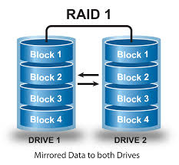
5.4.2 RAID Facts
RAID 1 (Mirroring) | A mirrored volume stores data to two duplicate disks simultaneously. If one disk fails, data is present on the other disk, and the system switches immediately from the failed disk to the functioning disk.
 | Mirroring: Provides fault tolerance for a single disk failure Does not increase performance Requires two disks Has a 50% overhead. Data is written twice, meaning that half of the disk space is used to store the second copy of the data. Overhead is 1/n where n is the price of the second disk. RAID 1 is the most expensive fault tolerance system.

Slide 23
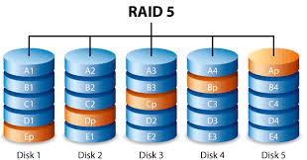
5.4.2 RAID Facts
RAID 5 (striping with distributed parity) | A RAID 5 volume combines disk striping across multiple disks with parity for data redundancy. Parity information is stored on each disk. If a single disk fails, its data can be recovered using the parity information stored on the remaining disks.
 | RAID 5: Provides fault tolerance for a single disk failure Provides and increase in performance for read operations. Write operations are slower with RAID 5 than with other RAID configurations because of the time required to compute and write the parity information. Requires a minimum of three disks. Has an overhead of one disk in the set for parity information: (1/n-1) A set with 3 disks has 33% overhead. A set with 4 disks has 25% overhead. A set with 5 disks has 20% overhead.

Slide 24
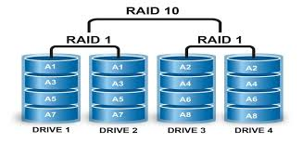
5.4.2 RAID Facts
RAID 10 (stripe of mirrors) | A RAID 10 volume stripes data across mirrored pairs and across multiple disks with parity for data redundancy. If a single disk fails, its data can be recovered using the parity information stored on the remaining disks. If two disks in the same mirrored pair fail, all data will be lost, because there is no parity in the striped sets.
 | RAID 10: Provides fault tolerance for a single disk failure. Provides redundancy and performance. Is the best option for I/O-intensive applications like database, email, web servers, or any other system requiring high disk performance. Uses 50% of the total raw capacity of the drives is due to mirroring. Requires a minimum of four disks.

Slide 25
5.4.2 RAID Facts
Be aware of the following facts about RAID:
Some RAID controllers support combined levels of RAID. For example, RAID 0+1 is a striped array that is mirrored. Other combined configurations that might be supported include RAID 1+0 (also called RAID 10), RAID 5+0, and RAID 5+1.
For all RAID configurations, the amount of disk space used on each disk must be of equal size. If disks in the array are of different sizes, the resulting volume will be limited to the smallest disk. Remaining space on other drives can be used in other RAID sets or as traditional storage.
While some RAID configurations provide fault tolerance in the event of a disk failure, configuring RAID is not a substitute for regular backups.

Slide 26
5.4.4 RAID Configuration
RAID can be implemented in the following ways:
Method | Description
Hardware | Hardware RAID uses a special controller card that includes a RAID processor. Hardware RAID is the most expensive method but provides much better performance and is more reliable than other methods.
Software | Software RAID uses a driver and the system CPU for controlling RAID operations. This is the slowest form of RAID. Some RAID controller cards support RAID configuration, but without the onboard RAID processor. These solutions are classified as software RAID (sometimes called fake RAID) even though you install a controller card to provide RAID capabilities. Many motherboards include built-in (onboard) support for RAID. RAID implemented in this way is typically software/driver RAID.
Operating system | Operating system RAID uses RAID features within the operating system. Like software RAID, the system CPU is used for RAID operations, but performance is typically better than software RAID because of integration with the operating system.

Slide 27
5.4.4 RAID Configuration
Windows 7 supports creating RAID 0 and RAID 1 arrays in Disk Management, but does not support configuring RAID 5 arrays.
To use RAID 5 on a client computer, you will need to use hardware or software RAID. The exact process you use to configure RAID depends on your motherboard and/or controller card.

Slide 28
5.5.3 File System Facts
A file system is a means for organizing and storing data and information on a storage device.
The file system and the operating system work together to ensure data availability, integrity, and accessibility.
The following table gives a description for the four main components of a file system:

Slide 29
5.5.3 File System Facts
Component | Description
Partition | A partition is a logical division of a storage device associated with a hard disk drive. Multiple partitions can be assigned to a single device in which case a drive letter is assigned to represent each partition. Multiple letters do not always mean that there are multiple devices, just multiple partitions.
 | Some reasons why you may consider partitioning your hard drive are:
 | Assigning the boot system to a different partition than application and data files can help many computers run more smoothly and minimize damage in a system crash.
 | It is sometimes necessary or useful for the swap file to be stored on its own partition.
 | Some operating systems can't run on a large partition. Creating a separate partition for your operating system can help it run properly.
 | Assigning log files to be stored on distinct partitions can help minimize the effects of a system crash due to excessively large log files.
 | Distinct operating systems can be assigned to run on assigned partitions to allow a dual boot system setup.
 | Unallocated space is space on a partition that has not been assigned to a volume. You cannot store or read data in unallocated space.

Slide 30
5.5.3 File System Facts
Volume | A volume is a single accessible storage area within a file system. A volume can encompass a single partition or span across multiple partitions depending on how it is configured and what operating system you are using. Volumes are identified by drive letters.
Directory | A directory (also called a folder) is a container in a volume that holds files or other directories. It is used to logically sort and organize data to keep related files grouped together. Most operating systems use a hierarchal filing structure.
File | A file is a one-dimensional stream of bits treated as a logical unit. They are the most basic component that a file system uses to organize raw bits of data on the storage device itself. The file name is made up of the directory path plus the file name. An extension can also be added to the filename to identify the file type and the program used to create, view, and modify the file.

Slide 31
5.5.3 File System Facts
Formatting is the process of preparing a partition to use a specific file system. Be aware of the following facts regarding formatting:
When you format a disk, you identify the file system type and identify the cluster size used to store data.
Reformatting removes the existing file system and replaces it with the new file system type. Reformatting a drive deletes all existing data.
If your system or disk supports multiple operating systems, be sure to select a file system supported by all necessary operating systems.
NTFS is not recommended for disks smaller than 10 MB.
When using NTFS on removable devices, you must use Safely Remove Hardware before removing the flash device to prevent file corruption.

Slide 32
5.5.3 File System Facts
When configuring your hard drive, you must choose a file system that will be implemented on your computer.
The following table explains the characteristics of the file systems supported in Windows systems:
Property | FAT32 | NTFS
Partition size | 2 terabytes* | 256 terabytes
Volume size | 2 terabytes* | 256 terabytes
File name length | Long File Names (255 characters, spaces) | Unicode (256 characters, anything but /)
File size | 4 gigabytes | 16 terabytes
Amount of files | 268,435,437 | 4,294,967,295

Slide 33
5.5.3 File System Facts
*FAT32 partitions/volumes can be up to 2 terabytes in size. Windows can read partitions up to the 2 terabyte size, but cannot create them.
For Windows systems, you will likely choose NTFS over FAT for hard drives to take advantage of additional features not supported by FAT such as:
The ability to format larger partition sizes in Windows Smaller cluster sizes for more efficient storage with less wasted space File and folder permissions to control access to files Encryption to hide the contents of a file Compression to reduce the amount of space used by files Disk quotas to restrict the amount of disk space that files saved by a user can use Volume mount points that allow you to map disk space on another partition into an existing volume
The Extended File Allocation Table (exFAT, sometimes called FAT64) file system is a special file system that is designed to support large flash drives. Using NTFS on flash drives is usually not a good idea due to its high overhead and risk of corruption if the device is not stopped properly prior to removal. However, many flash drives exceed the 32 GB limit discussed above. Microsoft introduced native exFAT support in Windows 7 to allow large removable flash storage devices to continue to use a FAT-type file system.

Slide 34
5.5.5 MBR Partitioning Facts
A partition is a logical division of the storage space on a hard disk drive.
Partitions are identified by 16-bit entries that make up the partition table located in the master boot record (MBR) of that drive.
A hard disk can contain a single partition that encompasses the entire drive or multiple partitions that divide up the storage space on the hard disk drive.
Windows supports two different kinds of disks: basic and dynamic. The disk type controls characteristics about how partitions and volumes are defined.

Slide 35
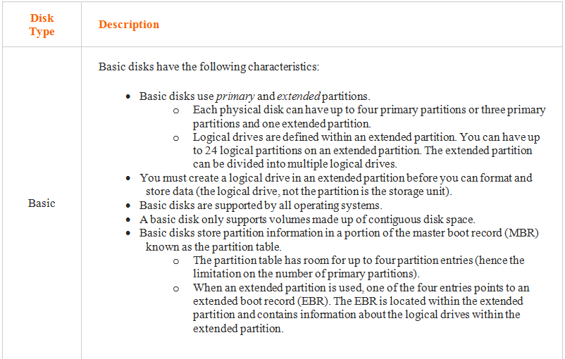
5.5.5 MBR Partitioning Facts

Slide 36
5.5.5 MBR Partitioning Facts
Dynamic | Dynamic disks have the following characteristics:
 | Volumes on dynamic disks are like partitions and logical drives on basic disks. Dynamic disks support up to 128 volumes. Dynamic disks support volumes that use discontiguous disk space. Simple volumes contain disk space from a single hard disk (either contiguous or discontiguous space). Spanned volumes contain disk space from multiple hard disks, grouped together into a single logical volume. Dynamic disks store partitioning information in a hidden database on all dynamic disks in the system.
Be aware of the following when managing partitions and volumes: Use Disk Management or DiskPart to create, format, and manage partitions and volumes. You access Disk Management on Windows systems through Computer Management. You access DiskPart from the command prompt by entering cmd. Basic and dynamic disks use the same hardware, but different partitioning methods.

Slide 37
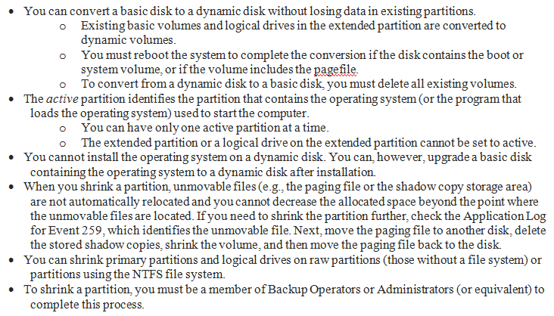
5.5.5 MBR Partitioning Facts

Slide 38
5.6.6 Disk Status Facts
The following table describes various disk and volume statuses that you might encounter in Disk Management:
Status | Description
Healthy or Online | The Healthy or Online status indicates that the disk is turned on and can be accessed. The volume on the disk is valid and has no errors.
Formatting | The Formatting status is shown for volumes during the formatting process. After formatting, the status for the volume changes to Healthy.
Unallocated | The Unallocated status shows for portions of a disk that have not been assigned to a partition or a volume.

Slide 39
5.5.5 MBR Partitioning Facts
Initializing | The Initializing process shows while a disk is being converted from a basic disk to a dynamic disk. After the conversion, the status for the volume changes to Healthy.
No Media | The No Media status shows for an optical or removable media drive that does not contain a valid disc. This disk status only applies to CD-ROM, DVD-ROM, or removable disks.
Foreign | A Foreign disk is a dynamic disk that was created in one system and moved to another system. When you first add the disk to a different system, the partition information for the disk must be updated to reflect all dynamic disks in the current system. Import the disk to make it available I the new system.
Not Initialized Unknown | The Not Initialized or Unknown status indicates a disk without a valid master boot record or partition table (either missing or corrupt). To correct the problem, initialize the disk. If the partition table is invalid, use third party tools to try to recover the partition table.

Slide 40
5.5.5 MBR Partitioning Facts
Online (Errors) | The Online (Errors) status indicates that I/O errors have been detected on a dynamic disk. To correct the problem, try reactivating the disk.
Unavailable | The Unavailable status indicates that errors have occurred on physical or dynamic disks.
Unreadable | The Unreadable status indicates a hardware failure, I/O errors, or other corruption but might also be caused by a delay in reading the disk in Disk Management. Try rescanning the disk to see if the status changes; if not, troubleshoot the hardware or disk problem
Missing Offline | The Missing or Offline statuses show when a dynamic disk has failed, been removed, or turned off. If the disk is turned off, turn it back on, then reactivate the disk If the disk no longer exists, then delete the disk from Disk Management.
Failed | The Failed status shows for a volume that cannot be started, such as when the disk is damaged or the file system is currupt. Make sure the disk is on, then try reactivating the volume. If that doesn’t work, then you likely have data loss.

Slide 41
5.5.7 GPT Partitioning Facts
GPT partitions are a new standard that are gradually replacing MBR partitions.
GPT is associated with UEFI. GPT stands for GUID Partition Table. It's called GUID Partition Table because every partition on the drive has a globally unique identifier or GUID.
That means that each partition worldwide would have its own unique identifying number. A GPT disk: (next slide)

Slide 42
5.5.7 GPT Partitioning Facts
Can be basic or dynamic
Supports up to 128 partitions depending on space allocated for the partition table. There is no need for extended and logical partitions.
Can support between 8 and 9.4 zettabytes depending on the sector size
Stores multiple copies of the partition table across the disk
Stores cyclic redundancy check (CRC) values to check that its data is intact. If the data is corrupted, GPT notices the problem and attempts to recover the damaged data from another location on the disk.
Include a protective MBR. The protective MBR sees the GPT drive as a single partition that extends across the entire drive. The protective MBR makes sure that the old tools don't mistake the GPT drive for a non-partitioned drive and overwrite all your data.

Slide 43
5.7.4 Storage Managment Facts
To add space to existing volumes, use one of the following strategies:
Method | Description
Configure a mount point | A mount point is an empty folder on the existing volume that points to another partition. Data saved to the folder is physically saved on the referenced partition. The volume with the empty folder must be formatted with NTFS. You can create mount points on basic or dynamic volumes. The folder on the source volume must be empty. The target partition must not have a drive letter. Using a mount point is the only solution to adding space to the system volume using space on a different disk or non-contiguous disk space.

Slide 44
5.7.4 Storage Managment Facts
Extend the volume | When you extend a volume, you add unallocated disk space to the volume.
 | For basic volumes, you can only extend the volume onto the same drive using contiguous unallocated space. Many third-party partitioning tools can extend partitions regardless of the operating system.
 | To extend the volume onto the same drive using non contiguous unallocated space, or to extend the volume onto another disk, convert the disk to a dynamic disk, then extend the volume. An extended volume uses disk space on the same disk. A spanned volume uses disk space on a different disk.
 | The system volume can only be extended using contiguous free space on the same disk. This is the same for both basic and dynamic disks.
 | Volumes must be unformatted or formatted with NTFS to be extended.

Slide 45
5.9.5 Disk Optimization Facts
Optimizing your hard disk drive can improve your computer’s overall performance. The following table lists some features you can upgrade to optimize your hard disk performance:
Utility | Description
Upgrade the hard disk | Upgrade to the fastest hard disk possible. Hard disk dries come in a variety of different rotation speeds such as: 5400 RPM (not desired) 7200 RPM (minimum) 10,000 RPM
Upgrade the disk interface | Upgrading your disk interface will greatly improve the throughput of data to and from your hard disk drive. For optimal performance, consider upgrading to SATA3. This will upgrade your speed to 600 Mbps.

Slide 46
5.9.5 Disk Optimization Facts
A mostly full drive can run slower than a mostly empty one. The following table contains various methods you can use to clean up a disk drive:
Utility | Description
Disk Cleanup | Disk Cleanup helps manage disks by locating and disposing of files that can be safely removed from the disk by:
 | Emptying the Recycle Bin Deleting temporary files such as those used by a web browser or for application installation Deleting installation log files Compressing old files
 | You can type Cleanmgr at the command prompt to run Disk Cleanup.

Slide 47
5.9.5 Disk Optimization Facts
Disk Defragmenter | Disk Defragmenter optimizes the performance of your hard drive by joining fragments of files that are different locations on your hard drive into a single location.
 | Some files, such as certain system files, cannot be moved. To improve defragmentation, disable programs that run in the background like screensavers and virus software. Any disk access while Disk Defragmenter is running (whether to read from or write to the disk) will slow down the defragmentation process. The more information that is on the drive, the more time it will take to defragment the drive.
 | Run Defrag at a command prompt to run Disk Defragmenter in a text mode.

Slide 48
5.9.5 Disk Optimization Facts
Check Disk | Check Disk is a utility that verifies the file system integrity of a hard disk. Errors that can be checked and fixed by Check
 | Disk includes: Lost clusters are a series of used clusters on the hard drive that are not associated with a specific file. A cross-linked file occurs when two files claim the same cluster. Check Disk will Identify cross-linked riles and correct their cluster associations. Orphaned files are files that exist on the hard drive but which are not associated with a directory in the index. Normally Check Disk can re-associate the file with the correct directory. A bad sector is a portion of the hard disk that cannot be used. Bad sectors are marked so that they are no longer used. Any used bad sectors are redirected to another sector.
 | *The NTFS file system automatically detects bad sectors as the system operates saving and reading files.
 | You can run Check Disk by typing Chkdsk at a command prompt.
 | Use Chkdsk with the /f switch to automatically fix errors without scanning for bad sectors. Use the /r switch to scan and fix bad sectors and other errors.

Slide 49
End of CIS101A Class Session 6

