Slide 1
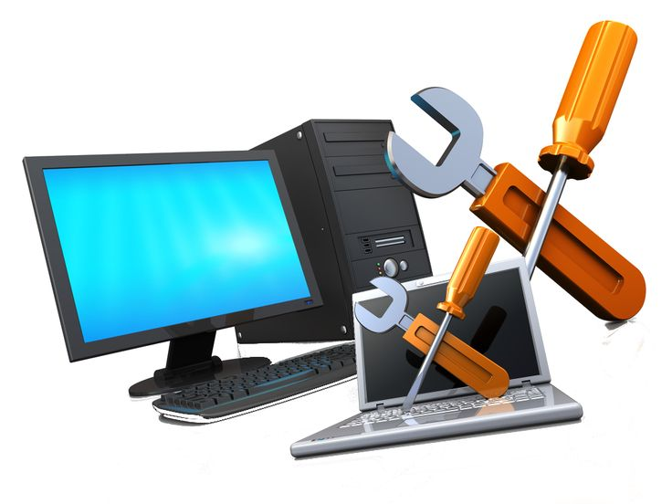
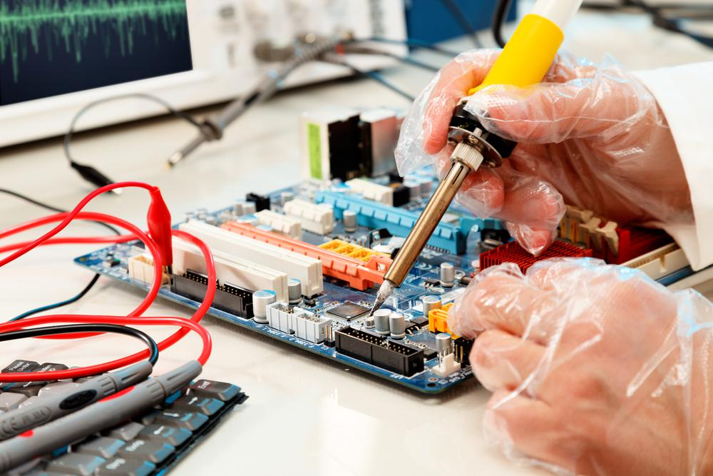
CIAT CIS 101A
Week 1 Class 2
Week 1 – PART 2: Chapter 2 – PC Technician
2.1 Protection and Safety | 2.1.8 Practice Questions
2.2 Professionalism | 2.2.3 Practice Questions
2.3 PC Tools | 2.3.3 Practice Questions
2.4 PC Maintenance | 2.4.7 Practice Questions
2.5 Troubleshooting Overview | 2.5.3 Practice Questions
 | Lab 2.4.6 Videos 2.1.3 +2.1.6 + 2.2.1 + 2.3.1 + 2.4.3 + 2.5.1

Slide 2
2.1 Protection and Safety
Power:
Before handling a system component make sure it is powered off. Make sure the ground pin on the PC Power Plug is intact. Unplug the system before working on components. Power inverter convert AC to DC and can retain a charge. Replace rather than fix power supplies. Avoid opening a power supply with a large capacitor since it holds a charge.
ESD and High Voltage: (Capacitors)
Discharge of capacitors should be done by a certified technician. Exercise caution around the DC converter in a laptop display.

Slide 3
2.1 Protection and Safety
Peripherals:
Can present a safety hazard.
Do not use a regular multi-meter to test the charge inside a monitor. Never clean the glass of a monitor with liquid solvent with the power on Studies indicate that laser printers emits particles that can be bad for human health. Do not locate laser printers close to workers desks. Avoid handling leaky batteries, since chemical can get in your eyes. Never look into the end of a fiber optic cable, it could damage your eyes

Slide 4
2.1 Protection and Safety
Thermal:
Components such as the CPU heat sink and fan, the printing head of a dot matrix printer, or components inside a laser printer can be hot.
After turning off the computer, allow components to cool sufficiently before servicing to prevent burns.
Physical:
Make sure the room and building are properly set up to ensure your safety.
Keep work area and floors clear of clutter to help prevent accidents. Do not route cables across the floor in pathways. This can lead to tripping accidents, and could also result in worn cables. Provide adequate ventilation in any enclosure to remove toxic fumes. Protect yourself from airborne particles by using a air filter mask. Wear safety goggles. Replace worn or frayed power cords.

Slide 5
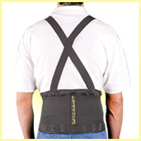
2.1 Protection and Safety
Lifting:
Be careful when lifting heavy objects:
Bend your knees and keep your back straight, using your legs to lift objects. If your job requires frequently lifting, wear a back brace for added protection. Follow the weight limitation guidelines defined by your employer.

Slide 6
2.1 Protection and Safety
Every room in which you work should be fire suppressed:
At a minimum, you should have a Class C fire extinguisher available to you. A Class C fire extinguisher is made for electrical fires. Make sure fire extinguishers and fire suppression methods (e.g., sprinklers) are properly implemented and maintained. Promptly report any potentially hazardous situations. Your top priority in responding to any incident is to ensure the safety of others. In the event of a hazardous situation, clear people from the area or remove the danger before attempting other actions such as preventing or repairing damage to components.
MSDS (Material Safety Data Sheets):
An MSDS describes safe handling and disposal procedures for dangerous materials and can provide you with the knowledge to resolve an uncertain situation.
Periodically review and update your Material Safety Data Sheets (MSDSs).

Slide 7
2.1.5 ESD (Electro Static Discharge) Facts:
Implement the following measures to protect against ESD.
Keep the relative humidity in the room high, ideally around 70%, and temperature between 72-77 degrees. The key is to avoid dry air in the computer repair location to prevent ESD. Use antistatic mats under the PC and on the floor. Discharge yourself before touching any computer component. When touching anything inside the computer, wear an antistatic wrist strap that is attached with an alligator clip to the metal PC chassis. Ground both yourself and the computer to the same ground. This provides a single path for the flow of electrical potential. Use static resistant materials to handle computer components.

Slide 8
2.1.5 ESD (Electro Static Discharge) Facts: (continued)
Implement the following measures to protect against ESD.
Never touch the metal connectors on a circuit board. Keep the computer repair location free of materials that accumulate electric charges (e.g., plastic or Styrofoam). Store sensitive components in static shielding bags (also called antistatic bags; they are usually tinted gray). Static resistant bags are not nearly as effective (usually tinted pink or blue). If a wrist strap is unavailable, keep your body in constant contact with the metal frame when working inside the computer.
Note: | Unplug the system before working on internal components. Do not rely on the power cord for an electrical ground.

Slide 9
2.1.7 Environmental Facts:
It is important to ensure that equipment and hazardous chemicals are disposed of properly.
Consult the manufacturer's documentation for recommended solutions for equipment disposal. Consult an MSDS (Material Safety Data Sheet) for information on physical data, toxicity, health effects, first aid, storage, disposal, and spill procedures for disposal of hazardous chemicals. You can download an MSDS from the manufacturer's website or check with a representative of that company.
Note: Table on next slide offers suggestions for disposing of used equipment.

Slide 10
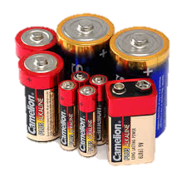
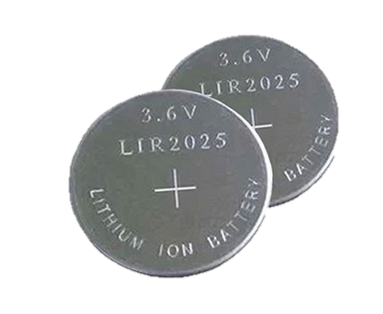
2.1.7 Environmental Facts:
The following table offers suggestions for disposing of used equipment:
Component/Material |  | Disposal Method
Alkaline Batteries |  | Recycle, if possible, otherwise dispose of alkaline batteries as your local laws require. For example, in some states, you can throw them in the regular trash. In California, it is illegal to throw them in the common trash. They are considered hazardous waste and are supposed to go with the household hazardous waste collection for special recycling.
Button Batteries |  | These are considered hazardous waste because they contain contains mercuric oxide, lithium, silver oxide or zinc-air. Return to manufacturer, recycle, or contact local authorities for disposal procedures.

Slide 11
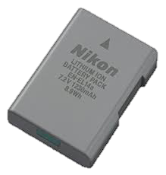
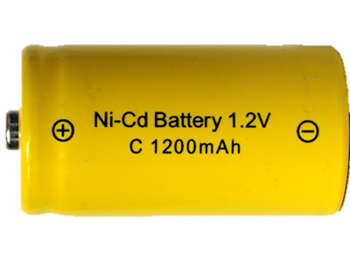
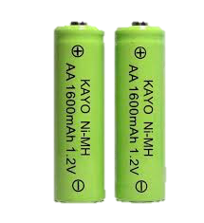
2.1.7 Environmental Facts:
The following table offers suggestions for disposing of used equipment:
Component/Material |  | Disposal Method
Lithium and Lithium Ion Batteries |  | Recycle these; lithium batteries are considered a non-hazardous waste.
Nickel-Cadmium (NiCad) Batteries |  | These are considered hazardous waste; take these batteries to either a household hazardous waste site or a recycling center
Nickel-Metal Hydride (NiMH) Batteries |  | Recycle these; NiMH batteries are considered a non-hazardous waste in most U.S. States, with the exception of California.

Slide 12
2.1.7 Environmental Facts:
The following table offers suggestions for disposing of used equipment:
Component/Material |  | Disposal Method
CRT Monitor |  | Contact local authorities for recycling these. CRTs contain many toxic and caustic substances that are illegal to incinerate. Also, discharge before disposal (CRTs can contain high voltages).
PC System |  | Recycle, give it away, or resell it; a typical PC contains $5 to $25 worth of precious metals. Remember to clean the hard drive before disposing of the machine.

Slide 13
2.1.7 Environmental Facts:
The following table offers suggestions for disposing of used equipment:
Component/Material |  | Disposal Method |  | Component/Material |  | Disposal Method
Power Supply |  | Contact local authorities. Recycle, if possible. Discharge before disposal (contains high voltages). |  | Inkjet Printer Cartridges |  | Recycle; you can return the cartridges to the manufacturer for recycling or recycle them yourself.
Laser Printer Tone Cartridges |  | Return to the manufacturer for recycling (to clean up spills, use a toner vacuum or a scoop and a damp cloth; never use a regular vacuum). |  | Cleaning Solutions and Solvents |  | Consult the MSDS, a licensed disposal organization, or local authorities for handling and authorized disposal procedures.

Slide 14
2.2.2 Professionalism:
As a PC technician, it is important to always act in a professional manner.
Being professional will not only optimize the client's experience, but also dispel the myth that PC technicians have poor people skills.
Consider the following guidelines when interacting with clients:
Make a good first impression. If your first contact with the client is positive, the relationship will be much easier to handle and maintain. Arrive to appointments on time and prepared. If you are going to be late, contact the client and let them know. Dress professionally and following any company dress codes. This includes appearing well kempt. Greet the client and introduce yourself. Ask permission before entering the client's office or home.

Slide 15
2.2.2 Professionalism:
Communicate Effectively.
Understanding both you and the client’s expectations is very helpful.
Use clear, concise, and direct statements. Allow the client to speak and avoid interrupting. Clarify client statements—restate what they have said and ask pertinent questions. Avoid using jargon, abbreviations, and acronyms. Take time to explain technical terms and issues in a simple way. Clearly explain the problem and any repair options. Be sure to explain the advantages, disadvantages, and cost of a repair. Set realistic expectations for finishing work—when in doubt, overestimate.

Slide 16
2.2.2 Professionalism:
Show respect..
This includes showing respect not only to your clients, but also their workspaces and computers.
Never argue with a client or become defensive. Avoid accusing the client. Even if the client caused the problem, do not point fingers. Ask before moving items on desks or making changes to computer systems. Stay calm and avoid being judgmental or insulting. Avoid distractions or interruptions. Don't take personal phone calls and ask permission before taking work-related calls. Do not browse files on computers that are not necessary or related to the repair. Never complain about clients on social media platforms

Slide 17
2.2.2 Professionalism:
 | Being professional extends to identifying the problem and implementing solutions.
 | During this process, keep in mind the following: (Continued…)
1 | Get authorization to proceed before making any unexpected repairs or fixing items that were not part of the original problem, especially if the extra repairs result in an additional charge.
2 | After you have fixed the problem, try it out (or let the client try it out) to make sure that other problems don't exist.
3 | After the repairs are finished, provide the client with a detailed invoice of the work performed. Also include any manuals or documentation related to new hardware.
4 | Ask the client if they would like to keep the failed components.

Slide 18
2.2.2 Professionalism:
 | Being professional extends to identifying the problem and implementing solutions.
 | During this process, keep in mind the following: (Continued…)
5 | If necessary, take the time to briefly explain any new software or hardware that was installed.
6 | If applicable, offer additional services or training that might be beneficial to the client.
7 | If the problem is related to user error or is caused by actions taken by the client, tactfully explain the problem without accusing or judging the client.
8 | Before leaving, make sure the client is satisfied that the problem has been resolved. For best client service and based on your company policy, follow up with the client at a later time to verify that the problem remains fixed.

Slide 19
2.3 PC Tools:
The following devices and components are used for computer repair and maintenance:
Combination ratchet/screwdriver |  | A combination ratchet has interchangeable bits with a ratcheting handle that provides multiple features in a single tool. Bit ends can be replaced for Phillips and flat-head screwdrivers, hex sockets, and torx (star-shaped) bits. The ratcheting handle allows you to drive the screw without repositioning the driver. Note: Most computer components use Phillips head screws.
IC insertion and extraction tool |  | An IC insertion and extraction tool is used to add or remove integrated circuit chips that are used on motherboard and some computer components. For example, on some motherboards you can use the IC insertion and extraction tool to change the BIOS chip.
Antistatic pad/wrist strap |  | An antistatic pad provides an insulated covering to prevent static electricity from moving between objects and damaging computer components. When working with computer components, use a wrist strap connected to the antistatic pad, and connect the pad to a ground.

Slide 20
2.3 PC Tools: (continued)
The following devices and components are used for computer repair and maintenance:
Extension magnet |  | An extension magnet is a small magnet on a collapsible rod. Use the extension magnet to retrieve screws that have fallen into a computer case or other areas you cannot reach. As an alternative to a magnet, use an extension tool with retractable prongs.
3-pronged parts retriever |  | A 3-pronged parts retriever is used to grasp and retrieve small parts that have fallen into difficult to reach areas.
Multimeter |  | A multimeter is a device for testing various electrical properties. | For example, most multimeters can measure:
 |  |  | AC and DC voltage Current (amps) 3Resistance (ohms) | Capacitance Frequency
Power supply tester |  | A power supply tester is a custom multimeter that is used for testing output from a PC power supply. The power supply tester has multiple connectors to test the output for each connector type.

Slide 21
2.3 PC Tools: (continued)
The following devices and components are used for computer repair and maintenance:
Cable tester | A cable tester verifies that a network can carry a signal from one end to the other, and that all wires within the connector are in their correct positions. Most testers have a single unit that tests both ends of the cable at once. Many testers come with a second unit that you can plug into one end of a long cable run to test the entire cable.
Loopback plug | A loopback plug is used to test network communications by redirecting a signal from the transmit port on a device to the receive port on the same device. Use the loopback plug to verify that a device can both send and receive signals.

Slide 22
2.3 PC Tools: (continued)
The following devices and components are used for computer repair and maintenance:
Known good spares | Known good spares are a set of components that you know are in proper functioning order. If you suspect a problem in a component, swap it with the known good component. If the problem is not resolved, troubleshoot other components. Examples of using this strategy are: 1 - Changing the cable connecting a computer to the network 2 - Connecting a different monitor to a computer 3 - Replacing an expansion card
POST card | A POST card is an expansion board that you insert into an expansion slot. It is typically used to troubleshoot a computer system that doesn't start up correctly. The POST card displays output from the BIOS during the Power-On Self-Test (POST).

Slide 23
2.4 Maintenance:
The following devices and components are used for computer repair and maintenance:
Heating, ventilation, and air conditioning (HVAC) | For computer components, design HVAC systems with the following in mind: 1 - Keep temperature between 70 and 74 degrees to prevent components from overheating. 2 - Keep humidity between 40 and 70 percent to prevent electrostatic discharge (ESD). 3 - Make sure server rooms have separate ducting or HVAC systems from the rest of the building for better temperature control. 4 - Use positive pressure systems. Positive pressure systems protect the air quality in the facility by causing air to be forced out through doors, windows, and other openings. Negative pressure systems draw air in, potentially bringing in airborne particles such as dust or smoke. Positive pressure systems are more energy effective. 5 - For areas with heavy smoke or dust, add filters to air Intake systems to filter out Airborne particulates.

Slide 24
2.4 Maintenance: (continued)
The following devices and components are used for computer repair and maintenance:
Interference | Interference is a signal that corrupts or destroys regular signals. Interference affects signals used by two devices to communicate on a network. Listed below are two types of interference that affect computer networks:
Electromagnetic Interference (EMI) | EMI is interference that affects wired networking signals. EMI is caused by motors, heavy machinery, and fluorescent lights. Use shielded twisted pair cable to protect signals sent on Ethernet twisted pair cabling. If necessary, use fiber optic cables to eliminate the effects of interference.
Radio Frequency | RFI is interference on the radio channel used by wireless networking devices 1 - RFI can be caused by nearby wireless devices using the same channel, cordless phones, or microwave ovens. 2 - Wireless networks that use the 2.4 GHz frequency range (801.11b and 802.11g) are susceptible to RFI. 3 - RFI can be reduced by using a wireless networking standard that operates in the 5.75 GHz range or by using a different channel for wireless devices.

Slide 25
2.4 Maintenance: (continued)
The following devices and components are used for computer repair and maintenance:
Magnetic fields | Magnetic fields located close to a computer can cause undesired effects or even data loss. 1 - Hard drives and tape storage devices use magnetic charges on a disk or tape for storing data. While hard disks are shielded and protected from all but the strongest magnets, be careful with tapes. Getting a magnet too close to these components could erase data. Speakers, motors, and generators contain magnets (keep sensitive components away from these devices). Solid state storage devices (such as RAM or flash drives) are not affected by magnetic fields.

Slide 26
2.4 Maintenance: (Cleaning)
One of the best things you can do to keep your system running efficiently is to keep it clean. Be aware of the following facts about cleaning your computer:
Common computer cleaning supplies include: 1 - Lint free cloth 2 - Compressed air or air compressor 3 - Small anti-static vacuum 4 - Denatured or isopropyl alcohol
Regular, periodic cleaning gives you the chance to inspect all components. Look for worn or failed components. On electrical components, dark areas might indicate a burned out component.
Prior to cleaning computer components, power down and unplug components and let them sit for at least 30 minutes to cool.

Slide 27
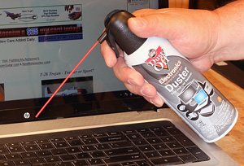
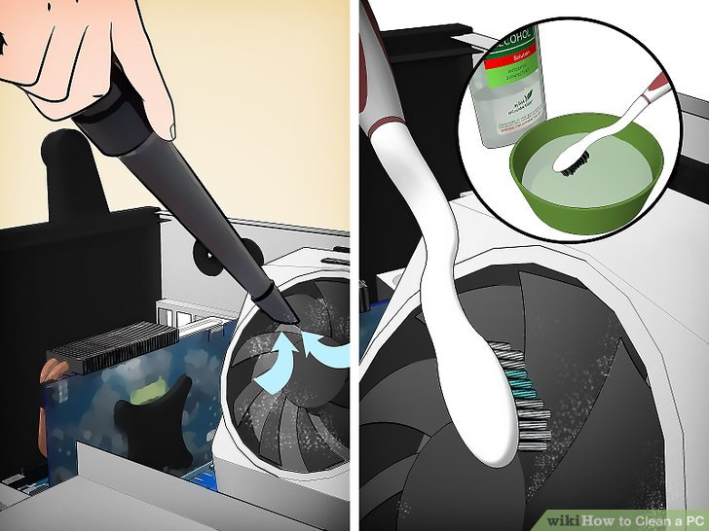
2.4 Maintenance: (Cleaning)
One of the best things you can do to keep your system running efficiently is to keep it clean. Be aware of the following facts about cleaning your computer:
Prior to cleaning computer components, power down and unplug components and let them sit for at least 30 minutes to cool.
Use caution with liquid-based cleansers. Use small amounts and always apply cleaning solutions to cloths and cleaning instruments, never directly to component surfaces.
Dust buildup inside a computer acts as an insulator for internal components, trapping heat and preventing adequate cooling of components. Use: Compressed air to blow dust off A non-static vacuum to remove dust A natural bristle paintbrush to wipe components off

Slide 28
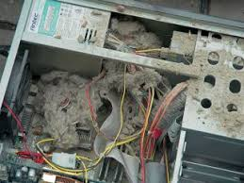
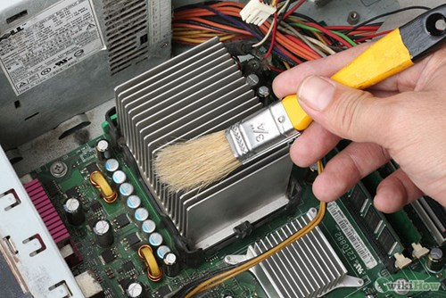
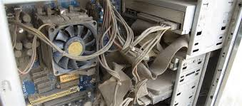
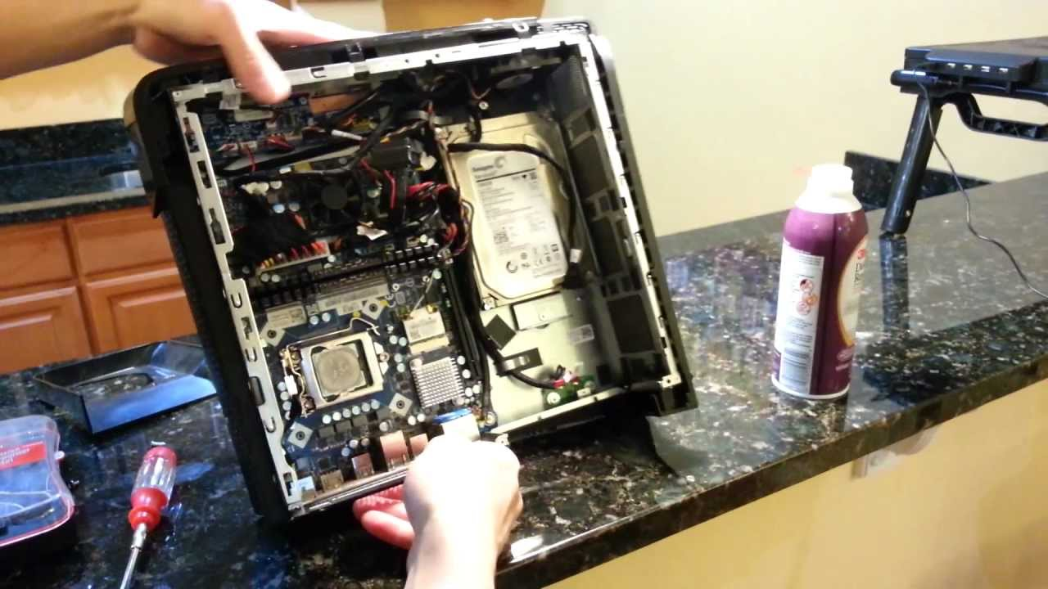
2.4 Maintenance: (Cleaning) continued…
One of the best things you can do to keep your system running efficiently is to keep it clean. Be aware of the following facts about cleaning your computer:
On removable media devices, use: 1 - A DDS-approved cleaning tape, to automatically clean the heads of a tape drive. 2 - Compressed air to blow dust and debris off of CD-ROM and DVD disc surfaces, out of drive bays, and off of drive heads. 3 - Soft lint-free cloths, dry, to wipe smudges off of CD-ROM and DVD disc media surfaces.

Slide 29
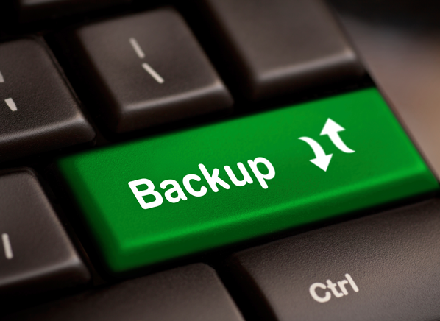
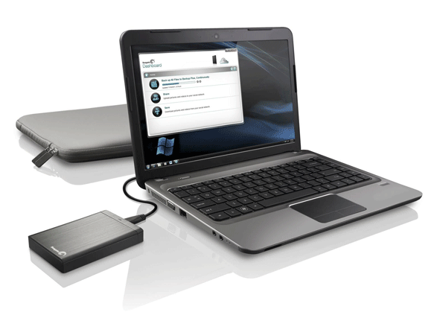
2.4 Maintenance: (Cleaning) continued…
One of the best things you can do to keep your system running efficiently is to keep it clean. Be aware of the following facts about cleaning your computer:
Be aware of the following additional tips for maintaining your computer: When receiving a new computer or component that has been shipped, let it sit for at least 6 hours (24 hours if it arrives in outside freezing conditions) before applying power. The rapid change in temperature can cause damage to components or can result in condensation within the computer. Perform regular backups. Backups protect your data if a hard disk fails. You can use covers and cases to protect some equipment (such as printers) from dust and liquid spills. Be sure to remove covers before use and replace after use.

Slide 30
2.4 Maintenance: (Cleaning) continued…
One of the best things you can do to keep your system running efficiently is to keep it clean. Be aware of the following facts about cleaning your computer: (Continued…)
Be aware of the following additional tips for maintaining your computer: Keep cables organized. Route cables to prevent them from being kinked or stepped on. For best results, use cable ties to bind and organize cables. Verify that your system's cooling fans are blowing air through the system case in the correct directions. A fan blowing in the wrong direction can negate the airflow through the case and cause the system to overheat.

Slide 31
2.4.5 Power Protection
The following lists power conditions you should be familiar with:
Problem | Description
Surge | Overvoltage that lasts seconds
Spike | Overvoltage that lasts milliseconds
Sag | Undervoltage that lasts milliseconds
Brownout | Undervoltage that lasts seconds (lights dim)
Blackout | Complete power failure

Slide 32
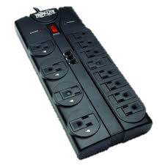
2.4.5 Power Protection
The following is a description of devices used to prevent power problems:
Device |  | Description
Surge Protector |  | A surge protector protects against over-voltages. A power strip provides multiple power outlets from a single plug-in, but is not necessarily a surge protector. Surge protectors can be destroyed by surges and lose their ability to protect. Consider using a surge protector with an indicator light to show whether it is working correctly.

Slide 33
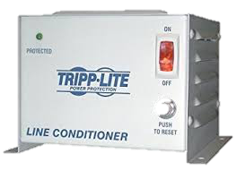
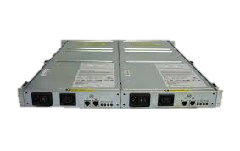
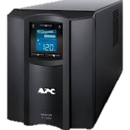
2.4.5 Power Protection
The following is a description of devices used to prevent power problems:
Device |  | Description
Line Conditioner |  | A line conditioner modifies the power signal to remove noise and create a smooth alternating current (AC) signal.
Standby Power Supply (SPS) |  | A standby power supply is an offline device that switches over to provide power when an under-voltage occurs. If the switchover is not fast enough, the computer loses power.
Uninterruptible Power Supply (UPS) |  | An uninterruptible power supply is an online device that is constantly providing battery power to the computer and being recharged by the wall outlet. There are two types of UPS Systems: 1. Online UPS, and 2. Offline UPS

Slide 34
2.4.5 Power Protection (continued)
The following is a description of devices used to prevent power problems:
Device | Description
Uninterruptible Power Supply (UPS) | There are two types of UPS Systems: 1 - An online UPS constantly powers the computer from the battery. 2 - An offline UPS powers the computer from the wall power. When the power fails, a switch inside the UPS switches to power the computer from the battery. This is the most common form of UPS. UPS size is measured by the volt-amp (VA) rating. The capacity of the UPS determines the number of devices and how long the devices can run when power is interrupted.

Slide 35
2.4.5 Power Protection (continued)
The following is a description of devices used to prevent power problems:
Device | Description
Uninterruptible Power Supply (UPS) | When purchasing a UPS, purchase one with enough battery power to power only critical devices such as the computer and a single monitor. To reduce the amount of power required by the UPS, do not plug non-critical devices in to the UPS. Laser printers require more power than most UPS systems are capable of providing. For this reason, you should not connect a laser printer to a UPS. If you must provide power to a laser printer, get a dedicated UPS for that device.
 | A UPS is designed to provide enough power to shut a system down safely during an extended power outage. Most are not intended as long-term power solutions.
 | The UPS connects to the power source (usually a wall socket), the computer plugs into the UPS, and the UPS is connected through a serial or USB port to the computer.

Slide 36
2.4.5 Power Protection (continued)
The following is a description of devices used to prevent power problems:
Device | Description
Uninterruptible Power Supply (UPS) | A UPS is designed to provide enough power to shut a system down safely during an extended power outage.
 | Most are not intended as long-term power solutions.
 | The UPS connects to the power source (usually a wall socket), the computer plugs into the UPS, and the UPS is connected through a serial or USB port to the computer.

Slide 37
2.4.5 Power Protection (continued)
The following is a description of devices used to prevent power problems:
Device | Description
Uninterruptible Power Supply (UPS) | Software on the computer uses this connection to monitor battery life and to detect when the regular power is lost. You can configure the software to shut the system down automatically when the battery charge reaches a certain level. You usually need to configure the following settings when working with UPS software: 1 - Time to wait before sending a warning to clients 2 - Time to wait before beginning a shutdown 3 - Name of programs or commands to run during shutdown

Slide 38
2.4.5 Power Protection (continued)
The following is a description of devices used to prevent power problems:
Device | Description
Uninterruptible Power Supply (UPS) | In addition to providing power when the power is lost, most UPS systems also condition the line and remove power spikes and sags.
 | Most UPS devices sound an alarm when the AC power is lost.
 | This alarm continues until AC power is restored, although many UPS devices have a switch to mute the alarm.
Note: During certain conditions, such as an electrical storm or when the power supply is constantly going up or down, you might need to unplug the computer to protect it.
Simply turning it off might still damage the components because some power remains supplied to the system.
In the case of an electrical storm, keeping the system plugged in leaves it susceptible to power spikes.

Slide 39
2.5.2 Troubleshooting
Good troubleshooting is a process that combines knowledge, experience, and intuition.
As you practice service and support in a work environment, you will add to your experience and develop intuition that will help you to quickly solve a variety of problems.
Regardless of your current troubleshooting abilities, you will benefit from following a systematic approach to problem solving.
The following process has proven effective in a variety of situations:
Step |  | Description
1 | Identify the problem | When identifying the problem, resist the urge to start fixing things at this point. To identify the problem:
 |  | Ask the user to describe the problem, check for error messages, or recreate the problem.
 |  | Establish what has changed. Most often, problems are caused by new hardware, software, or changes to the configuration.
 |  | If necessary, carefully ask users to discover what might have changed that could have caused the problem.

Slide 40
2.5.2 Troubleshooting
The following process has proven effective in a variety of situations:
Step |  | Description
2 | Backup the System | Before making changes to the system, back up user and system data (or make sure a recent backup exists).
 |  | While some changes can be made without affecting user data, you should back up data to protect against unintentional data loss caused by making changes.
3 | Identify the causes and identify a theory of probable cause. | Check for simple, obvious, and common problems first.
 |  | For example, check power cords, possible connectors, and common user errors.

Slide 41
2.5.2 Troubleshooting (continued)
Step |  | Description
4 | Test your | Test your theory to verify the cause of the problem. If your theory is not correct, examine other possible causes (return to the previous step). At this point, if the problem is caused by simple things like an unplugged system, you can safely take actions to resolve the problem. If the cause is not a simple one, identify the necessary steps to correct the problem. If you cannot identify the cause of the problem, or if the problem is beyond your ability or responsibility to fix, escalate the problem. Escalation means turning the problem over to someone more capable of handling the problem. When escalating the problem, be sure to detail the actions you took and the information you have discovered up to this point.

Slide 42
2.5.2 Troubleshooting (continued)
Step |  | Description
5 | Create an Action Plan | To create an action plan, address the most likely problem and account for side effects of the proposed plan. For example, Will the fix result in significant system downtime? Is the resolution best left for other times of the day? Is there a temporary solution that should be implemented immediately?
6 | Test the solution | When you are testing your solution, do the following: Ensure that the problem is fully resolved and that implementation did not cause any new problems. If necessary, take additional actions to prevent the problem from happening again.

Slide 43
2.5.2 Troubleshooting (continued)
Step |  | Description
7 | Ensure satisfaction | After the problem is fixed, ensure the customer's satisfaction and explain what you did to fix the problem. If possible, have the user perform the task to make sure that they understand and accept that the problem has been resolved.
8 | Document the solution and process | Documenting the solution and process provides you with a record of what the problem was and what you did to solve the problem. In the future, you can check your documentation to see what has changed or to help you remember the solution to common problems. It will save you time and money when troubleshooting problems.
Note: Remember that troubleshooting is a process of both deduction and induction. Experience will tell you when deviating from this process can save both time and effort.

Slide 44
2.5.2 Troubleshooting (continued)
Keep in mind the following tips when troubleshooting systems:
1 | Often the hardest part of troubleshooting is to reproduce the problem. You might need to ask the end user questions to identify exactly how the problem occurred, or you might need to watch them perform the task again to reproduce the problem.
2 | If a hardware device or a software program causes a specific error, check the manufacturer's website for additional help in troubleshooting the error.
3 | To help diagnose issues, you can run special software tools supplied by the hardware manufacturer.
4 | In addition to a basic toolkit, you can keep a few spare parts on hand that you know to be in working order. If you suspect that a component has failed, replace it with the known good spare. If that solves the problem, replace the faulty component.

Slide 45
2.5.2 Troubleshooting (continued)
Keep in mind the following tips when troubleshooting systems:
5 | Intermittent problems are particularly difficult to troubleshoot. Check for environmental conditions such as kinked cables or overheated components.
6 | If you have problems identifying a hardware error, you can simplify the system by removing all but necessary components (processor, memory, and hard disk). Add devices one at a time and restart the system. If an error occurs, remove the newly added device and troubleshoot that device. Another strategy would be to remove a single device and restart the system, seeing if removing that device corrects the problem.
7 | Some problems might be caused by software errors, not hardware failures. You might need to begin by updating the drivers or unloading software.

Slide 46
End of CIS101A Class Session 2

