Slide 1
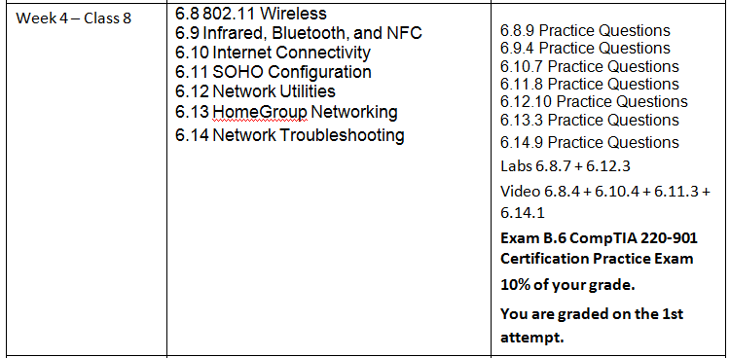
CIAT CIS101A
Week 4 - Class 2
Networking - Continued

Slide 2
CIAT CIS101A
IEEE 802 Networking Committee
802.3 – Ethernet
802.4 – Token Bus
802.5 – Token Ring
802.11 – Wireless (Wi-Fi)

Slide 3
6.8 801.11 Wireless / 6.8.3 Wireless Networking Facts
The following table describes details of a wireless networking architecture:
Characteristic | Description
Devices | A STA (station) is any device that is able to use the 802.11 protocol to communicate on a wireless network. Devices on a wireless network include:
 | A wireless NIC for sending and receiving signals. A wireless access point (AP) is the equivalent of an Ethernet switch. The wireless NICs connect to the AP manages network communication. A wireless bridge connects two wireless Aps into a single network or connects your wireless AP to wired network. Most Aps today include bridging features.
 | Many wireless access points include ports (i.e., switches or routers) to connect the wireless network to the wired portion of the network.

Slide 4
CIAT CIS101A
Characteristic | Description
Connection Method | Ad hoc | An ad hoc network works in peer-to-peer mode. The wireless NICs in each host communicate directly with one another. An ad hoc network is difficult to maintain for a large number of hosts because connections must be created between every other host, and special configurations are required to reach wired networks. You will typically only use an ad hoc network to create a direct, temporary connection between two hosts.
 | Infrastructure | An infrastructure wireless network employs an access point that functions like a hub on an Ethernet network. With an infrastructure network, you can easily add hosts without increasing administrative efforts (scalable), and the access point can be easily connected to a wired network, allowing clients to access both wired and wireless hosts. You should implement an infrastructure network for all but the smallest of wireless networks.
Service Set Identifier (SSID) | The SSID, also called the network name, groups wireless devices together into the same logical network. All devices on the same network must use the same SSID.

Slide 5
CIAT CIS101A
The original 802.11 specification operation in the 2.4 GHz range and provided up to 2 Mbps. Additional IEEE subcommittees have further refined wireless networking, resulting in the following standards:
Specification | Standard
 | 802.11 a | 802.11 b | 802.11 g | 802.11 n | 802.11 ac
Frequency | 5 GHz (U-NII) | 2.4 GHz (ISM) | 2.4 GHz (ISM) | 2.4 GHz (ISM) or 5 GHz (U-NII) | 5 GHz (U-NII)
Maximum speed | 54 Mbps | 11 Mbps | 54 Mbps | 600 Mbps | 1.3 Mbps
Maximum distance | 100 ft. | 150 ft. | 150 ft. | 300 ft. | 150 ft.
Channels (non-overlapped) | 23 (12) | 11(3) | 11(3) | 2.4 GHz: 11 (3 or 1) 5 GHZ: 23 (12 OR 6) | Depends on configuration

Slide 6
CIAT CIS101A
Be aware of the following regarding the wireless networks:
The actual speed and maximum distance depends on several factors including obstructions (such as walls), antenna strength, and interference.
The speed of data transmission decreases as the distance between the transmitter and receiver increases. In other words, in practice, you can get the maximum distance or the maximum speed, but not both.
The ability of newer devices to communicate with older devices depends on the capabilities of the transmit radios in the access point. For example, some 802.11n devices can transmit at either 2.4 GHz or 5.75 GHz. While the radio is capable of transmitting at either frequency, a single radio cannot transmit at both frequencies at the same time. When you connect a legacy device to the wireless network, all devices on the network operate at the legacy speed. For example, connecting an 802.11 b device to an 802.11 n or 802.11 g access point slows down the network to 802.11 b speeds.
A dual band access point can use one radio to transmit at one frequency, and a different radio to transmit at a different frequency. For example, you can configure many 802.11n devices to use one radio to communicate at 5.75 GHz with 802.11a devices, and the remaining radios to use 2.4 GHz to communicate with 802.11 n devices. Dual band 802.11 a and 802.11 g devices are also available.
When you configure an access point, some configuration utilities use the term mixed mode to designate a network with both 802.11 n and non-802.11 n clients. In this configuration, one radio transmitter is used for legacy clients, and the remaining radio transmitter are used for 802.11n clients.

Slide 7
6.8.5 Wireless Security Facts
Authentication to wireless networks is implemented using the following methods:
Method | Description
Open | Open authentication requires that clients provide a MAC address in order to connect to the wireless network. You can use open authentication to allow any wireless client to connect to the AP. You can implement MAC address filtering to restrict access to the AP to only known (or allowed) MAC addresses. Because MAC addresses are easily spoofed, this provides little practical security.

Slide 8
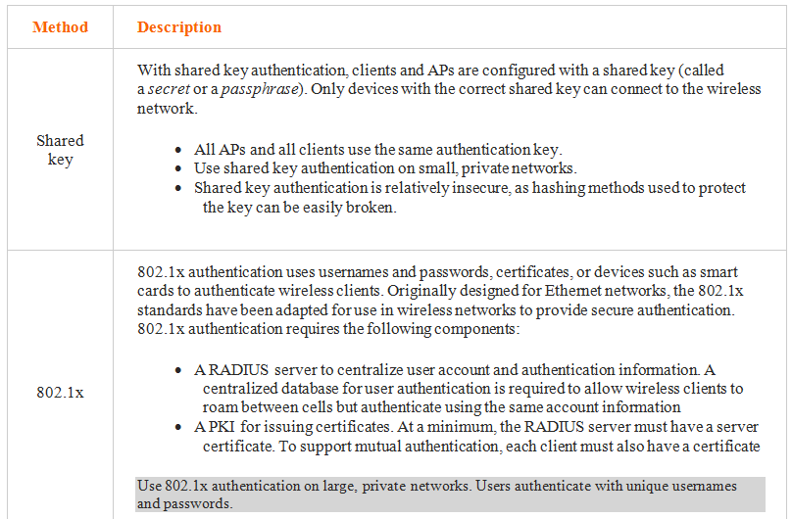
CIAT CIS101A

Slide 9
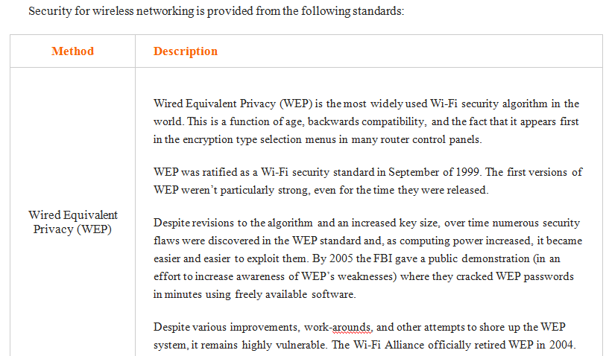
CIAT CIS101A

Slide 10
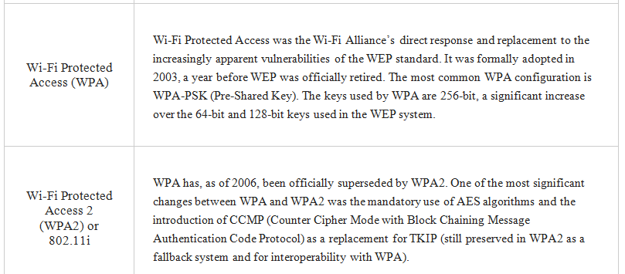
CIAT CIS101A

Slide 11
6.9 Infrared, Bluetooth, and NFC / 6.9.3 Infrared, Bluetooth, and NFC Facts
In addition to 8u02.11 specifications for wireless networking, there are several more wireless communication methods that you should be familiar with:
Method | Description
Bluetooth | Bluetooth uses radio waves in the 2.4 GHz frequency range for communications. Bluetooth uses ad hoc connections between devices to create personal area networks called piconets. A piconet can have up to 7 devices, and each device can participate in multiple piconets at the same time. By using adaptive frequency hopping (AFH), Bluetooth is able to automatically detect other devices in thbe area and avoid the frequencies used by those devices. It can switch bretween 79 channels to avoid interference.
 | A 128-bit proprietary encrption mechanism is used to encrypt signals.
 | Common applications for Bluetooth include the following: Connection peripheral devices (e.g., keyboard and mouse) Wireless headphones and smartphone headsets Peer-to-Peer communications (e.g., sharing data between a smartphone, notebook, and tablet)
 | Bluetooth is also able to transmit audio and video data signals.
Bluetooth version | Max data rate
Bluetooth v1.0 and v1.08 | 768 kbps
Bluetooth v1.1 | 768 kbps
Bluetooth v1.2 | 1 Mbps
Bluetooth v2.0 (and v2.1)+EDR (Enhanced Data Rate) | 3 Mbps
Bluetooth v3.0+HS (High Speed) | 24 Mbps
Bluetooth Smart (v.4.0 and 4.1) | 24 Mbps

Slide 12
CIAT CIS101A
Method | Description
NFC (Near Field Communication) | NFC enables communication between two devices that are in very close proximity with each other.
 | NFC operates in the 13.56 MHz frequency and has a maximum transmission speed of 424 Kbps. Special chips called NFC chips are used to send, receive, and store data.
 | Devices using NFC operate in one of three modes: Read/write mode is used to read information stored on an NFC chip. Peer-to-Peer mode enabled two devices to communicate and exchange information. Card Emulation mode emulates the functionality of a smart card in order to perform contactless payment or ticketing (this mode is typically used by smartphones).
 | In order to communicate, devices must be within 2 inches of each other. Data transmission can be secured by using encryption algorithms.
 | NFC has seen widespread use in the following areas: Contactless payment (e.g., using a smartphone as a payment method) Identification (e.g., passports that contain an NFC chip) Video gaming.
 | Even though NFC has slower transmission speeds than Bluetooth, it consumes much less power and sets up connections much faster.

Slide 13
6.10 Internet Connectivity / 6.10.3 Internet Connection Facts
The following table lists various services you can use to connect to the internet:
Method | Description
Dial-up | A dial-up connection uses a modem connected to the phone line to connect to the internet. Dial-up connections use the public switched telephone network (PSTN). Phone lines are sometimes referred to as POTS (plain old telephone service). Multiple standards define how to send digital data over the analog phone lines at various speeds and compression ratios. Dial-up connections are available anywhere a telephone line exists. Data transfer rates include 28.8 Kbps, 33.3 Kbps, and 56 Kbps. Dial-up connections cannot be used for both voice (phone calls) and data at the same time.

Slide 14
6.10 Internet Connectivity / 6.10.3 Internet Connection Facts
Method | Description
Digital Subscriber Line (DSL) | DSL provides broadband digital data transmission over existing telephone lines. DSL divides the telephone line into multiple channels. One channel is used for analog voice, while the remaining channels are used for digital data. Filters are used to separate the analog voice data from digital data. Several DSL standards exist, including ADSL, SDSL, and HDSL (collectively referred to as xDSL). Depending on the type of DSL used, you can use the same line for simultaneous voice and data. DSL is not available in all areas; the service location must be within a fixed distance of telephone switching equipment.

Slide 15
6.10 Internet Connectivity / 6.10.3 Internet Connection Facts
Method | Description
Integrated Services Digital Network (ISDN) | ISDN is a digital service, running over a switched network. There are two version of ISDN: ISDN BRI divides the regular telephone line into three channels: 2 64-Kbps bearer (B) channels can transfer data up to 128 Kbps (data compression increases the data transfer rate). Only one B channel is used during phone use reducing maximum speed to 64 Kbps. 1 16-Kbps delta (D) channel for connection control.
 | ISDN PRI requires different cables to be installed rather than the regular phone lines. The Cable divided into 24 channels: 23 B channels (each at 64 Kbps) for data transmission. 1 D channel (at 64 Kbps) for connection control.
 | ISDN is not available in all areas; subscribers are required to be within a certain proximity of telephone company equipment. ISDN is more common in Europe than in the United States.

Slide 16
6.10 Internet Connectivity / 6.10.3 Internet Connection Facts
Method | Description
Cable | Cable networking uses a cable TV connection to create a wide area connection to the Internet. A cable modem (router) connects the computer to the cable network for sending networking signals. The same cable line is used to carry networking cable TV signals, although in some cases a separate line is installed for Internet access Cable networking requires the installation of a cable TV line to your location if one does not exist.

Slide 17
6.10 Internet Connectivity / 6.10.3 Internet Connection Facts
Method | Description
Cellular | Cellular networking uses the cellular phone infrastructure for Internet access. Mobile phones with digital data plans use cellular signals to connect to the internet.
 | Devices can connect to a cellular Internet connection in a variety of ways: Many smartphones use a technique known as tethering to provide cellular Internet to another device. Tethering typically requires the smartphone to be connected visa a USB cable. A mobile hotspot is a cellular device that provides Internet access by creating a small Wi-Fi network to which multiple devices can connect. Most smartphones have built-in mobile hotspot functionality. Some mobile devices (e.g., notebook computers and tablets) has integrated cellular antennas. USB cellular adapters can be connected to most mobile devices to provide cellular access.
 | Cellular networking is a truly mobile solution. You can often be moving and still have Internet access without manually having to reconnect.

Slide 18
6.10 Internet Connectivity / 6.10.3 Internet Connection Facts
Method | Description
Cellular | Internet access is limited to areas with cellphone coverage. Coverage will be dictated by the service provider’s network. Cellular networks used for voice and data include the following types:
 | 2G (second generation) networks were the first to offer digital data services. 2G data speeds are slow (14.4 Kbps) and were used mainly for text messaging and not Internet connectivity. 2.5G was an evolution that supported speeds up to 144 Kbps. EDGE (also called 2.75G) networks are an intermediary between 2G and 3G networks. EDGE is the first cellular technology to be truly Internet compatible, with speeds between 400 and 1000 Kbps.
 | 3G (third generation) offers simultaneous voice and data. The minimum speed for stationary users is quoted at 2 Mbps or higher. 4G (fourth generation) offers minimum speeds of around 38 Mbps, with up to 100 Mbps possible.

Slide 19
6.10 Internet Connectivity / 6.10.3 Internet Connection Facts
Method | Description
Satellite | Satellite networking uses radio signals send and received from a satellite.
 | Satellite networking: | Uses a transmitter with an antenna (dish) directed skywards to a satellite Requires line-of-sight to the satellite (dish placement is crucial) Is affected by mild atmospheric and weather conditions (fog, rain, or snow can disrupt service). May have a long delay time (latency) between requests and downloads Can be a portable solution for cars or trucks with an attached satellite dish. Provides nearly 100% global coverage.
 | *Some satellite Internet access solutions are limited to download only. Another solution, such as dial-up, is required to provide upload capabilities.
Line of site | Line of site Internet access (also called fixed wireless broadband) is similar to satellite Internet; however, instead of antennas being directed to a satellite in orbit, they are pointed at a large antenna on land. The antennas use radio signals-typically microwaves—to transmit and receive data.
 | Line of site Internet: | Requires a direct line of site between two fixed antennas. A single, large antenna provides connections for all subscribers in an area. Provides Internet access without needing to run cables or lines to each subscriber’s premise. Can provide Internet to remote area by installing a single antenna. As with satellite networking line of site is affected by weather conditions. Offers speeds of up to 1520 Mbps.

Slide 20
6.10 Internet Connectivity / 6.10.3 Internet Connection Facts
Be aware of the following regarding Internet access:
Regardless of the method, Internet connections are made from the subscriber location to an Internet Service Provider (ISP). The ISP might be the cable TV company, the phone company, or another company, offering Internet access.
Internet requests are sent to the ISP, who then forwards the request to the Internet.
Most wireless networks are local area networks that are connected to the Internet using a wired method (such as DSL or another broadband solution).
Some metropolitan areas provide free, city-wide wireless or wired Internet connectivity. This type of network is known as a metropolitan area network (MAN).
Because many Internet service providers also provide other services (such as cable TV or telephone), you can often combine services to get Internet access with other services.
Voice over IP (VoIP) sends voice phone calls using the TCP/IP protocol over digital data lines. With VoIP, phone calls are made through your Internet connection, not through a phone line. When you make a phone call, the call is converted into digital data and sent through the internet. VoIP is provided by many ISPs to replace existing analog telephone lines (even using the same phone number). Desktop computers can be used to make VoIP calls by using VoIP software and the computer’s microphone and speakers. The most common example of this is the VoIP application Skype.

Slide 21
6.11 SOHO Configuration & 6.11.2 SOHO Configuration Facts
A small office/home office (SOHO) is a small network that is typically based in the home or a small business center. Most SOHO networks have the following characteristics:
Between 1 and 10 connected hosts (computers, mobile devices, or printers) Uses Ethernet or 802.11 wireless networking (both) as the network medium A single Internet connection is shared among all hosts Uses a single subnet Employs a workgroup networking model (i.e., there are no dedicated servers and a domain is not used)
A typical SOHO network uses the following devices:
A modem or router connects the location to the Internet. This connection provides a single IP address for connecting to the Internet. A router connects the private network to the Internet connection. This router is typically a multifunction device, which includes a four port switch, wireless access point, and firewall functionality. Additional wired connections can be provided by connecting additional switches to the router.
A SOHO network uses multiple devices that share a single Internet connection. The connection to the Internet is typically through an access point or router that includes switch ports and/ or a wireless access point to connect devices to the local area network and the Internet. The type of device you use depends on the Internet connection type (DSL, cable, fiber, etc.). The following table describes general steps you would take to configure a SOHO router and set up the network:

Slide 22
CIAT CIS101A
Action | Description
Configure the Internet connection | Begin by connecting the router to the Internet connection using the device’s WAN port. For a DSL or ISDN router, connect the device directly to the DSL/ISDN line. For a cable, fiber optic, or satellite connection, connect the router to the Ethernet port on the modern or connection device. Many routers will automatically detect and configure the Internet connection. If not, follow the ISP instructions for setting up the connection.
Configure the router | Change the default administrator username and password. Default usernames and passwords are easily guessed or discovered by checking the device documentation. By changing the password, you protect the system from unauthorized access. Update the firmware on the router to fix bugs or security vulnerabilities.

Slide 23
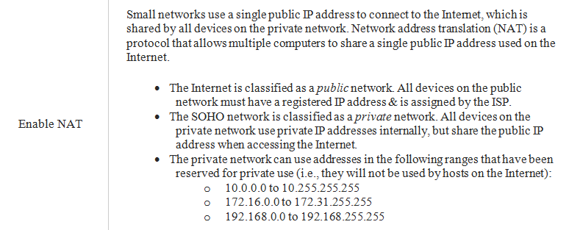
CIAT CIS101A

Slide 24
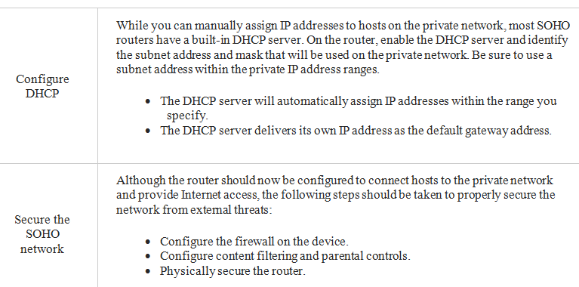
CIAT CIS101A

Slide 25
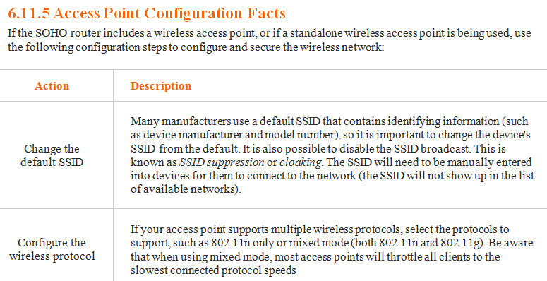
CIAT CIS101A

Slide 26
CIAT CIS101A
6.11.5 Access Point Configuration Facts
If the SOHO router includes a wireless access point, or if a standalone wireless access point is being used, use the following configuration steps to configure and secure the wireless network:
Action | Description
Configure encryption and authentication | Add authentication to allow only authorized devices to connect and use encryption to protect wireless communications from eavesdropping.
 | Always use WPA2 when possible. If WPA2 isn’t available, use WPA. For a SOHO network without a domain, use pre-shared key (PSK) authentication with either AES (more secure) or TKIP (less secure) encryption. Configure the shared secret (passphrase) value used with WPA2 or WPA, Each client needs to be configured with same secret value.
 | Because WEP has several known security vulnerabilities and can be easily cracked, it should only be used as a last resort. Wen using WEP, never use shared key authentication; only use open authentication.

Slide 27
CIAT CIS101A
Action | Description
Enable MAC address filtering | By specifying which MAC addresses are allowed to connect to your network, you can prevent unauthorized devices from connecting to the access point. MAC address filtering can be implemented in one of two ways: All MAC addresses are allowed to connect to the network, except for those specified in the deny list. All Mac addresses are denied access, except for those specified in the allow list.
Disable DHCP for wireless clients | Disabling DHCP on the wireless access points allows only users with a valid, static IP address in the range to connect. An attacker would have to be able to discover or detect the IP address range, subnet mask, and default gateway information to connect to the access point.

Slide 28
CIAT CIS101A
Action | Description
Access point placement | The location of the access can affect signal strength and network access.
 | Keep in mind the following recommendations:
 | Place access points in central locations. Radio waves are broadcast in each direction, so the access point should be located in the middle of the area that needs network access.
 | In general, place access points higher up to avoid interference problems caused by going through building foundations.
 | For security reasons, do not place access points near outside walls. The signal will extend outside beyond the walls. Placing the access point in the center of the building decreases the range of the signals available outside of the building.
 | Do not place the access point net to sources of interference, such as other wireless transmitting devices (cordless phones or microwaves) or other sources of interference (motors or generators).

Slide 29
CIAT CIS101A
Network Utilities
IPCONFIG
PING
TRACERT
NSLOOKUP
NETSTAT
NBTSTAT
TELNET
SSH

Slide 30
CIAT CIS101A
Utility | Description
Ipconfig (Windows OS) | Ipconfig displays IP configuration information for network adapters. Use the ipconfig command as follows:
 | Use Ipconfig to view IP address, subnet mask, and default gateway configuration.
 | Use ipconfig/all to view detailed configuration information including the MAC address and the DHCP server used for configuration.
 | Use ipconfig/release to release the IP configuration information obtained from the DHCP server.
 | Use ipconfig/renew to request new IP configuration information from the DHCP server.
 | Use ipconfig/displaydns and ipconfig/flushdns to view and manage the local DNS cache. The first command displays the contents of the local DNS cache that Windows maintains and updates every 24 hours. The second option flushes (or removes) all the entries in the current DNS cache. If the IP address of a network server is changed, your local cache will contain the old IP address until the cache is updated or the flushdns option is used.

Slide 31
CIAT CIS101A
Utility | Description
ping | Ping sends an ICMP echo request/reply packet to a remote host. A response from the remote host indicates that both hosts are correctly configured and a connection exists between them. You can ping a host by IP address or use the DNS name. When the DNS name is used, the computer must look up the corresponding IP address before performing the ping test.
-a | Looks up the hostname from a given IP address.
-t | Pereforms a continuous ping test (press Ctrl+C to stop sending the ping tests).
-l [size] | Specifies the packet payload size (in bytes) to use in the test. This can help identify if packets above a certain size being lost.

Slide 32
CIAT CIS101A
Utility | Description
Tracert, traceroute | tracert is similar to the ping utility in that it tests connectivity between devices; however, tracert also shows the path between the two devices.
 | Responses from each hop on the route are measured three times to provide an accurate representation of how long the packet takes to reach, and be returned by, the specific host. On a Windows system, use the tracert command. On Linux and mac OS systems, use the traceroute command.
nslookup | nslookup resolves (look up) the IP address of the specifiedc hostname. It also displays additional name resolution information, such as the DNS servder used for the lookup request.
netstat | netstat displays the following IP-related statistics:
 | Current connections Incoming and outgoing connections Active sessions, ports, and sockets The local routing table

Slide 33
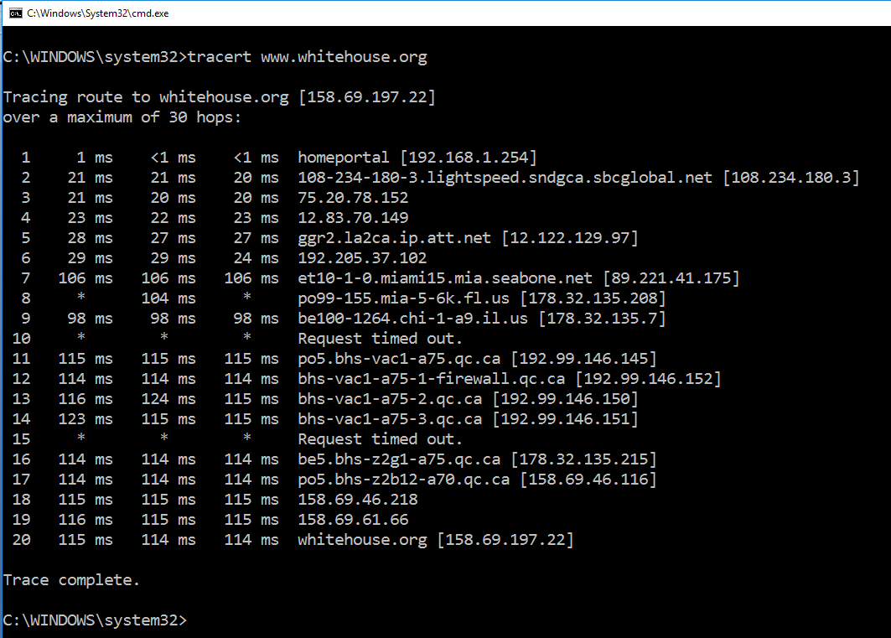
CIAT CIS101A

Slide 34
CIAT CIS101A
nbtstat | Nbtstat is used to diagnose issues regarding NetBIOS over TCP/IP.
 | The following options can be used with nbtstat:
 | -c | Displays the NetBIOS cache of remote machine names and their IP addresses.
 | -n | Displays NetBIOS names that have been registered on the local system.
 | -r | Displays names resolved by broadcast and via WINS.
 | -R | Clears and then reloads the remote cache name table.
 | -S | Displays curent NETBIOS sessions with the destination IP addresses.
 | -s | Displays current NETBIOS sessions by NETBIOS names.

Slide 35
CIAT CIS101A
Telnet | The telnet utility is used for remote server management.
 | The Telnet protocol must be running and configured on the remote server in order for a Telnet session to be established. By default, Telnet does not encrypt transmissions (they are sent as clear text). Telnet is mostly used by specialized industrial and scientific devices.
 | In addition to sending transmission in clear text, there are several well-known vulnerabilities in the Telnet protocol. Because of this, Telnet should not be used when sending sensitive information.
SSH | Similar to Telnet, the SSH utility is used for remote server management; however, SSH encrypts all communications and is much more secure.
 | SSH can be used to remotely log on to a server and complete configuration tasks. In order to establish an SSH session, the server must have the SSH process running and configured to allow remote connections. Use the following syntax to establishing as SSH connection: ssh[username]@[server_address]

Slide 36
End of CIS101A Class Session 8

