Slide 1
PREParation for Appalachian Research Experiences (PREPARE)
Karen Fletcher,
Director, Grants Resources & Services
Appalachian State University

Slide 2
The Program
Fall 2017 – Spring 2018 (8 months)
Beaver College of Health Sciences (BCHS)
Nine mentees
Matrix of Mentors
8 Educational Sessions
Increase NIH submissions/funding

Slide 3
Goal 1. Build strong networks of research active faculty in BCHS.

Slide 4
Goal 1 Activities: Mentoring Relationships
Scientific
Senior
Mentee
Staff
Peer

Slide 5
Goal 2. Provide Grantsmanship Training that will develop successful researchers.

Slide 6
Goal 2 Activities: Education Sessions
Program and Mentoring orientation
NIH & Proposal Writing & individual meetings
SPIN Database
Funding Your Research
eRA system
Library services & databases; where to publish; assessing your research - measures & metrics

Slide 7
Goal 2 Activities: Education Sessions
New Faculty Workshop
IP; Technology Transfer; online identity; digital scholarship; data curation; preservation and access
Grant Writing Overview
Communicating Science
Mock Panel Review

Slide 8
Goal 3. Create faculty advocates for the Office of Research Staff to improve compliance with standards on and off campus.

Slide 9
Goal 3 Activities
Meetings with Sponsored Programs & other Office of Research staff
New Faculty Orientation

Slide 10
Monthly Program Requirements
Senior mentor/mentee meetings
Educational session
Supplemental reading
Meetings with Office of Research personnel as needed

Slide 11
Results
Seven out of the nine mentees attended at least six education sessions
Seven out of the nine mentees submitted either an internal or an external grant proposal

Slide 12
Feedback:
“What came out of that initial meeting…was that all of my mentees…who are further along in their careers - felt overwhelming stress because of their workload and personal lives…there appears to be a lot of stress in balancing the intensely time-consuming, clinical nature of their respective undergraduate and graduate programs with the need to conduct, publish, and fund their research.”

Slide 13
Feedback:
“What they most wanted out of mentoring was not the writing help that I was anticipating (and what I think PREPARE was set up to do), but rather the social support and advice about navigating the "soft-skills" of the job, as well as just connecting with other people who shared their research interests.”

Slide 14
The Future
Continue to monitor mentee output
NSF ADVANCE grant submission
No funding
Volunteers
Expanding to the College of Arts & Sciences
Focus on Early Career Awards
Add component of Research Readiness Awareness

Slide 15
Questions?

Slide 16
The Problem with Contracts: A Triage Solution for Business Agreements
Megan Moore, Co-Investigator
Harvard University
Notes:
Good morning, my name is Megan Moore and I am the Associate Director, Grants and Contracts within the Harvard University Office for Sponsored Programs. I am also a Co-Investigator, along with Jennifer Ponting, the Director of Pre-Award within OSP, and Tiffany Blackman, the Senior Director of Pre-Award Services, Faculty of Arts and Sciences at Harvard, on the NCURA funded project entitled “The Problem with Contracts: A Triage Solution for Business Agreements.” The aim of our project is to create a simple tool to address a not-so-simple problem, that is the efficiency impacts and business risks caused by the misidentification and misrouting of legal agreements within an institution.

Slide 17
The Problem(s) with Contracts
Legal agreements impact University researchers and administrators on a daily basis
Agreements are non-standard and arrive on campus through varied avenues
Workflow processes only effective if agreement types are properly identified
Notes:
How many of you deal with – and by that I mean review, sign, or otherwise facilitate the review and signature of some kind of legal agreement at least weekly? And how many of you more broadly need to be aware of the requirements of a contract, for example a sponsored agreement, in your day to day work?
Clearly agreements play a central role in really all University functions, including, and with particular pertinence to, research and related activities. Whether an agreement is being used to formalize a collaboration between two PIs, license an invention to industry partners, or codify a purchase order, legal agreements impact University researchers and administrators on a daily basis. Compounding the volume of contracts that are received by or otherwise impact the operations of a University on any given day, is the fact that, notwithstanding the buckets we put them in – Sponsored Research Agreement, DUA, Non-funded collaborations – agreement templates are non-standard. Further they arrive on campus through varied points of entry. While a senior administrator managing a central sponsored notices inbox may know whom to route an incoming agreement to, that may not, quite understandably, be the case, for the grad student who receives an NDA from a prospective data provider, or the department administrator who receives a vaguely titled “Memorandum of Understating” from his or her PI for process (or worse, one already signed by his/her PI!).
While as institutions we put top-down processes in place dictating which agreement type should go where, and who it may be signed by, the fact is, these processes and guidance are only effective if the agreement itself is properly identified. Indeed, a not insignificant amount of time is dedicated to recapturing those agreements that fall outside of the proper channels. This impacts not only efficiency, but can poses significant business risks, depending on the content and scope of the agreement. We recognized that while we spent a lot of time discussing process, and even presenting on the purpose and scope of research-related agreements to departments, these approaches failed to consider the objective difficulty – even for seasoned negotiators at times – of figuring out which process, what box, a particular agreement fits into, when it doesn’t have (or even often enough when it purports to) its name and purpose prominently defined.
Given this disconnect, we proposed to develop a simple, web-based tool, customizable by institution, that could assist administrators in real time to identify and properly route legal agreements for review.

Slide 18
Where to Begin?
Notes:
Having acknowledged the problems with the top-down, prescriptive approach, and wanting to develop a more practical, accessible resource for researchers and administrators, we went back to the basics. That is, how do we define the type of agreement to begin with? If agreements are non-standard in form and are being triaged by administrators of varied experience and familiarity with contract types, how do we approach making sense of the word soup that agreements, particularly those that arrive with those super helpful Memorandum of Understanding or Letter of Agreement titles, can so easily present as?

Slide 19
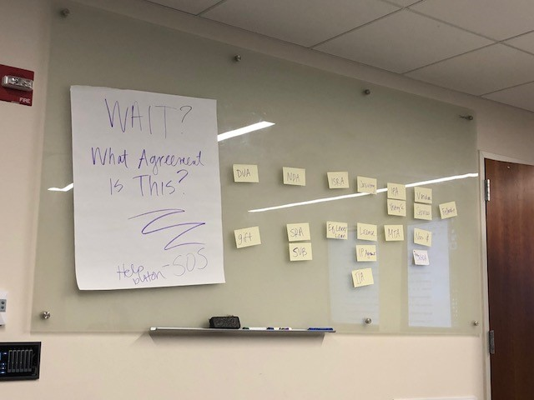
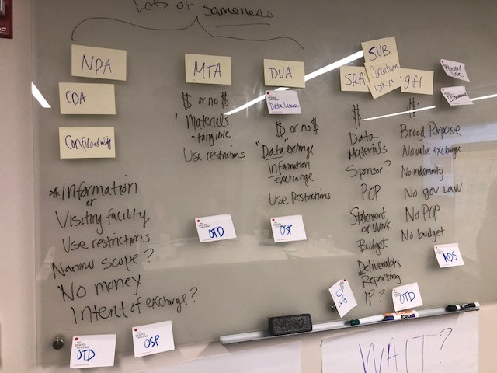
Design Phase
W.A.I.T
What Agreement Is This?
Planning Meeting!
Notes:
We approached this initial question with a couple of whiteboards, a lot of post-its, and a brain trust of seasoned agreement negotiators to sort through the defining characteristics of agreements that we would then use to map our WAIT, or What Agreement is This?, Web tool (then and still the working name). As research administrators, our focus was naturally on those agreements that touch on research activities (recognizing of course those are only a slice of the pie), and accordingly, we narrowed out initial focus for the WAIT tool to what we agreed were the most common agreements that impact sponsored research: NDA/CDA, DUA, MTA, Sponsored Research Agreements, no-$/Collaboration Agreements, MOUs (e.g. teaming, preliminary agreement), Gifts and Services/Vendor Agreements. We then attempted to list their defining characteristics, group those agreements that were largely similar in type, and otherwise ensure we had a ‘home’ in terms of responsible reviewing office, for each type listed.

Slide 20
Design Phase
Notes:
From the forest of post-it notes, we worked to more clearly map the landscape of agreements and their respective characteristics. In certain instances, such as terms describing the tangible exchange of materials under an MTA, these characteristics were essential to the agreement type, giving us a factor to either group or separate one agreement type from another; in others, such as IP terms under a DUA, they may be present, or may not be, making such factors less useful to arriving at a determination. We also found it was important to consider that the absence of characteristics, such as under a Gift, could also be integral to defining the type of agreement at hand.

Slide 21
Design Phase
Attribute
Distinguish Agreements by identifiable characteristics
Agreement Type
Correlation of characteristics leads to identification of Agreement Type
Responsible Office
Successful identification linked to existing workflow processes
Notes:
Sorting through Agreement components led to us to a bottom-up approach to Agreement identification – if identifiable characteristics could be identified by the user, and correlated by the tool, they could be used to generate an agreement definition more effectively, rather than requiring individuals unfamiliar with agreement components to make a holistic assessment of the document in front of them. In other words, those essential characteristics could be used as yes/no points in a decision tree to guide users to the appropriate agreement ‘bucket,’ which could then be linked to existing workflow processes.

Slide 22
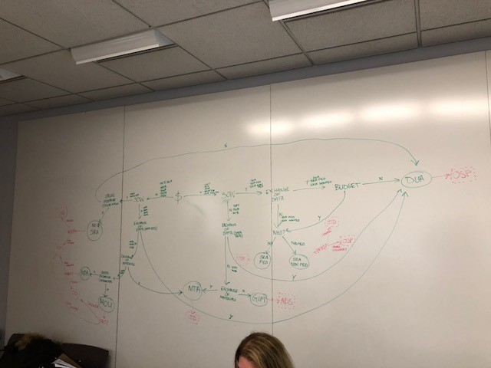
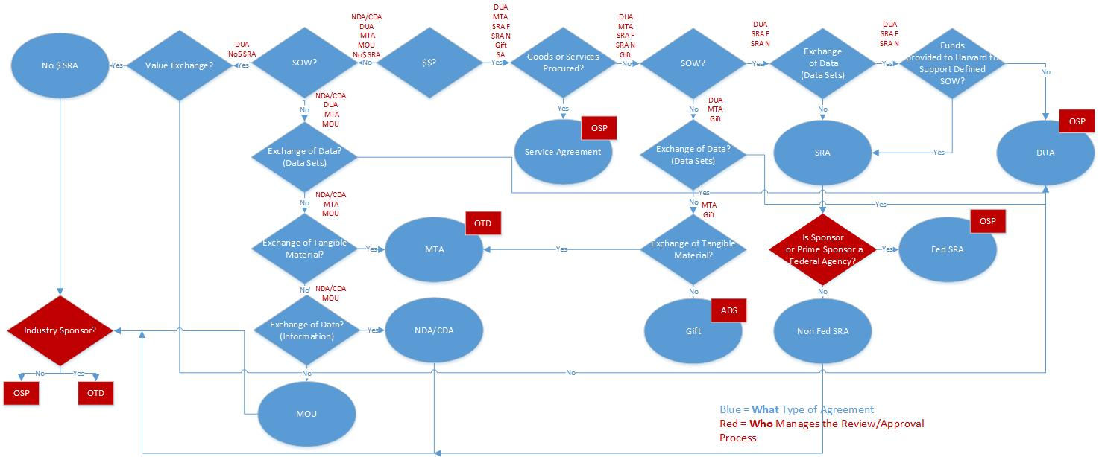
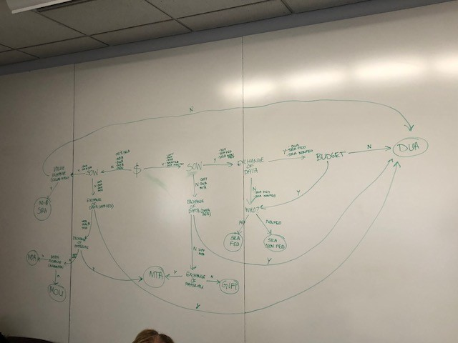
Design Phase
Notes:
Returning to the whiteboard, this time we sorted through the determinative characteristics to assess how we could align them into a decision tree, with the goal of each yes or no answer further put the user down the path towards an accurate ID, in the most direct way possible. (i.e. – how many components did we REALLY need to assess to distinguish an agreement into one of our defined buckets.) The white board ‘mapping of our brains’ as we called it, was then molded into a much more legible Visio chart representing the underlying decision tree for the WAIT Tool.

Slide 23
Testing Phase
Cross-section of testers
Pilot testers
selected from
across departments
“De-identified” Agreement samples
Test examples culled from actual executed Agreements
“Control group” of experienced contract officers
Sponsored Programs negotiation team as “control group”
JotForm mapping
Notes:
In preparation for testing the decision tree we had mapped, we assembled a selection of 25 Sample Agreements, from which we redacted any ‘giveaways’ (such as the agreement title) and personally identifiable information. We then reconstructed the decision tree in a JotForm form, and assembled a selection of pilot testers from across departments w/varying levels of experience reviewing agreements. We further included a “control group” of experienced contracts officers – not the intended audience of the tool, but who could help us to verify its accuracy. We sent them a detailed list of instructions on how to complete the JotForm, along with the sample agreements for testing, and afforded them 3 weeks in which to complete as many reviews as time allowed. As part of the JotForm, we also asked for feedback on certain aspects of the user experience, to assess the weaknesses of the decision tree as we looked towards revising it for further testing.

Slide 24
Testing Phase
8.3%
24 sample agreements
41% response rate
18.8%
60.4%
12.5%
Notes:
24 sample agreements – 3 of each type within system
41% response rate on initial testing phase
Questions Clear/Agreement Type as Expected 60.41%
Questions Clear/Disagree w/Agreement Type 12.50%
Questions Should Be Refined 18.75%
Incomplete/User Error 8.33%

Slide 25
Testing Phase
(i) Assessing Question Clarity
Terms of Art
Decision tree should incorporate appropriate ‘terms of art’ reflecting common agreement terminology
Common Understanding
Questions must reflect unambiguous, recognizable components, notwithstanding experience of user
Notes:
The two key points of feedback we asked for from our Phase I testers were their thoughts on individual question clarity, and whether they agreed with the agreement type designated by the WAIT Tool.
Focusing first on Issues with Question Clarity: It became evident in reviewing the first round of responses that there is an inherent challenge in distilling terms of art into objectively recognizable agreement components, without assuming familiarity with their nuances. For example – in an effort to get at whether an agreement had a defined statement of work, our initial decision tree asked “Does your agreement contain a defined statement of work or project description?” This led to some testers conflating the agreement’s purpose with such an SOW – a reasonable conflation. Similarly, our initial question, “Are you procuring goods and services?” places the onus on the user, and suggests only incoming vendor engagements.
“Does your agreement provide for the exchange or receipt of IP...or other value exchange?”
Accordingly, for Phase II testing, we changed this decision point to “Does your agreement contain a detailed statement of work with specified objectives?” and will compare feedback. Similarly, for Services agreements, we revised the question to ask, instead of “Are you procuring goods and services,” “Is the purpose of the agreement procuring goods or services?,” emphasizing purpose over simple procurement language.
Recognizing, while working to limit, education/familiarity gap.

Slide 26
Testing Phase
(ii) Disagreement with Agreement Type
No $ Research Agreement
MOU
How do we make the non-standard…
standard?
NDA
DUA
Notes:
(2) Disagreement w/ Agreement Type: Not unrelated to the challenge of phrasing characteristic questions appropriately, we further encountered a handful of issues where the user disagreed w/the Agreement type. In further analyzing the commentary, these disagreements tended to stem from either
a high level misunderstanding of the type of Agreement (or user error) or (ii) the fact that, notwithstanding our ‘ideal’ framing of the components of an agreement, certain of our samples deviated from the defined ‘standard’.
I. High Level disagreement – Intent was to have non-funded research agreements include all agreements that purport to encompass a defined research collaboration (i.e. an SRA w/o money), confusion over the scope of an MOU – and the fact that many types of agreements may be called an MOU – led us to question how to better encapsulate the MOU bucket, which we intended to capture preliminary, generally non-binding agreements under which parties agree to contemplate a future action. Similarly, the distinction between data and information, and even materials and data, depending on how each is defined in a given agreement, can be a tricky one, if a use is unfamiliar with how such categories are typically defined. Given that in all instances of a user disagreeing with an agreement type, the tool’s assessment aligned with ours, we recognized that provided further guidance as to intended buckets/definitions of these agreements, would be helpful to include in the guidance documentation that we intend to accompany the final tool. That said, we decided to rename the MOU category as MOU/Other, to see if in impacted user ‘agreement’ with the result. We further recognized that, in institutions where these types of agreements follow different paths, if these ‘disagreements’ keep coming up, we will need to further revisit whether our gating questions are in fact the correct ones, or otherwise give thought to how to whether we can use this tool to better combat those “grey area” inconsistencies in interpretation, recognizing we can’t be perfect – limiting rather than getting rid of the unknown – will always be tricky agreements.
II. Incongruous components: One of our MOU samples had an attachment labelled “SOW,’ while MOUs were in the “no” column of that particular column. Accordingly, we had confusion between agreements being placed in the non-funded research agreement vs. MOU bucket. – while our. BUT ALSO, AGREEMENTS CONTAINING ASPECTS THEY ‘SHOULDN’T’ – SOW in an MOU. Might not technically define it as an SOW in the deliverable sense, but it still sets forth the intended scope of the project. Similarly, a DUA – which SHOULD – may not (also not an obligatory deliverable). How to address that lack of standardization that led us to pursue the project in the first place?

Slide 27
What’s Next?
Summer
Phase II Testing
Fall
Collaborate with Web Designer on Platform and UI Design
Finalize Internal Version for Further Testing
Winter
Rollout Customizable Platform and Accompanying Guidance Documentation
Finalization of Decision Tree
Notes:
Success metrics – Long term: increase in volume of ‘correct’ agreements, decrease in ‘what do I do with this’, Short Term: Reducing User confusion over question clarity, disagreement w/type.
Consider role of outreach/guidance

Slide 28
Questions?

Slide 29
Increasing the Odds of the Return on University Investments into Faculty Research: Skills versus Money
Katy Hendry, M.S.
University of West Florida
Senior Grant Specialist & Internal Grants Coordinator

Slide 30
The Problem, The Purpose & The Polestar
The Problem: UWF is a predominately undergraduate serving institution with a 3:3 teaching-load and is recognized as a teaching institution versus research-intensive institution. The University wants to shift from being strictly focused on teaching and become more balanced with equal weight on research and research (grant expenditure) output.
The Purpose: This project was designed to analyze and design the best method for increasing external funding at a small institute or PUI-university.
The Polestar: Increase faculty output in external grant submissions by identifying appropriate internal grant mechanism(s) to both motivate faculty scholarship desires and provide funding support for their projects that yield the
highest return on the University’s investments from external funding
agencies.

Slide 31
Methodology & Design Understanding the Players
Faculty Categories |  | Motivation
 |  | High | Low
Ability | High | High Motivation & High Ability | Low Motivation & High Ability
 | Low | High Motivation & Low Ability | Low Motivation & Low Ability
Analyze previous internal grant funding programs at UWF
Evaluate the UWF faculty and climate of research taking place at the institution
Prepare baseline data for benchmarking
Research, H. (2014, May 1). (Rep.). Retrieved from https://www.hanoverresearch.com/media/Building-a-Culture-of-Research-Recommended-Practices.pdf

Slide 32
Internal Research Initiative Model (IRIM)
Small Grant RIO
Medium Grant RIO
Grant Writing Boot Camp RIO
The goal of this project is to develop an efficient and ongoing mechanism for internally supporting faculty research that produces a higher rate of return on externally submitted proposals; Internal Research Initiatives Model (IRIM)

Slide 33
Data Collection & Results
Additional data being collected:
Finalize Baseline data for model design (remaining data received on July 1, 2018).
FY16-17 – external proposal submissions (funded/unfunded)
Faculty Questionnaire (non-internal grant participants & internal grant participants)
Development of IRIM Model (spring 2019)
Category | Total Results/Entries
Fiscal Years | 8
University Colleges | 5
Total Internal Grant Requests | 423
Total Funds Requested | $7,638,059*
Total Match Provided | $378,964*
Total Funded | $2,893,609*
Total External Proposals | TBD
Total External Proposals Funded | TBD

Slide 34
Expected Outcomes & Broader Impacts
Internal Funding from the institution
Specialized Proposal Development
Tailored Trainings from start through submission
Expected Outcomes: Long-term writing group which incorporate motivational tools and mentoring will achieve the best return on university investments.
Broader Impacts: The Internal Research Initiatives Model (IRIM) will be used as a platform for enhancing Research Administration across all types of higher education institutions.

Slide 35
NCURA Research Program for 2017-2018 Funded Projects: Global Mentoring Program For Research Administrators
Mary Catherine “MC” Gaisbauer, Contracts & Grants Accounting, Assistant Controller, UCSF
Georgina Lopez, Director, Institute for Global Health, UCSF
Winona Ward, Director, Office of Sponsored Research, UCSF

Slide 36
Agenda
Introductions
Project background
Project findings
Ideal future program
Next steps
Discussion

Slide 37
Introductions
We represent the spectrum of research administrators across our organization, the University of California San Francisco:
Winona Ward, Office of Sponsored Research (the pre-award perspective)
Georgina Lopez, Institute for Global Health Sciences (the department perspective)
MC Gaisbauer, Contracts & Grants Accounting (the post-award perspective)

Slide 38
Project Background - Overview
Pilot a structured global mentoring program linking an experienced mentor from the U.S. with an internationally based mentee
Determine if an international mentoring program is sustainable, and
Derives benefits to both the participating individuals and their employing institutions

Slide 39
Project Background – Program Structure
Application submission and review through mentor/mentee selection and matching
In person launch at the 2017 NCURA annual meeting
7 month of program delivery included
Mentoring pair one-on-one sessions, virtual training for mentees, support meetings for mentors, and
The implementation of a business process improvement project by the mentee at their institution with support from their mentor
In person capstone event at the 2019 FRA/PRA that included poster presentations of BPIs by mentees, final training opportunity, and completion awards

Slide 40
Global Representation of Mentoring Pairs
Notes:
Mentee - Mentor
Anthony Wachira - Azeb Sertsu
Kenya Medical Research Institute - University of California San Francisco
Assistant Director of Finance - Contracts & Grants Accounting Service Team Lead
Jasminka Sterjovski - Olive Giovannetti
Doherty Institute, The University of Melbourne - University of California San Francisco
Research Manager - Assistant Team Manager, and Contracts & Grants Officer
Kevin Okoth - Panda Powell
Kenya Medical Research Institute - University of North Carolina Wilmington
Program Finance Manager - Director, Sponsored Programs & Research Compliance
Jessica Brody - Cormac Slevin
University of Melbourne - New York University
Senior Grants Officer, International (Acting Manager, International Grants) - Projects Officer for Global Research
Cecilia Martinsson Björkdahl - Gai Doran
Karolinska Institutet - Yale School of Forestry & Environmental Studies
Project Manager - Director of Research
Christine Chang - Sally Brown
Karolinska Institutet - University of California San Francisco
US Research Funding Specialist - Research Services Coordinator

Slide 41
Project Background – Program Goals
Demonstrate that a global mentorship program provides:
mentees with a broad range of personal and professional benefits (i.e., development of new skills and knowledge)
mentors with tangible benefits (i.e., recognition as subject matter experts and leaders)
benefits to the participating organizations (i.e., enhance staff leadership and coaching skills)
benefits to NCURA Region VIII (i.e., increase awareness at international institutions)
Notes:
Mentee benefits: Exposure to new ideas and ways of thinking; Advice on developing strengths and overcoming weaknesses; Guidance on professional development and advancement; Increased visibility and recognition within the organization; Development of new skills and knowledge
Mentor benefits: Recognition as a subject matter expert and leader; Exposure to fresh perspectives, ideas and approaches; Extension of their professional development record; Opportunity to reflect on their own goals and practices; Development of their personal leadership and coaching styles
Institutional benefits: Develop a culture of personal and professional growth; Share desired company behaviors and attitudes; Enhance leadership and coaching skills in managers; Improve staff morale, performance and motivation; Engage, retain and develop top performers
NCURA benefits: increase awareness and involvement of research administrators at international participating partner institutions

Slide 42
Project Background – Program Goals
Demonstrate that investing in research administrators at partner institutions via global mentorships directly benefit US institutions and improves our ability to conduct global research
Staff development at international institutions improves compliance at international partner institutions and reduces compliance costs for the prime institutions

Slide 43
Project Background – Program Monitoring and Evaluation
Conduct evaluation of effectiveness of meetings/trainings through pre- and post-testing of each activity
Conduct quarterly evaluation of effectiveness of mentoring program from mentees and mentors, including identification of potential barriers/challenges
Program review via mentor and mentee focused sessions to obtain feedback
Compile evaluation feedback and determine if the program is sustainable and has achieved desired outcomes

Slide 44
Project Findings: Mentee Benefits
Full support of mentors on daily issues
Exposure to better ways to implement current activities
Increased exposure to new ways of looking at improvements for compliance, change management, benchmarking and working with employees
Gained knowledge from experts
Helped drive home what mentee already knew
Notes:
Mentee benefits:
Exposure to new ideas and ways of thinking;
Advice on developing strengths and overcoming weaknesses;
Guidance on professional development and advancement;
Increased visibility and recognition within the organization;
Development of new skills and knowledge
Exposure to new ideas and ways of thinking
Mentee was able to learn about how to implement change, and change management. Learning about successful changes made at the mentor’s institution was helpful for context.
Mentee was exposed to subject matter expertise and training.
Mentee focused on different models for Research Administration, tools, checklists, etc. and was able to see the differences in how the institutions do business. In some cases, there are good reasons why things are done differently, in others, it is purely due to manpower or organizational structure.
The True Colors exercise was impactful for mentee and she reflected on the exercise and results.
Mentee wanted to be successful; needed a good “closeout process” he used much of the information garnered during the program from the mentor institution as a model. In the future, mentor believed that additional exposure to process improvement tools, such as Lean, would be beneficial.
Advice on developing strengths and overcoming weaknesses
Mentor believed that the True Colors and Business Improvement Project was important for mentee; helped mentee see the big picture and was good to work on a focused, innovative project.
Mentor felt he could have done a better job of steering the mentee; been more firm with deadlines, etc. When asked if the reason for this was the 1:1 pairing, or programming, the mentor felt it was the pairing, since this particular mentor did not supervise any staff at his institution. A few mentors agreed that deadlines and sticking to deadlines could be improved. But one mentor reassured her mentee that he did not have to be completely prepared in order to meet or talk about progress.
Guidance on professional development and advancement
Mentor had a mentee conduct professional interviews.
Mentor felt her mentee was more concerned about the development of his own staff than his own professional development.
Mentor confirmed mentee wanted to grow in her current role.
One mentor had some expressed that due to his mentees supervisory role, much of their discussion was about metrics, new Director and related issues. While another mentor who was also paired with a higher level mentee did not express concern. This was due in part to the mentor having a good support structure, cultural similarities with the mentee, as well as existing collaboration with the mentor and mentee institutions. It was noted that perhaps the program should consider levels, or at minimum, train mentors to set aside their position and give them confidence in their experience and exposure as senior research administators.
Increased visibility and recognition within the organization
Mentor indicated it would be great if the mentor and mentee could spend time together in person; possibly combine with the NCURA fellowship program. Also a longer time period is desired, perhaps 18 months; 12 months to ramp up and 6 months for BPI; or 6 months to get to know each other and institutions, and 12 months for project. Also would be good to have 3 months after BPI to check and adjust.
Mentor felt that the program should pay for travel to the kickoff and capstone.
When asked if their institution would support a two week on-site fellowship, mentor said his institution would want to see a direct connection and benefit.

Slide 45
Project Findings: Mentee Benefits
Business Process Improvement Project
Led by the mentee at their institution and guided by the mentor
Created a joint goal for the mentoring partnership
Method for mentee to continually apply their learned skills at their institution and increase their institutional professional standing
Notes:
Business Process Improvement (BPI) activity led by the mentee at their institution and guided by the mentor. A good portion of the annual meeting and the first check-in meeting were dedicated to the BPI planning. The BPI activity proved useful in creating a joint goal for the mentoring partnership, which was a little more objective than other identified mentee goals for their relationship. It also has proven to be a good method for the mentee to continually apply their learned skills at their institution as well as increase their institutional professional standing.
Cecilia Martinsson Björkdahl presented the project “US non-Financial Compliance Processes at a Swedish Medical University”
Successes and challenges: Existing US federal grant non-financial processes are revised; gaps between US requirements and existing national and /or European regulations are identified; and international collaboration are improved.
Next steps: Karolinska Institute is looking forward to continuing the relationship and work as a team.
Anthony Wachira presented the project “to Develop and Implement a Standard Closeout Procedure that Can be Used As a Guideline for Existing and New Employees to Close 50% of the Current Closeout Population of Three Hundred Projects at KEMRI by February 2018”
Successes: 135 externally funded projects have been closed during the 9 months; administrative and financial closeout policies and processes are developed; the project allows an easier process to implement the upcoming Enterprise Resource Planning (ERP) as well as increases the chance of incremental funding; and enforces management to understand the importance of closeout in a timely and effective manner.
Challenges: There is a lack of performance measures; procedures in award closeout is not effective; growth rate in awards has been rising faster than its staff levels, policy, and procedure development; and there are too many tasks that take precedence over closeout.
Next steps: KEMRI is looking forward to continuing the relationship and also learning the annual PI review.
Discussions: KEMRI hired 2 compensated interns to work on this project for a period of 6 months, and KEMRI is going to replace these 2 interns with the new staff.
Christine Chang presented the project “Establishing a US Research Funding Grants Tracking System for Karolinska Instituted Grants Office in Sweden”
Successes: Salesforce was identified to fulfill the grant tracking system requirements based on criteria, including low cost; great interactive interface suitable for users without extensive IT knowledge; fantastic customer support; and free-trail options.
Challenges and Next Steps: The project’s result must comply with the General Data Protection Regulation (GDPR) agreement before bringing it into the institute. It takes steps, but is endurable.
Olive Giovannetti presented the project “From Little Things, Big Things Glow.. Wild (Business Process Improvement: Establishing Processes for Grant and Contract Proposal Submission for a New and Growing Department”
Successes: Improved processes of pre- and post-award are implemented; MS Excel database stored on the shared network folder that can be accessed by all staff.
Challenges: The Doherty Department has nearly tripled the number of staff and students over the past 4 years and so the process of approval for research proposal submissions needs to be reassessed, formalized and streamlined.
Next Steps: Satisfaction of the faculty and staff about the new process needs to be assessed.

Slide 46
Project Findings: Mentor Benefits
Opportunity to reflect on careers and their future
Opportunity to "think outside the box" and evaluate the day to day way of doing things
Exposure to other ways of handling situations and all of the training
Enhanced skills related to finding resources and sharing knowledge
Increased confidence in sharing mistakes and successes as a way of motivation
Notes:
Mentor benefits: Recognition as a subject matter expert and leader; Exposure to fresh perspectives, ideas and approaches; Extension of their professional development record; Opportunity to reflect on their own goals and practices; Development of their personal leadership and coaching styles
Mentor saw where he could improve as a mentor and also a supervisor, he needs to be more assertive with deadlines and making progress. The program helped to position him as a professional with global experience.
Mentors thought it might be beneficial to have the True Colors exercise earlier in the program in order to leverage the information learned. Also check in with mentors early on, expectations and how to move relationship forward.
A mentor gained a deeper appreciation for her own institution.
Another said it helped him gain insight into what it would be like to move to another institution.
Mentor did her own research on mentoring to prepare.
Mentor gained a deeper appreciation of her own institutional processes and a feeling of self-worth through sharing knowledge with and guiding her mentee.
Participating Program Benefits
Mentors and Mentees agreed that the BPI is a clear, tangible benefit/output for the mentee and mentee institution from the program.
Mentor indicated that his initial goal was professional development, but with no tangible benefit for the mentor, he was anxious to see if his performance evaluation would be reflective of his mentorship effort.

Slide 47
Project Findings: Benefits to Institutions
Business process improvement enhanced the institution’s environment
Supervisors noticed professional growth and improve employee motivation
Networking opportunity with institutions skilled in the conduct of global research
Access to subject matter experts
Future consultation and information related to regulations, laws, challenges, etc.
Notes:
Institutional benefits: Develop a culture of personal and professional growth; Share desired company behaviors and attitudes; Enhance leadership and coaching skills in managers; Improve staff morale, performance and motivation; Engage, retain and develop top performers
development of research administrators at their institutions, international sub-recipients can improve their ability to meet funder compliance thereby increasing their capacity to serve as future prime recipients.
Broader Impacts
Mentor indicated he would be working to evaluate whether a satellite campus should become an EU-eligible institution; looking at EU criteria, terms and conditions, data protection, etc. Mentor indicated that he would like to see participation as a mentee paired with a mentor already operating a global campus in a non-us campus.
Could we expand the program to include foreign to US mentorships?
Mentor indicated that the program already led to improved coordination of subcontracts with mentee institution.
Challenges
Only five continents were involved so we were able to find optimal meeting times for all participants; if we expand the program, we may have to move to 2 or more cohorts due to time zones.
The participants discussed alternate options for live meetings; e.g. use of technology for videos, written assignments, Google, Blackboard, Facebook, WhatsApp, “meet-ups”, blog posts etc.
Mentors sought more opportunity for collaboration among the mentors. Smaller cohorts may help this (region-specific) and/or more “breakout” sessions.

Slide 48
Project Findings: Benefits to NCURA
New international institutions participated and gained awareness of NCURA
Increase global footprint of NCURA programs
Development of next generation research administrators skilled in the administration of global research
Notes:
NCURA benefits: increase awareness and involvement of research administrators at international participating partner institutions

Slide 49
Project Findings: Program Sustainability
Achievable goal to conduct virtual mentoring
Requires dedicated program administration and technology
Coordination of time zones needs to be considered
Modified application structure; matching
Addition of on-site fellowship
Notes:
Sustainability Ideas
NCURA/SRA/INORMS
More refined applicant criteria and matching process
Existing collaborative relationships (organizational and/or individual)
Pre-award/post-award pairing
Should we allow mentors/mentees to link applications, or apply together? This could be beneficial, and institutions may be more willing to provide matching funds.
The addition of an on-site fellowship would be useful, perhaps leveraging existing NCURA program. This may also require existing collaborative relationship to get institutional “buy in”.

Slide 50
Future Program Options: Participant Recommendations
Extend program length from 9 months to 12-24 months (sweet spot is 16)
Expand objective to include bi-lateral international cross-learning
Include additional in-person activities
Preference for institutional exchange
Notes:
Sweet 16 month program !

Slide 51
Next Steps: Moving Towards the Future Ideal Program
Appoint oversight committee
Develop monitoring and evaluation plan
Finalize sustainable program plan
Identify administrator and funding
Establish program technical requirements (i.e., websites, meeting space, collaboration space)
Launch awareness campaign
Kickoff the first cohort
Check and adjust after each year

Slide 52
Discussion – Q&A

