Slide 1
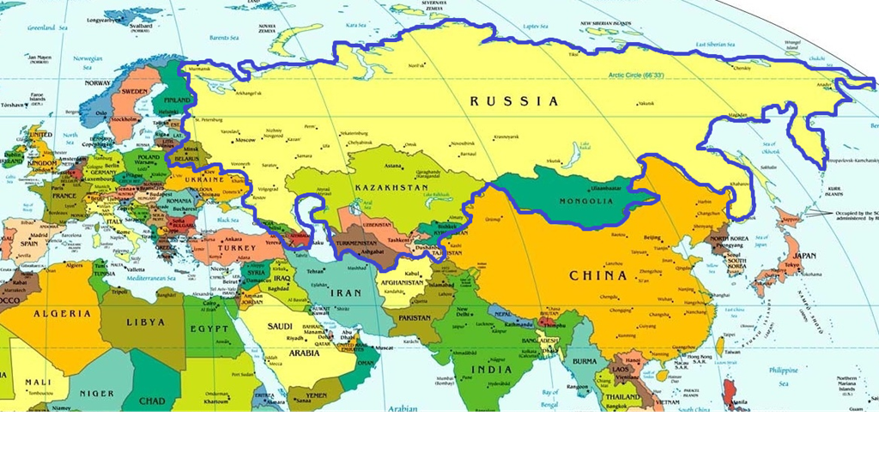
Defining Eurasia

Slide 2
A region defined by trade: The Silk Road

Slide 3
Mongol Empire

Slide 4
Russian Empire

Slide 5
Empires
Ottoman
Russian
Mongol
Persian
Arab Conquest
China

Slide 6
The Rise and Fall of Eurasia

Slide 7
Country choices
Armenia
Azerbaijan
Georgia
Iran
Iraq
Afghanistan
Pakistan
Uzbekistan
Turkmenistan
Tajikistan
Kyrgyzstan
Kazakhstan
Mongolia
Xin Jiang

Slide 8
Cities to Highlight
Ashgabat
Astana
Bagdad
Bukhara
Kashgar
Dushanbe
Tashkent
Osh
Kabul
Samarkand
Termez
Nishapur
Merv

Slide 9
Themes/Issues to Explore
Ethnic identities and relations in your place
National Identity, story-telling, geography
Spiritual/philosophical foundations of your place and their visibility, influence today
Legacies of sovietization (political, economic, cultural, gender relations, security)
Relations with, influence of Russia
Relations with, influence of China
Gender roles (past, present)
Eurasianism, what it means in your place, stance towards
Security, what security regime is your place a part of? What are they main security threats it faces today?
Region as a whole: Belt and Road Initiative; Security; Interstate Relations (cooperation, competition, conflict)

Slide 10
Geohistory on Central Asia
UNESCO definition of Central Asia based on climate
Includes part of Iran, all of Afghanistan, half of Pakistan, part of India, half of China and all of Mongolia, steppe portions of Siberia

