Slide 1
The Politics of Eurasianism
Confed confab cosmo

Slide 2
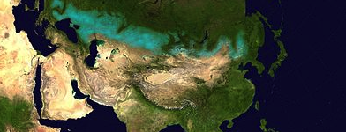

Slide 3
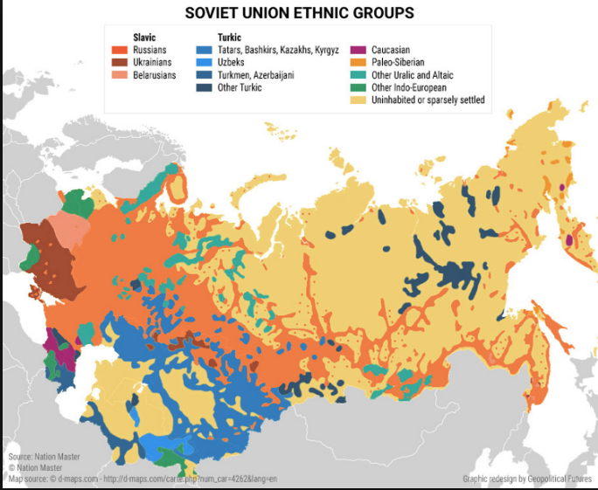
Plurality interculturality flexibility

Slide 4
Multiple Usages, multiple Meanings
Russian aristocrats
  Anti Bolsheviks
  Anti Western
Soviets
20th Century Germans
Post-Soviet Russia
Putin
Dugin
Ascendant China

Slide 5
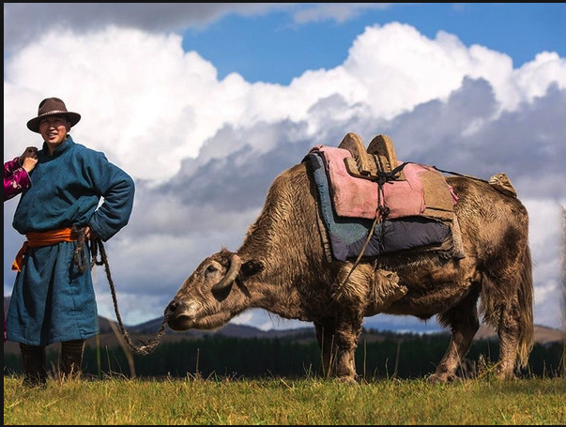
4 post-Soviet meanings enumerated in text
1. Populist, revanchist, nationalist Russian neo-Eurasianism
“Russkii mir” Russian World Alexandr Dugin
2. Nazarbayev’s Kazakh Eurasianism
Assembly of equal and sovereign states
3. Tatar Eurasianism
Regional autonomy, Cultural self-definition and pride, self govt within Russian Federation
4. “Official” Russian Eurasianism
Putin, Eurasian Economic Union
Mutual integration, counter balance to “the West”

