Slide 1
Eurasia revealed
Using Pop Archeology to Central Asia’s cultural patrimony

Slide 2
cultural currents revealed by our objects
Where?
Across Eurasia
Between East and West
Between the Holy Lands and all points north and east

Slide 3
What stories do your objects tell?

Slide 4
What stories do your objects tell?

Slide 5
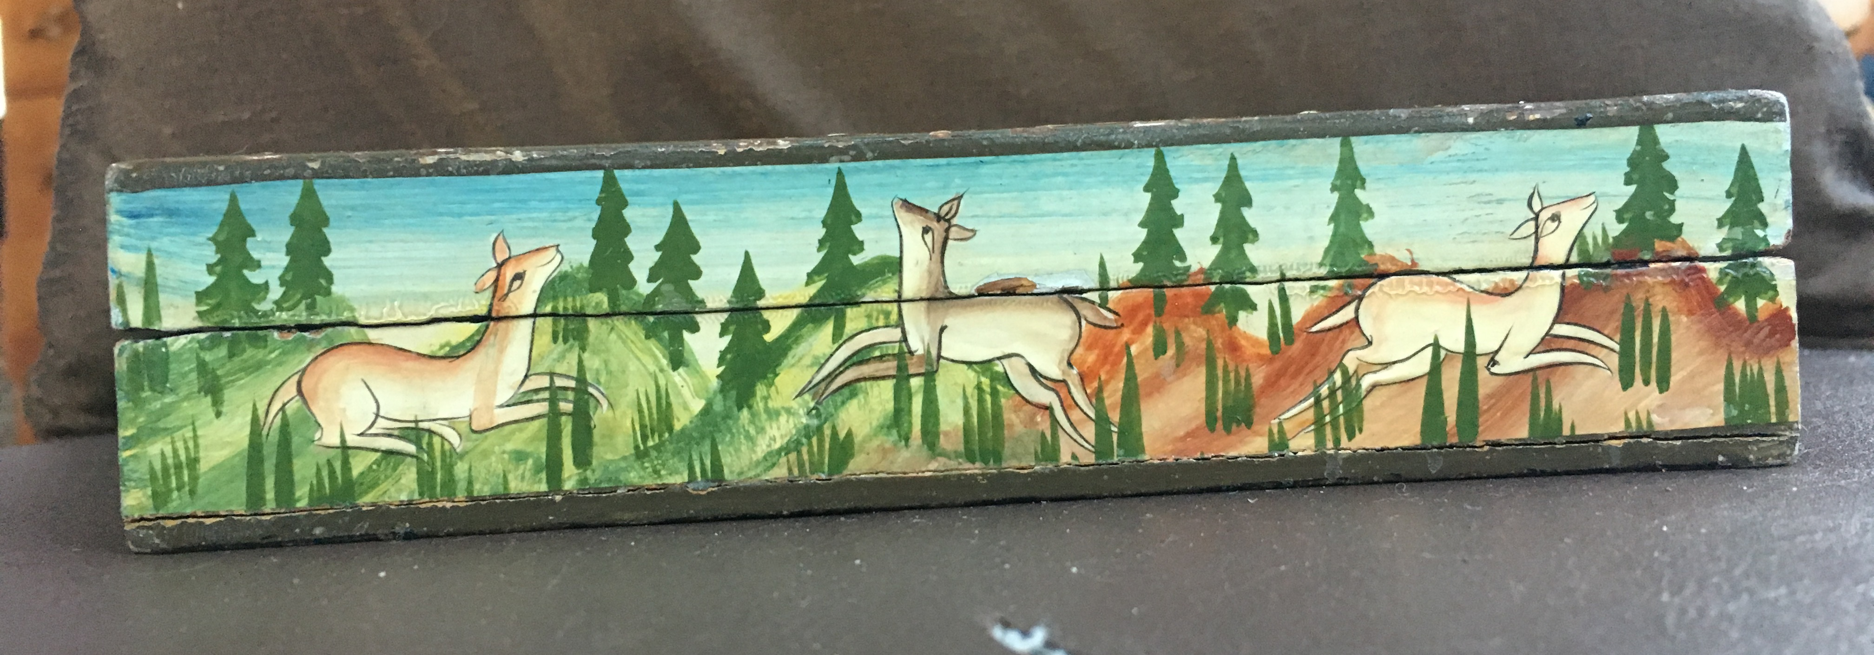
What stories do your objects tell?

Slide 6
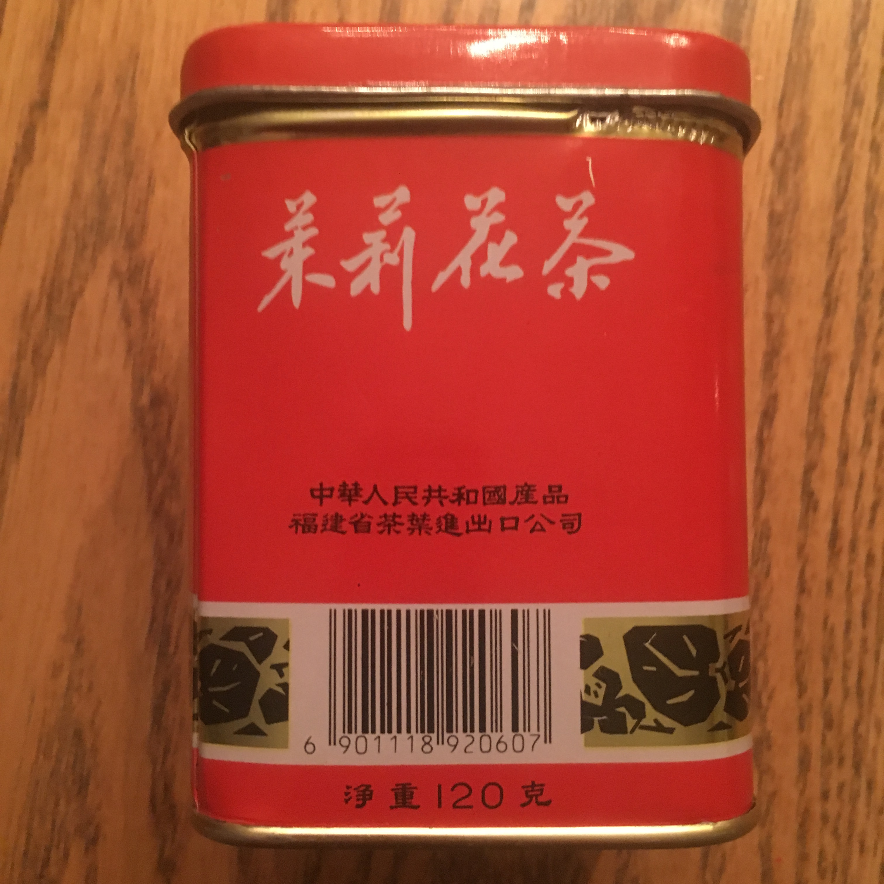
What stories do your objects tell?

Slide 7
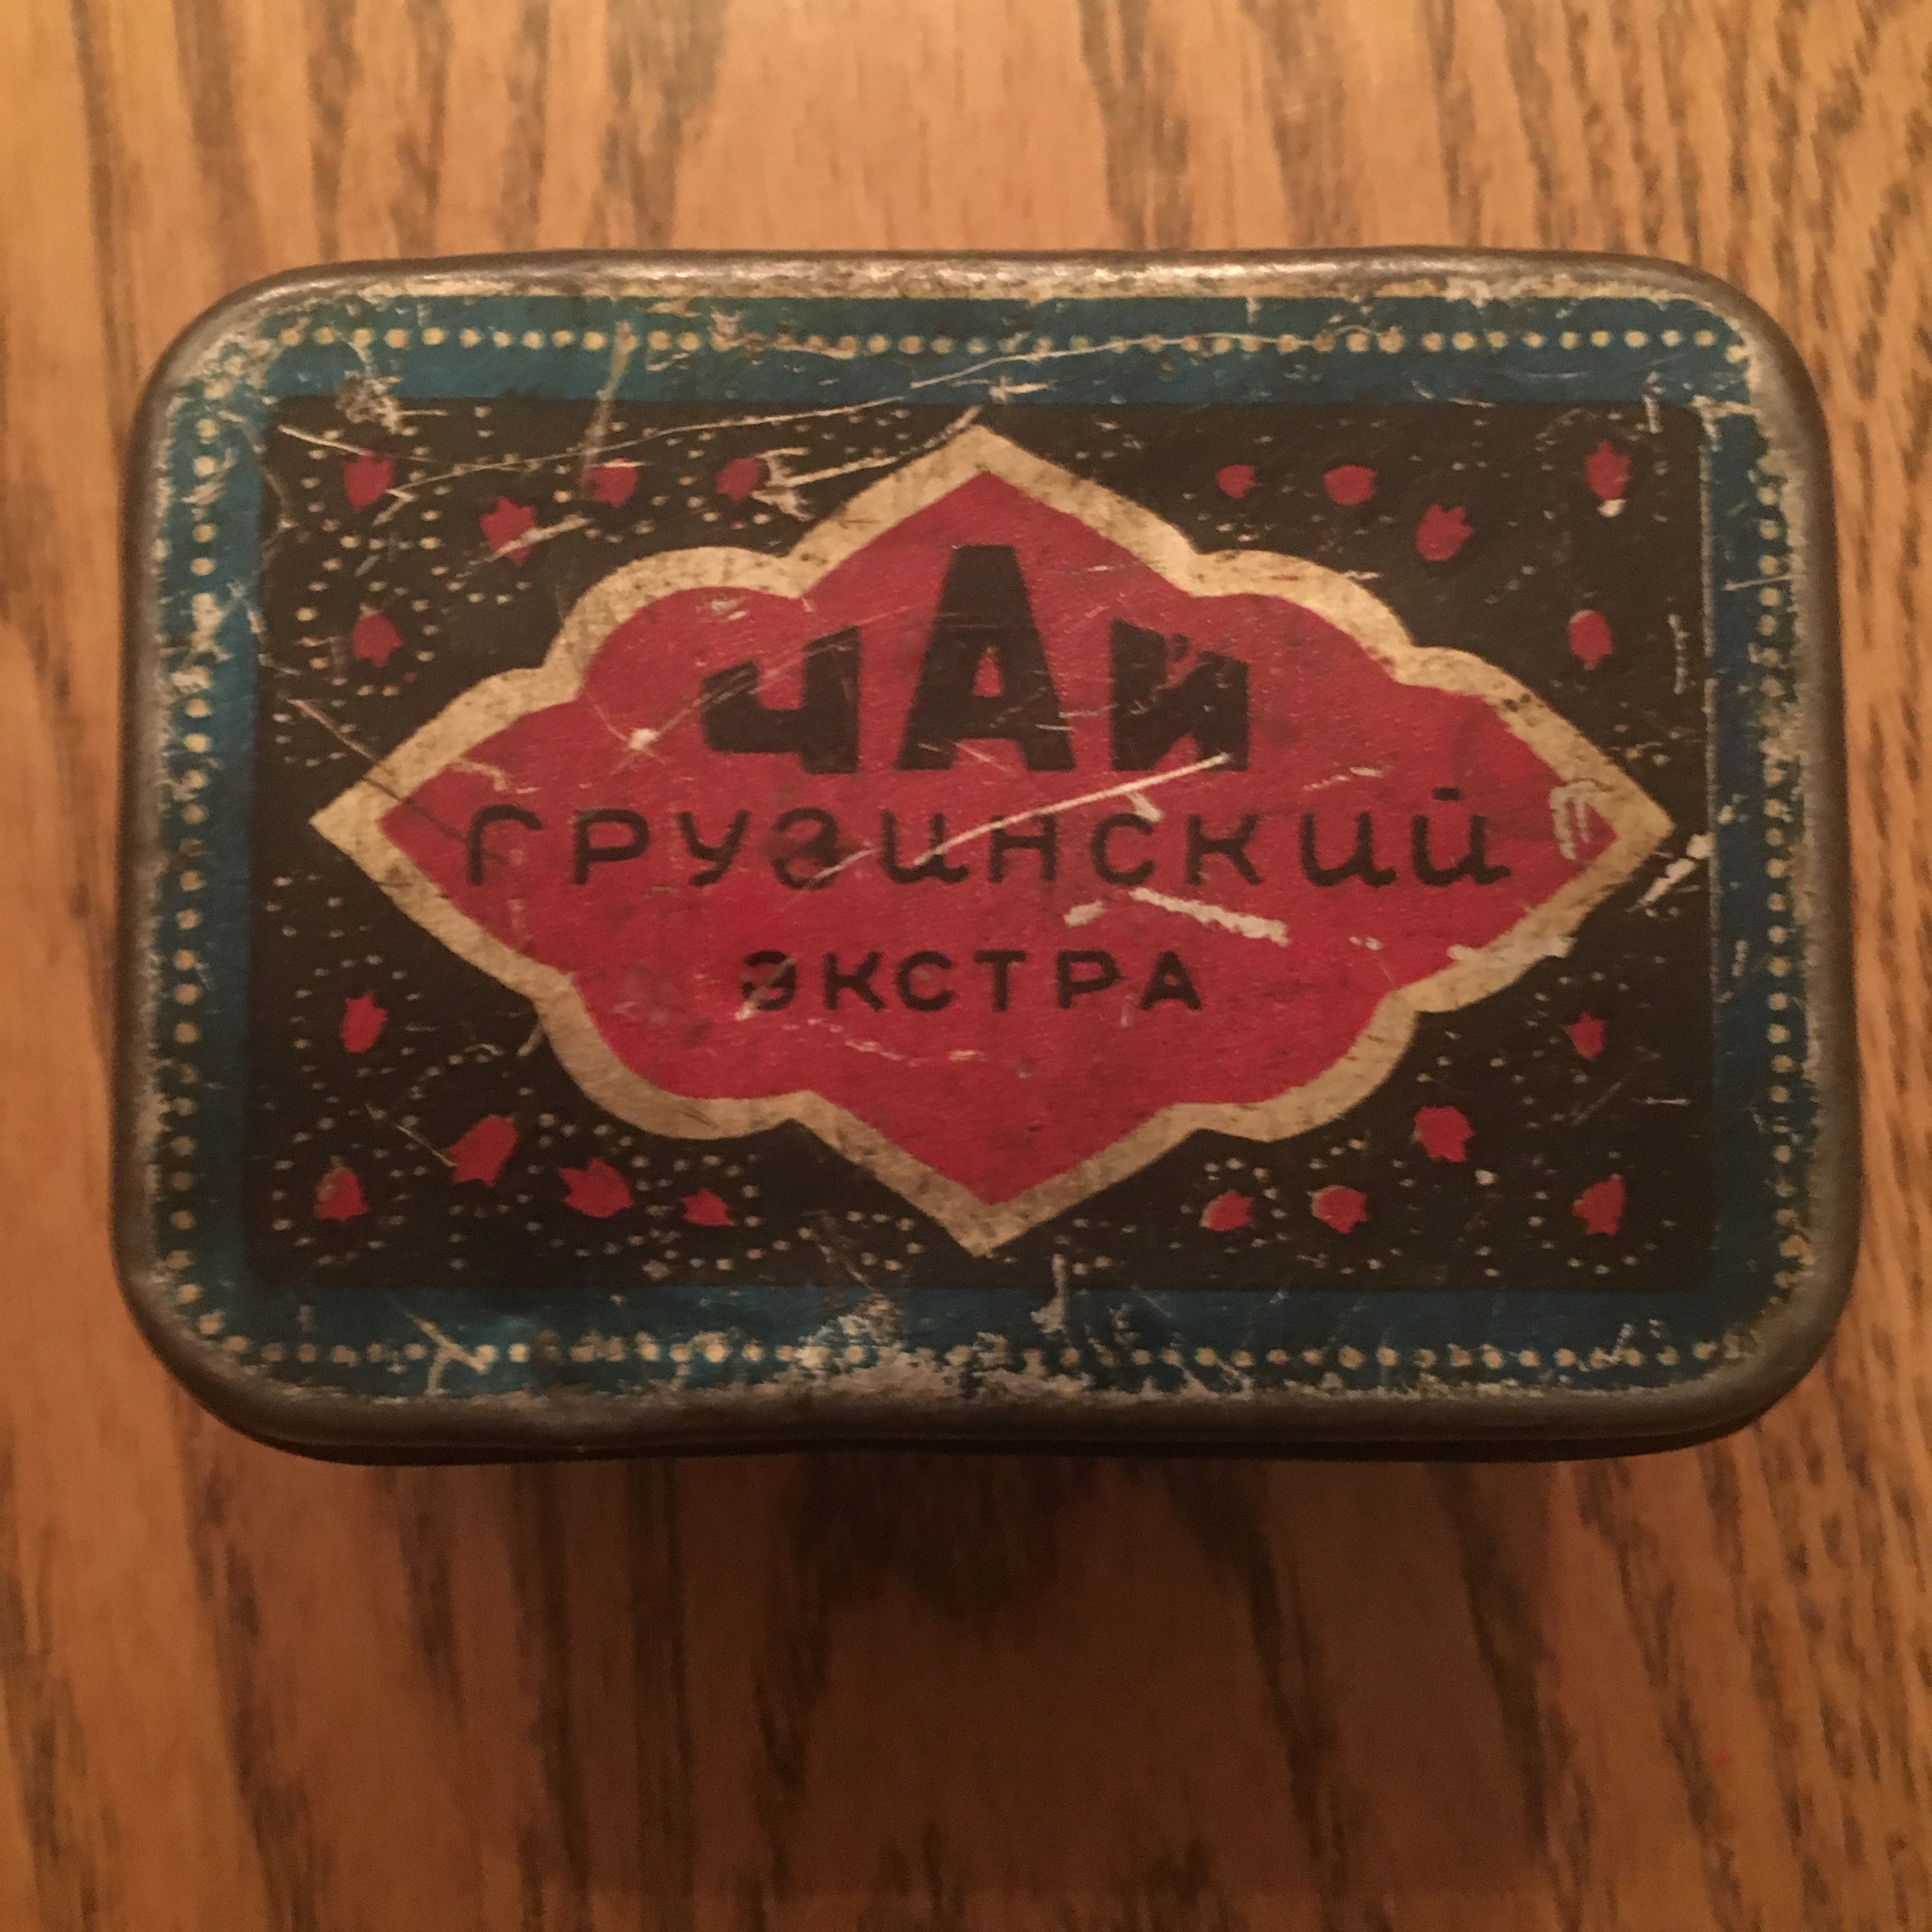
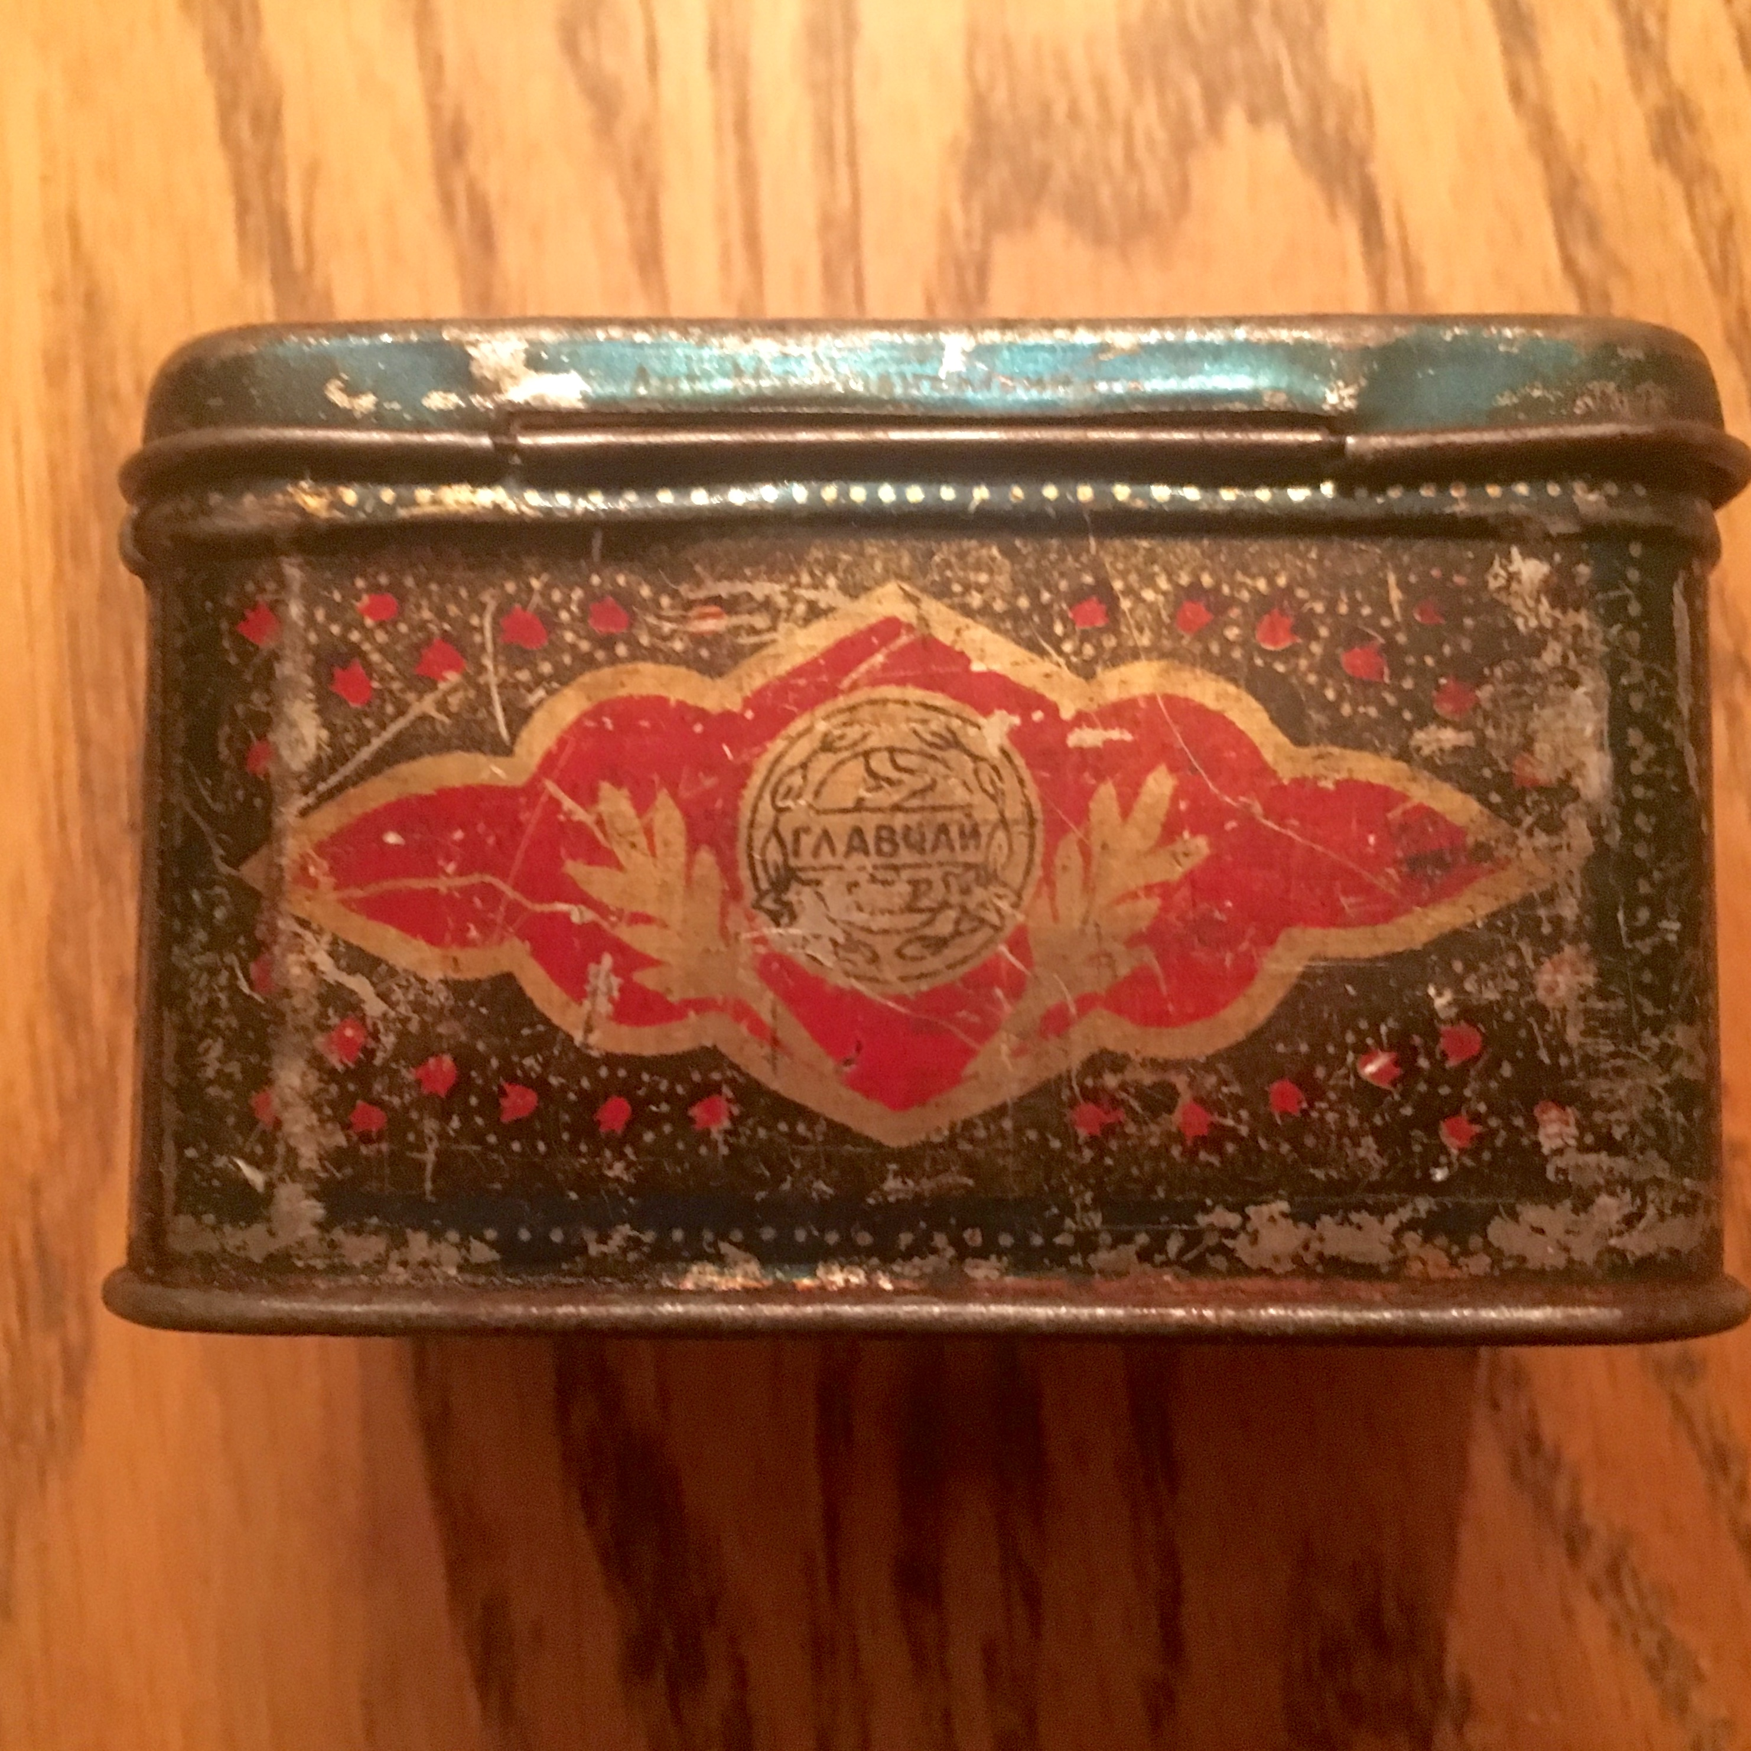
What stories do your objects tell?

Slide 8
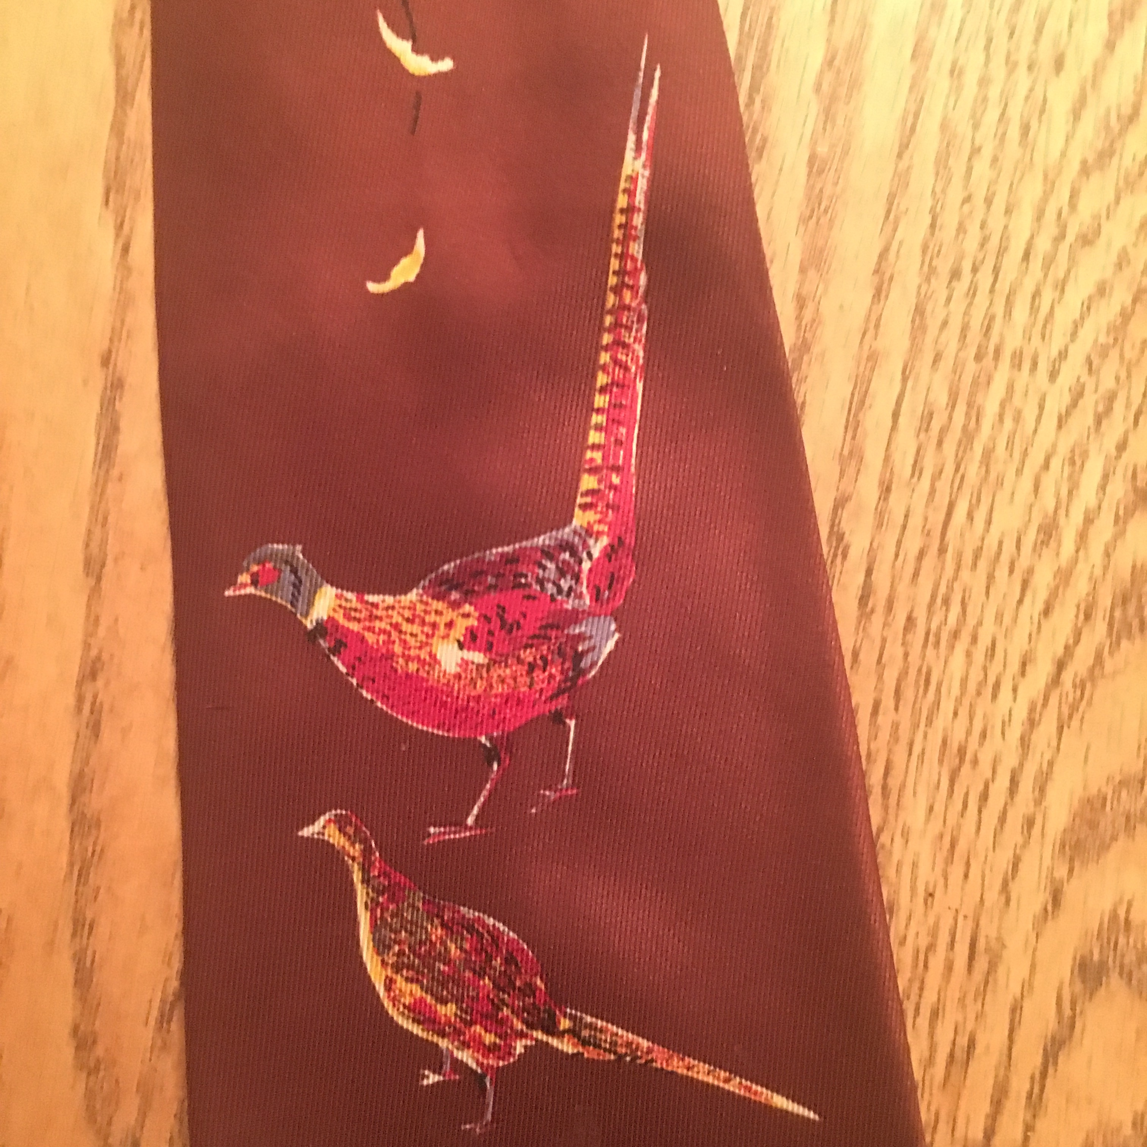
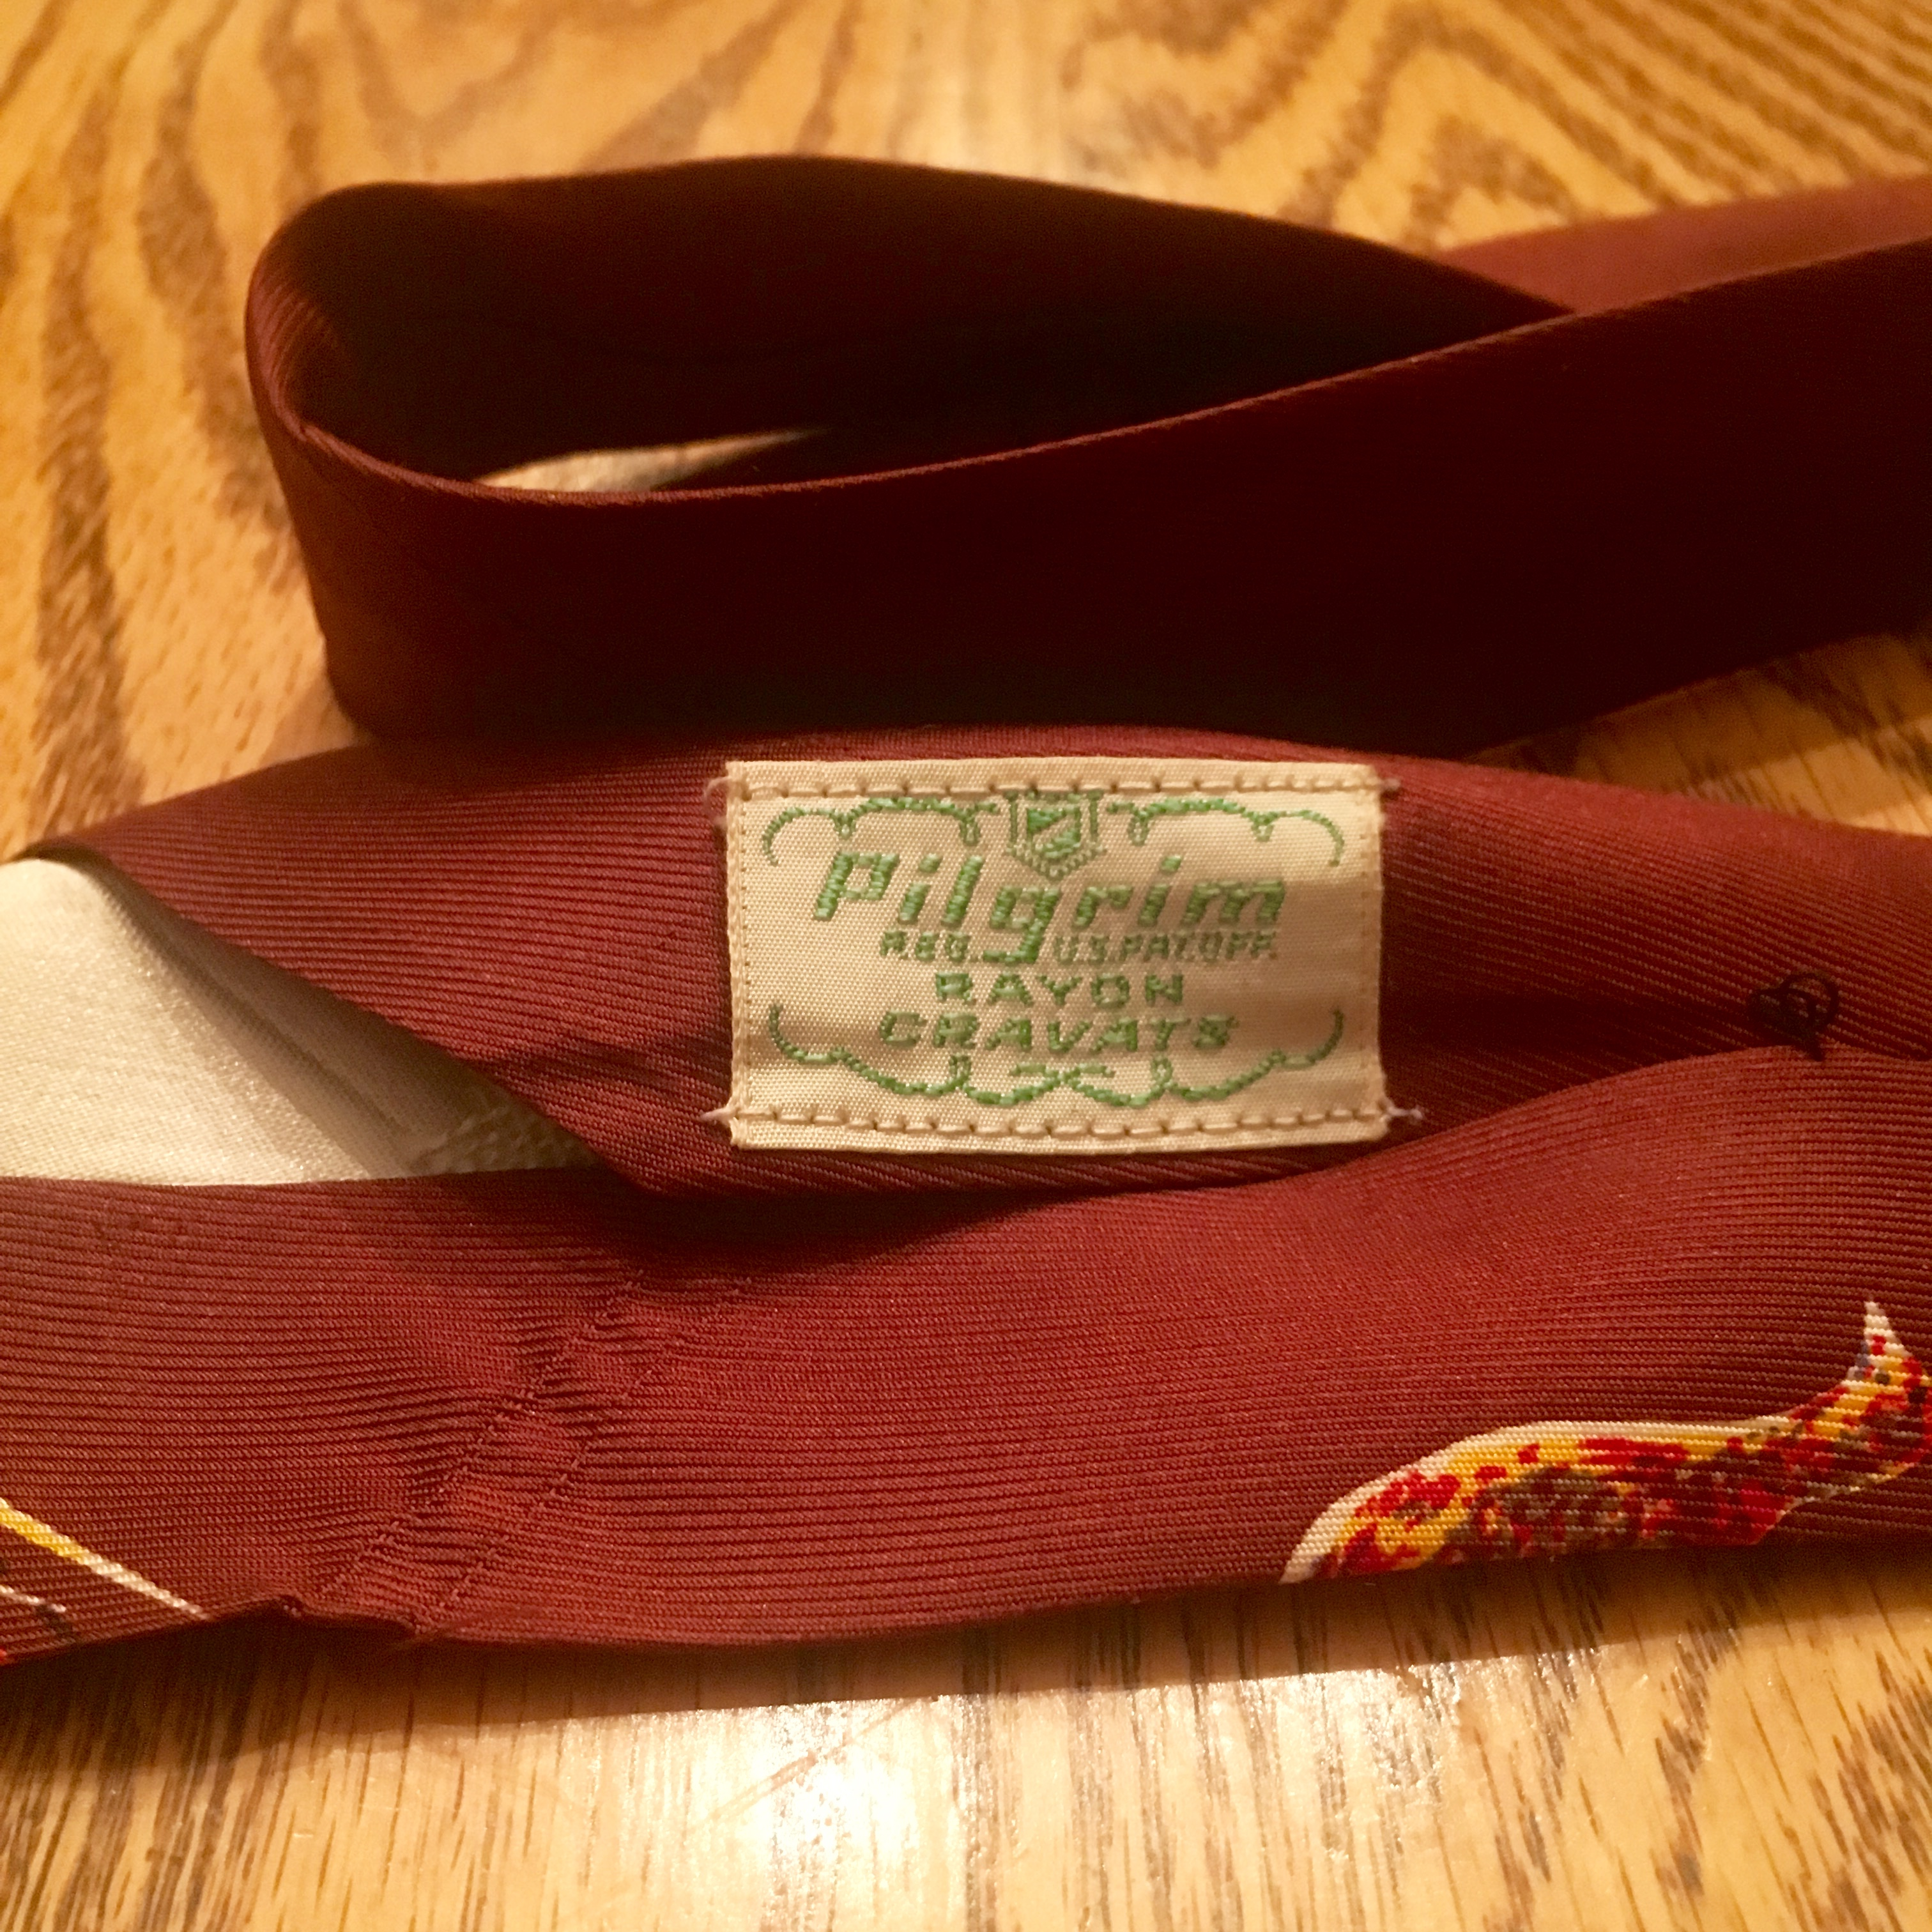
What stories do your objects tell?

Slide 9
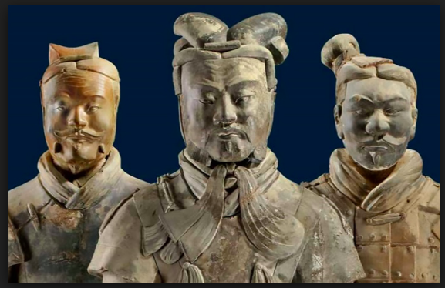

Slide 10
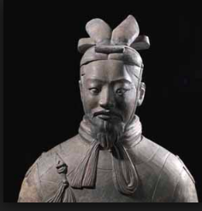
What stories do your objects tell?

Slide 11
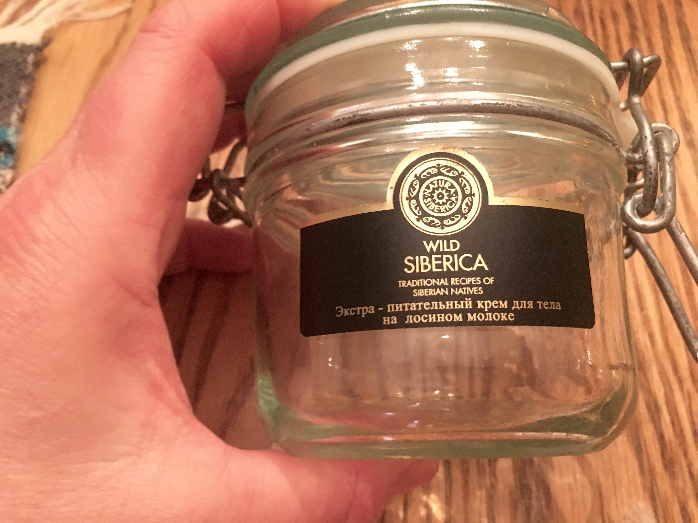
What stories do your objects tell?

Slide 13
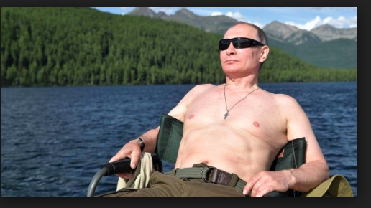
Siberia: The best place for tourism in the world

Slide 14
Siberian Beauty

Slide 15
Siberian Beauty

Slide 16
Siberian Beauties

Slide 17
Siberian Beauties

Slide 18
Siberian Beauties

Slide 19
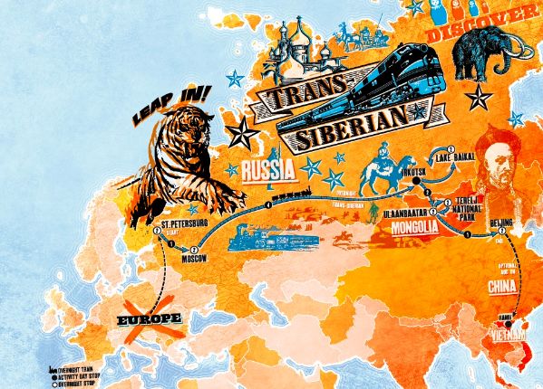
Trans-Siberian Adventure

Slide 20
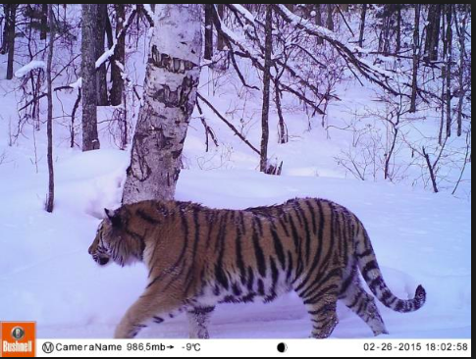
Trans-Siberian Adventure
SAVING
THE
SIBERIAN
TIGER

Slide 21
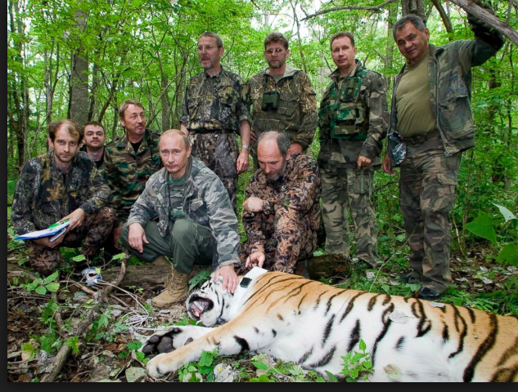
Trans-Siberian Adventure

Slide 22
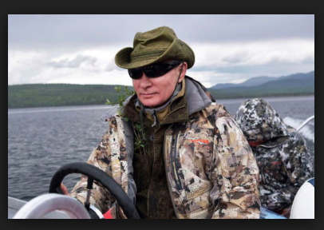
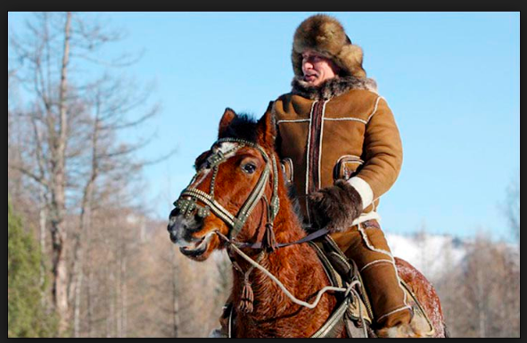
Trans-Siberian Adventure

Slide 23
Siberian Mystique, Mystery, Romance

Slide 24
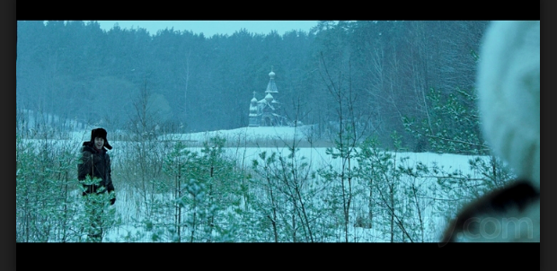
Siberian Mystique, Mystery, Romance

Slide 25
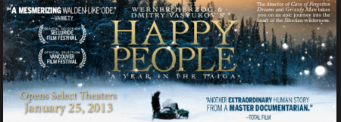
Siberian Mystique, Mystery, Romance

Slide 26
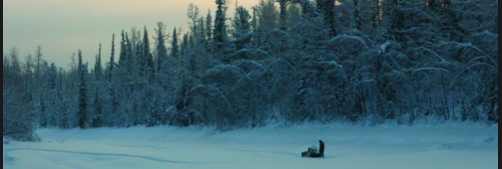
Siberian Mystique, Mystery, Romance

Slide 27
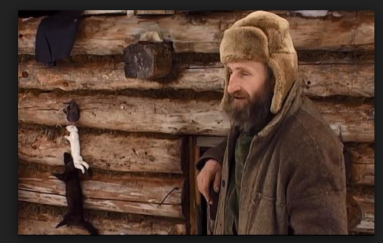
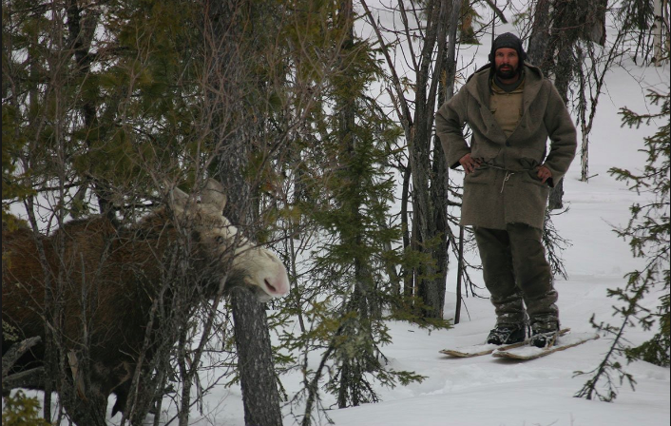
Siberian Mystique, Mystery, Romance

Slide 28
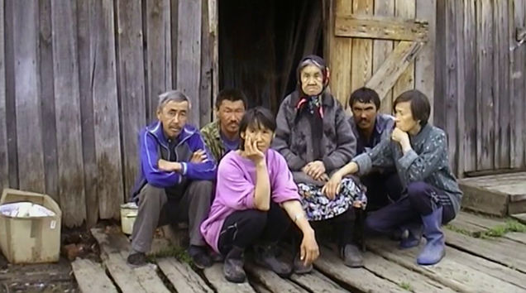

Slide 29
Putin enjoys lunch with Siberian Herder

Slide 30
GETTING THE SIBERIAN VOTE OUT

Slide 31
Luxury: Vestiges of Empire

Slide 32
luxury: Vestiges of Empire

Slide 33
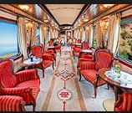
luxury: Vestiges of Empire

Slide 34
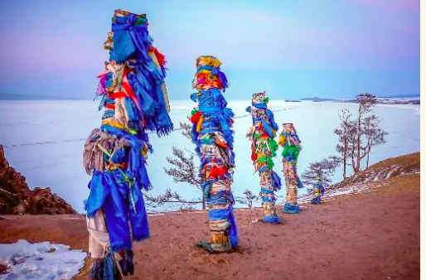
Imperialism
Exoticism

Slide 36
