Slide 1
Making a “Nation-State”
Narratives and Performance of
Social Solidarity & State Power
Laura Brunell, PhD
Gonzaga University
Spring 2019

Slide 2
The Functions of Holidays
Create and maintain collective identities
  Tribe, clan, family
    traditional, ancient ways –
    public and private,
    pagan and religious
  Ritualized marking of time
  Feasting
  Visiting as sign of bonds of communal and/or extended family solidarity, mutual support
    Esp if a birth, wedding or death occurred over past year
Nation–building
    Recycled from Soviet period (some, not all)
    Independence from Soviet Union 1991
    Pagan (traditional, ancient, indigenous) and religious (Muslim)

Slide 3
The Functions of Holidays
Nation–building
    Some, not all recycled from Soviet period
    Independence from Soviet Union (1991)
    Pagan (Zoroastrian -traditional, ancient, indigenous) and religious (Muslim)
Social Control
  Hmmm…

Slide 4
Uzbek Official Holidays –
Secular/National
International New Year (Jan 1)
International Women’s Day (March 8) [Soviet]
[NOT May Day – May 1 - Soviet]
National Day of Rememberance (May 9 – Victory in Europe Day – end WWII) [Soviet and Uzbek]
Independence Day (From Soviet Union – September 1 - Uzbek)
Teacher’s Day (not a day off! - Soviet)
Constitution Day (post-Soviet Constitution – December 8 - Uzbek)

Slide 5
Uzbek Official Holidays –
Traditional or Religious
Navruz (First Day of Spring; Spring Equinox – March 21 – indigenous; traditional; Zoroastrian)
2 Muslim Feasts
  Ramazon Hayiti (Eid al-Fitr – End of Ramadan– moves with lunar calendar)
  Qurbon Hayiti (Eid al-Adha – Feast of Sacrafice – Abraham and Ismael (son of Hagar - Muslim Day of Charity – lamb or goat sacrafice – food distributed to the poor)

Slide 6
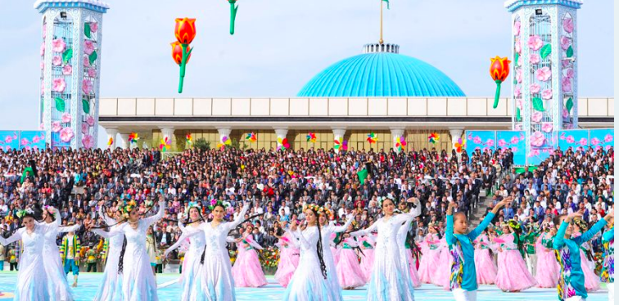
Navruz

Slide 7
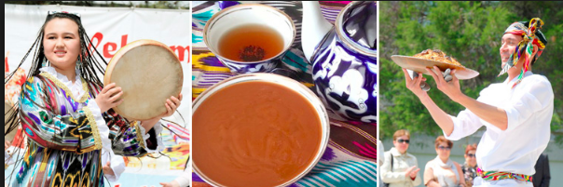
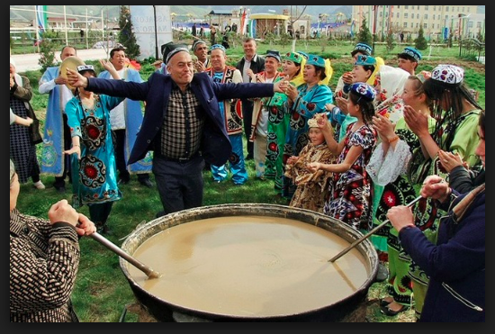
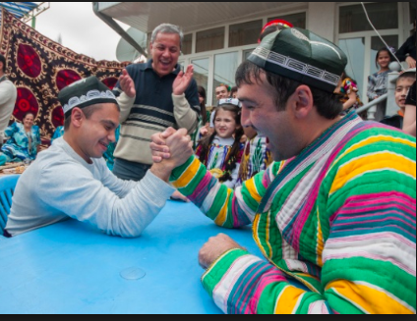
Navruz

