Slide 1
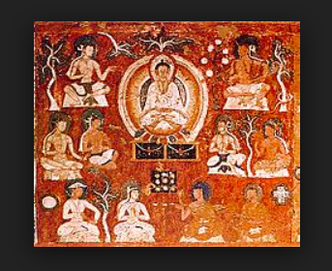
THE ROLE OF RELIGION IN CENTRAL ASIA
POLITICS OF EURASIA
DR BRUNELL
https://en.wikipedia.org/wiki/Manichaeism

Slide 2
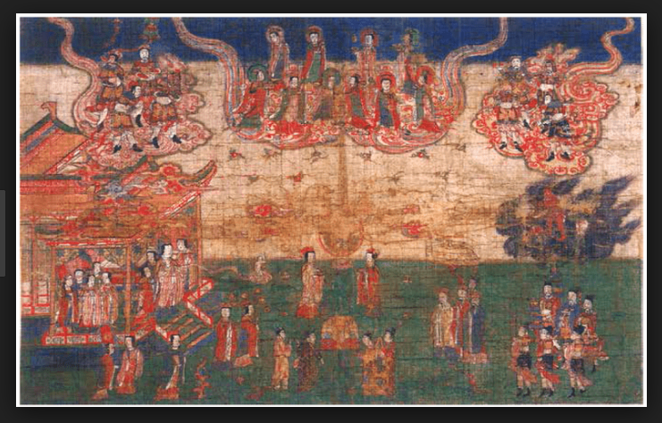
INTRO TO RELIGION IN TEXT
ROLE OF RELIGION IN HUMAN SOCIETIES
TWO MAIN ROLES IDENTIFIED BY AUTHORS IN INTRO
  FAITH IN THE SUPERNATURAL
  PROVIDING CONTEXT AND CONTENT OF COMMUNITARIAN RITUALS

Slide 3
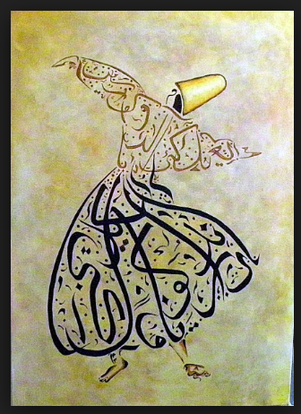
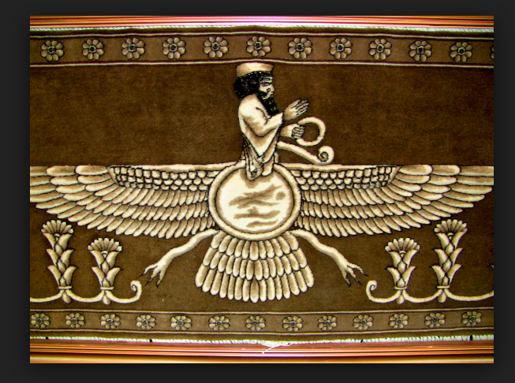
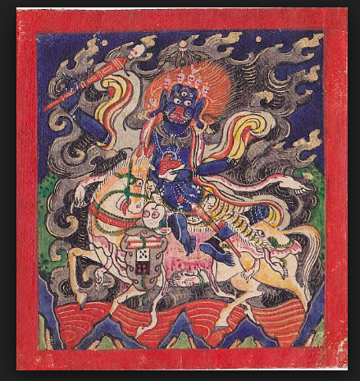
THREE FAITHS THE CENTRAL ASIAN WAY
SUFISM
ZOROASTRIANISM
BUDDHISM IN MONGOLIA

Slide 4
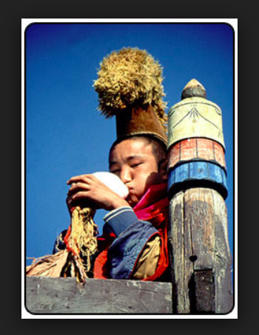
THE ROLE OF RELIGION
  IN EVERYDAY LIFE OF CENTRAL ASIANS
  ANCIENT, MIDDLE AGES, MODERN PERIODS
  PRE-SOVIET
  SOVIET
  POST-SOVIET

Slide 5
IDEA FOR 5 SLIDE PROJECT
ONE OF THE REGION’S RELIGIONS
ORIGINS
TENETS
OVER-TIME
ESP 20TH C /SOVIET → TODAY
ROLE IN EVERYDAY LIFE
AND
NATIONAL IDENTITY

