Slide 1
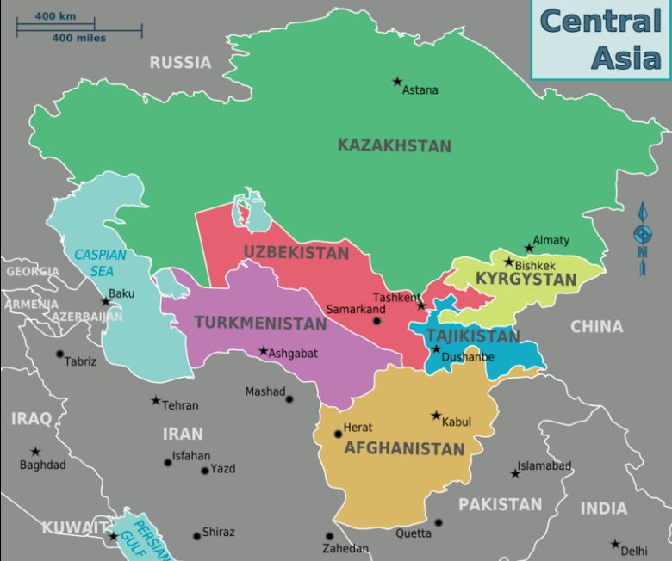
The
Central Asian Republics
Language and Economy

Slide 2
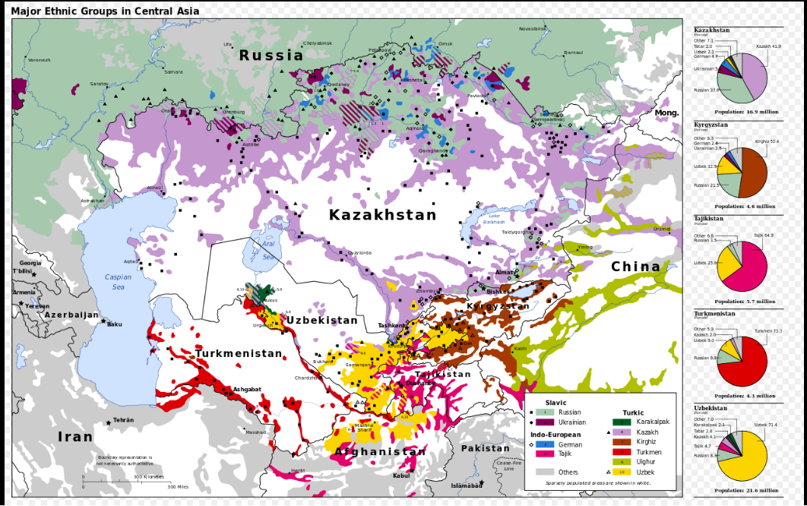
Screen Shot 2019-04-11 at 8.37.05 AM

Slide 3
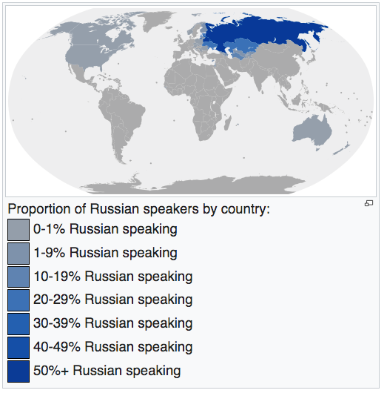
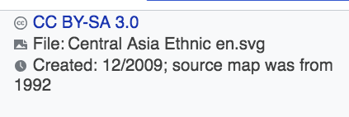
Russian Speakers Worldwide

Slide 4
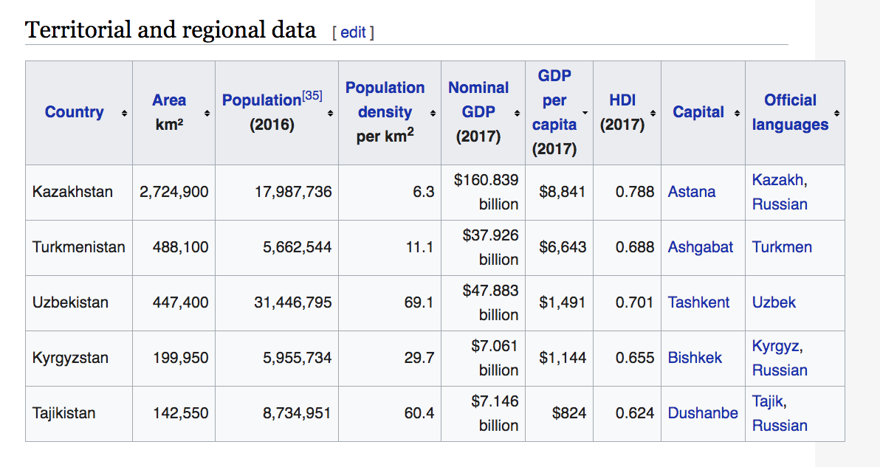
Economic Data

Slide 5
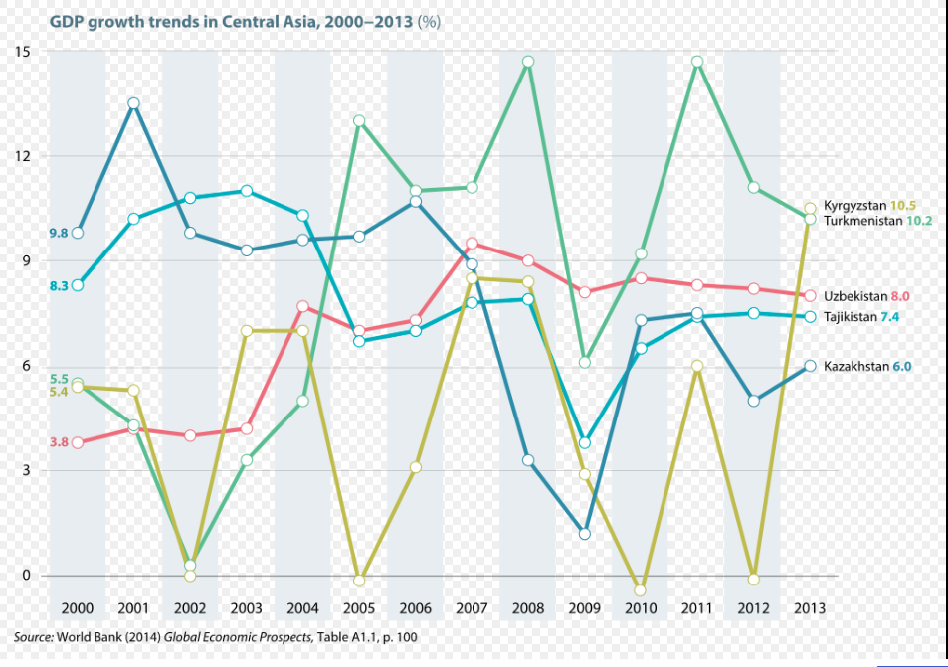

Slide 6
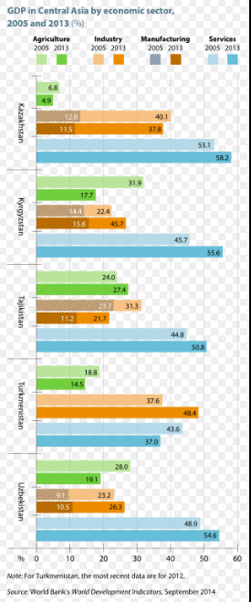
GDP by Sector
2005, 2013

