Slide 1
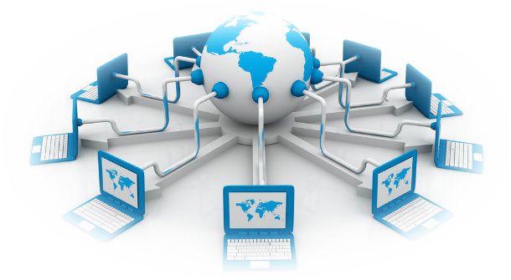
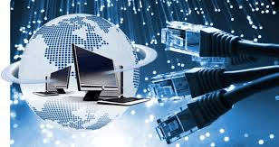
CIAT CIS101A
Week 4
Class 1
Networking

Slide 2
6.1 Networking Overview/ 6.1.4 Networking Facts
A network is a group of computers that can share information through their interconnections. A network is made up of the following components:
Computers | (often called nodes or hosts)
Transmission media | a path for electrical signals between devices
Network interfaces | devices that send and receive electrical signals
Protocols | rules or standards that describe how hosts communicate and exchange data
Despite the costs of implementation and maintenance, networks actually save organizations money by allowing them to:
Consolidate (centralize) data storage Share peripheral devices like printers Increase internal and external communications Increase productivity and collaboration

Slide 3
6.1.4 Networking Facts (Continued)
There are several ways to classify networks. The following table lists several ways to describe a network:
Type | Classification | Description
Host Role | Peer-to-Peer | In a peer-to-peer network, each host can provide network resources to other hosts or access resources located on other hosts. Each host is in charge of controlling access to those resources.
 |  | Advantages of peer-to-peer networks include the following: | Easy implementation Inexpensive
 |  | Disadvantages of peer-to-peer networks include the following: | Difficult to expand (not scalable) Difficult to support Lack centralized control No centralized storage
 | Client-Server | In a client-server network, hosts have specific roles. For example, some hosts are assigned server roles, which allow them to provide network resources to other hosts. Other hosts are assigned client roles, which allow them to consume network resources.
 |  | Advantages of client-server networks include the following: | Easy to expand (scalable) Easy to support Centralized services Easy to back up
 |  | Disadvantages of client-server networks include the following: | Expensive server operating systems Extensive advanced planning required

Slide 4
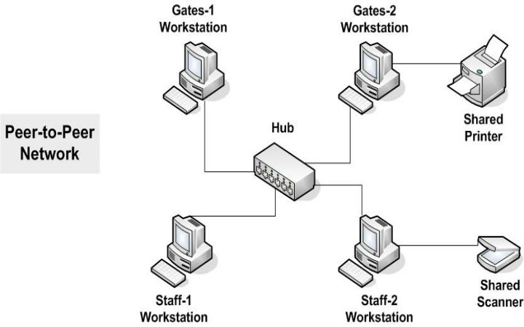
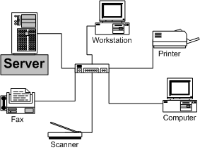
6.1.4 Networking Facts (Continued)
Peer-to-Peer Client-Server
(Workgroup Model) (Enterprise Model)

Slide 5
6.1.4 Networking Facts (Continued)
Type | Classification | Description
Geography | Personal Area Network (PAN) | A personal area network is a very small network used for communicating between personal devices. For example, a PAN may include a notebook computer, a wireless headset, a wireless printer, and a smartphone. A PAN is limited in range to only a few feet. A PAN is typically created using Bluetooth wireless technologies.
 | Local Area Network (LAN) | A local area network is a network in a small geographic area, like an office. A LAN typically uses wires to connect systems together.
 | Wireless Local Area Network (WLAN) | A wireless LAN covers an area that is roughly the same size as a standard LAN. However, it uses radio signals instead of wires to connect systems together.
 | Metropolitan Area Network (MAN) | A metropolitan area network is a network that covers an area as small as a few city blocks to as large as an entire metropolitan city. MANs are typically owned and managed by a city as a public utility. Be aware that many IT professionals do not differentiate between a wide area network and a MAN, as they use essentially the same network technologies.
 | Wide Area Network (WAN) | A wide area network is a group of LANs that are geographically isolated, but are connected to form a large internetwork.

Slide 6
6.1.4 Networking Facts (Continued)
Type | Classification | Description
Management | Network | The term network often describes a computer system controlled by a single organization. This could be a local area network at a single location or a wide area network used by a single business or organization. If two companies connected their internal networks to share data, you could call it one network. In reality, however, it is two networks, because each network is managed by a different company.
 | Subnet | A subnet is a portion of a network with a common network address. All devices on the subnet share the same network address, but they have unique host addresses. Each subnet in a larger network has a unique subnet address. Devices connected through hubs or switches are on the same subnet. Routers are used to connect multiple subnets.
 | Internetwork | A network with geographically disperse (WAN) connections that connect multiple LANs is often called an internetwork. Additionally, connecting two networks under different management is a form of internetworking, because data must travel between two networks.

Slide 7
6.1.4 Networking Facts (Continued)
Type | Classification | Description
Participation | Internet | The Internet is a large, world-wide, public network. The network is public because virtually anyone can connect to it, and users or organizations make services freely available on the Internet. Users and organizations connect to the Internet through an Internet service provider (ISP). The Internet uses a set of communication protocols (TCP/IP) for providing services. Individuals and organizations can make services (such as a website) available to other users on the Internet.
 | Intranet | An intranet is a private network that uses Internet technologies. Services on an intranet are only available to hosts that are connected to the private network. For example, your company might have a website that only employees can access.
 | Extranet | An extranet is a private network that uses Internet technologies, but its resources are made available to external (but trusted) users. For example, you might create a website on a private network that only users from a partner company can access.

Slide 8
6.1.6 Topology Facts
Topology is the term used to describe how devices are connected and how messages flow from device to device. There are two types of network topologies:
The physical topology describes the way the network is wired. The logical topology describes the way in which messages are sent.
The following table describes several common physical topologies:

Slide 9
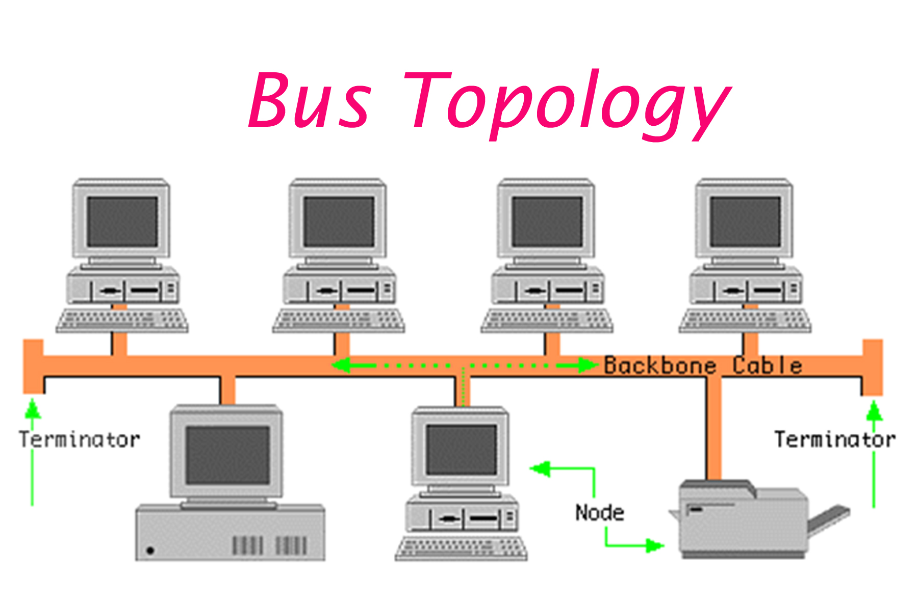
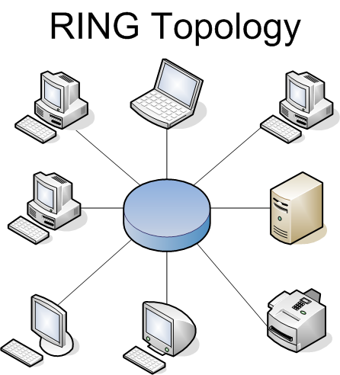
6.1.6 Topology Facts (Continued)
TOPOLOGY | DESCRIPTION
BUS | A bus topology consists of a trunk cable with nodes either inserted directly into the trunk or tapped into the trunk using offshoot cables called drop cables.
 | With a bus: Signals travel from one node to all other nodes. A device called a terminator is placed at both ends of the trunk cable. Terminators absorb signals and prevent them from reflecting repeatedly back and forth on the cable. It can be difficult to isolate cabling problems.
 | A broken cable anywhere on the bus breaks the termination and prevents communications between any devices on the network.
RING | A ring topology connects neighboring nodes until they form a ring. Signals travel in one direction around the ring; each device on the network acts as a repeater to send the signal to the next device.
 | With a ring: Installation requires careful planning to create a continuous ring. Isolating problems can require going to several physical locations along the ring. A malfunctioning node or cable break can prevent signals from reaching nodes further along on the ring.

Slide 10
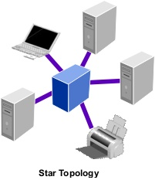
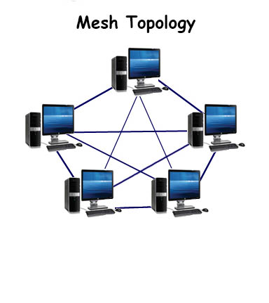
6.1.6 Topology Facts (Continued)
TOPOLOGY | DESCRIPTION
STAR | A star topology uses a hub or switch to connect all network connections to a single physical location. Today it is the most popular type of topology for a LAN.
 | With a star: All network connections are located in a single place, which makes it easy to troubleshoot and reconfigure. Nodes can be added to or removed from the network easily. Cabling problems usually affect only one node.
MESH | A mesh topology exists when there are multiple paths between any two nodes on a network. Mesh topologies are created using point-to-point connections. This increases the network's fault tolerance because alternate paths can be used when one path fails.
 | Two variations of mesh topologies exist: Partial Mesh—Some redundant paths exist. Full Mesh—Every node has a point-to-point connection with every other node.

Slide 11
6.1.6 Topology Facts (Continued)
TOPOLOGY | DESCRIPTION
MESH (Cont…) | Full mesh topologies are usually impractical in a standard LAN, because the number of connections increases dramatically with every new node added to the network.
 | A separate network interface and cable for each host on the network is required. A full mesh topology is commonly used to interconnect routers, providing alternate paths should one path go down or become overloaded. Mesh networks are also commonly used to create redundant paths between access points in a wireless network, providing alternate paths back to the wireless controller should one access point go down or become overloaded. With this topology, every access point can communicate directly with any other access point on the wireless network.

Slide 12
6.1.6 Topology Facts (Continued)
Logical Topology | Physical Topology | Description
Bus | Bus | Messages are sent to all devices connected to the bus.
 | Star
Ring | Ring | Messages are sent from device to device in a predetermined order until they reach the destination device.
 | Star
Star | Star | Messages are sent directly to (and only to) the destination device.
Mesh | Mesh | Messages are sent from one device to the next around the ring until they reach the destination device.

Slide 13
6.2 Network Hardware / 6.2.3 Networking Infrastructure and Device Facts
The following hardware devices are used to create a network's physical infrastructure:
Component | Description
Media | The networking medium provides the path for signals to pass between devices. | Copper cables use electrical signals. Fiber optic cables use light pulses. Wireless networks use radio waves or infrared waves.
 | Networking media that use cables are considered bounded, because the transmission signals are contained within the wire. Networks that use wireless communications are considered unbounded.
Network adapter | A network adapter is responsible for creating and receiving transmission signals that are sent along the networking medium.
 | A network interface card (NIC) uses a cable medium (such as twisted pair or fiber optic cables). A wireless network adapter transmits radio waves.
Hub | A hub provides a central connection for multiple media segments on the same subnet. The hub repeats a signal received on one port out all other ports. Hubs operate in half-duplex mode because the path between devices is shared, meaning that devices can only send when no other devices are sending data. Hubs are a legacy network device and are rarely used because of their lack of features and poor performance.

Slide 14
6.2.3 Networking Infrastructure and Device Facts (continued)
Component | Description
Switch | A switch provides a central connection for multiple media segments on the same subnet. A switch receives a signal on one port and forwards that signal only to the port where the destination device is connected.
 | Switches learn where a device is connected by copying the MAC address of the source device and placing it into the MAC address table. The port number which the frame entered is also recorded in the table and associated with the source MAC address. If the switch doesn't yet know which port a destination device is connected to, it will send the frame in question to all ports, much like a hub does.
 | Switches use the MAC address to send frames to the destination device. Switches can operate in full-duplex mode, where a device uses a different channel for sending and receiving and where the transmission paths are dedicated to only the communicating devices. A switch should be used instead of a hub in all situations. Many switches allow you to configure Quality of Service (QoS) settings, which prioritize certain types of network traffic over others. For example, if your network includes Voice over IP (VoIP) telephones, you could increase the priority of VoIP traffic on the switch to increase call quality.

Slide 15
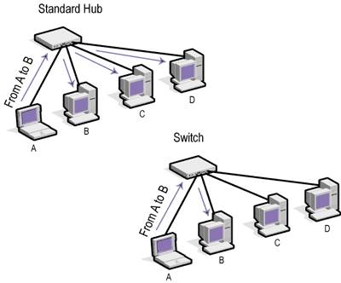
CIAT CIS101A

Slide 16
6.2.3 Networking Infrastructure and Device Facts (continued)
Component | Description
Router | A router connects two network segments that have a different subnet address.
 | A router has multiple network connections, with each connection being on a different subnet. Routers use the IP address within a packet to move packets between networks. Routers maintain a list of known networks and the next router in the path to reach the destination network.
Bridge | A bridge connects two segments within the same subnet.
 | Bridges learn which side a host resides on by copying the MAC address of the source device and placing it into the MAC address table. The port number which the frame entered is also recorded in the table and associated with the source MAC address. Another functionality of a bridge is to convert one type of transmission medium into another. A common example of this is a wireless bridge, which converts wired transmissions into wireless transmissions, and vice versa.

Slide 17
6.2.3 Networking Infrastructure and Device Facts (continued)
In addition to the physical infrastructure, networks are also made up of other networking devices that provide specific services or perform a specific role.
Component | Description
Server | Networks contain two types of hosts: hosts that consume a service and hosts that provide a service. Hosts that provide a server are called servers.
 | The following are some of the more common types of servers:
 | File and Print Server - Provides file sharing and print sharing services. Application Server - Provides access to a shared network application (e.g., a database server that contains customer information). Directory Server - Handles user authentication. Also stores user credentials, permissions, and settings. Remote Access Server - Provides remote access to network resources. Web Server - Serves web pages and web content via HTTP. DNS Server - Uses the domain name service to map IP addresses to domain names. DHCP Server - Automatically configures network hosts with an IP address, subnet mask, DNS server, and default gateway.
VoIP | VoIP devices provide voice communication over a packet-switched network (an IP network).
 | The most common VoIP device is an IP phone. Instead of using the standard public switched telephone network, IP phones connect to an Ethernet network using an RJ45 connection. Basic VoIP services include Skype or Google Voice. Businesses that use VoIP typically hire a third-party entity (e.g., Vonage or Jive) to set up the service and configure devices.

Slide 18
6.2.3 Networking Infrastructure and Device Facts (continued)
In addition to the physical infrastructure, networks are also made up of other networking devices that provide specific services or perform a specific role.
Component | Description
Internet appliance | An Internet appliance is a specialized device that performs a specific network role. The following are some common Internet appliances:
 | Web proxy Content filter Malware scanner
 | Internet appliances are typically more expensive than configuring a server to perform the same task. However, Internet appliances perform much better and have more features.
Network attached storage (NAS) | A NAS is a device that is optimized to provide a single service: file sharing.
 | NAS devices range in price from several hundred to several thousand dollars. A NAS can be connected to a network and configured very easily. This makes them a great choice for most networks needing a file sharing service.

Slide 19
6.2.4 Network Adapter Facts
A network adapter (also called a network interface card or NIC) connects a host to the network medium.
The network adapter is responsible for converting binary data into a format to be sent on the network medium.
A transceiver is responsible for converting digital data into digital signals to be sent on the medium. The type of signal the transceiver sends depends on the type of network. A fiber optic NIC sends light signals, an Ethernet NIC sends electronic signals on a wire, and a wireless NIC sends radio signals. To receive signals, the transceiver converts digital signals from the network to digital data for the PC. A modem converts binary data to analog waves (modulation) on the sending end, and then converts the analog waves back to binary data (demodulation) on the receiving end.
Most desktop computers have motherboards with built-in network adapters. Practically all mobile devices (i.e., smartphones, tablets, laptops, etc.) have a built-in wireless NIC.
Network adapters must match the network medium of the network.

Slide 20
6.2.4 Network Adapter Facts (Continued)
Ethernet network adapters that are connected to a switch will operate in full-duplex mode. This allows the adapter to send and receive at the same time.
The speed of an Ethernet network adapter is determined by the NIC, the network medium, and the connectivity device. The speed can only go as fast as the slowest component.
For example, if the NIC runs at 1000 Mbps, but the Ethernet cable only runs at 100 Mbps, the speed to the network will be 100 Mbps.
Most network adapters support Wake-on-LAN (WOL) functionality, which allows you to power on a computer system over the network through the network adapter.

Slide 21
6.2.4 Network Adapter Facts (Continued)
The MAC address is a unique hexadecimal identifier burned into the ROM of every NIC.
The MAC address is a 12-digit (48-bit) hexadecimal number. Each number ranges between 0–9 or A–F. The numbers in a MAC address can be divided by dashes (00-B0-D0-06-BC-AC), periods (00B0.D006.BCAC), or colons (00:B0:D0:06:BC:AC). The MAC address is guaranteed unique through design. The first half (first six digits) of the MAC address is assigned to each manufacturer.
The manufacturer determines the rest of the address, assigning a unique value which identifies the host address. A manufacturer that uses all the addresses in the original assignment can apply for a new MAC address assignment.
Some network cards allow you to change the MAC address through jumpers, switches, or software. However, there is little practical reason for doing so.

Slide 22
6.2.4 Network Adapter Facts (Continued)
Devices use the MAC address to send frames to other devices on the same subnet.
Before two devices can communicate, they must know the MAC address of the receiving device. They do this by using the Address Resolution Protocol (ARP):
The sending device sends out a broadcast frame: The destination MAC address is all Fs (FFFF:FFFF:FFFF). The sending MAC address is its own MAC address. The destination IP address is the known IP address of the destination host. The sending IP address is its own IP address.
All hosts on the subnet process the broadcast frame, looking at the destination IP address.
If the destination IP address matches its own address, the host responds with a frame that includes its own MAC address as the sending MAC address.
The original sender then reads the MAC address from the frame and associates the IP address with the MAC address, saving it in cache.
Once the sender knows the MAC address of the receiver, it sends data in frames addressed to the destination device.

Slide 23
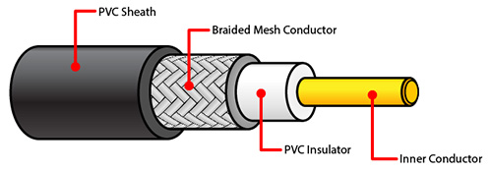
6.3 Networking Media / 6.3.2 Coaxial Cable Facts
Coaxial cable is primarily used to carry broadband Internet signals.
Coaxial cable is built with the following components:
inner conductor | carries data signals and is made of solid copper or tin.
insulator | surrounds the inner conductor and keeps the signal separated from the mesh conductor. It is made of PVC plastic.
braided mesh | conductor is a second physical channel and also functions as a ground. It is made of aluminum or copper-coated tin.
sheath | is made of PVC plastic and encases the cable, protecting it from external elements.

Slide 24
6.3.2 Coaxial Cable Facts (Continued)
Coaxial cable has the following advantages and disadvantages:
Advantages | Disadvantages
Less susceptible to electromagnetic Interference (EMI) Resistant to physical damage Large existing infrastructure | Expensive Not very flexible (difficult to bend around corners) Using splitters degrades signal quality
The table below describes the different coaxial cable grades.
Type | Uses | Resistance Rating
RG-59 | CCTV video systems; short cable lengths (less than 3 meters) are sometimes used for cable TV | 75 ohms
RG-6 | Cable TV, satellite TV, and broadband cable Internet | 75 ohms
Because RG-6 is able to carry a higher-quality signal with much lower signal loss than RG-59, RG-6 cabling should always be used for any coaxial cable implementation.

Slide 25
6.3.2 Coaxial Cable Facts (Continued)
The following table describes the two most common types of connectors used with coaxial cable
Connector | Description
F-Type | Crimped onto the cable using a special tool Used to create cable and satellite TV connections Used to connect a cable modem to a broadband cable connection Some F-Type connectors can be twisted onto a cable without needing a special tool. However, these types of connectors can cause signal leakage.
BNC | Molded onto the cable Used in legacy 10Base2 Ethernet networks Used in specialized industries

Slide 26
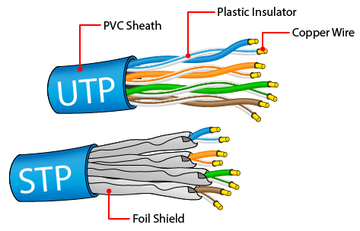
6.3.3 Twisted Pair Facts
Twisted pair cables support a wide range of fast, modern network standards. Twisted pair cabling is composed of the following components:
Four pairs of copper wires carry the data signals (one wire in the pair carries a positive signal, the other carries a negative signal). Wires are twisted into pairs to reduce the effects of electromagnetic interference and crosstalk.
PVC plastic insulation surrounds each copper wire.
An outer plastic sheath bundles the wires together and protects them.
Unshielded twisted pair (UTP) has only an outer plastic sheath. UTP cables are easier to work with and are less expensive than shielded cables. Shielded twisted pair (STP) has a grounded outer copper shield around the entire wire bundle or around each wire pair. STP provides additional EMI protection, but costs considerably more than UTP.

Slide 27
6.3.3 Twisted Pair Facts (Continued)
Twisted pair cable has the following advantages and disadvantages:
Advantages | Disadvantages
Inexpensive compared to other media types Easy to install and manage Very common (media and tools are easy to obtain) The most common (and most supported) network medium | Very susceptible to EMI Cables are easily damaged Vulnerable to eavesdropping

Slide 28
6.3.3 Twisted Pair Facts (Continued)
The table below describes the different unshielded twisted pair (UTP) cable categories.
Category | Connector | Speed | Frequency | Description
Phone cable | RJ-11 | 10 Mbps | N/A | Used to connect a modem to a phone jack in a wall outlet to establish a dial-up Internet connection Has two pairs of twisted cable (a total of 4 wires).
Cat 3 | RJ-45 | 10 Mbps | 16 MHz | Designed for use with 10 megabit Ethernet or 16 megabit token ring.
Cat 5 |  | 100 Mbps | 100 MHz | Supports up to 100 Mbps Ethernet.
Cat 5e |  | 1000 Mbps | 100 MHz | Similar to Cat 5 but provides better EMI protection. Supports gigabit Ethernet (gigabit connections require the use of all four twisted pairs)
Cat 6 |  | 10 Gbps | 250 MHz | 10 Gbps speeds are limited to cable lengths less than 55 meters.
Cat 6e |  | 10 Gbps | 500 MHz | Provides additional shielding and tighter cable twists than standard Cat 6.
Cat 7 |  | 10 Gbps | 600 MHz | Has the strictest specifications for crosstalk and noise.

Slide 29
6.3.3 Twisted Pair Facts (Continued)
The table below describes the two types of connectors used with twisted pair cables.
Connector | Description
RJ-11 | Has 4 connectors Supports up to 2 pairs of wires Uses a locking tab to keep a connector secure in an outlet Used primarily for telephone wiring
RJ-45 | Has 8 connectors Supports up to 4 pairs of wires Uses a locking tab to keep aconnector secure in an outlet Used for Ethernet networks
Always use a special crimping tool to attach connectors to UTP cable.

Slide 30
6.3.3 Twisted Pair Facts (Continued)
Keep the following in mind when working with twisted pair cables
Even though different cable categories may look physically similar, they are electrically different. Higher cable categories use different wire gauges and have more wire twists per inch than lower cable categories, which allows for much faster transmission speeds.
Some cables use plenum plastic as an insulator. Plenum wires are fire resistant and non-toxic when burned. These types of cables are rated to be run in the plenum (the space above a ceiling or below a floor) or a building.
Each type of UTP cable can be substituted for any category below it, but never for a category above. For example, Cat 6 can be substituted for a task requiring Cat 5e; however, neither Cat 5 nor Cat 3 should be used for this particular task.

Slide 31
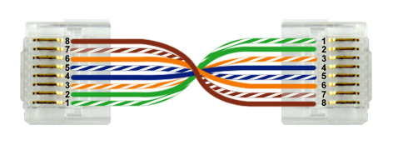
6.3.4 Twisted Pair Connector Facts
Twisted pair cables remain one of the primary ways that computers connect to a network. The table below illustrates both patch (also called straight through) and crossover cable configurations.
Cable | Description
Patch | Computers connect to the network through a hub or switch with a patch cable. Patch cables use the same wire configuration on each connector end. The following are the two most commonly used wiring configurations: T568A Wires are arranged from pins 1 to 8 in each connector in the following order: GW, G, OW, B, BW, O, BrW, Br. T568B Wires are arranged from pins 1 to 8 in each connector in the following order: OW, O, GW, B, BW, G, BrW, Br. It doesn't matter which standard is used as long as all cables use the same standard. This helps prevent confusion during troubleshooting.

Slide 32
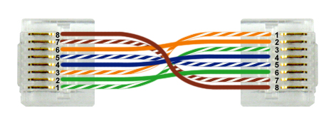
6.3.4 Twisted Pair Connector Facts
Twisted pair cables remain one of the primary ways that computers connect to a network. The table below illustrates both patch (also called straight through) and crossover cable configurations.
Cable | Description
Crossover | Computers can connect directly to one another using a crossover cable. The easiest way to create a crossover cable is to arrange the wires in the first connector using the T568A standard and arrange the wires in the second connector using the T568B standard.

Slide 33
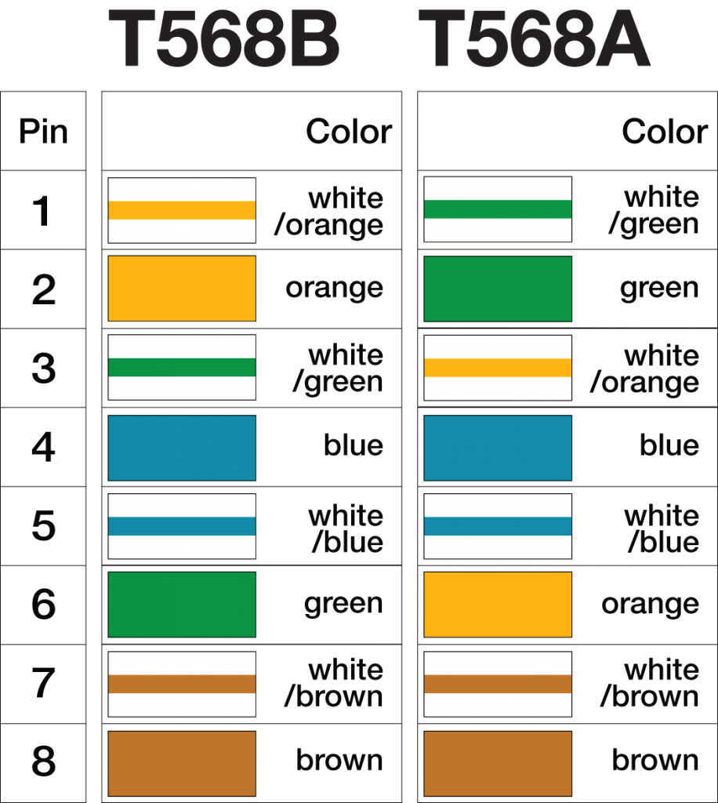
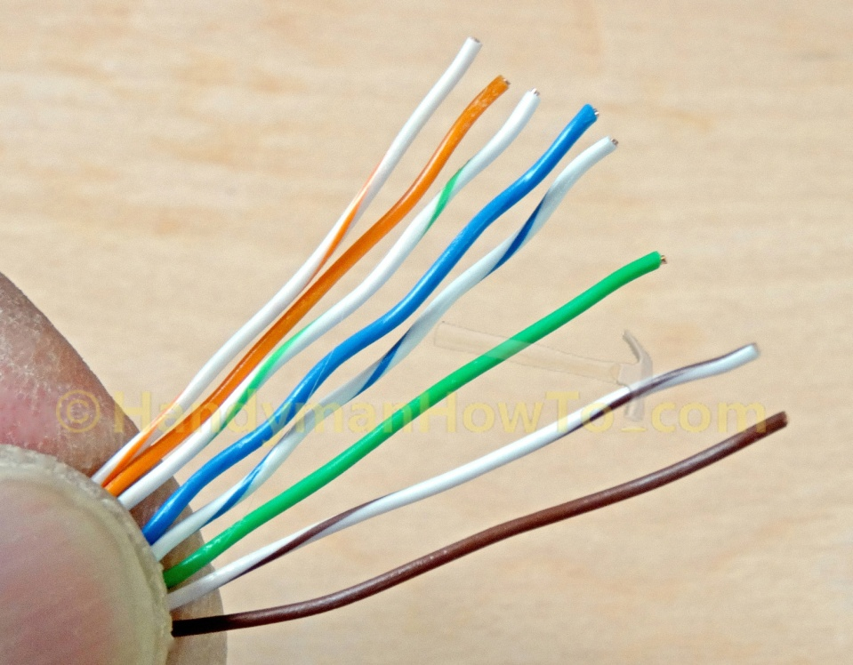
6.3.4 Twisted Pair Connector Facts

Slide 34
6.3.4 Twisted Pair Connector Facts (Continued)
Ethernet specifications use the following pins for communication:
Cat 5 Ethernet (100BASE-T) and below (Tx is a pin used for transmitting and Rx is a pin used for receiving): | Cat 5e (1000BASE-T) and above (Bi indicates the pin is used for both transmitting and receiving):
Pin 1: Tx+ Pin 2: Tx- Pin 3: Rx+ Pin 4: Unused Pin 5: Unused Pin 6: Rx- Pin 7: Unused Pin 8: Unused | Pin 1: Bi+ Pin 2: Bi- Pin 3: Bi+ Pin 4: Bi+ Pin 5: Bi- Pin 6: Bi- Pin 7: Bi+ Pin 8: Bi-

Slide 35
6.3.4 Twisted Pair Connector Facts (Continued)
Be aware of the following when making cables for Ethernet:
Use a crimping tool designed for RJ45 connectors to attach connectors to UTP cable. Most crimping tools include an integrated wire stripper that you can use to remove the outer sheath from the cable so you can access the individual wires.
Cat 5/5e/6/6a cables come with wires that have solid cores or stranded cores. Use solid core cables for longer runs inside walls or the ceiling; use stranded wires for drop cables where flexibility and frequent movement occurs.
There are different connectors rated for solid or stranded core wires; be sure to use the correct connector type.
To reduce crosstalk, keep the pairs twisted as much as possible right up to the connector.
Making Cat 6 compliant cables is difficult; if you do not add the connectors exactly right, the cable will only be capable of 100 Mbps speeds. In most cases, it would be easier to buy cables of the correct length than to try and make your own.
Be sure you use the appropriate punch-down tool when connecting UTP cabling to a punch-down block. To use a punch-down tool, position the UTP wire into a slotted post in the punch-down block. Then press down on the top of the wire over the post with the punch-down tool.

Slide 36
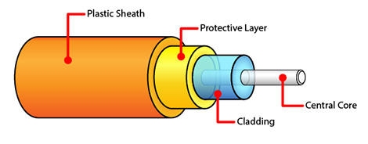
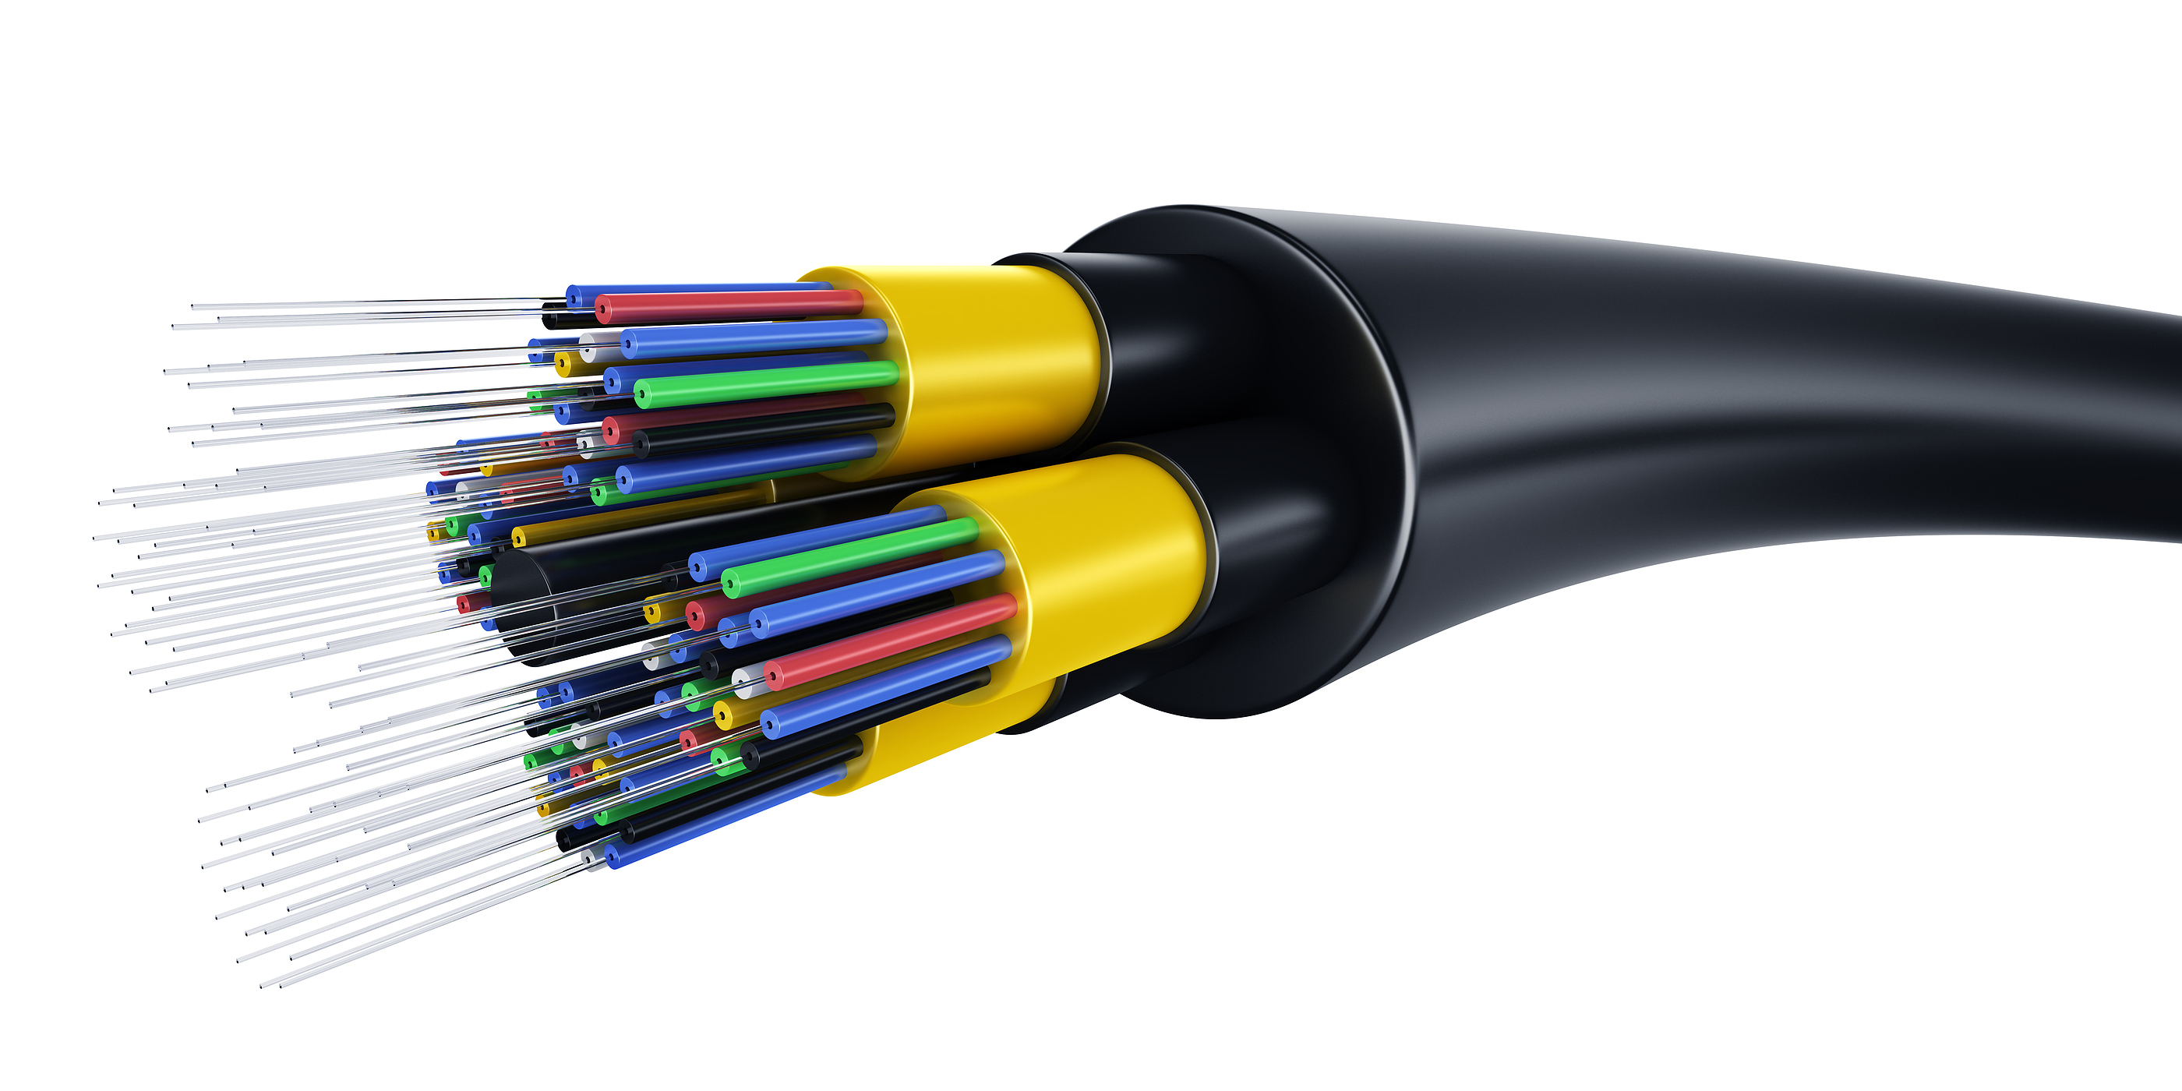
6.3.5 Fiber Optic Facts
Fiber optic cabling is composed of the following components:
The central core carries the signal. It is made of plastic or glass. The cladding maintains the signal in the center of the core as the cable bends. The protective layer provides a stiff structure to prevent the cladding and central core from breaking. The plastic sheath encases everything and protects the cable.
To connect computers using fiber optic cables, you need two fiber strands: one for transmitting and the other for receiving.

Slide 37
6.3.5 Fiber Optic Facts (Continued)
Fiber optic cabling offers the following advantages and disadvantages:
Advantages | Disadvantages
Completely immune to EMI Highly resistant to eavesdropping Fastest available transmission rates Allows greater cable distances without a repeater | Very expensive Difficult to work with Special training required to attach connectors to cables

Slide 38
6.3.5 Fiber Optic Facts (Continued)
Multi-mode and single mode fiber cables are distinct from each other and not interchangeable. The table below describes multi-mode and single mode fiber cables.
Type | Description
Single Mode | Transfers data through the core using a single light ray (the ray is also called a mode) The core diameter is around 10 microns Supports a large amount of data Cable lengths can extend a great distance
Multi-mode | Transfers data through the core using multiple light rays The core diameter is around 50 to 100 microns Cable lengths are limited in distance

Slide 39
6.3.5 Fiber Optic Facts (Continued)
Fiber optic cabling uses the following connector types:
Type | Description
ST Connector | Used with single mode and multi-mode cabling Keyed, bayonet-type connector Also called a push in and twist connector Each wire has a separate connector Nickel plated with a ceramic ferrule to ensure proper core alignment and prevent light ray deflection As part of the assembly process, it is necessary to polish the exposed fiber tip to ensure that light is passed on from one cable to the next with no dispersion
SC Connector | Used with single mode and multi-mode cabling Push on, pull off connector type that uses a locking tab to maintain connection Each wire has a separate connector Uses a ceramic ferrule to ensure proper core alignment and prevent light ray deflection As part of the assembly process, it is necessary to polish the exposed fiber tip

Slide 40
6.3.5 Fiber Optic Facts (Continued)
Fiber optic cabling uses the following connector types:
Type | Description
LC Connector | Used with single mode and multi-mode cabling Composed of a plastic connector with a locking tab, similar to an RJ45 connector A single connector with two ends keeps the two cables in place Uses a ceramic ferrule to ensure proper core alignment and prevent light ray deflection Half the size of other fiber optic connectors
MT-RJ Connector | Used with single mode and multi-mode cabling Composed of a plastic connector with a locking tab Uses metal guide pins to ensure it is properly aligned A single connector with one end holds both cables Uses a ceramic ferrule to ensure proper core alignment and prevent light ray deflection

Slide 41
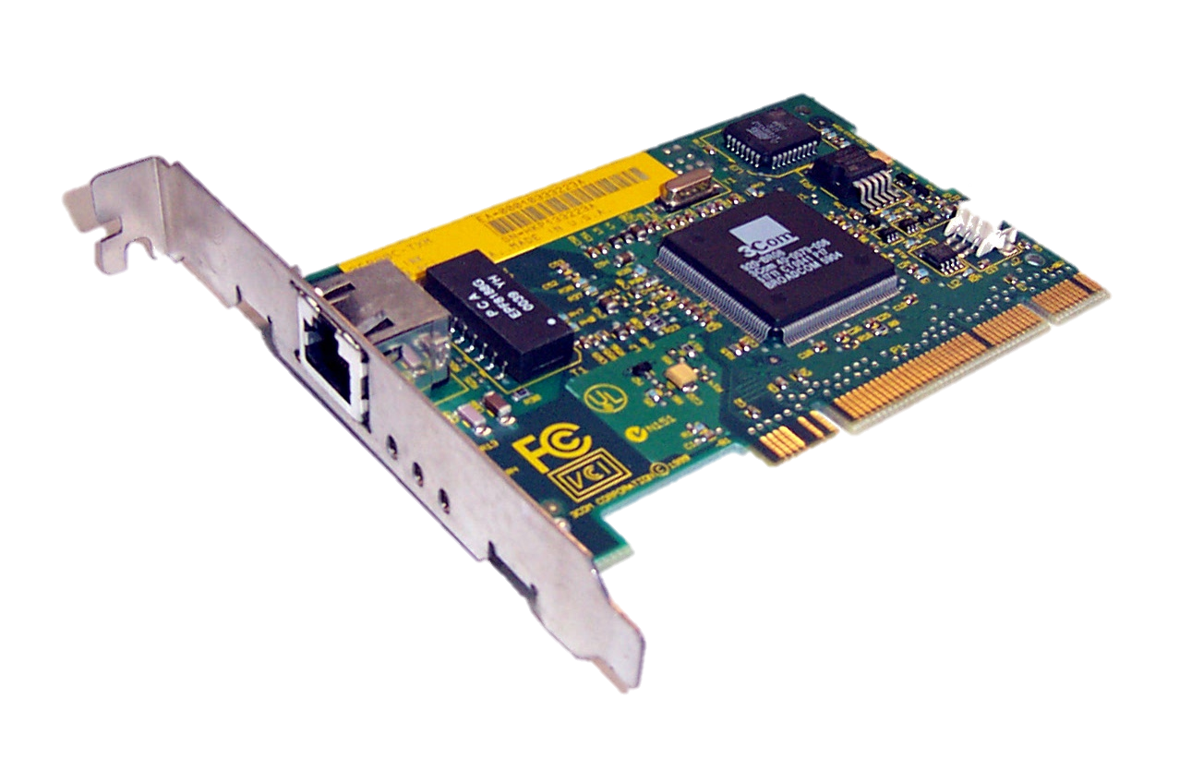
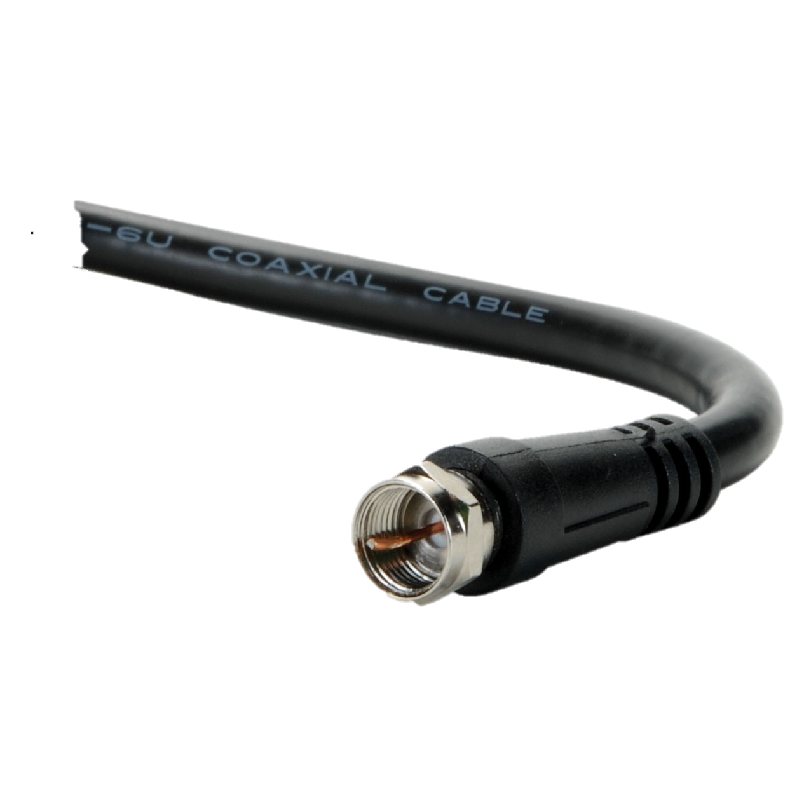
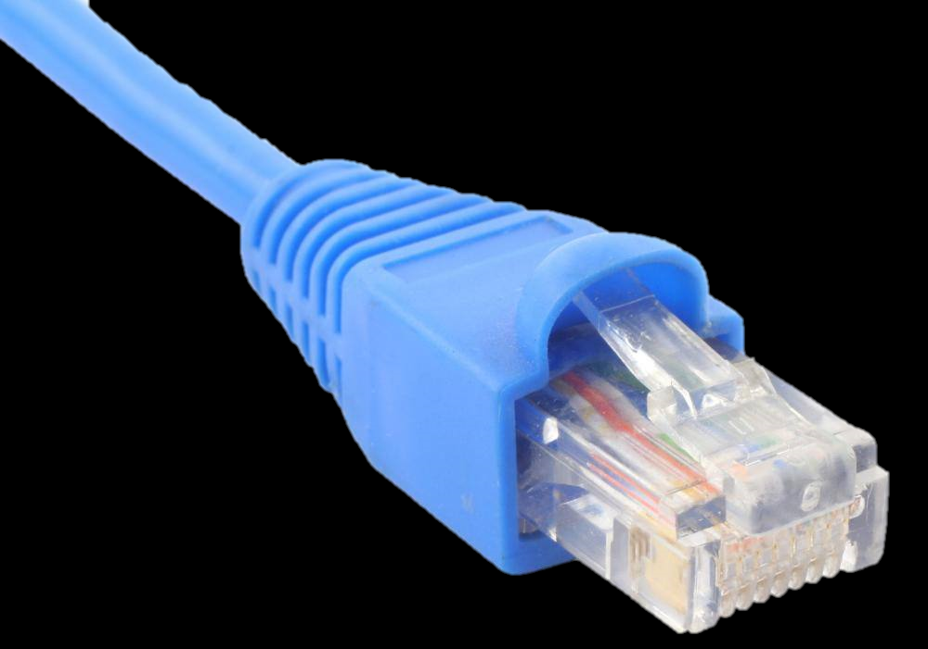
6.4 Ethernet / 6.4.2 Ethernet Facts
Ethernet is the most common local area networking standard for wired networks. The following table describes the various components that compose an Ethernet network:
Component | Description
Network interface card | A network interface card (NIC) creates the signals that are sent along the networking medium. A transceiver built into the network adapter formats the binary data for transmission on the network medium. Ethernet devices are identified using the MAC address, which is burned into the network interface card.
Networking media | Ethernet supports the following cable types: Unshielded twisted-pair cables (UTP) with RJ45 connectors. This is the most common transmission medium used for Ethernet. Fiber optic cables, which are used in high-speed applications (e.g., servers or streaming media). Coaxial cable with F-type connectors for cable Internet services. Coaxial cable is also used for older Ethernet implementations (often called thinnet or thicknet networks).

Slide 42
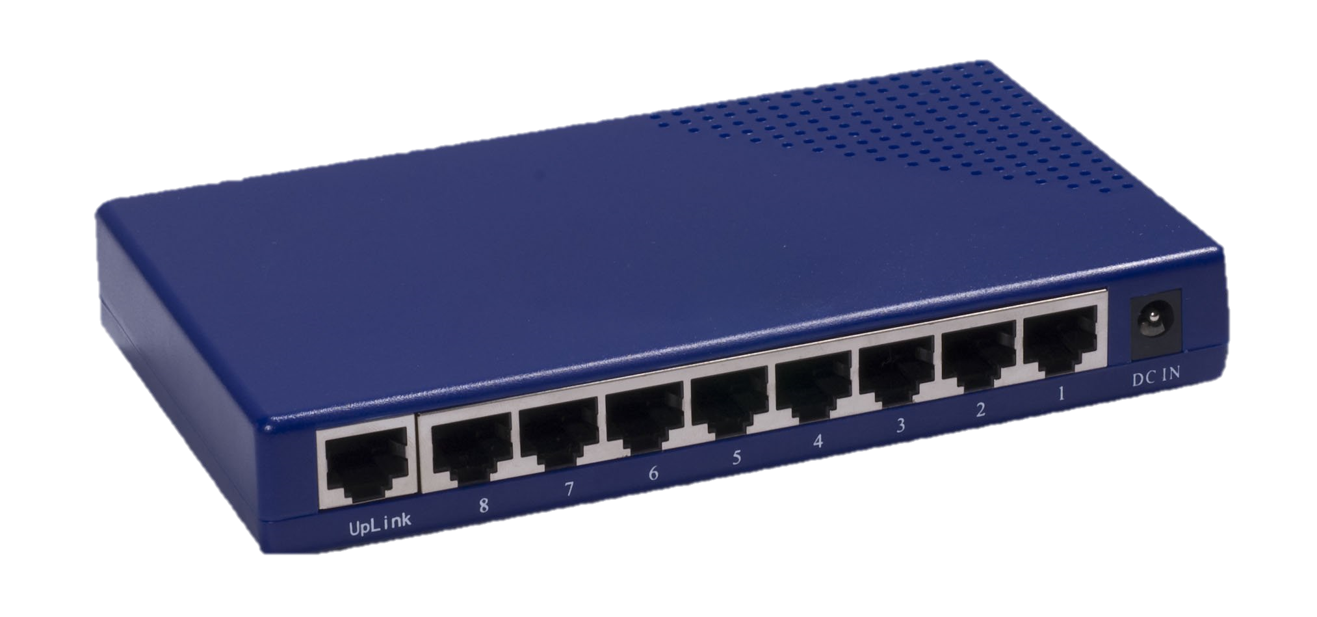
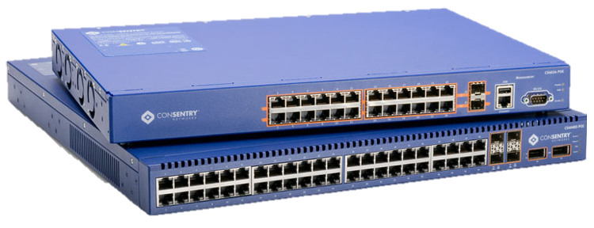
6.4.2 Ethernet Facts (continued)
Component | Description
Connectivity devices | Ethernet uses the following connectivity devices.
 | A hub provides a central connection for multiple media segments on the same subnet. When a hub receives a signal, it is repeated out to all other ports. Hubs operate in half-duplex mode, meaning devices can either send or receive data at any given time.
 | Hubs are rarely used in networking environments and should be avoided if possible.
Connectivity devices | A switch provides a central connection for multiple media segments on the same subnet.
 | When a switch receives a signal, it forwards that signal only to the port where the destination device is connected. Switches use the MAC address to send frames to the destination device. Switches operate in full-duplex mode, meaning devices can send and receive data at the same time because transmission paths are dedicated to only the communicating devices.
 | When possible, use switches instead of hubs.

Slide 43
6.4.2 Ethernet Facts (continued)
Component | Description
Connectivity devices | A router connects two network segments that have different subnet addresses. A router has multiple network connections, with each connection being on a different subnet. Routers use the IP address within a packet to move packets between networks.
 | A bridge connects two segments within the same subnet that use different media types. For example, use a bridge to connect wireless clients to wired clients on the same network.

Slide 44
6.4.2 Ethernet Facts (continued)
Component | Description
Connectivity devices | A patch panel is a device that is commonly used to connect individual stranded wires into female RJ45 connectors. For example, you might connect 4 pairs of wires from a punchdown block to a port on the patch panel. On the patch panel, you then connect drop cables (cables with RJ45 connectors) to the patch panel on one end and a computer on the other end.
 | An Ethernet over Power device allows for network communications to be transmitted over existing AC power lines. An Ethernet over Power device is plugged in to one AC power outlet, and a second Ethernet over Power device is connected to the same AC circuit. These devices multiplex the AC copper power lines to transmit digital network signals at a frequency higher than the AC electrical power already on the circuit.

Slide 45
6.4.2 Ethernet Facts (continued)
Component | Description
Standards | Ethernet standards identify the transmission speed and the cable type. Data transfer rates are between 10 Mbps (very old Ethernet networks) to up to 10 Gbps. Between 100 and 1000 Mbps are the most common speeds for most networks.
Distance | Ethernet standards define the maximum distance for cable lengths between two devices: The maximum cable length for UTP Ethernet "T" implementations is 100 meters for all standards. The length for fiber optic cables varies depending on the cable type and specification, but typically ranges from 100 meters all the way up to 40 kilometers.
Power over Ethernet | Power over Ethernet (PoE) technology can be used to distribute electrical power along with network data on twisted-pair Ethernet cabling (CAT 5 or higher). Power is usually supplied by a PoE-enabled Ethernet switch. PoE is commonly used to power network devices that are located where physical access to a power outlet may not be available. For example, a PoE-enabled surveillance camera mounted on a tall pole can be powered via its Ethernet cabling.

Slide 46
6.4.3 Ethernet Standards
Ethernet standards are defined by the IEEE 802.3 committee. The following table compares the characteristics of the various Ethernet standards:
Category | Standard | Bandwidth | Cable Type | Maximum Segment Length
Ethernet | 10BaseT | 10 Mbps (half-duplex) 20 Mbps (full-duplex) | Twisted pair (Cat3, 4, or 5) | 100 meters
 | 10BaseFL | 10 Mbps (multimode cable) | Fiber optic | 1,000 to 2,000 meters
Fast Ethernet | 100BaseTX | 100 Mbps (half-duplex) 200 Mbps (full-duplex) | Twisted pair (Cat5 or higher) Uses 2 pairs of wires | 100 meters
 | 100BaseFX | 100 Mbps (multimode cable) | Fiber optic | 412 meters

Slide 47
6.4.3 Ethernet Standards (Continued)
Category | Standard | Bandwidth | Cable Type | Maximum Segment Length
Gigabit Ethernet | 1000BaseT | 1,000 Mbps (half-duplex) 2,000 Mbps (full-duplex) | Twisted pair (Cat5 or higher) | 100 meters
 | 1000BaseCX (short copper) |  | Special copper (150 ohm) | 25 meters, used within wiring closets
 | 1000BaseSX (short) |  | Fiber optic | 220 to 550 meters depending on cable quality
 | 1000BaseLX (long) |  |  | 550 meters (multimode) 10 kilometers (single-mode)

Slide 48
6.4.3 Ethernet Standards (Continued)
Category | Standard | Bandwidth | Cable Type | Maximum Segment Length
10 Gigabit Ethernet | 10GBaseT | 10 Gbps (full-duplex only) | Twisted pair (Cat6, or 7) | 100 meters
 | 10GBaseSR/10GBaseSW |  | Multimode fiber optic | 300 meters
 | 10GBaseLR/10GBaseLW |  | Single-mode fiber optic | 10 kilometers
 | 10GBaseER/10GBaseEW |  | Single-mode fiber optic | 40 kilometers
You should also know the following facts about Ethernet:
The maximum cable length for UTP Ethernet "T" implementations is 100 meters for all standards.
Ethernet standards support a maximum of 1024 hosts on a single subnet.

Slide 49
6.5 IP Networking / 6.5.3 Addressing Facts
Network devices use addresses to identify other devices.
These addresses are used to send and receive packets of electronic data over the network.
The addresses used depend on the physical topology of the network as well as the protocols being used.

Slide 50
6.5.3 Addressing Facts (Continued)
Each network device is identified using a physical address. For Ethernet networks, the physical device address is the MAC address.
The MAC address is a unique hexadecimal identifier burned into the ROM (physically assigned address) of every network interface.
The MAC address is a 48-bit, 12-digit hexadecimal number (each number ranges from 0–9 or A–F).
The address is often written as 00-B0-D0-06-BC-AC or 00B0.D006.BCAC (although dashes, periods, and colons can also be used to divide the MAC address segments).
The MAC address is guaranteed unique through design. The first half (first 6 digits) of the MAC address is assigned to each manufacturer. The manufacturer determines the rest of the address, assigning a unique value which identifies the host address.

Slide 51
6.5.3 Addressing Facts (Continued)
A manufacturer that uses all of the addresses in the original assignment can apply for a new MAC address assignment.
Although some network cards allow you to change the MAC address (or specify one of your own choice), this is rarely done in practice.
When you change the network card, the host will have a new physical device address.
When you move a device to another network, the physical address remains the same (as long as the network card has not been changed).

Slide 52
6.5.3 Addressing Facts (Continued)
In addition to the physical device address, two logical addresses are also used.
The logical network address identifies a network segment (called a subnet).
All devices on the same network segment share the same logical network address.
The logical host address identifies a specific host on the network. Each device must have a unique logical host address.

Slide 53
6.5.3 Addressing Facts (Continued)
The format for the logical addresses used depends on the protocol suite. With TCP/IP, the logical network and logical host addresses are combined into a single address called the IP address.
An IP address:
Is a 32-bit binary number represented as four octets (four 8-bit numbers). Each octet is separated by a period.
Can be represented in one of two ways: Decimal (e.g., 131.107.2.200). In decimal notation, each octet must be between 0 and 255. Binary (e.g., 10000011.01101011.00000010.11001000). In binary notation, each octet is an 8-digit number.
Includes both the network address and the host address.
Uses a subnet mask to differentiate the network and host addresses.

Slide 54
6.5.3 Addressing Facts (Continued)
IP addresses use default classes that includes a default subnet mask value. The class defines the default network address portion of the IP address.
Address Range | Default Class | Default Subnet Mask
1.0.0.0 to 126.255.255.255 | A | 255.0.0.0
128.0.0.0 to 191.255.255.255 | B | 255.255.0.0
192.0.0.0 to 223.255.255.255 | C | 255.255.255.0
224.0.0.0 to 239.255.255.255 | D | N/A
240.0.0.0 to 255.255.255.255 | E | N/A

Slide 55
6.5.3 Addressing Facts (Continued)
The IP address 192.168.6.11 is an example of a Class C address, which uses a default mask of 255.255.255.0.
With this address, the network address is 192.168.6.0, and the host address is 11. Know that the address range from 0.0.0.0 to 0.255.255.255 is reserved for broadcast messages to the current network. The address range from 127.0.0.0 to 127.255.255.255 is reserved for loopback addresses to the local host.
Instead of using the default subnet mask, it is possible to use custom subnet masks to define different network addresses.
This process is called subnetting.

Slide 56
6.5.5 TCP/IP Protocol Facts
A protocol is a rule that identifies some aspect of how computers communicate on a network.
For two computers to communicate, they must be using the same protocols.
Protocols are grouped into protocol suites, or sets of related protocols, that are meant to be used together.
Common protocol suites include:
Protocol | Description
TCP/IP | TCP/IP is the protocol suite used on the Internet and on most networks. Nearly all computers today use TCP/IP for communication. The Internet Protocol (IP) is a key component of the TCP/IP protocol suite. The IP protocol is responsible for determining how to deliver data from the sending host to the destination host. However, it does not provide a mechanism for segmenting and sequencing packets in a communication. To accomplish this, IP is used in conjunction with another transport protocol:

Slide 57
6.5.5 TCP/IP Protocol (Facts Continued)
Common protocol suites include:
Protocol | Description
TCP/IP | Transmission Control Protocol (TCP) - TCP is a connection-oriented protocol. To ensure reliable delivery of data, TCP requires the recipient of a network transmission to send an acknowledgement of each and every IP packet it receives to the sender. Packets that don't make it are retransmitted. This ensures that the data is delivered reliably.
 | User Datagram Protocol (UDP) - UDP is a connectionless protocol. Unlike TCP, UDP does not require acknowledgements. One of the key drawbacks of using TCP is the fact that its reliability introduces latency. For small data transmissions, such as sending an e-mail, moderate latency is not a problem. However, for large data transmissions, such as video or audio streaming, the latency associated with TCP is unacceptable. By using UDP instead, the latency of the transmission is significantly reduced, with the assumption that an occasional lost packet won't be detrimental.

Slide 58
6.5.5 TCP/IP Protocol (Facts Continued)
Common protocol suites include:
Protocol | Description
NetBIOS | NetBIOS is the term used to describe the combination of two protocols: NetBEUI and NetBIOS. NetBIOS was used in early Windows networks. Because NetBIOS is a non-routable protocol, it was often combined with IP to enable internetwork communications. NetBIOS over TCP/IP, or NetBT, is used to allow older computers and applications that rely on NetBIOS to communicate on a TCP/IP network.

Slide 59
6.5.5 TCP/IP Protocol (Facts Continued)
Be aware of the following facts regarding protocol suite support and features:
Virtually all operating systems today provide native (built-in) support for TCP/IP.
Most older versions of some operating systems used a different protocol as the default protocol suite. For example, older NetWare servers used IPX/SPX, while older Mac OS systems used AppleTalk.
Older operating systems without native TCP/IP support enabled IP communications by either installing the protocol stack or through a process known as encapsulation or tunneling. With this process, non-IP packets are re-packaged as IP packets at the sending device. The receiving device strips off the IP headers to reveal the original packets.

Slide 60
6.5.5 TCP/IP Protocol (Facts Continued)
The following table lists several protocols in the TCP/IP protocol suite:
Protocol | Default Port(s) | Description
Hypertext Transfer Protocol (HTTP) | 80 | HTTP is used by web browsers and web servers to exchange files (such as web pages) through the World Wide Web and intranets. HTTP can be described as an information requesting and responding protocol. It is typically used to request and send Web documents, but is also used as the protocol for communication between agents using different IP protocols.
Hypertext Transfer Protocol over Secure Socket Layer or HTTP over SSL (HTTPS) | 443 | HTTPS is a secure form of HTTP that uses SSL as a sublayer for security. SSL secures messages being transmitted on the Internet. It uses RSA for authentication and encryption. Web browsers use SSL (Secure Sockets Layer) to ensure safe Web transactions. URLs that begin with https://trigger your Web browser to use SSL.

Slide 61
6.5.5 TCP/IP Protocol (Facts Continued)
The following table lists several protocols in the TCP/IP protocol suite:
Protocol | Default Port(s) | Description
File Transfer Protocol (FTP) | 21 | FTP provides a generic method of transferring files. It can include file security through usernames and passwords, and it allows file transfer between dissimilar computer systems. FTP can transfer both binary and text files, including HTML, to another host. FTP URLs are preceded by ftp://followed by the DNS name of the FTP server. To log in to an FTP server, use:ftp://username@servername.
Simple Mail Transfer Protocol (SMTP) | 25 | SMTP is used to route electronic mail through the internetwork. E-mail applications provide the interface to communicate with SMTP or mail servers.

Slide 62
6.5.5 TCP/IP Protocol (Facts Continued)
The following table lists several protocols in the TCP/IP protocol suite:
Protocol | Default Port(s) | Description
Internet Message Access Protocol (IMAP) | 143 | IMAP is an e-mail retrieval protocol designed to enable users to access their e-mail from various locations without the need to transfer messages or files back and forth between computers. Messages remain on the remote mail server and are not automatically downloaded to a client system.
Post Office Protocol 3 (POP3) | 110 | POP3 is part of the IP protocol suite and used to retrieve e-mail from a remote server to a local client over an IP connection. With POP3, e-mail messages are downloaded to the client.
Remote Terminal Emulation (Telnet) | 23 | Telnet allows an attached computer to act as a dumb terminal, with data processing taking place on the IP host computer. It is still widely used to provide connectivity between dissimilar systems. Telnet can also be used to test a service by the use of HTTP commands. You should avoid using Telnet as it transmits all data, including usernames and passwords clear text.

Slide 63
6.5.5 TCP/IP Protocol (Facts Continued)
The following table lists several protocols in the TCP/IP protocol suite:
Protocol | Default Port(s) | Description
Secure Shell (SSH) | 22 | SSH allows for secure interactive control of remote systems. SSH is much more secure alternative to Telnet.
Secure FTP (SFTP) | 22 | SFTP addresses one of the key weaknesses of FTP; namely, FTP doesn't use encryption. All data, including user names and passwords, is sent clear text. SFTP provides the same functionality as FTP, but secures the data transmissions using the SSH protocol.
Domain Name System (DNS) | 53 | DNS is a system that is distributed throughout the internetwork to provide address/name resolution. For example, the name www.mydomain.com would be identified with a specific IP address.

Slide 64
6.5.5 TCP/IP Protocol (Facts Continued)
The following table lists several protocols in the TCP/IP protocol suite:
Protocol | Default Port(s) | Description
Remote Desktop Protocol (RDP) | 3389 | RDP allows you to view and use the graphical desktop of a remote computer system as if you were sitting in front of it.
Dynamic Host Configuration Protocol (DHCP) | 67, 68 | DHCP is used to dynamically assign IP addressing information to network hosts when they come online. The client system, when it connects to the network, broadcasts a DHCPDISCOVER message on the network, looking for a DHCP server. The DHCP server responds with a DHCPOFFER message containing proposed IP addressing configuration information. The client then responds with a DHCPREQUEST message to the DHCP server indicating it wants to use the proposed configuration. The DHCP server makes the assignment with a DHCPACK message.

Slide 65
6.5.5 TCP/IP Protocol (Facts Continued)
The following table lists several protocols in the TCP/IP protocol suite:
Protocol | Default Port(s) | Description
Lightweight Directory Access Protocol (LDAP) | 389, 636 | LDAP is a protocol used to access information about network resources stored by a directory service, such as Active Directory or eDirectory. LDAP uses port 389 for clear text transmissions and port 636 for secure transmissions.
Simple Network Management Protocol (SNMP) | 161, 162 | SNMP is used to monitor and manage network devices. SNMP agents can be installed on network devices such as PCs, switches, and routers. These agents send data to an SNMP manager application running on an administrative workstation, which aggregates the information and displays an overview of the current network status. Thresholds can be configured which trigger alerts if exceeded.

Slide 66
6.5.5 TCP/IP Protocol (Facts Continued)
The following table lists several protocols in the TCP/IP protocol suite:
Protocol | Default Port(s) | Description
Server Message Block (SMB) | 137,138, 139 | SMB enables the sharing of folders and printers on the network. Using SMB, remote users can access files in a shared folder on a server or workstation. Likewise, a remote user can send print jobs to a shared printer. SMB is also known as Common Internet File System (CIFS).
Service Location Protocol (SLP) | 427 | SLP is a protocol that is able to organize and locate various network devices and services, such as printers, shared disk drives, directories, etc.
Apple Filing Protocol (AFP) | 548, 427 | AFP is the protocol used by systems running Mac OS X or newer to support filer sharing on the network. AFP replaced AppleTalk and has gone through several revisions.

Slide 67
6.6 IP Configuration / 6.6.4 IP Configuration Facts
The following table summarizes the configuration settings required to connect to a TCP/IP network:
Parameter | Description
IP address | The IP address identifies both the logical host and the logical network addresses. Each host on the entire network must have a unique IP address. Two devices on the same subnet must have IP addresses with the same network portion of the address. Two devices on the same subnet must have unique host portions of the IP address. Do not use the first or the last host address on a subnet address range.
Subnet mask | The subnet mask identifies which portion of the IP address is the network address and which portion is the host address. Two devices on the same subnet must be configured with the same subnet mask.
Default gateway | The default gateway identifies the router to which communications for remote networks are sent. The default gateway address is the IP address of the router interface on the same subnet as the local host. Without a default gateway set, most clients will be unable to communicate with hosts outside of the local subnet.
DNS server | The DNS server address identifies the DNS server that is used to resolve host names to IP addresses.
Hostname | The hostname identifies the logical name of the local system.

Slide 68
6.6.4 IP Configuration Facts (Continued)
The following table describes the methods you can use to configure TCP/IP parameters:
Method | Description
Static | With static addressing, you manually assign all configuration values. Static addressing is prone to error and should only be used under the following conditions: The network has a small number of hosts. The network will not change or grow. You have some hosts that must have the same address each time.
Dynamic Host Configuration Protocol (DHCP) | On a network configured with DHCP, IP hosts contact a DHCP server for IP addressing and other configuration information. This ensures error-free host configuration. With DHCP: The host uses broadcast messages to locate a DHCP server when it boots. The DHCP server assigns IP address and mask values to the host (called an address lease). The DHCP server ensures that no two hosts are assigned the same IP address. You can configure the DHCP server to deliver default gateway, DNS server, and other configuration information to hosts. DHCP requires a special DHCP server, which is built-in to most SOHO routers.

Slide 69
6.6.4 IP Configuration Facts (Continued)
The following table describes the methods you can use to configure TCP/IP parameters:
Method | Description
Automatic Private IP Addressing (APIPA) | If a Windows client is configured to receive an IP address from a DHCP server, but cannot contact a DHCP server, it will automatically assign itself an IP address within the following range: 169.254.0.1 to 169.254.255.254 with the subnet mask 255.255.0.0 with APIPA: The host is configured to obtain IP information from a DHCP server (this is the default configuration). If a DHCP server cannot be contacted, the host uses APIPA to assign itself an IP address. The host only configures the IP address and mask. It does not assign itself the default gateway and DNS server addresses. For this reason, APIPA can only be used on a single subnet. You can use APIPA instead of a DHCP server, but it should only be used on a small network that does not need default gateway or DNS server settings configured.

Slide 70
6.6.4 IP Configuration Facts (Continued)
The following table describes the methods you can use to configure TCP/IP parameters:
Method | Description
Alternate IP configuration | With an alternate IP configuration, the system attempts to use DHCP for TCP/IP configuration information. If a DHCP server cannot be contacted, the static configuration values are used. When you configure an alternate IP address, APIPA is no longer used. Use an alternate configuration: If you have a computer (e.g., a laptop) that connects to two networks (i.e., one with a DHCP server and another without a DHCP server). If you want to provide values to properly configure the computer in case the DHCP server is unavailable.

Slide 71
6.6.4 IP Configuration Facts (Continued)
You should know the following facts about IP address assignments:
By default, all Windows computers try to use DHCP for TCP/IP configuration information.
If your computer has used APIPA because the DHCP server is unavailable, it will have an IP address in the 169.254.x.x range. The workstation will be able to communicate with other hosts that have addresses in this range, but will not be able to communicate with hosts on other networks.
When you configure a static IP address, you disable DHCP and APIPA.
If you use a DHCP server for IP address configuration, you can still manually configure DNS server addresses.
By default, a Windows workstation will use the hosts file to resolve hostnames into IP addresses first. If a match can't be found for the hostname to be resolved in the hosts file, the workstation will contact the DNS server it has been configured to use.

Slide 72
6.7 IP Version 6 / 6.7.2 IPv6 Facts
IP version 6 (IPv6) was developed to address the fact that IPv4 addresses have been exhausted. The IPv6 address is a 128-bit binary number. The following list describes the features of an IPv6 address:
The address is made up of 32 hexadecimal numbers, organized into 8 quartets (e.g., 35BC:FA77:4898:DAFC:200C:FBBC:A007:8973).
The quartets are separated by colons.
Each quartet is represented as a hexadecimal number between 0 and FFFF. Each quartet represents 16-bits of data (FFFF = 1111 1111 1111 1111).
Leading zeros can be omitted in each section. For example, the quartet 0284 could also be represented by 284.
Addresses with consecutive zeros can be expressed more concisely by substituting a two colons for the group of zeros. For example: FEC0:0:0:0:78CD:1283:F398:23AB FEC0::78CD:1283:F398:23AB (concise form)
If an address has more than one consecutive location where one or more quartets are all zeros, only one location can be abbreviated. For example, FEC2:0:0:0:78CA:0:0:23AB could be abbreviated as: FEC2::78CA:0:0:23AB or FEC2:0:0:0:78CA::23AB But not FEC2::78CA::23AB
The 128-bit address contains two parts:

Slide 73
6.7.2 IPv6 Facts (Continued)
Component | Description
Prefix | The first 64 bits are known as the prefix. The 64-bit prefix can be divided into various parts, with each part having a specific meaning. Parts in the prefix can identify the geographic region, the ISP, the network, and the subnet. The prefix length identifies the number of bits in the relevant portion of the prefix. To indicate the prefix length, add a slash (/) followed by the prefix length number. Full quartets with trailing 0's in the prefix address can be omitted (for example 2001:0DB8:4898:DAFC::/64). Because addresses are allocated based on physical location, the prefix generally identifies the location of the host. The 64-bit prefix is often referred to as the global routing prefix.
Interface ID | The last 64 bits are the interface ID. This is the unique address assigned to an interface. Addresses are assigned to interfaces (network connections), not to the host. Technically, the interface ID is not a host address. In most cases, individual interface IDs are not assigned by ISPs, but are rather generated automatically or managed by site administrators. Interface IDs must be unique within a subnet, but can be the same if the interface is on different subnets. On Ethernet networks, the interface ID can be automatically derived from the MAC address. Using the automatic host ID simplifies administration.

Slide 74
End of CIS101A Class Session 7

