Slide 1
CIAT
CIS101B
Welcome to CIS101B
Operating Systems

Slide 2
CIAT CIS101B
Operating Systems
Rick Del Rosario
rdelrosario@ciat.edu
B.S. – Electronics Engineering Technology; ITT Technical Institute
MSIT – Network Management; Coleman University
M.Ed. – Educational Technology Management; Northcentral University
21 years with ITT Technical Institute
Instructor: Electronics, PC, Networking, Network Security
Network Administrator
IT Department Chair
Associate Dean of Academics
Personal Family Financial Advisor/Coach
Business Owner
Hobbies: Movies, Football, Cooking, Cruise Travel, Star Wars

Slide 3
CIAT CIS101B
Operating Systems
Grading System for this Course
Students are expected to complete all assigned labs from Canvas.
Student must also complete assigned quizzes from Canvas.
Quizzes and Labs may be re-taken until student is satisfied with his/her score.
A final exam, however, is given at the end of week 4 that cannot be re-taken.
Scores from the labs, quizzes and final make up student’s grade.
Week 5, Capstone Week is used for Certification Exam Review

Slide 4
CIAT CIS101B
Operating Systems
Course Objectives
Scroll to view all of them

Slide 5
CIAT CIS101B
Operating Systems
Syllabus

Slide 6
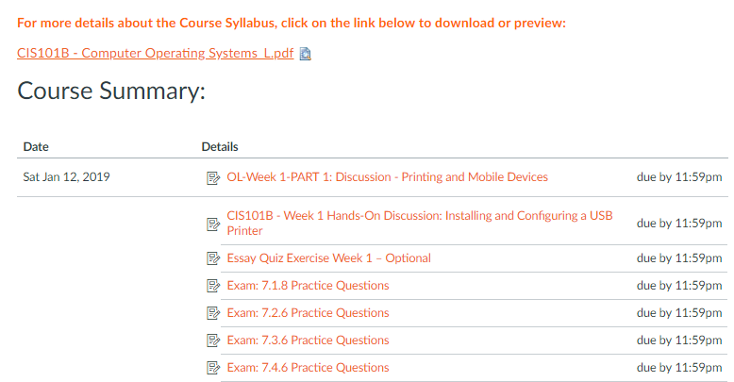
CIAT CIS101B
Operating Systems
Syllabus
PDF File

Slide 7
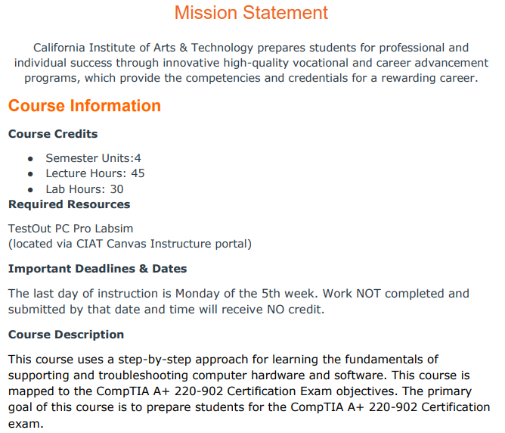
CIAT CIS101B
Operating Systems
Syllabus:
Mission Statement
&
Course Description

Slide 8
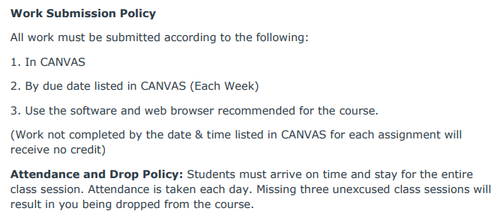
CIAT CIS101B
Operating Systems
Syllabus:
Work Submission Policy

Slide 9
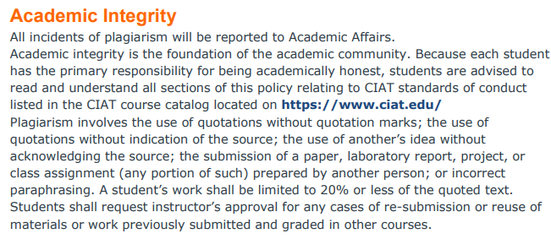
CIAT CIS101B
Operating Systems
Syllabus:
Academic
Integrity

Slide 10
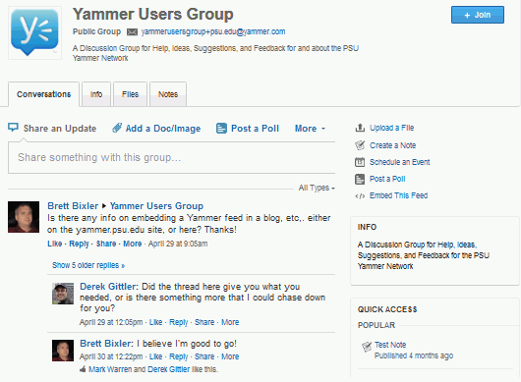
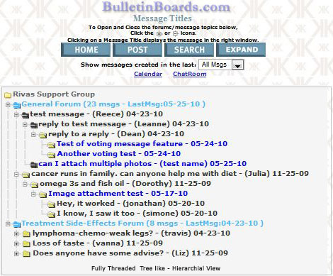
CIAT CIS101B
Operating Systems
Discussions
http://www.citethisforme.com/us/citation-generator/apa

Slide 11
CIAT CIS101B
PC Hardware Components

Slide 12
CIAT CIS101B

Slide 13
CIAT CIS101B
Operating Systems
Discussions
www.citethisforme.com/us/citation-generator/apa

Slide 14
CIAT CIS101B
Operating Systems
Week 1 – Class 1
Chapter 7
Printers
Labs due
7.1.7, 7.2.5, 7.4.5
Printers Overview
Printer Configuration
Network Printing
Printing Management
Printer Maintenance
Printer Troubleshooting

Slide 15
CIAT CIS101B
Operating Systems
7.1 Printers (Types):
First…
The history & trend setter…

Slide 16
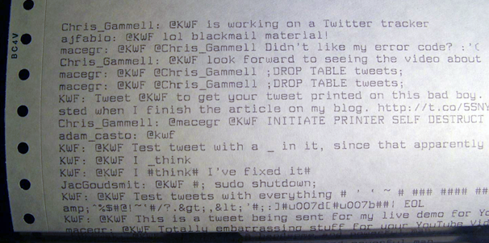
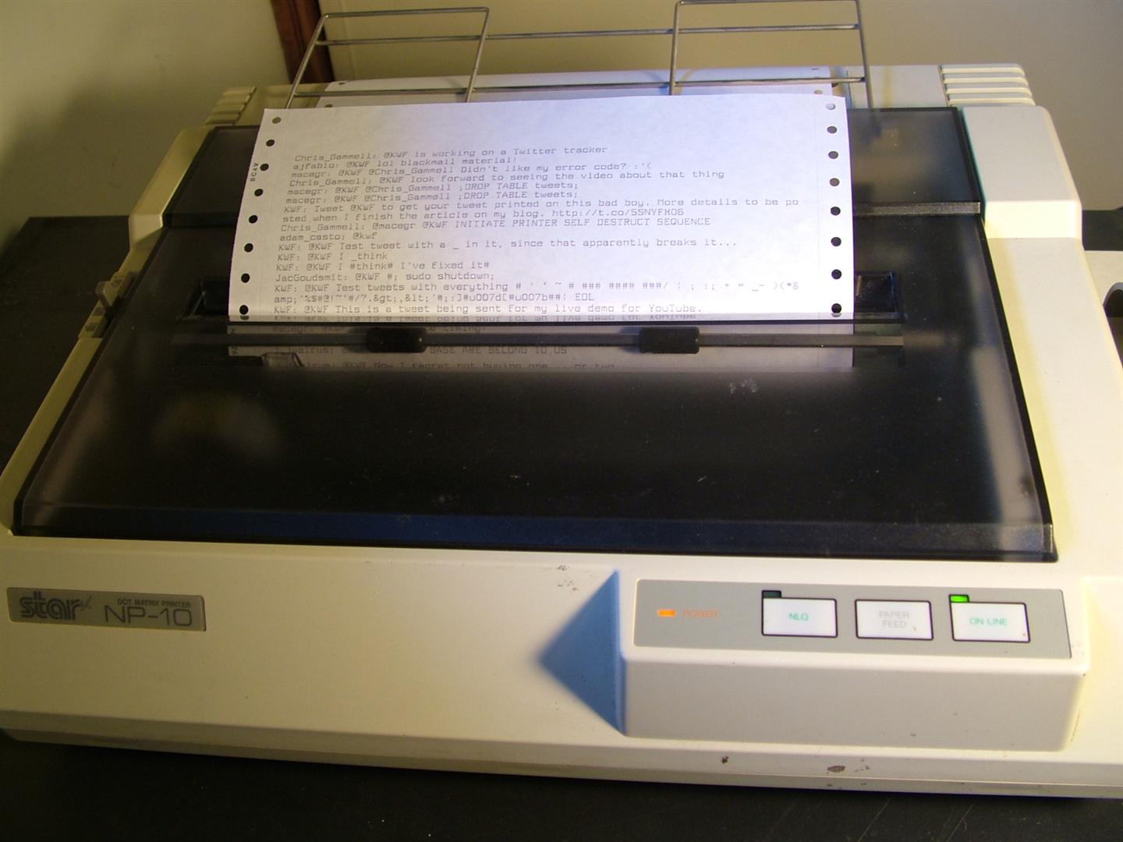
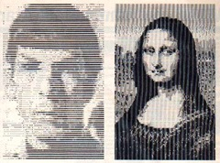
CIS101B
7.1 Printers (Types):
Dot Matrix

Slide 17
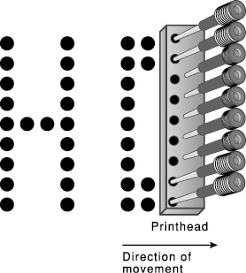
CIS101B
7.1 Printers (Types):
The table below lists and describes the most common types of printers:
Printer Description
Dot Matrix A dot matrix printer is an impact printer that transfers characters by striking a pattern (from a matrix) through an inked ribbon and onto paper.
o The most common number of pins on a dot matrix printer is 9, 18, or 24, with more pins providing a higher resolution. 24-pins create a near-letter quality print and anything with less than 24-pins provides a draft quality print. The overall print quality of a dot matrix printer is quite poor when compared to that of other types of printers.
o The speed of dot matrix printers is measured in characters per second (CPS). Common speeds for a dot matrix printer are 32 to 72 CPS.

Slide 18
CIS101B
7.1 Printers (Types):
The table below lists and describes the most common types of printers:
o Dot matrix printers operate in either a font (letters, numbers and symbols) or dot-addressable (graphs and charts) mode.
o Dot matrix printers can use either a friction feed or a tractor feed system to move paper through the printing assembly.
o Because dot matrix printers strike the image onto paper, it is a good printer to use when carbon-copy documents are being printed.
o The print head can become dangerously hot due to pin friction.
o Dot matrix printers can be loud because printing takes place by pins physically striking the ink ribbon, paper, and the platen (a metal plate behind the paper).

Slide 19
CIS101B
7.1 Printers (Types):
The Minor Leagues
and support staff…

Slide 20
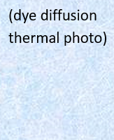
CIS101B
7.1 Printers (Types):
The table below lists and describes the most common types of printers:
Printer Description
Dye sublimation A dye sublimation printer is a non- impact printer that uses film-embedded dye.
(dye diffusion
thermal photo) o The print head heats and passes over the film, causing the dye to vaporize and soak into the film paper.
o Produces photographic quality images.

Slide 21
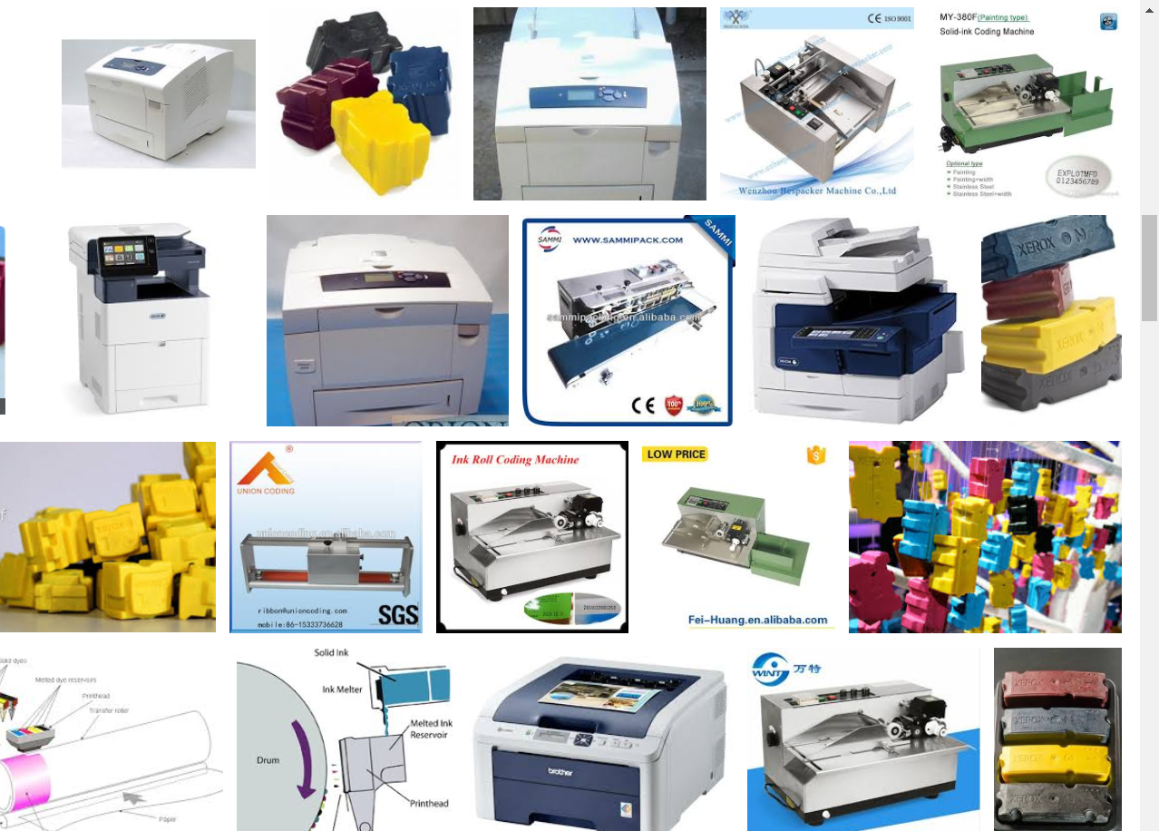
CIS101B
7.1 Printers (Types):
The table below lists and describes the most common types of printers:
Printer Description
Solid ink Solid ink printers melt ink onto the print head (which is as wide as the paper). The head jets the melted ink onto the paper as the paper passes by on the print drum (similar to the laser printing process).
* Offer excellent print quality
* Offer easy set up and maintenance
* The head takes as long as 15 minutes to heat prior to printing.

Slide 22
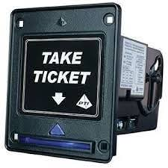
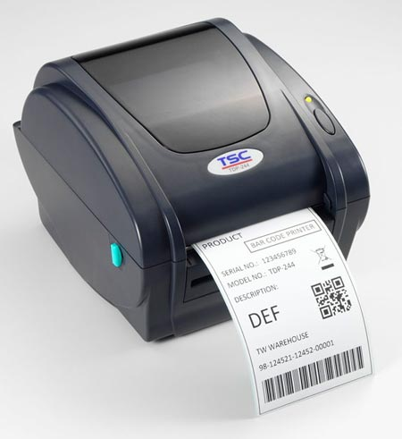
CIS101B
7.1 Printers (Types):
The table below lists and describes the most common types of printers:
Printer Description
Thermal A thermal printer is a non-impact printer that uses heat to cause a reaction on specially treated paper.
o Monochrome thermal paper is chemically treated to darken where heated (photosensitive). Many cash registers use this type of printer for creating receipts.
o For color printers, the color system used by thermal printers is CMYK (cyan, magenta, yellow, and black).
o The paper must make one pass for each application of a different color.
o Color thermal printers are very expensive, high quality, and operate quietly.

Slide 23
CIS101B
7.1 Printers (Types):
The Major Leagues and Heavy Hitters…

Slide 24
CIS101B
7.1 Printers (Types):
https://youtu.be/BhdgvIL7EZ4

Slide 25
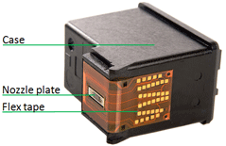
CIS101B
7.1 Printers (Types):
The table below lists and describes the most common types of printers:
Printer Description
Inkjet Inkjet printers are quiet non-impact printers with ink stored in a reservoir.
Bubble jet printers are the most popular form of inkjet printers.
o The ink reservoir is in a disposable cartridge that includes the printing
mechanism.
o Bubble jet printers print by heating the ink and squirting it through tiny nozzles in the print head and onto the paper.
o The crispness of an inkjet printer's image is usually rated as dots per inch or dpi. Ink jets range from 150 to over 1400 dpi.
o A new generation of inkjet printers produce photo-quality printouts when used with photo- quality paper.
o Photo-quality inkjet printers mix up to 16 drops of ink to form a single dot of color on the page.
o Inkjet printers feed single cut sheets of paper, from a feed tray, by clamping them between rollers and advancing them one print line at a time, from top to bottom, and then placing the newly printed paper into a tray, other than the feed tray.
o Inkjet printers are an inexpensive way to produce color printouts.

Slide 26
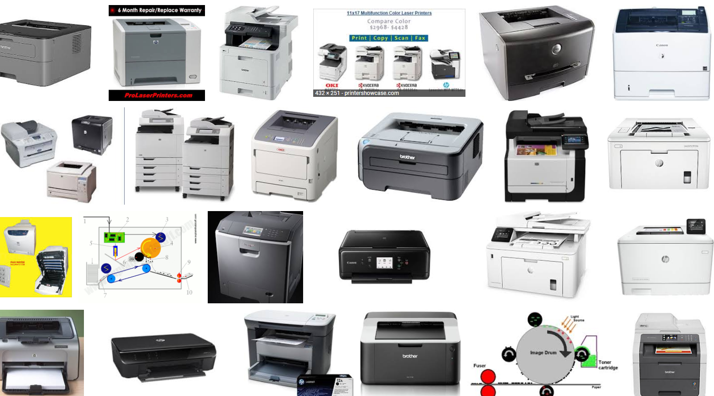
CIS101B
7.1.4 Laser Printers:

Slide 27
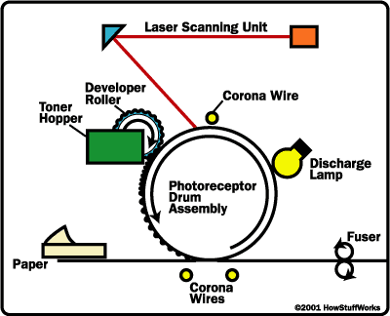
CIS101B
7.1.4 Laser Printers:
In addition to the laser, laser printers share the following components:
o Laser printers use a laser and electrical charges to transfer images to paper.
o Laser printers move paper through the printer via motorized rollers.
o Each laser printer has a high-voltage power supply to charge the drum.
This power supply converts AC current into higher voltages required for the
printing process.
o Each laser printer has a DC power supply to operate most of the electronic
components inside the printer.
o Each laser printer has a controller, which is a circuit board that acts like a
motherboard in the printer. This controller board makes it possible for the
printer to have and add its own memory.
o Laser printers use a laser to charge a metal drum. The drum picks up plastic
toner, and the toner is then fused onto the paper (using rollers and heat).
o Of all the types of printers discussed in this course, laser printers have the highest print quality. o Some laser printers can use duplexing assemblies to print two-sided paper. Duplexing assemblies are typically mounted on the back of a laser or inkjet paper.

Slide 28
CIS101B
7.1.4 Laser Printers:
The layout of physical parts in laser printers can vary greatly, however, the basic process remains the same. The following table describes the steps in the laser printing process:
Step Description
1-Cleaning The cleaning phase prepares the drum by removing the previous image printed. It uses a rubber-cleaning blade to remove any excess toner on the drum and then it scrapes off the debris into a debris cavity. Next, a heat roller is lubricated to ensure that enough heat will be evenly applied to transfer the next image printed. Then an electrostatic erase lamp neutralizes the electrical charges that remain on the drum from the previous printed image.
2-Processing The printer receives a document to be printed from the connected computer and converts it into a bitmap raster image, which is divided into horizontal raster lines.
3- Charging The primary corona prepares the photosensitive drum for writing by causing it to receive a negative electrostatic charge. Depending on the printer, the primary corona will be wires or rollers.
4- Exposing A laser beam changes the charge on the surface of the drum in a pattern of the page's image.

Slide 29
CIS101B
7.1.4 Laser Printers: (continued)
The layout of physical parts in laser printers can vary greatly, however, the basic process remains the same. The following table describes the steps in the laser printing process:
Step Description
5-Developing The developing roller applies toner to the drum. The toner sticks to the charged areas on the drum.
6-Transferring The transfer roller charges the paper to attract the toner.
7-Fusing The fusing assembly attaches the toner to the paper using rollers that press and melt the toner to the paper. As the paper leaves the printer, a static eliminator strip removes the static charge from the paper.

Slide 30
CIS101B
Which one to buy Inkjet or Laser???

Slide 31
CIS101B
https://youtu.be/5t3-OAuJd_Y

Slide 32
CIS101B
7.1.5 Printer Connections:
Printers use one of the following methods for connecting to a computer or sending and receiving print jobs:
Connection Description
Type
USB Most printers use a USB connection, allowing for multi-use devices that also include scanners & card readers. The USB connection increases speed considerably over previously used printing connections such as the a parallel port.
Wireless Many printers connect using a wireless connection. This is especially useful when working with laptop computers.
o Bluetooth is a wireless technology for creating simple connections between two devices. Unlike infrared, line-of-sight connections are not required.
o 802.11a/b/g wireless standards use radio waves and are used to create wireless networks between multiple devices.
Network Some printers also have their own network interface card, which allows them to connect directly to a network. Network printers can also be connected to a computer that is connected to the network. Another way to connect a non-network-ready printer to a network is with a network interface device. Network printers are useful for allowing multiple people to share the same printer. This is a common way to connect printers used in a business environment.

Slide 33
CIS101B
7.1.6 Printer Characteristics:
When purchasing a printer, consider the following factors:
Consideration Description
Connection Serial, Parallel, USB, TCP/IP, Wireless
Print Quality Print quality (resolution) is often measured in dots per inch (DPI). The higher the DPI, the higher quality the image.
Print Speed Print speed is expressed as the number of pages that can be printed in a minute (PPM or pages per minute). Printers often rate both the black and white and color print speeds.
Memory Built-in memory varies and some can have memory expanded to improve performance.

Slide 34
CIS101B
7.1.6 Printer Characteristics: (continued)

Slide 35
CIS101B
7.1.7 Lab: Select a printer
Selecting a printer with the best detail and color printing options.
Detail is measured in dpi resolution
Color printers can be either inkjet or laser
Reminders:
Data cable must be connected between the printer and the PC
Power cable must be plugged into the printer and into a surge protector
Now work on Lab 7.1.7. Instructor will assist you if necessary.

Slide 36
CIS101B
7.1.7 Lab: Select a printer
Now work on Lab 7.1.7.
Instructor will assist you if necessary.

Slide 37
CIS101B
7.2 Printer Configuration within the operating sysgtem:
Key definitions:
Term Definition
Printer A virtual device (logical software entity) inside the print server that can be configured to send output to a printing device. The printer is made up of the print driver, the printing device, and the spooler.
Print Device The physical device connected to the print server where print output occurs.
Print Driver The software that allows the printer to communicate with the print device. Printer drivers provide the following support functions:
o Translate data into a recognizable form for the given printer
o Manage graphics via graphics drivers, converting graphics into the appropriate printer commands
o Allow management of the print job by displaying print and printer properties in the operating system
Print Queue (Spooler) The portion of the hard drive where print jobs are stored before going to the print device.
Printer Port The means by which a print device connects to a print server (the printer's NIC). Many printers can be configured in the same way that most plug and play devices are.

Slide 38
CIS101B
7.2 Printer Configuration: (continued)
To configure a printer, you would:
1 - Connect the print device to an available port.
2 - Create a printer object by installing the driver. For Plug and Play printers connected to a USB port, the printer
might be configured automatically.
3 - Edit the printer object to configure device-specific settings such as color profiles, paper trays, or features such as stapling or double-sided printing.
4 - Verify that the printer works by sending a test print.
5 - If you have more than one printer configured on your computer, the default printer is the printer that will be automatically selected.

Slide 39
CIS101B
7.2 Printer Configuration: (continued)
Driver and Languages
https://youtu.be/NgG7blfqnfg

Slide 40
CIS101B
7.2.5 Lab: Install a printer
Now work on Lab 7.2.5.
Instructor will assist you if necessary.

Slide 41
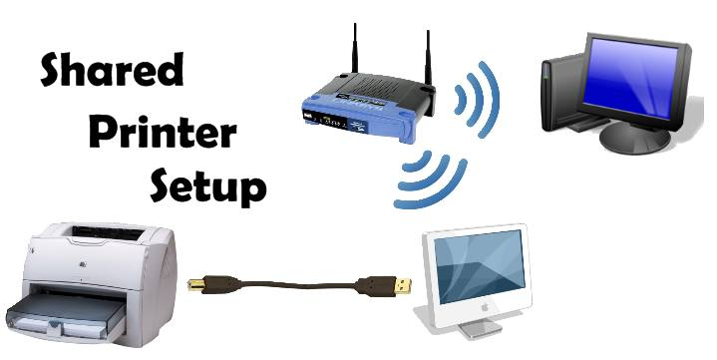
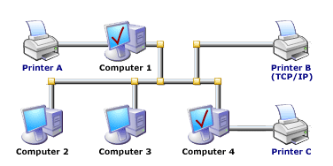
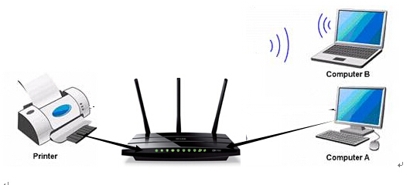
CIS101B
7.3 Network Printing:
By making a printer accessible on the network, you allow multiple devices to share a single print device. Network printing uses the following three special processes and components:
O The client application generates the print job on the local system. This process is known as spooling.
O The print job is sent to a print queue. The queue is a location for storing waiting print jobs.
O A print server is responsible for managing the flow of documents from the queue to the printer. When the printer is ready, the print server takes the next document out of the queue and sends it to be printed.

Slide 42
CIS101B
7.3 Network Printing:
When configuring network printing, keep in mind the following considerations:
Consideration Description
Connect the The printer must have a connection to the network (either wired or wireless). This can be done Printer to the in one the following ways:
Network
o Install a network interface card in the printer.
o Connect the printer to a workstation or server that is connected to the network. The printer is shared to make it available to other computers.
o Connect the printer to a special print server that has a network connection.
o Use Google Cloud Print to wirelessly send jobs from Internet-connected devices to a remote printer.

Slide 43
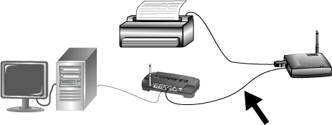
CIS101B
7.3 Network Printing:
When configuring network printing, keep in mind the following considerations:
Consideration Description
Use a If the printer itself does not have a network
Print Server connection, use the USB port to connect the
printer to another device.
The print server manages the flow of documents sent to the printer. Using a print server lets you customize when and how documents print. The print server can be any one of the following devices:
o An internal print server is inside the printer itself. You use special management software to connect to the print server and manage print jobs.
o You can configure a computer (either a server or a workstation) to perform print server functions. The computer can fill other roles on the network in
addition to being the print server. Most operating systems
include print server software.
o You can purchase an external print server. This device is only
used as a print server, although many print servers can manage
multiple printers.

Slide 44
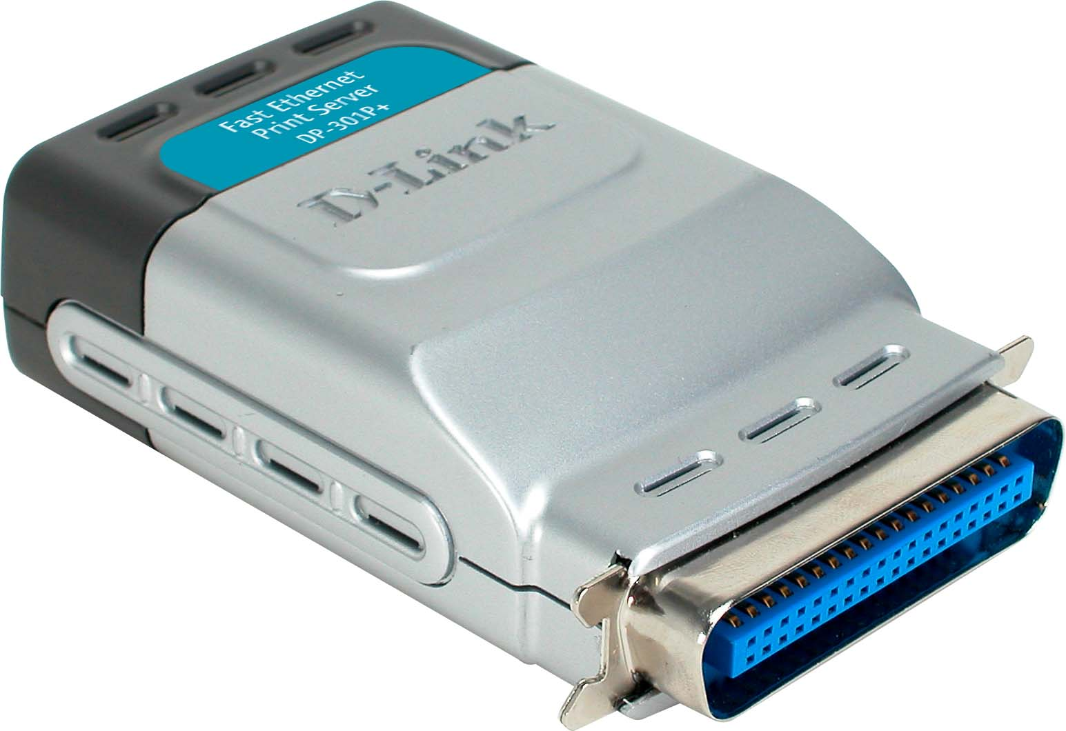
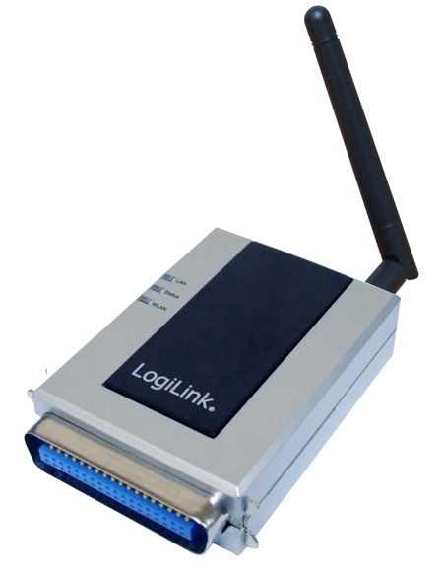
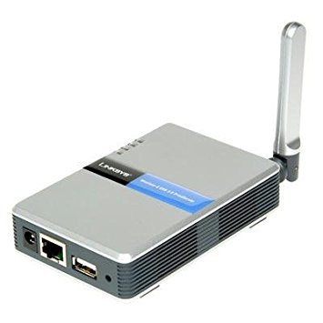
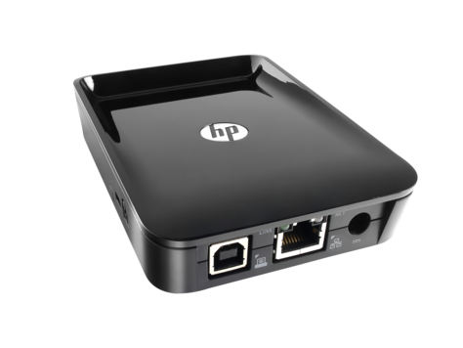
CIS101B
7.3 Network Printing:
Print Server

Slide 45
CIS101B
7.3 Network Printing:
When configuring network printing, keep in mind the following considerations:
Consideration Description
Install the Each network host that wants to use the printer must have the corresponding printer driver printer drivers installed. When you share a printer in Windows, the current printer driver is automatically delivered to clients that connect to the shared printer.
If the client computers run a different version of Windows, you can add the necessary printer drivers to the printer object.
To add drivers for network users:
o Edit the printer properties and use the Advanced tab
o Edit the print server properties and use the Sharing tab

Slide 46
CIS101B
7.3 Network Printing:
To configure a printer attached to a Windows computer as a network printer:
1. Connect the print device to the computer.
2. Configure the printer object where the print device is connected.
3. Share the printer. On Windows 7, click Start > Devices and Printers. Right-click on the printer you want to share and select Printer Properties. Click the Sharing tab. On Windows 8.1 and 10, click Start > Settings > Devices. Scroll to the bottom and select Devices and Printers. Right-click on the printer you want to share and select Properties. Click the Sharing tab.
4. If necessary, configure additional drivers to support client computers.
5.On a client computer, create a network printer object using the share name of the shared printer. To manually identify the shared printer, use the format: \\computername\sharename.
To connect to a network-attached printer or one using an external print server, create a printer using a TCP/IP port. Use the IP address and port name information to connect to the printer. Also, with network printing, you should also be aware of data privacy issues when using public devices. When you send a print job to a network printer, your job is cached to the hard drive and saved there.

Slide 47
CIS101B
7.4 Printing Management:
You should be familiar with the following components for managing printing on a Windows system:
Component Description
Printer Edit the properties of the printer object to:
Properties
o Print a test page
o Share the printer
o Change the driver used by the printer object
o Add drivers for network users
o Change the port used by the printer
o Match the colors on the screen to the colors that are printed by loading color management profiles.
o Assign permissions to control what users can do
o Configure a time range during which the printer will be available
o Configure custom settings for the specific print device
Users with the Print permission can print using the printer; users with the Manage printers permission can edit the printer properties and pause the printer, but cannot manage any documents waiting to be printed.

Slide 48
CIS101B
7.4 Printing Management:
You should be familiar with the following components for managing printing on a Windows system:
Component Description
Print Queue A print queue is a location on the hard disk that holds print jobs that are waiting to be processed. Each printer object has its own print queue.
o Double-click the printer to open the print queue.
o By default, users can manage their own jobs in the print queue (pause/unpause or delete).
o Users who have the Manage documents permission can manage all documents in the queue (pause, resume, delete, or rearrange the order). Users can only pause individual documents (or all documents) in the queue; they cannot pause the printer.

Slide 49
CIS101B
7.4.5 Lab: Managing Printers
Now work on Lab 7.4.5.
Instructor will assist you if necessary.

Slide 50
CIS101B
7.5 Printer Maintenance:
Implementing preventative maintenance can significantly extend the life of a printer. The following table provides a guideline for preventative maintenance for laser printers:
Element Recommended Maintenance
Environment Keeping printers in a clean, safe area helps prevent premature failure. An optimal printing environment includes:
o Keeping the printer in an area with minimal amounts of dust or other air debris will help the printer to run smoothly and will extend the life of its mechanical components.
o Using surge protectors will help protect a printer from the effects of power surges and spikes.
o Proper ventilation will help a printer to not overheat. Excessive heat causes electrical components to degrade rapidly. Avoid keeping printers in closets or rooms that aren't properly ventilated

Slide 51
CIS101B
7.5 Printer Maintenance: (continued)
Implementing preventative maintenance can significantly extend the life of a printer. The following table provides a guideline for preventative maintenance for laser printers:
Element Recommended Maintenance
Toner A printer's reported toner level isn't based on how much toner is actually left in the cartridge, but on how many pages have been printed since the toner cartridge was installed. For this reason, it is important to check the actual toner level periodically. If the cartridge still has sufficient toner, but you are receiving prompts that say that toner level is low, you can reset the toner page counter by following the instructions in your owner's manual.
The toner cartridge might include some of the components necessary in the printing process such as the developing roller, corona wire, and OPC drum in a single cartridge referred to as an electro photographic (EP) cartridge. If this is the case, these components are replaced every time you change the toner.
Excess toner can clog up the inner components of a printer over time. Toner has a magnetic charge, so it is important that it only be cleaned by an anti-static vacuum cleaner. The dust and toner on the inside of printers should be cleaned out on a regular basis.

Slide 52
CIS101B
7.5 Printer Maintenance: (continued)
Implementing preventative maintenance can significantly extend the life of a printer. The following table provides a guideline for preventative maintenance for laser printers:
In addition, it is a good idea to:
o Send empty toner and inkjet printer cartridges to be recycled.
o Use only approved toner or ink cartridges.
o Refilling cartridges might cause ink or toner spills, result in unsatisfactory output, void the printer warranty, or cause damage to printer components.

Slide 53
CIS101B
7.5 Printer Maintenance: (continued):
Other types of printers need periodic maintenance as well. Observe the following:
Printer Recommended Maintenance
Inkjet Complete the following to maintain inkjet printers:
o Replace the ink cartridge as needed. Avoid refilling and reusing the ink cartridge as it could decrease your print quality. In addition, many ink cartridge manufacturers include a small fuse or switch that is tripped when the cartridge runs out of ink. The switch has to be reset or the fuse replaced before the cartridge could be refilled and reused.
o Calibrate the print head after replacing the ink cartridge. Most inkjet printers include a calibration utility that you can use to align the new print head in the new cartridge.
o Check the carriage assembly and belt. The carriage is the assembly that holds the ink cartridges and slides back and forth using a belt drive to transfer ink onto the paper.

Slide 54
CIS101B
7.6 Printer Troubleshooting:
If a printer does not print, try the following troubleshooting techniques:
O Check to make sure that the printer is turned on and is online.
O Make sure that the printer is not paused.
O Verify that the cable is connected on both ends and that it is the correct cable for that printer.
O For network printers, make sure that the printer is configured with correct TCP/IP settings for the network.
O Ensure that there is paper in the feed tray and that the tray, feed, and rollers are all in their correct positions. Verify that the correct paper tray was selected when sending the print job.
O Look for a paper jam. If a jam is found, clear it and then check any feed and roller mechanisms nearby and confirm that they are clean and operating correctly.
O Check the ink and toner levels.

Slide 55
CIS101B
7.6 Printer Troubleshooting:
If a printer does not print, try the following troubleshooting techniques:
Perform a test print from the workstation.
1. Open an application and try to print directly from the application.
2. If this does not work, access the printer properties in Devices and Printers and then click Print Test Page. This option bypasses the application. If it works, troubleshoot the printing configuration in the application.
O Check the print queue. Sometimes a large document might be first in the queue and is stalling or otherwise preventing other documents from printing. Move the document down in the queue, or delete the document from the queue if necessary.
O If a problem cannot be found, try restarting the printer and the computer.

Slide 56
CIS101B
7.6 Printer Troubleshooting:
If a printer does not print, try the following troubleshooting techniques:
Last step is to check and reinstall the driver.

Slide 57
CIS101B
- End of Class 1 -

