Slide 1
Studying
Cultures
Laura Ann Brunell, PhD
Gonzaga University

Slide 2
What is Culture?
My favorite definition because it is so complete:
“Culture refers to the cumulative deposit of knowledge, experience, beliefs, values, attitudes, meanings, hierarchies, religion, notions of time, roles, spatial relations, concepts of the universe, and material objects and possessions acquired by a group of people in the course of generations through individual and group striving.”
                Definition is courtesy of Texas A&M Associate Professor Choudhury
(click and browse his page and the other two links below)
LiveScience definition and discussion
Wikipedia entry

Slide 3
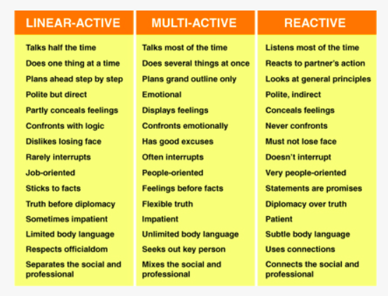
A Behavioral Model
Developed by CrossCulture Founder Linquist Richard Lewis
Which one do you think you are and why? Where do these behaviors come from?

Slide 4
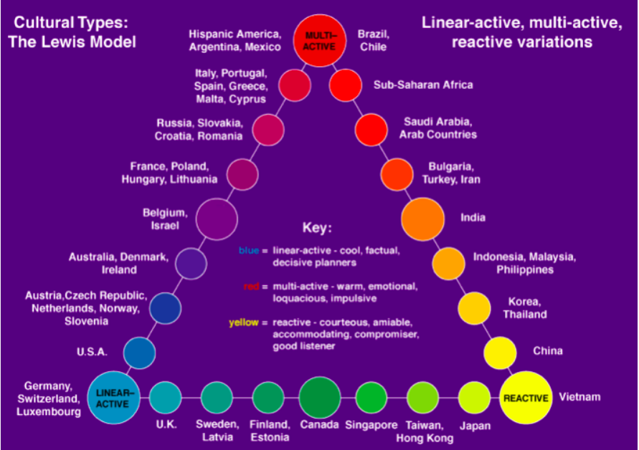

Source:

Slide 5
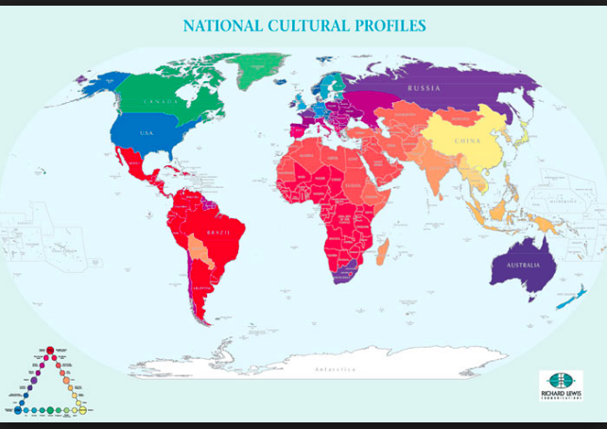
Source:

Slide 6

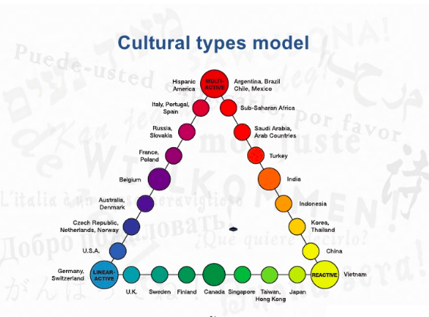
Source:

